Slide 1
STABILISING A NETWORK IN LINEAR NETWORK SYSTEMS
Under the guidance of
Mr A.V Murali Krishna
Asst. Prof
Batch no-A3
1608-19-733-023 G. Shreya
1608-19-733-022 K. Raja sheker
1608-19-733-037 M. Venkatesh

Slide 2
ABSTRACT
Linear network systems in which nodes transmit data from source nodes to sink nodes. Stabilized linear network system should be established for the access of the nodes in the network and control the system. By analyzing all the paths of the network, the optimized network is found in the network among the nodes. Stabilizing a network in linear network system is an essential task to ensure the reliable operation of interconnected system. The success of the stabilization process is evaluated based on the network ability to maintain the stability.

Slide 3
INTRODUCTION
Network systems arise in many applications. In the system, nodes must use sensed data to characterize the network and coordinate with one another to predict the network path.
Stabilizing the network in the system that the node will sense the data and check the neighboring node data to get the distributed data.
Sensor nodes are generally equipped with a radio transceiver, a microcontroller, a memory unit, and a set of transducers with which they can acquire and process data.
The network system is established in graphical manner with the nodes and optimized path is obtained to the base station.

Slide 4
TECHNOLOGY STACK
SOFTWARE REQUIREMENTS
Python 3.9
Windows 10
Python design interface
Cisco Packet Tracer
HARDWARE REQUIREMENTS
64 bit operating system
8GB RAM
Intel Core i5 processor

Slide 5
IMPLEMENTATION
Modules
Network System Formation Phase
Initialize Network with Controller
Optimize Network to base station
Optimization Graph
Techniques used
Data based predictive control algorithm
Optimization technique

Slide 6
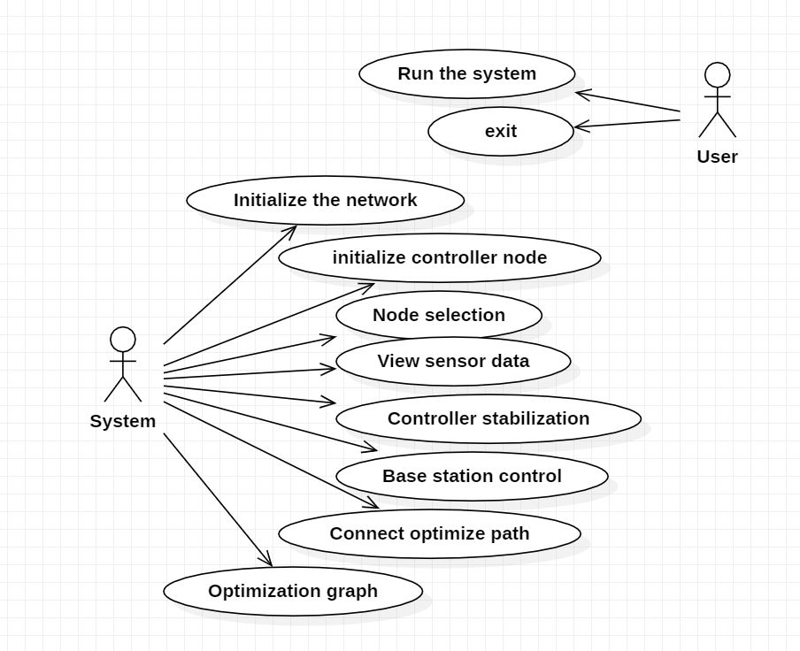
SYSTEM DESIGN
USE CASE DESIGN

Slide 7
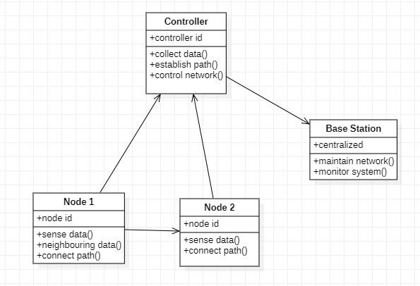
SYSTEM DESIGN
CLASS DIAGRAM

Slide 8
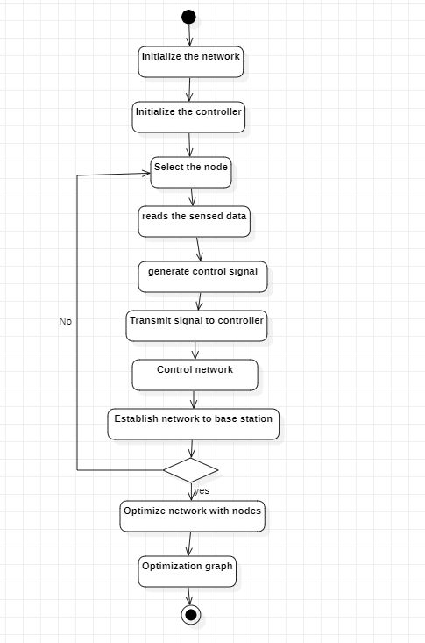
SYSTEM DESIGN
ACTIVITY DIAGRAM

Slide 9
TECHNICAL ARCHITECTURE
SOURCE NODE
NEIGHBOURING NODES
CONTROLLER NODE
OPTIMIZED NETWORK PATH
BASE STATION

Slide 10



NETWORK TOPOLOGY
N
N
N
N
CN
N
N
N
N
N
BS
CN
N
N
N
N
N
CN
N
N
N
N
N
N

Slide 11
REFERENCES
B. T. Stewart, A. N. Venkat, J. B. Rawlings, S. J. Wright, and G. Pannocchia, “Cooperative distributed model predictive control,” Syst.Control Lett., vol. 59, no.8, 2010.
C. D. Persis and P. Tesi , “Formulas for data-driven control: Stabilization, optimality and robustness,” 2019. Available:arXiv:1903.06842.
R. R. Negenborn and J. M. Maestre, “Distributed model predictive control: An overview and roadmap of future research opportunities,” IEEE Control Syst., vol. 34, no. 4,pp. 87–97, Aug. 2014.
J. Coulson, J. Lygeros, and F. Dörfler, “Data-enabled predictive control: In the shallows of the DeePC,” in Proc. Eur. Control Conf., Naples, Italy, 2019, pp. 307–312.

Slide 12
THANK YOU

