Slide 1
GraphQL – An Introduction

Slide 2
Contents
Who Invented GQL – Who?
What is GQL – What?
Which framework/libarary – Which?
Why do you need GQL – Why?
When to use GQL and when to NOT – When?
How to Build your schema – How?
Questions

Slide 3

Who?
GraphQL was developed internally by Facebook in 2012 before being publicly released in 2015.
GraphQL was built from the ground up by its co-creators Lee Byron, Dan Schafer, and Nick Schrock to be an API and query language for object graphs.

Slide 4
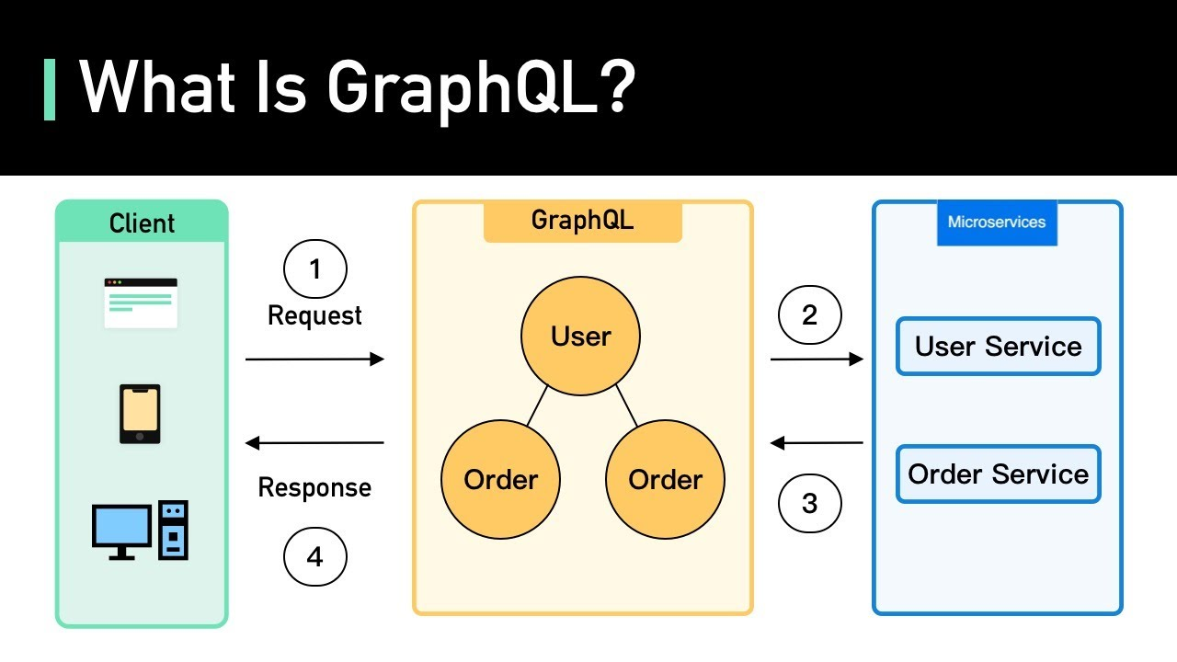
What?
GraphQL is a query language, architecture style, and set of tools for creating and manipulating APIs. It allows developers to specify the exact data they want to fetch from an API and return that data from multiple sources.
Apollo GraphQL is a set of tools from the GraphQL tooling company Apollo that allows developers to build apps with GraphQL.

Slide 5
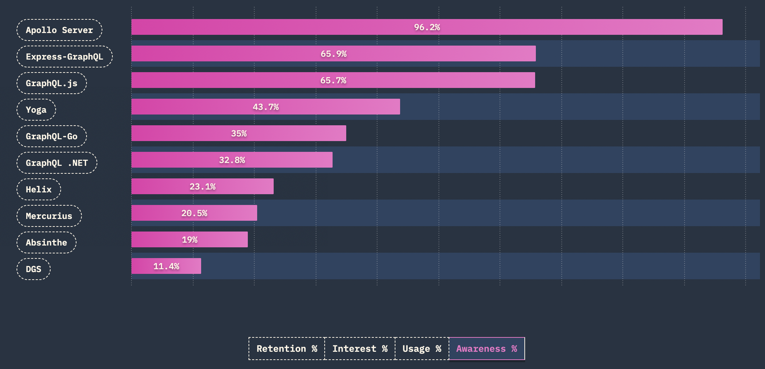
Which?
A Query Language to Query Api Data!

Slide 6
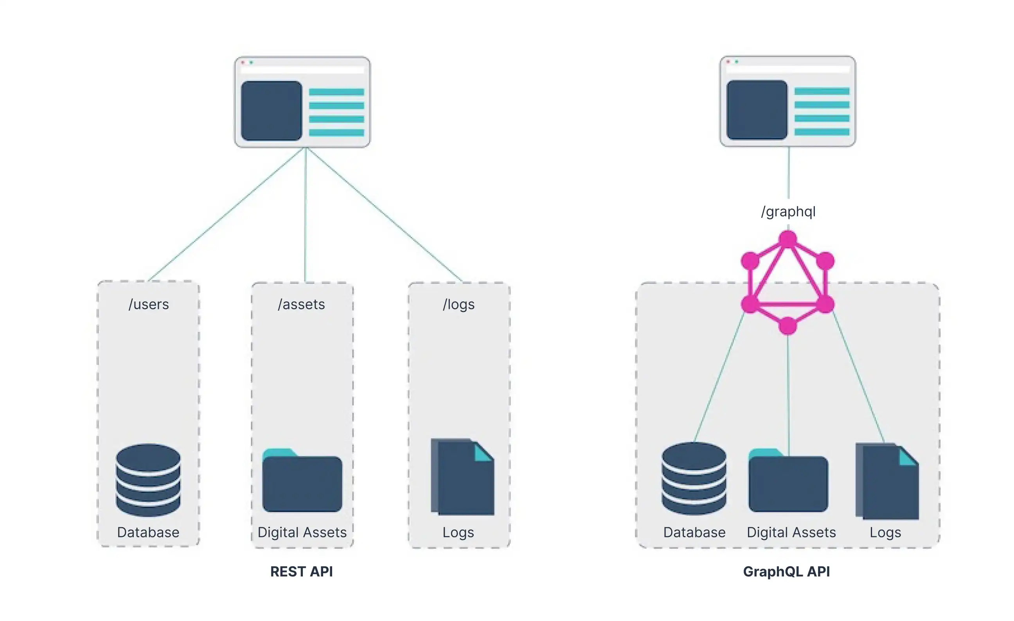
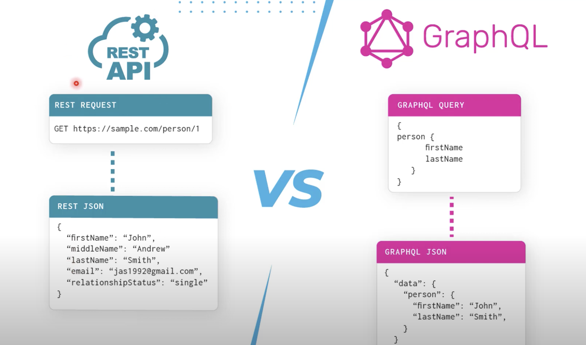
When?
When you over fetch/ under fetch your data
When you have A composite pattern, where an application retrieves data from multiple, different storage APIs. For example, a blog or social networking platform where posts need to be fetched along with nested comments and details about the person commenting.
If you want to scale a complex and large microservice based app
Notes:
Consider talking about:
Libraries and frameworks
Operating systems
Remote APIs
Web APIs

Slide 7
When to Not?
When clients make predictable, monotonous calls that are cached for performance
If you have smaller applications with less complex data, or if you have data and operations that all clients use similarly.
GQL always does strict input output validation whereas for REST these are optional. Also parsing the GQL query is an extra step you don't have in REST.
Building monolithic architectures – where you own the server & client both.
Your Engineers don’t have the bandwidth for a learning curve
Notes:
Consider talking about:
Libraries and frameworks
Operating systems
Remote APIs
Web APIs

Slide 8
Why REST is faster than GQL for a simple query?
Although negligible in most cases, REST API endpoint (/users) might have a slight performance edge over a GraphQL query (query Users)
Direct Endpoint: The client directly requests the user data from the known / users' endpoint without an additional layer for parsing and query Execution.
GraphQL (query Users{}):
Potential Overhead: strict Parsing and executing the GraphQL query might add some overhead on the server compared to REST call
Notes:
Consider talking about:
Libraries and frameworks
Operating systems
Remote APIs
Web APIs

Slide 9
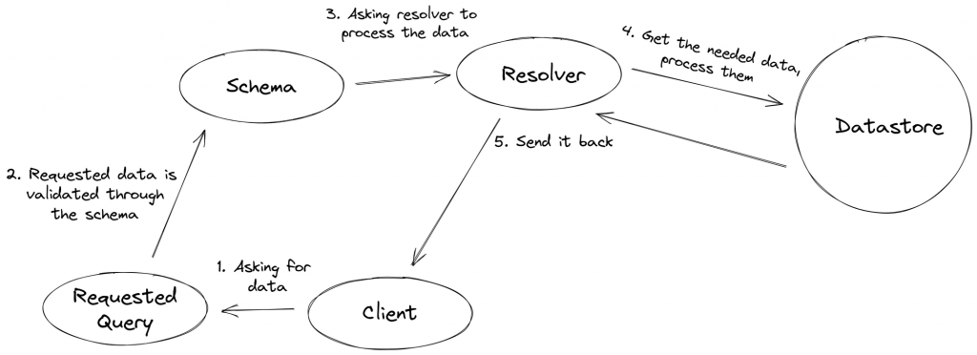
How?

Slide 10
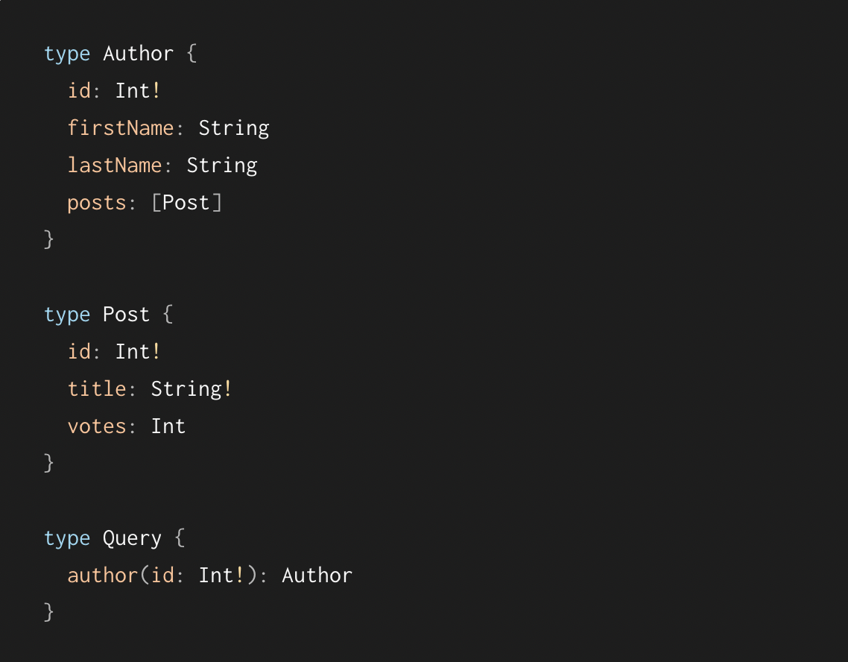
How?
Schema first:

Slide 11
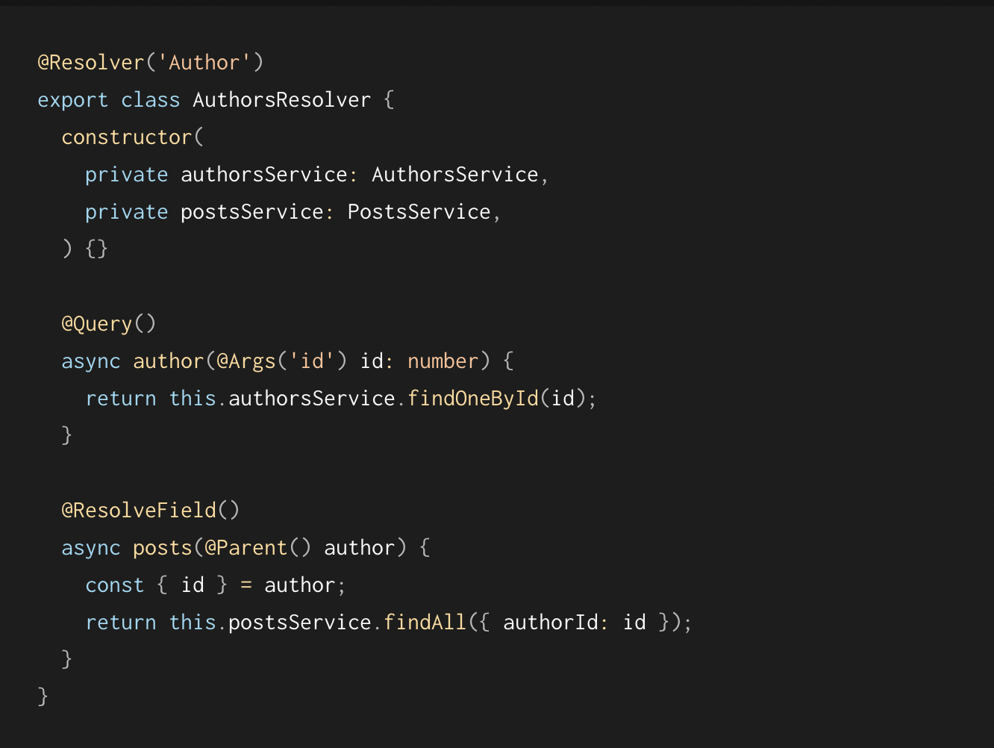
How?
Resolver - function that resolves a query/request. What data the Query will return!
Select in relational will select rows, insert will insert. In same way for any query you can write a resolver to define what operation it will perform and We use mutations to update, delete and insert and Queries to Get data.
Eg:

Slide 12
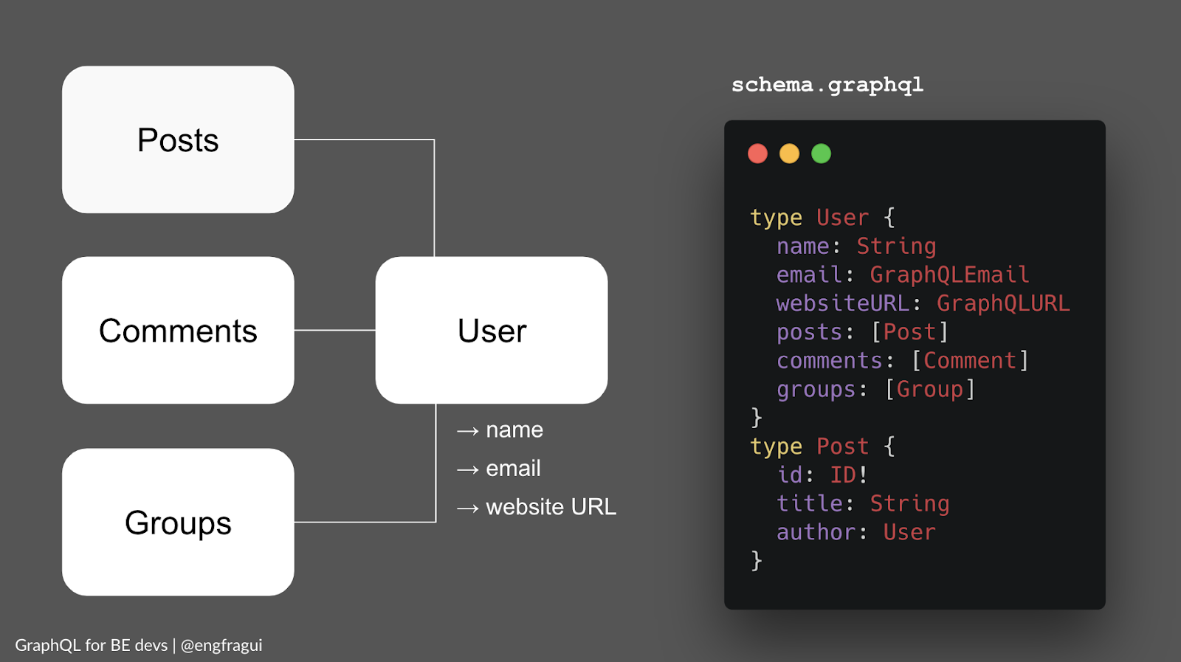
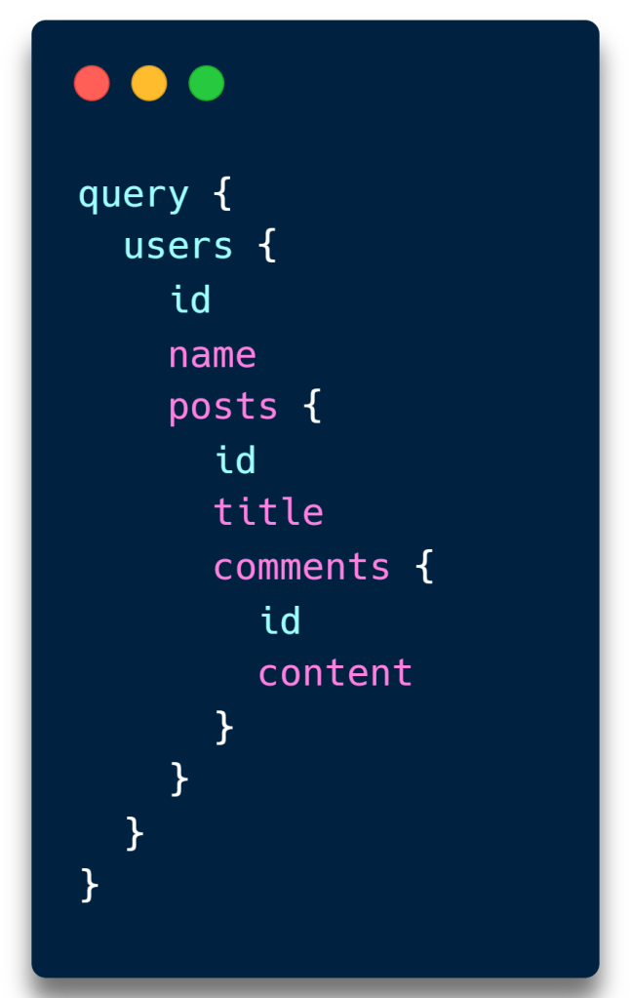
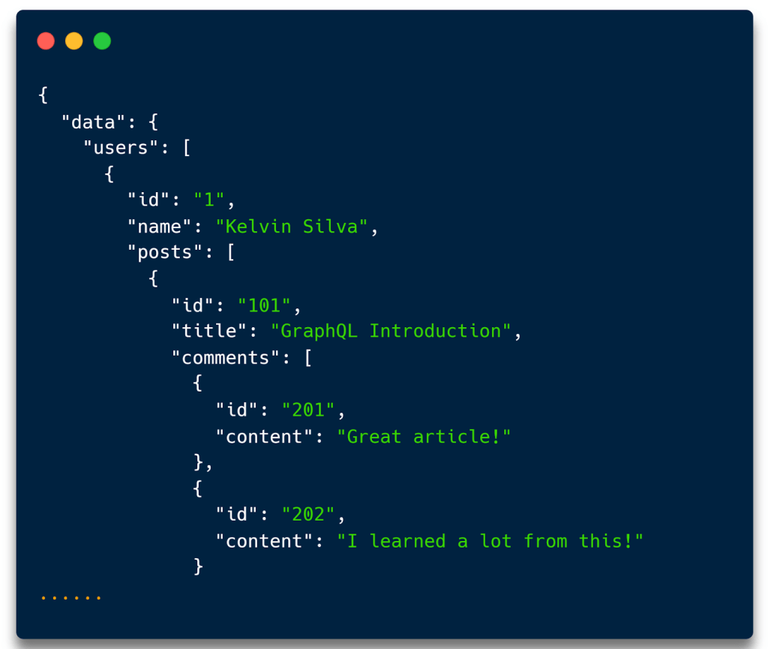
In Action
To query comments on a specific post:
/users -> user_ids
/posts:user_id -> post_ids
/comments:post_id -> comments

Slide 13
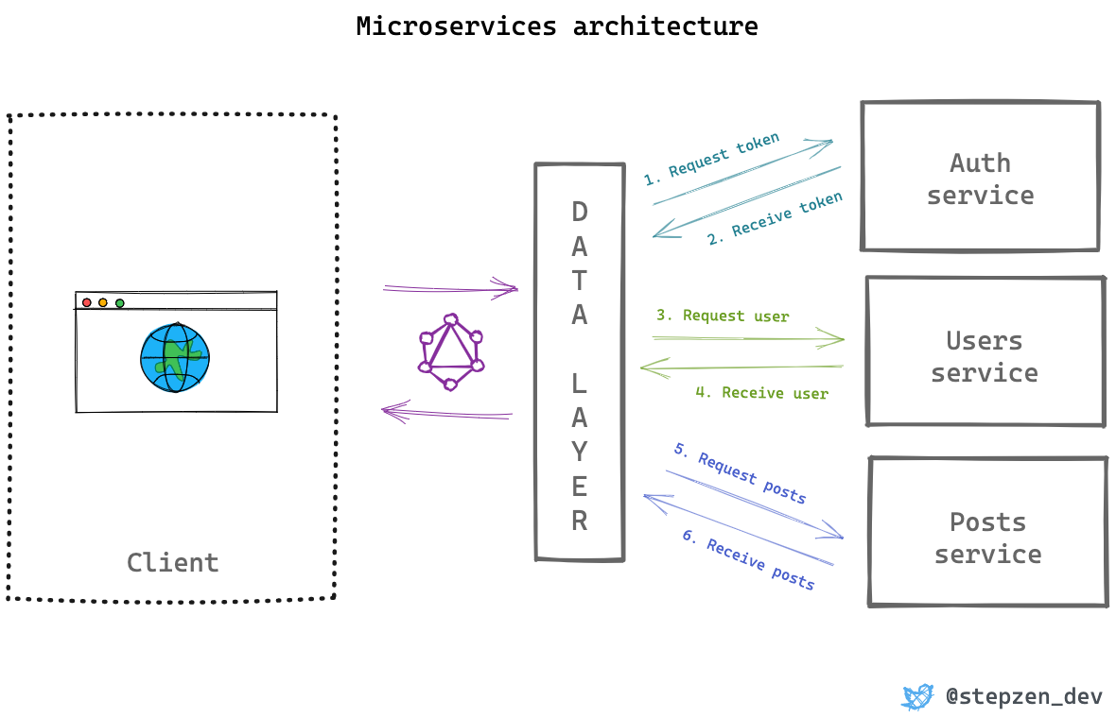
The problem we solved

Slide 14
Advantages
Efficient Data Fetching: Clients can request exactly the data they need, reducing over-fetching and improving efficiency.
Flexibility: GraphQL's query language allows clients to specify their data requirements, reducing the need for multiple endpoints.
Strong Typing: GraphQL schemas provide clear and strong typing, which aids in documentation and validation.
Backend Aggregation: GraphQL can aggregate data from multiple sources, making it easier to serve complex client needs.
Live Queries: GraphQL supports real-time data with subscriptions, allowing for more interactive applications.
Runtime Validation: GraphQL schema validation with non-nullable types (!) does perform a form of runtime validation
Learning Curve: GraphQL's syntax and concepts can be more complex for newcomers, especially those familiar with REST.
Caching: Because GraphQL queries can be highly customized, caching can be more challenging to implement effectively.
Security: Poorly implemented GraphQL queries / introspection Queries can lead to security vulnerabilities, requiring careful validation.
Disadvantages

Slide 15
Questions & Open Forum
Additional resources for Fidelity adoption of GQL
My documentation https://myfiles.fmrcloud.com/:w:/r/personal/a758736_fmr_com/Documents/GraphQL.docx?d=w802697c51c544f61878aac7d8cb2de63&csf=1&web=1&e=xibxnm
Using GQL with Keel Node.js – https://keel-docs.static.aws.fmrcloud.com/docs/products/keel-nodejs/graphql/client/
Fidelity guide for GQL adoption - https://productionreadygraphql.com/
More Questions about Architecture / Schema Design / GQL in general:
Meyana, Pamal - Architecture
Sykes, Matthew - Architecture

