Slide 1
Team 27 :Ninja Hackers
BHUMI
Team Members
Padmaja Nadar
Pravalika Gilakamshetty
Sahaj Alva
Saksham Bajaj
Samarjeet Singh Gandhi
Shivanya Singh
Sindhuja Reddy
Team Mentors
Monish Pingle
Snehal Lad
Swapnali Chougule

Slide 2
Challenge
Bhumi envisions a solution that helps the team in understanding the behavior exerted by the visitors of their website to visualize, analyze the data for improving their engagement, registrations and donations.

Slide 3
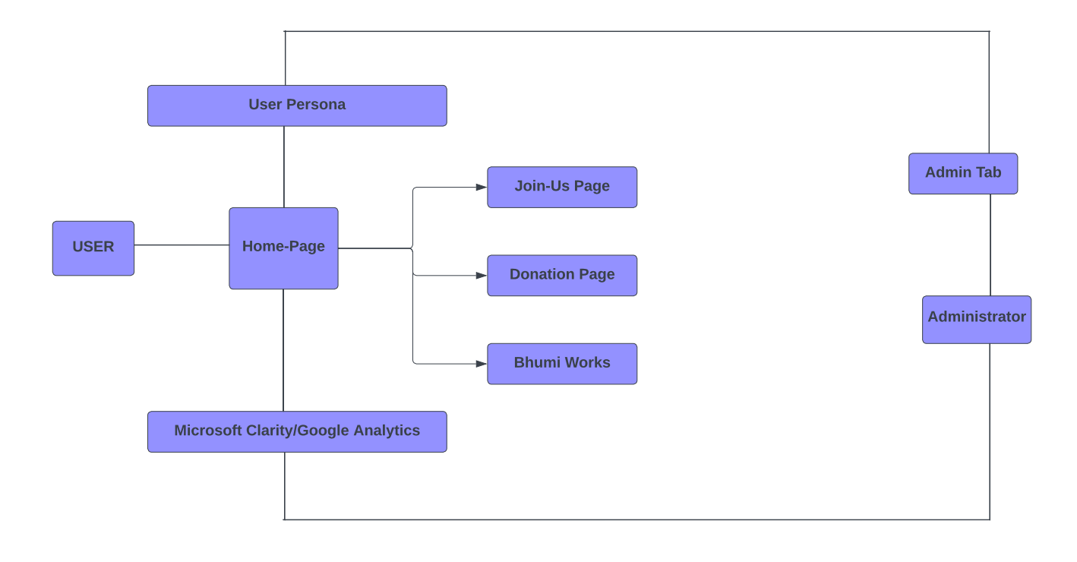
System Architecture

Slide 4






Tech Stack

Slide 5
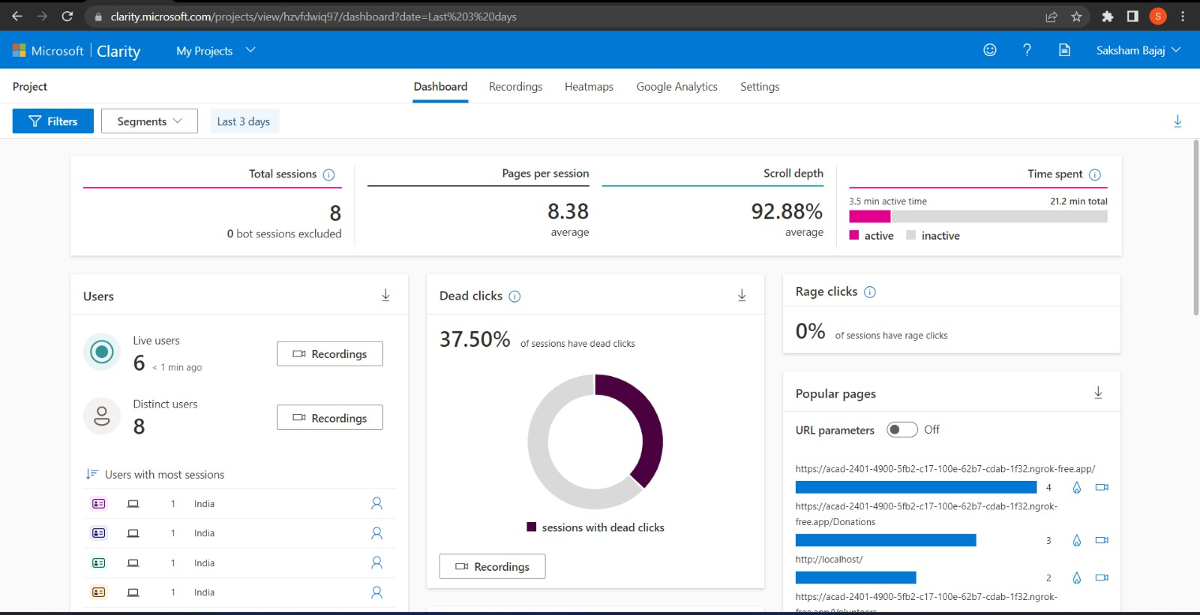
Analysis of user engagement data

Slide 6
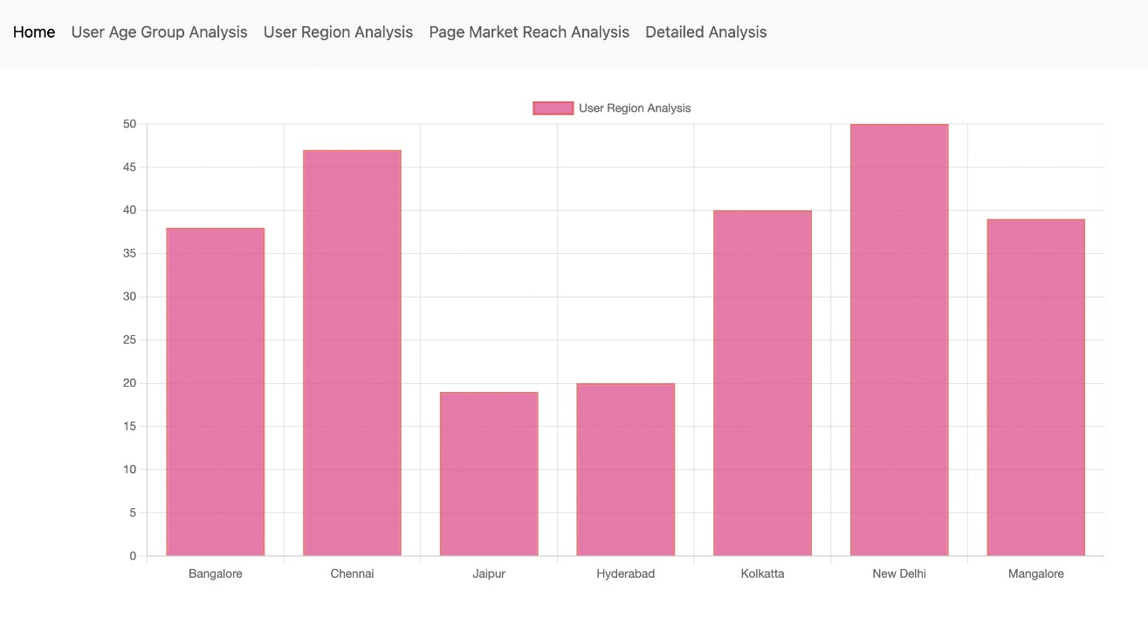
Analysis of user persona

Slide 7
Future Enhancement of the Project
User Interface can be further enhanced.
We can use more Key performance Indicator(KPIs) for better analysis of user engagement data.
User Persona marketing strategies to increase efficiency.
We can improvise on the search feature in the navigation bar.
In future we can make the website multilingual for inclusion of people from larger diversity.
Plan to show events being hosted by Bhumi depending on the location of the user in a way that the events closest to them are showcased.

Slide 8
Thank You!!!

