Slide 1

Simple High-level Design
DNS
Load Balancer
Load Balancer
App
App
App
Master DB
Backup DB
Replication

Slide 2
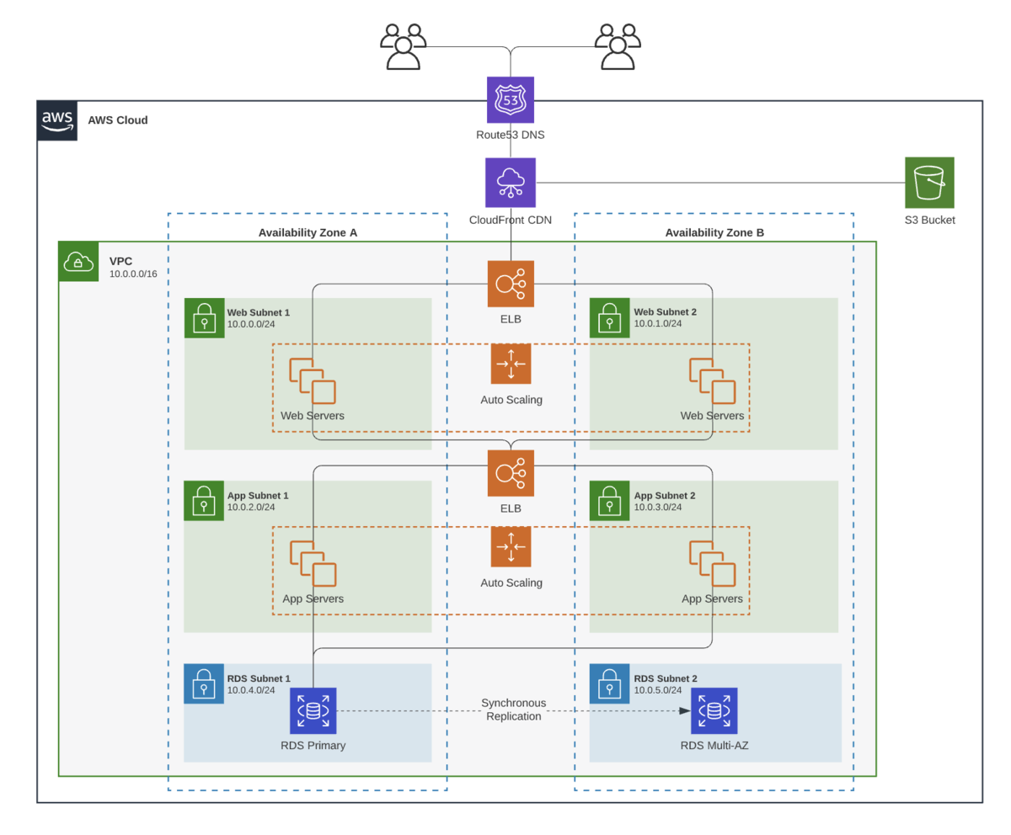
Detailed design

Slide 3
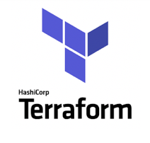


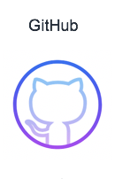
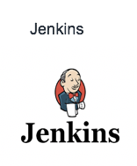
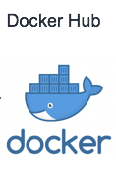


CICD
1
Provision Jenkins server using Terraform
us-east1
us-east2
2
Developers integrate code changes to code repository
7
3
New code changes trigger Jenkins pipeline
6
1
4
Jenkins build a new docker image and pushes it to registry
5
Spinnaker/ArgoCD or any other CD tool
Cluster - 1
5
New docker image triggers the spinnaker/argoCD pipeline
3
4
6
Code Deployment tool performs a deployment into first cluster
8
OR
7
UAT testing
2
9
2
Cluster - 2
8
CD tool performs deployment into other clusters post UAT user testing is successful
9
End user

