Slide 1
Lead Scoring Case Study

Slide 2
Approach to Solve the Problem
Understanding the Problem Statement
The objective is to improve the lead conversion rate by identifying potential "Hot Leads.“
Creating a model to assign a lead score indicating the likelihood of a lead converting.
The goal is to prioritize the sales team's focus on high-potential leads and achieve a conversion rate of ~80

Slide 3
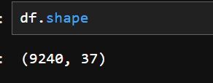
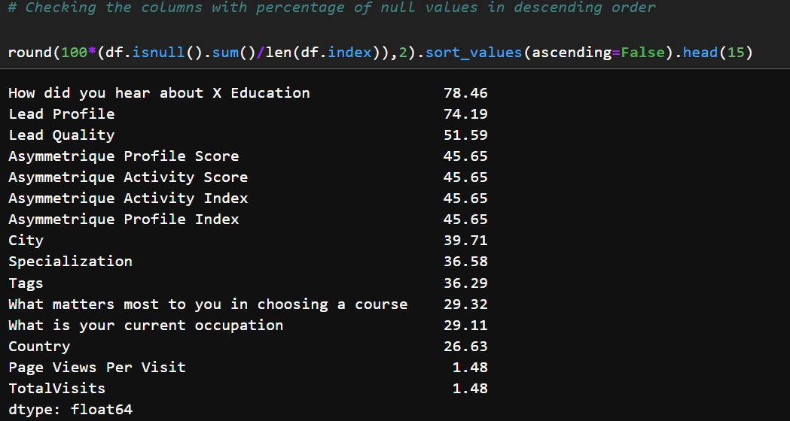
2. Data Understanding and Preprocessing
Dataset Overview:
3.Handle Missing Values

Slide 4
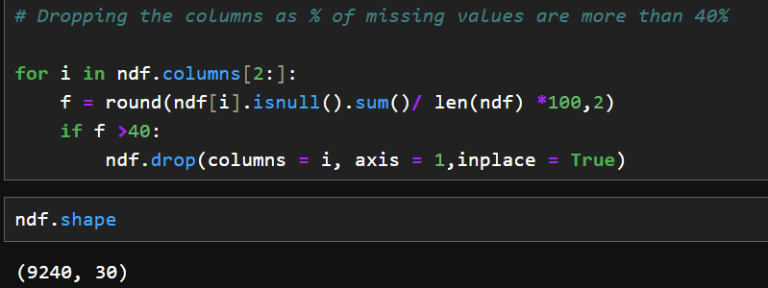
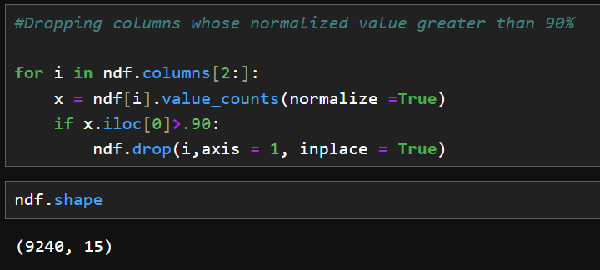

Slide 5
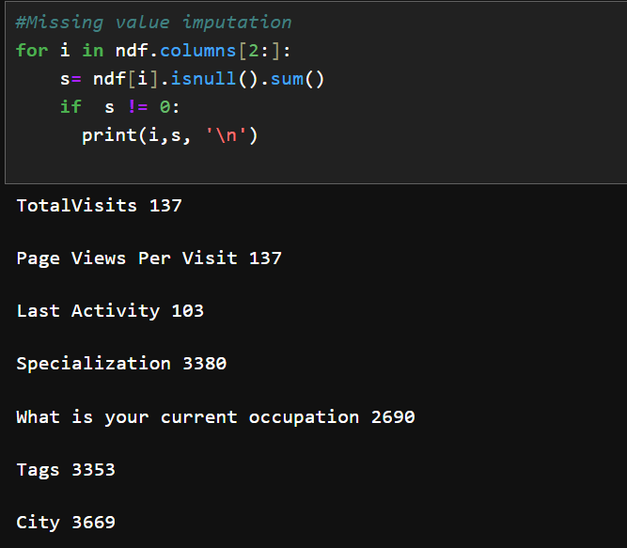
3. Missing Values Imputation
Page Views Per Visit - replacing nan values with median
TotalVisits - replacing nan values with median
Rest Paramesters with ‘UNKNOWN’

Slide 6
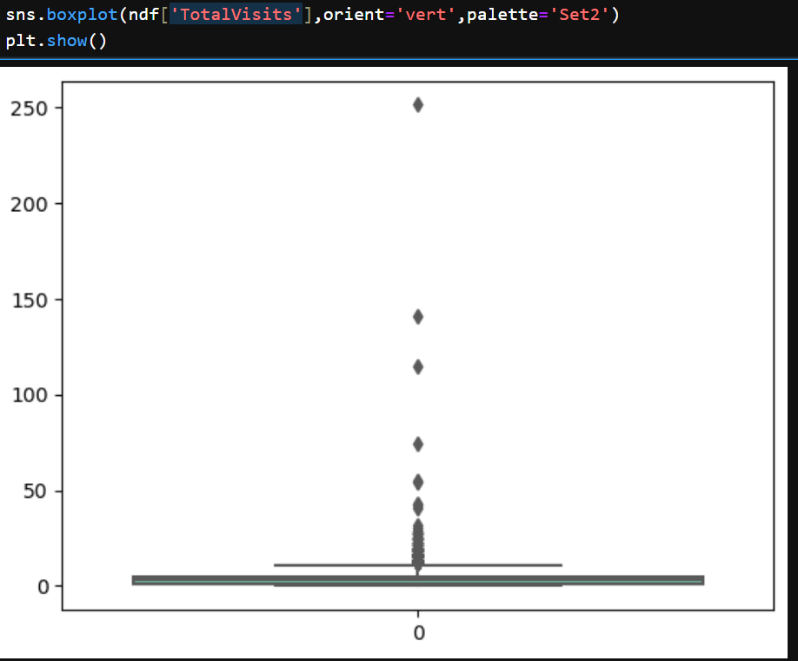
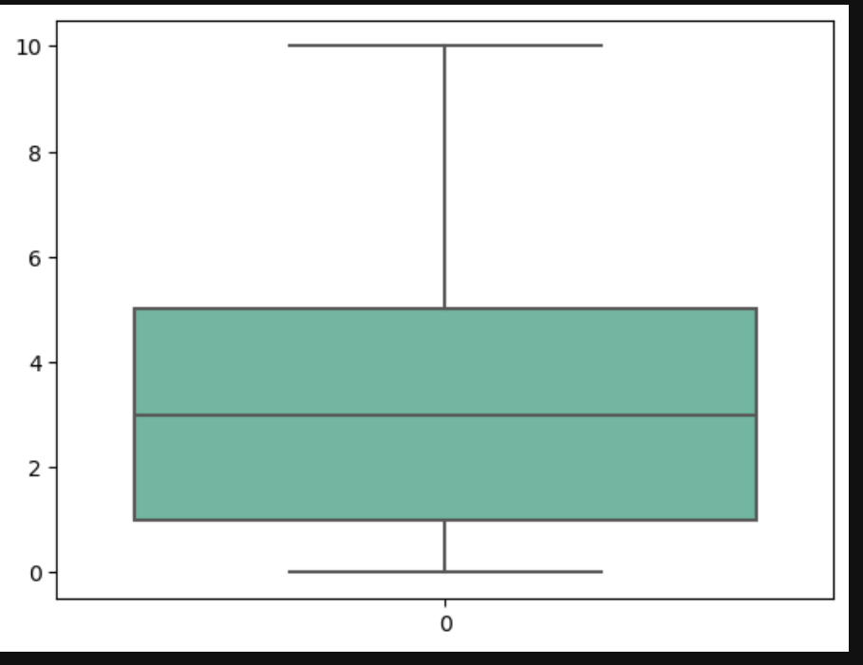
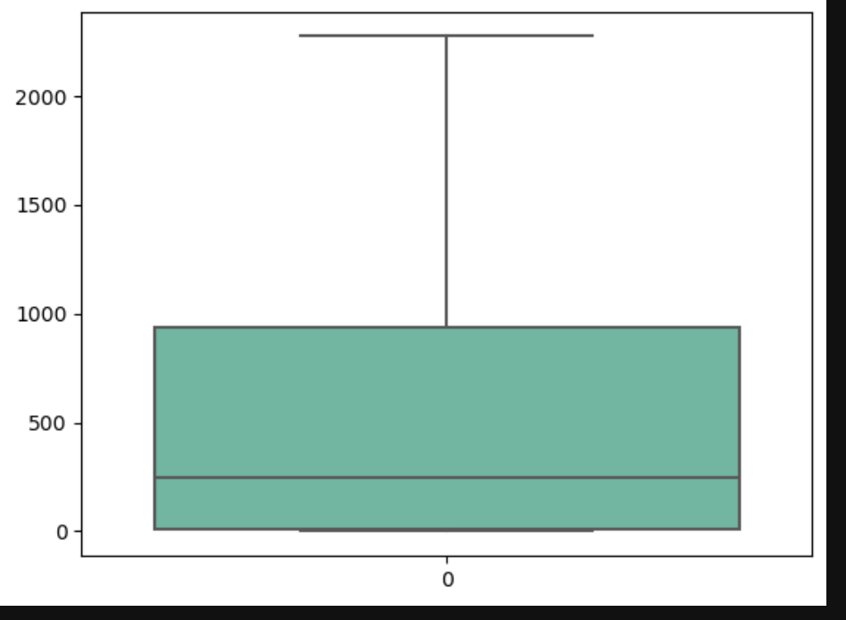
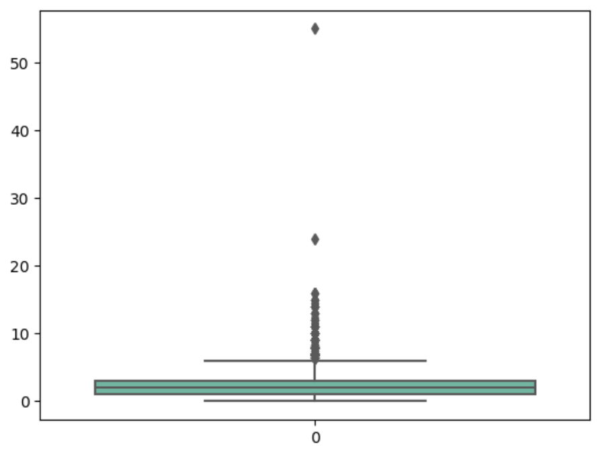
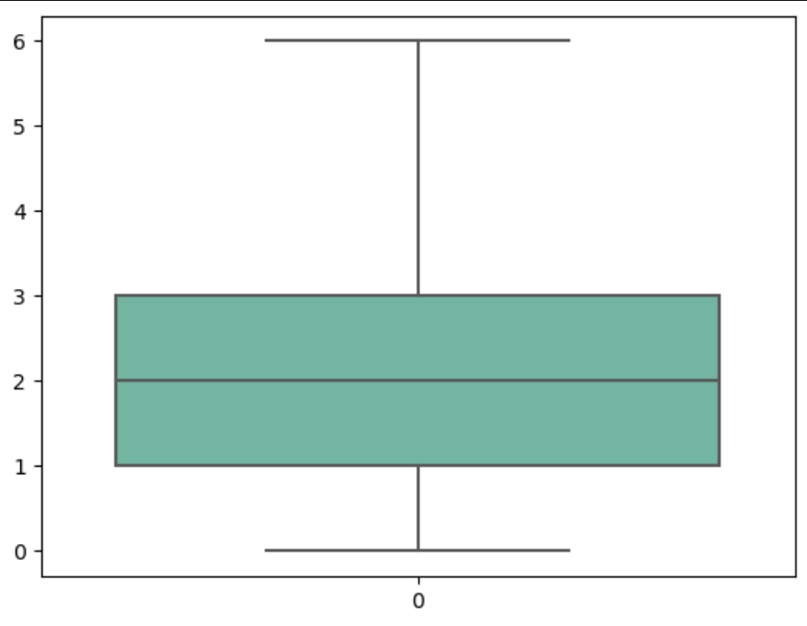
4. Outlier Treatment:
A. 'TotalVisits’ - capping between 5th – 95 th Percentile
B. Total Time Spent on Website-
C. 'TotalVisits’ – capping between 5th – 95 th Percentile

Slide 7
5. Categorising and Grouping variables with negligible counts
A. Lead Source
'bing’, 'Click2call’, 'Social Media’, 'Live Chat','Press_Release','Pay per Click Ads','blog','WeLearn','welearnblog_Home','youtubechannel','testone','NC_EDM'
D. City
'Other Metro Cities','Tier II Cities'
B. Last Activity
'Approached upfront','View in browser link Clicked','Email Received','Email Marked Spam','Visited Booth in Tradeshow','Resubscribed to emails'
E. Last Notable Activity’
Grouping variabales having counts >10
C. Tags
'Ringing','Busy','Lost to EINS', 'Already a student','switched off', 'opp hangup', 'wrong number given', 'invalid number', 'Diploma holder (Not Eligible)','switched off’, 'Not doing further education','Interested in full time MBA','University not recognized', 'Recognition issue (DEC approval)', 'Shall take in the next coming month','Lateral student','Lost to Others','Still Thinking','in touch with EINS','number not provided','Want to take admission but has financial problems','In confusion whether part time or DLP','Interested in Next batch'

Slide 8
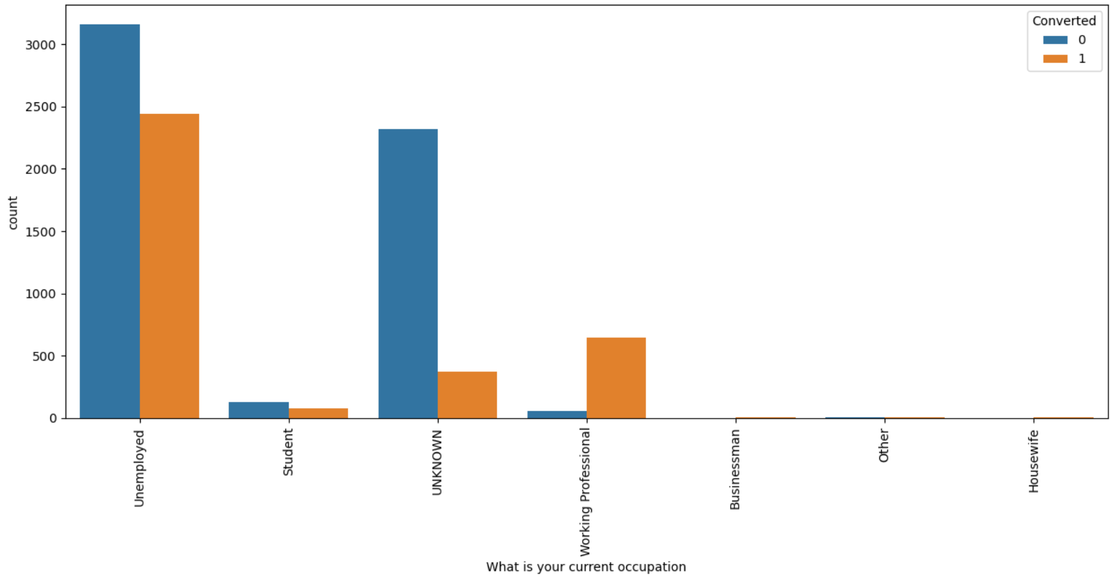
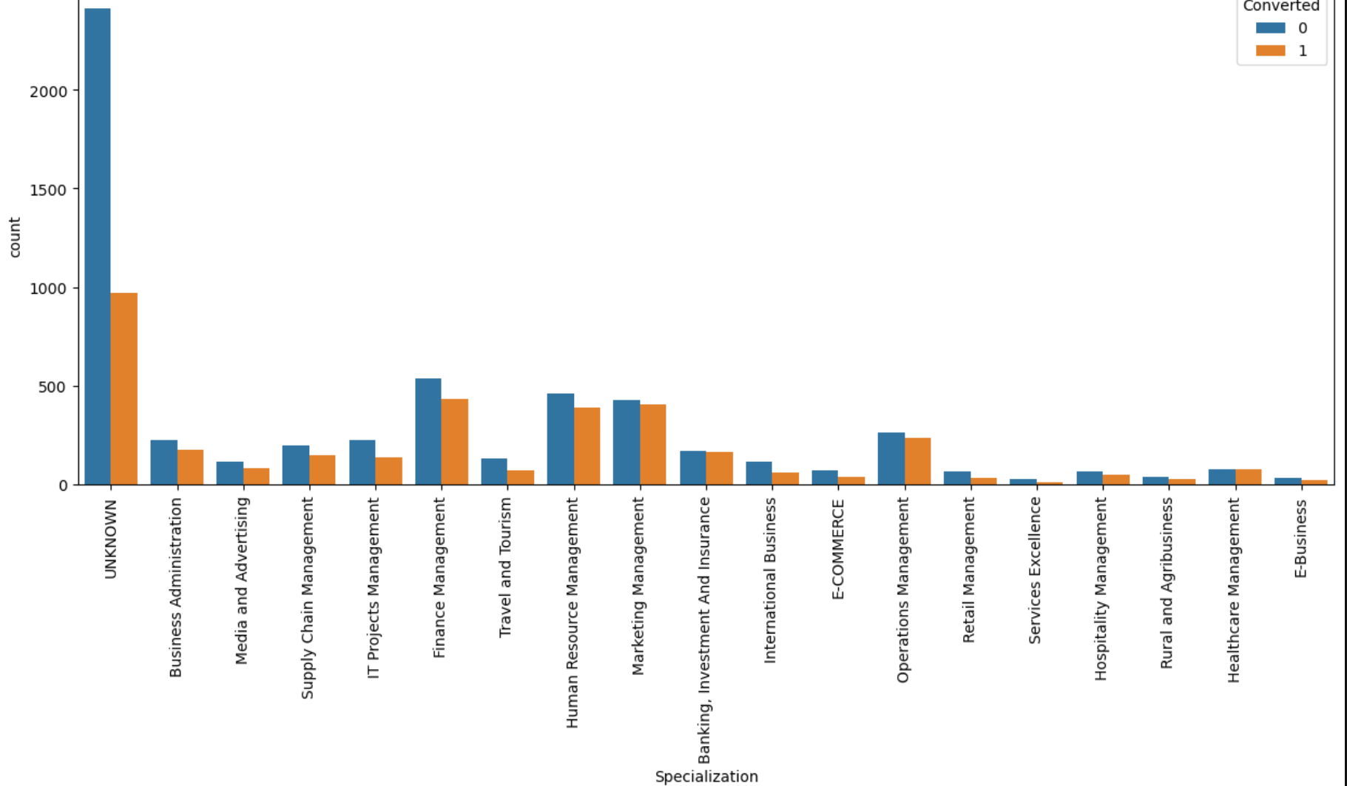
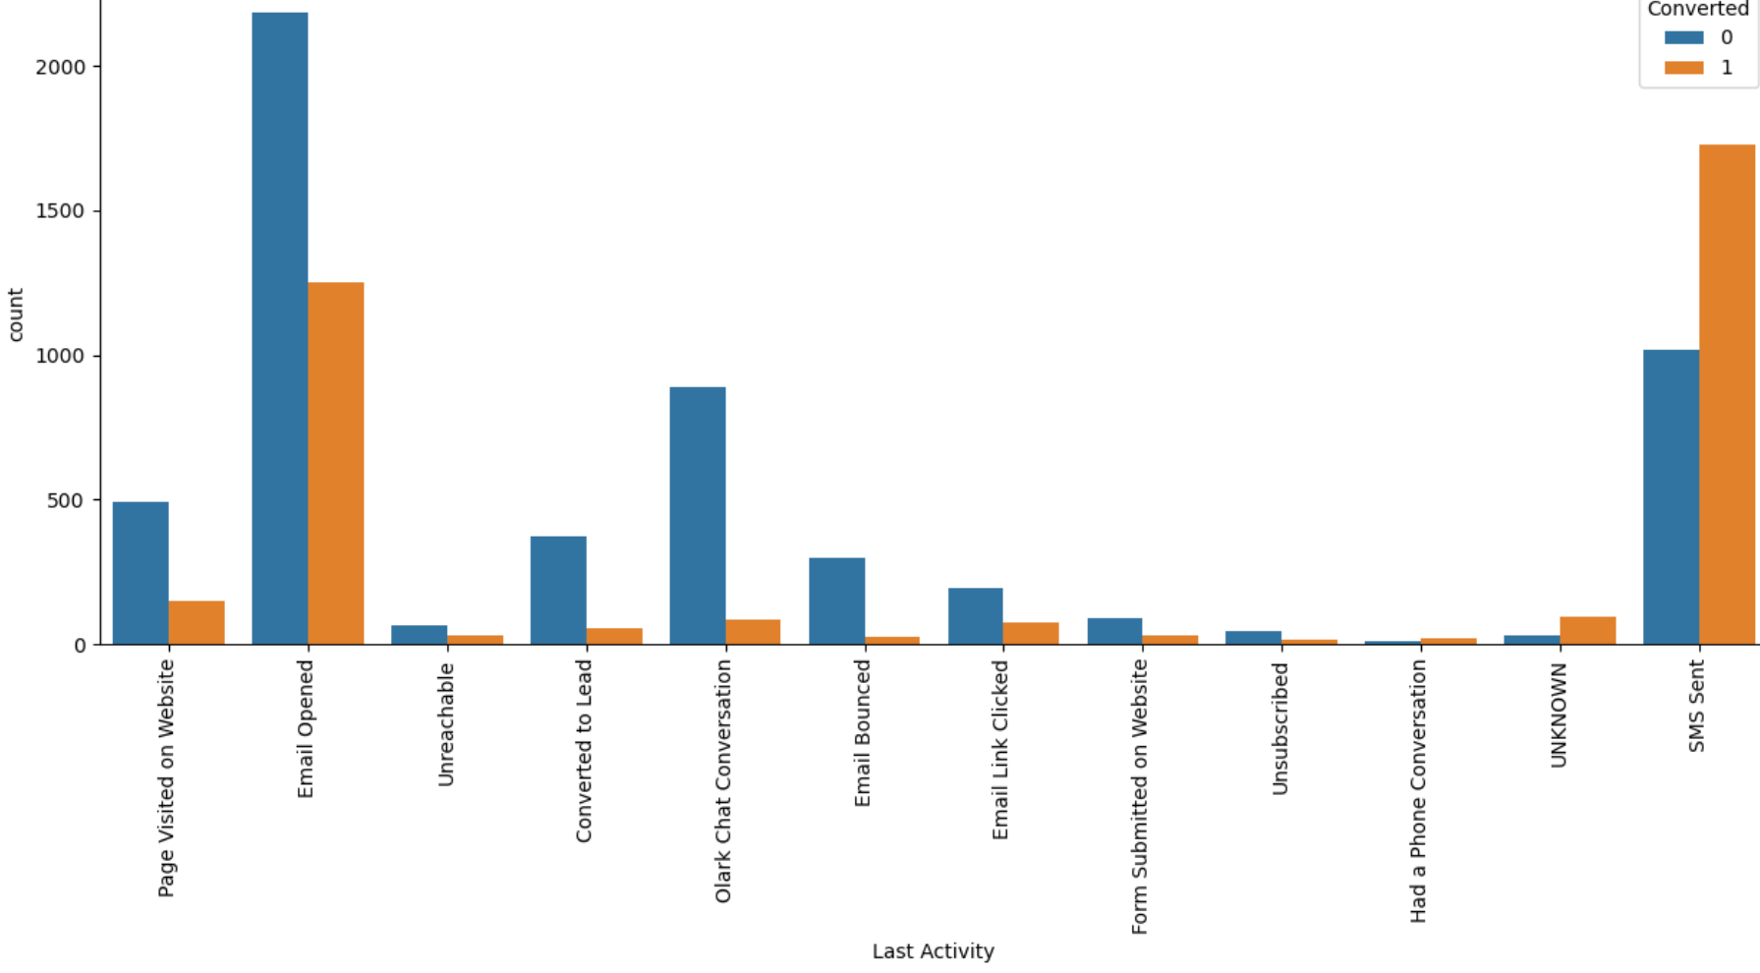
6. Bi- variate Analysis

Slide 9
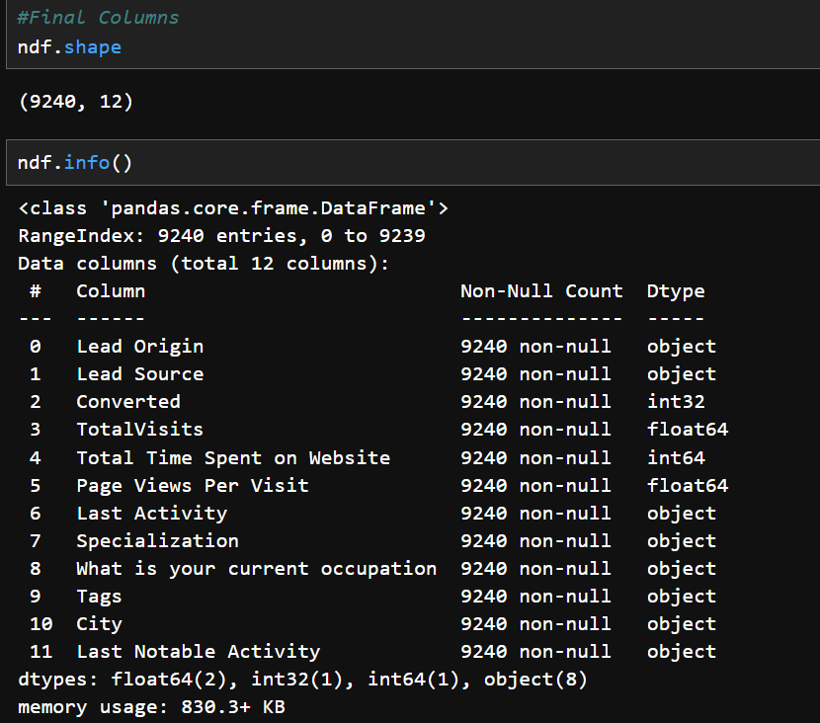
7. Final Columns for Analysis

Slide 10
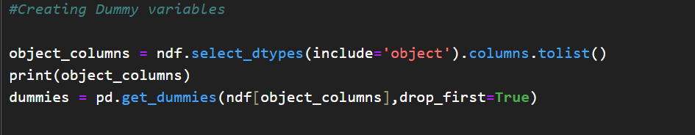

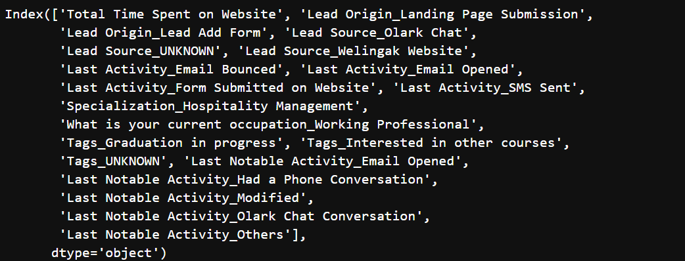
8. Feature Selection
Using RFE selecting 20 feature columns

Slide 11
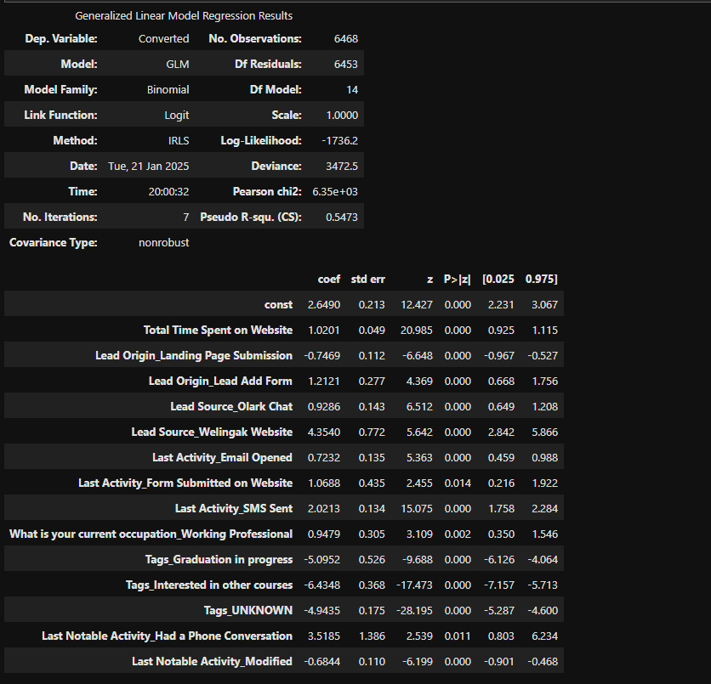
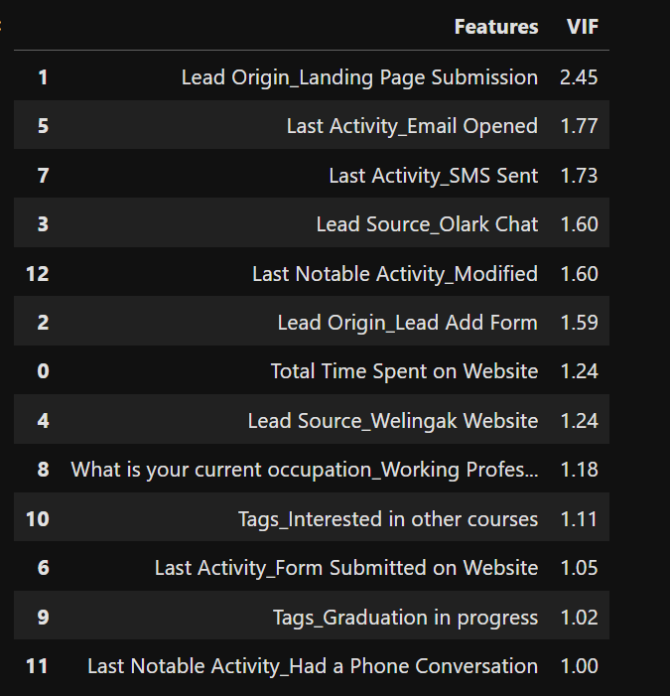
9. Model Results
A. GLM
B. VIF

Slide 12
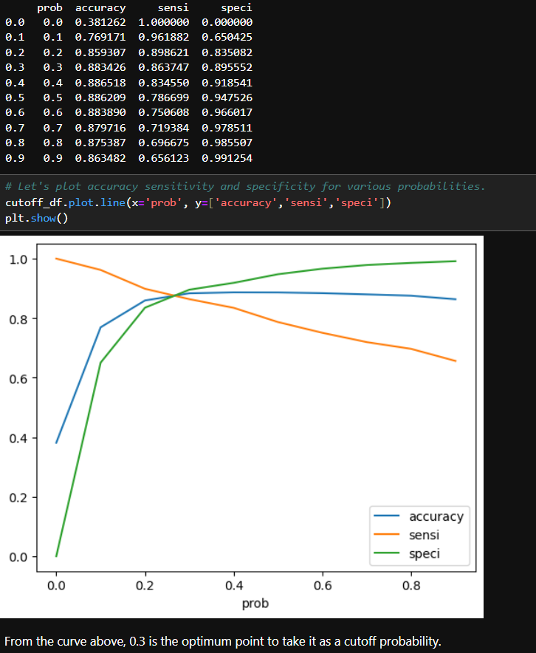

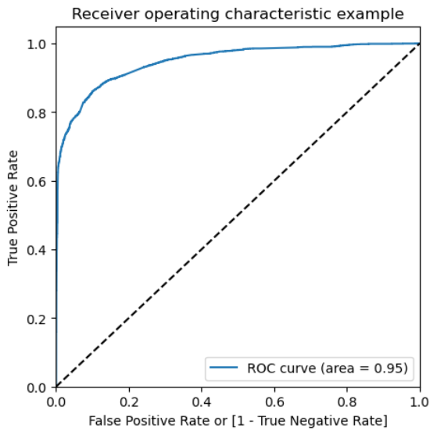

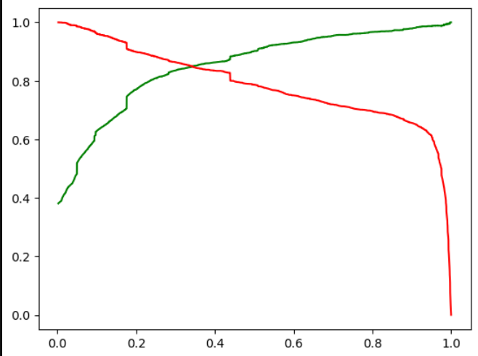
10. ROC Curve and Model Evaluation
Precision and recall tradeoff
C. Precision and recall trade off
A. Graph showing ROC Curve Area
B. Graph showing optimum point

Slide 13
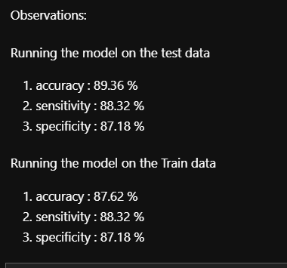

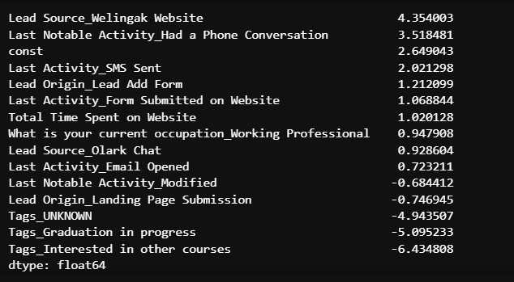
11. Results:
There are about 768 prospect leads which can be contacted and having high chances of enrolment into a course.

Slide 14
12. Recommendations:
The company should focus on leads coming from the followings given below:
Lead Source_Welingak Website
Last Notable Activity_Had a Phone Conversation
Last Activity_SMS Sent
Lead Origin_Lead Add Form
Last Activity_Form Submitted on Website
Total Time Spent on Website
What is your current occupation_Working Professional
Lead Source_Olark Chat
Last Activity_Email Opened
Last Notable Activity_Modified
Lead Origin_Landing Page Submission
Tags_UNKNOWN
Tags_Graduation in progress
Tags_Interested in other courses

