Slide 1
Fertility Trends between First & Third World Countries
Group2:
Chunbing Yang
Mihir Gandhi
Ruchi Parab
Sharad Sawhney
Unnaty Gandhi

Slide 2
DATA CLEANING
Variables “GDP” and “Fertility” contained missing values
“GDP” contained 10% missing and “Fertility” contained 8% missing values
Some missing values were filled by taking the mean of existing values in a country.
Values for countries with no data were retrieved from internet sources such as World Bank and Trading Economics
Final total of 3% missing values in total were removed from the data set.

Slide 3
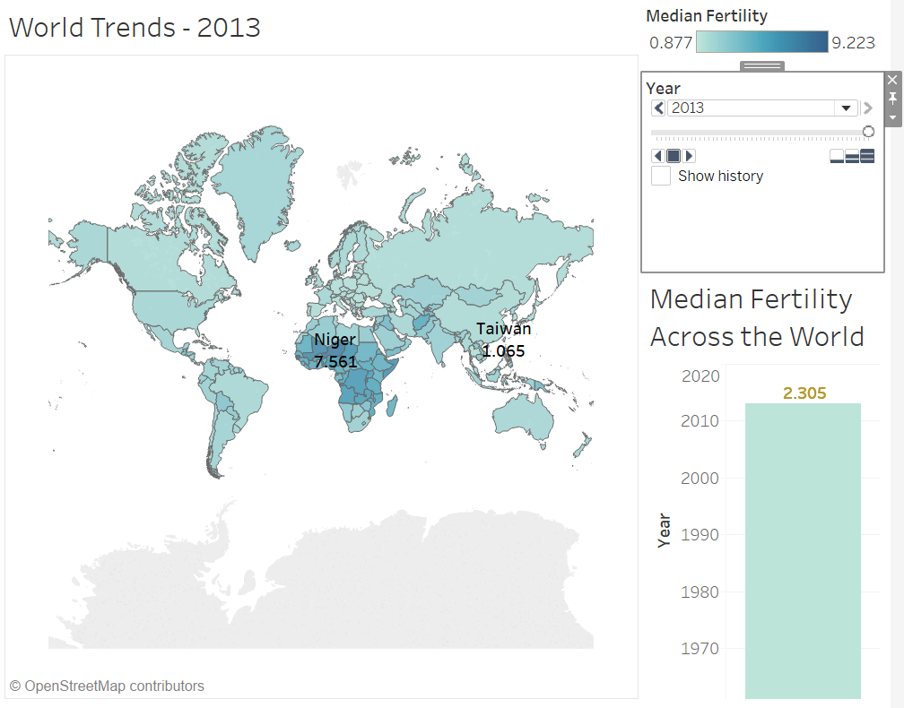
WORLD TRENDS
Median fertility across the world in 1964 and 2013 – 6.094 and 2.305 respectively
High fertility rate in earlier times because of literary reasons and lower cost of living
Low fertility rate in recent times due to urbanization and population scare
Highest fertility is seen around the African continent
Developed countries saw a plummeting fertility rate over time
Fertility rate if below 2.1 – “baby bust” leads to population decline

Slide 4
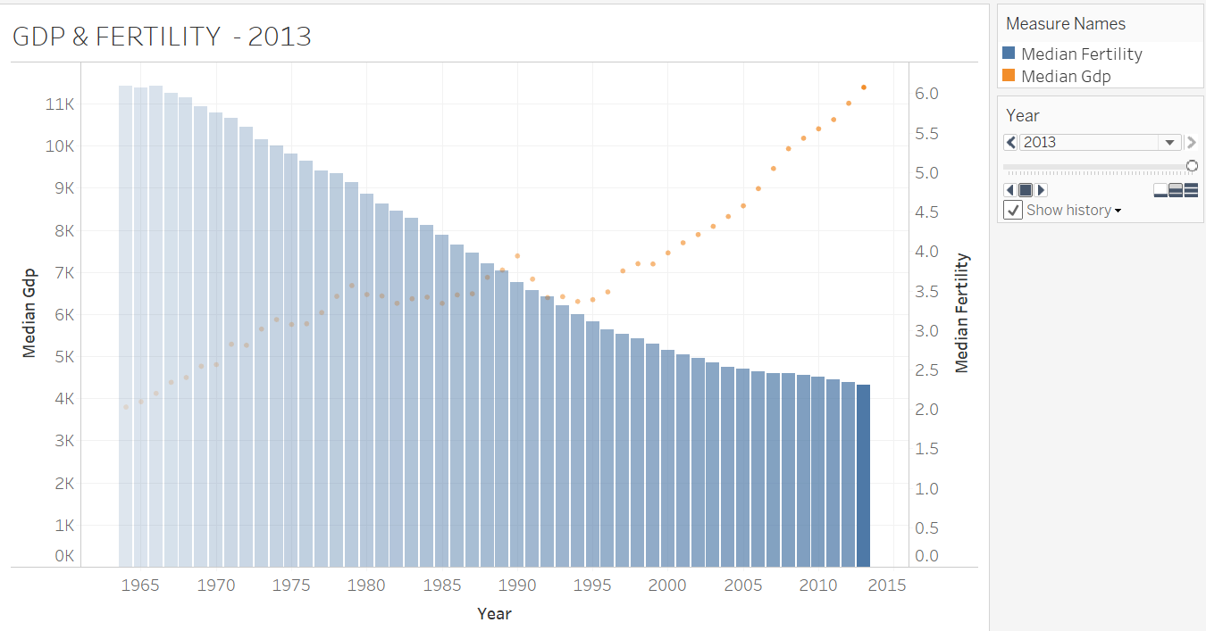
GDP & FERTILITY: IS DEVELOPMENT THE BEST CONTRACEPTIVE
Inverse relationship between GDP & FERTILITY observed
Addressed as demographic –economic paradox
Higher GDP pulls the FERTILITY down
Reason: Economic & Psychosocial Factors owing to Political & Policy Transformations
Median Fertility has fallen by 62%

Slide 5
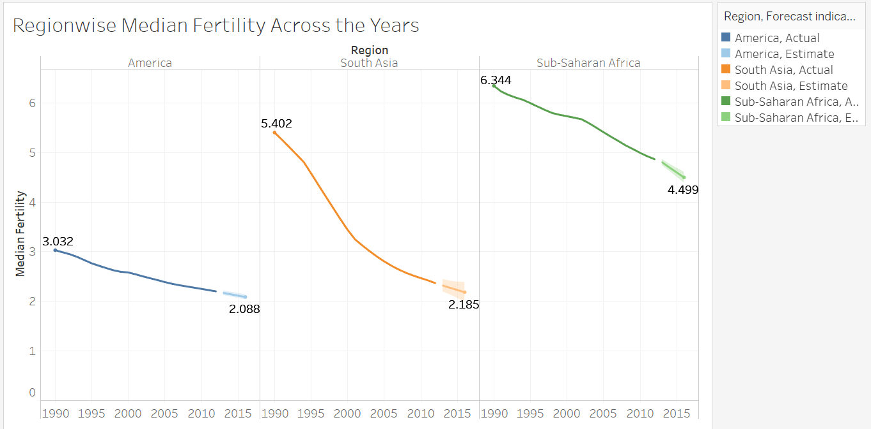
TRENDS IN DEVELOPED, DEVELOPING & UNDERDEVELOPED COUNTRIES
Three regions-American, East Asia & Pacific, Sub-Saharan
Year from 1990-2013
95% prediction interval
Fertility of East Asia & Pacific sharply decrease between 1991- 2005
Sub-Saharan demonstrated highest range for fertility drops
East Asia has widest range of fertility forecasting

Slide 6
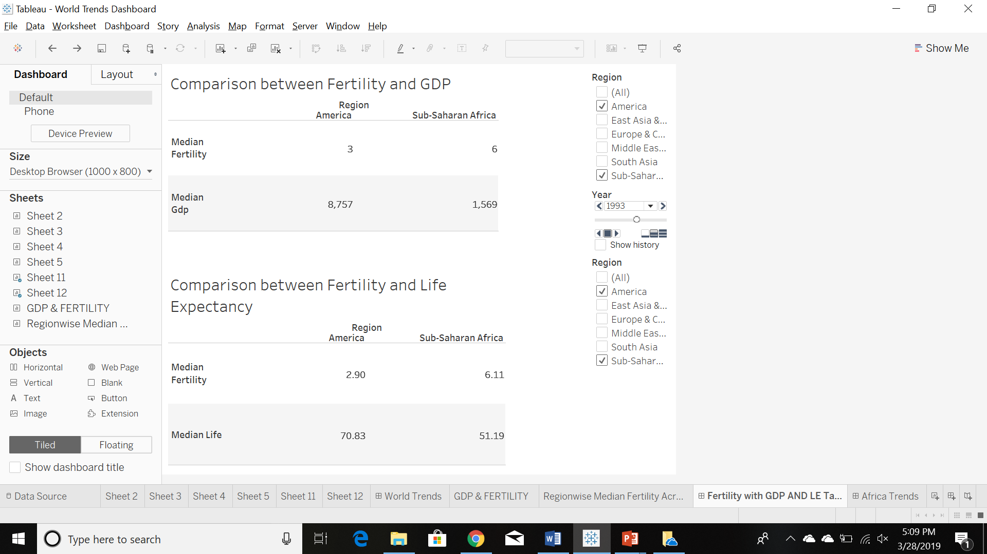
TRENDS BETWEEN FIRST & THIRD WORLD COUNTRIES
Fertility & Life Expectancy are inversely related to GDP
This trend is same for both AMERICA & AFRICA
Consistent with Demographic transition model

Slide 7
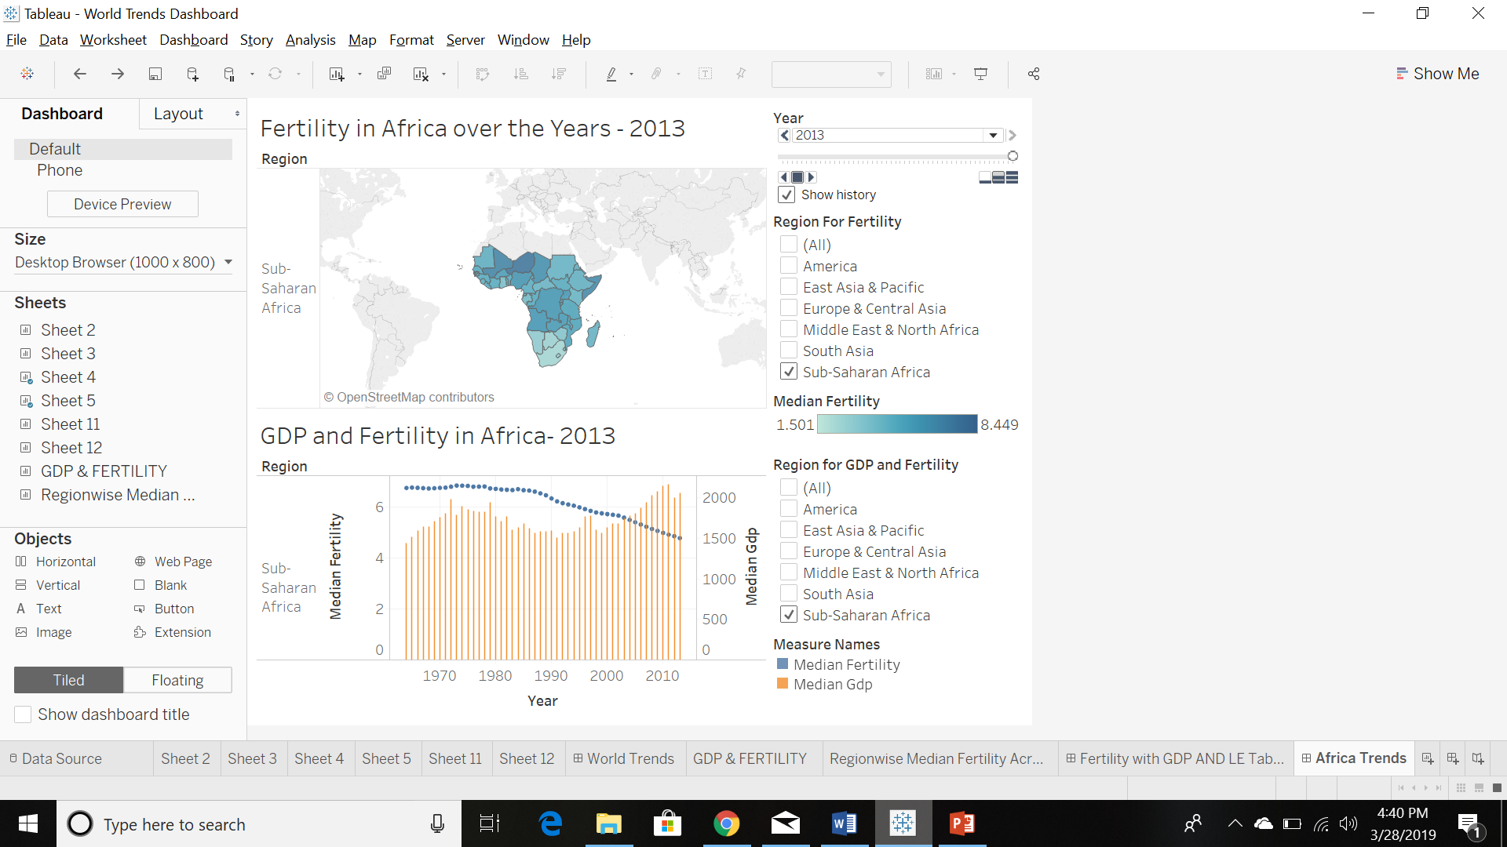
PUZZLING TRENDS IN AFRICA
Plateaued fertility in 1960-1990 despite rising GDP
Sharp decline in 21st century
Reason: Diffusion & Social Interaction Processes
Myriad Socioeconomic & Environmental Factors acted as catalysts

Slide 8
CONCLUSION

Slide 9
REFERENCE
How Income Affects Fertility. (n.d.). Retrieved from https://ifstudies.org/blog/how-income-affects-fertility
Ashraf, Q. H., Weil, D. N., & Wilde, J. (2013, March). The Effect of Fertility Reduction on Economic Growth. Retrieved from https://www.ncbi.nlm.nih.gov/pmc/articles/PMC4267474/
Federal Reserve Bank of St. Louis. (2016, December 12). The Link between Fertility and Income. Retrieved from https://www.stlouisfed.org/on-the-economy/2016/december/link-fertility-income
Trading Economics. (2019). Indicators. Retrieved from:
https://tradingeconomics.com/countries
The World Bank. (GDP per capita, PPP (constant 2011 international $)).
Retrieved from:
https://data.worldbank.org/indicator/NY.GDP.PCAP.PP.KD?locations=CZ

