Slide 1


Slide 2
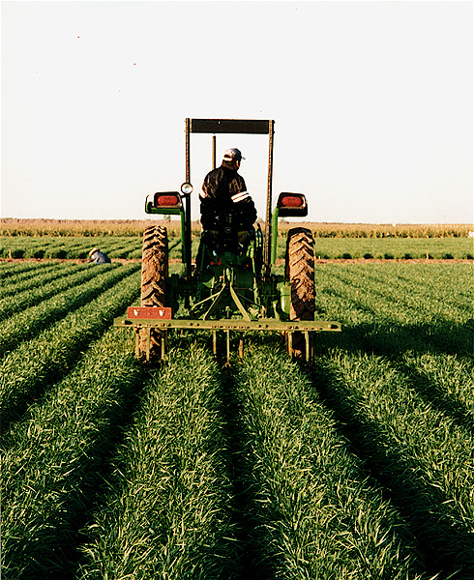
Activities
Irrigation
Mulching
Ploughing
Planting

Slide 3
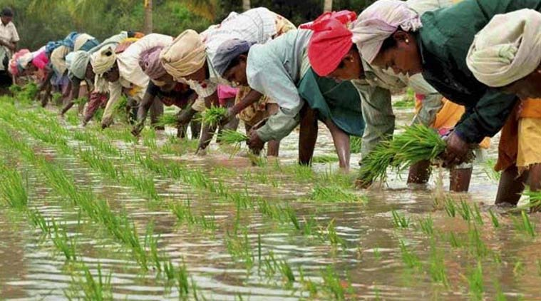
Turning Point
Activities have a direct affect on the Temperature and Moisture of the soil

Slide 4
Small Scale
Home gardens with sensors that monitor plant light, water, and nutrients for optimal growth.
Examples :
Application the alert users if the plants need water or sunlight
Examples:

Slide 5
Description and Purpose

Slide 6
Large Scale
We could connect a network of sensors in a farm to retrieve the data
We could also know the log activities of the farmer.

Slide 7
Use Case 1

Slide 8
Use Case 2

Slide 9
Data Collection and Usage
User Activities
Mining
Queries

