Slide 1
GastroWave
Neonatal Belt
Treating GERD in Premature Infants
Team Bio Wizards

Slide 2
01
Background

Slide 3
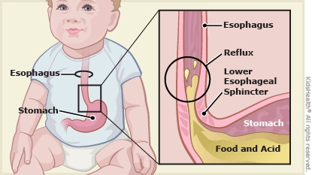
Gastroesophageal Reflux Disease (GERD)
Immature lower esophageal sphincter (LES) and underdeveloped GI motility → stomach contents flow back into the esophagus
Frequent reflux episodes in NICU → feeding intolerance, poor weight gain, and increased risk of aspiration → hindered weight gain and increased length of stay (LOS)
GERD is a common and significant clinical challenge in the care of premature infants.
Notes:
Devika

Slide 4
1 in 10 [1]
2-3 episodes [2]
$70,000 [3]
Preterm infants diagnosed with GERD
Of reflux per hour
Added per discharge of baby diagnosed with GERD
Notes:
Devika

Slide 5
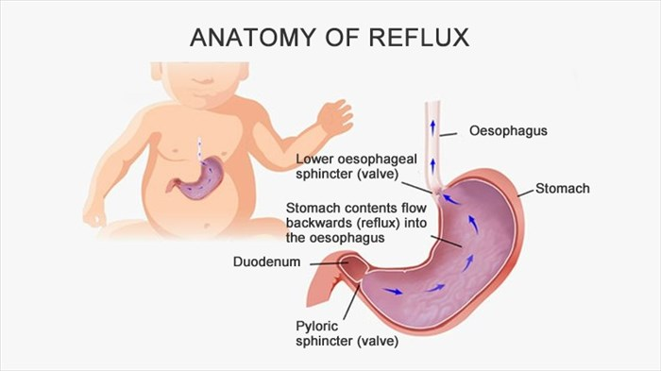
Anatomy[4]
Lower Esophageal Sphincter (LES): Prevents backflow to the esophagus
Diaphragm: Maintain Pressure Differences
Esophagus: Tube that connects mouth to the rest of the digestive system
Peristalsis: Contractions to move food downward
Weak LES + high stomach pressure: reflux episodes
Notes:
samika

Slide 6
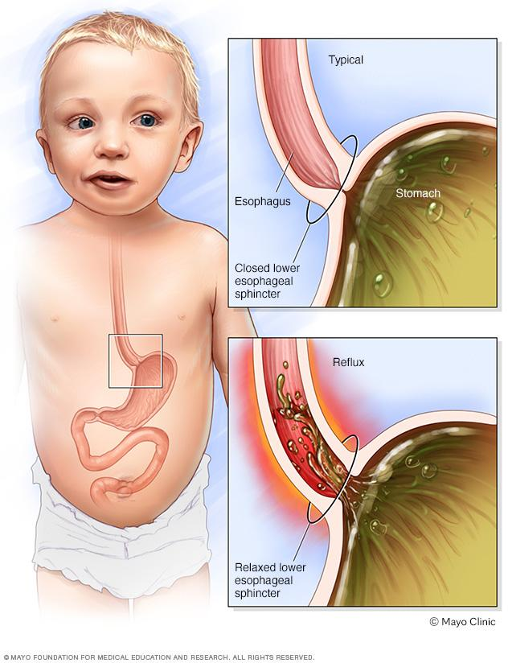
Physiology[5]
Premature infants have incomplete digestive systems
Milk stays in the stomach longer, which increases stomach pressure
Weaker peristalsis and flat position pushes contents back to mouth through the esophagus
Notes:
samika

Slide 7
Problem Statement
“To develop a non-invasive gastric stimulator for premature infants that reduces GERD while addressing the invasiveness, inconsistency, and nurse-dependence of current treatments.”
Notes:
Devika

Slide 8
02
Design

Slide 9
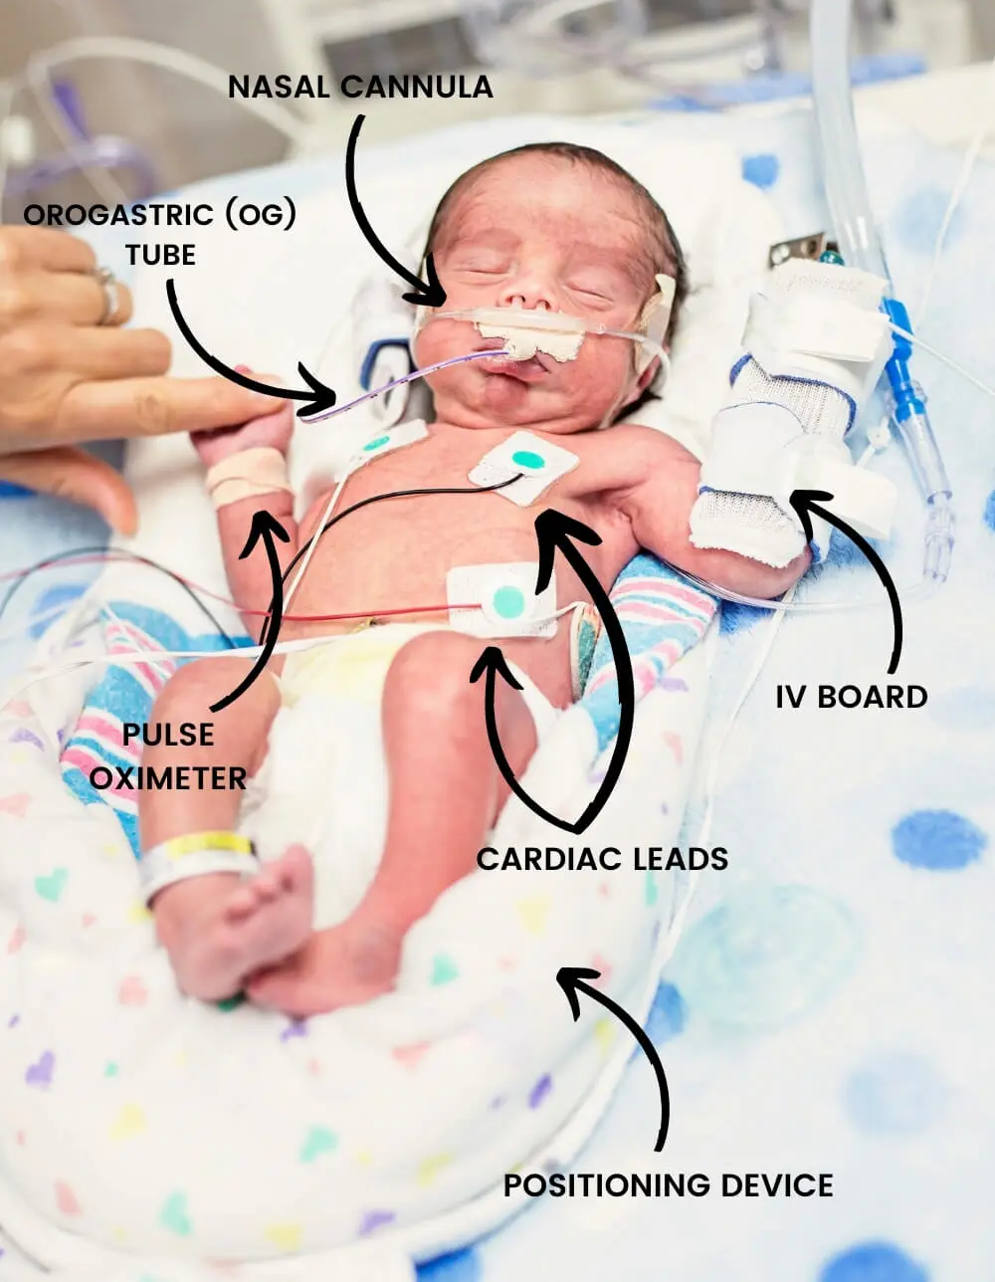
Design Constraints
Temperature probes and cardiac leads on abdomen
  Gentle pressure should not interfere with temperature or heart activity readings
Nurse workflow is tight, avoid additional lengthy procedures
  Device should be able to be worn for extended periods of time and activate autonomously
Notes:
Mythili

Slide 10
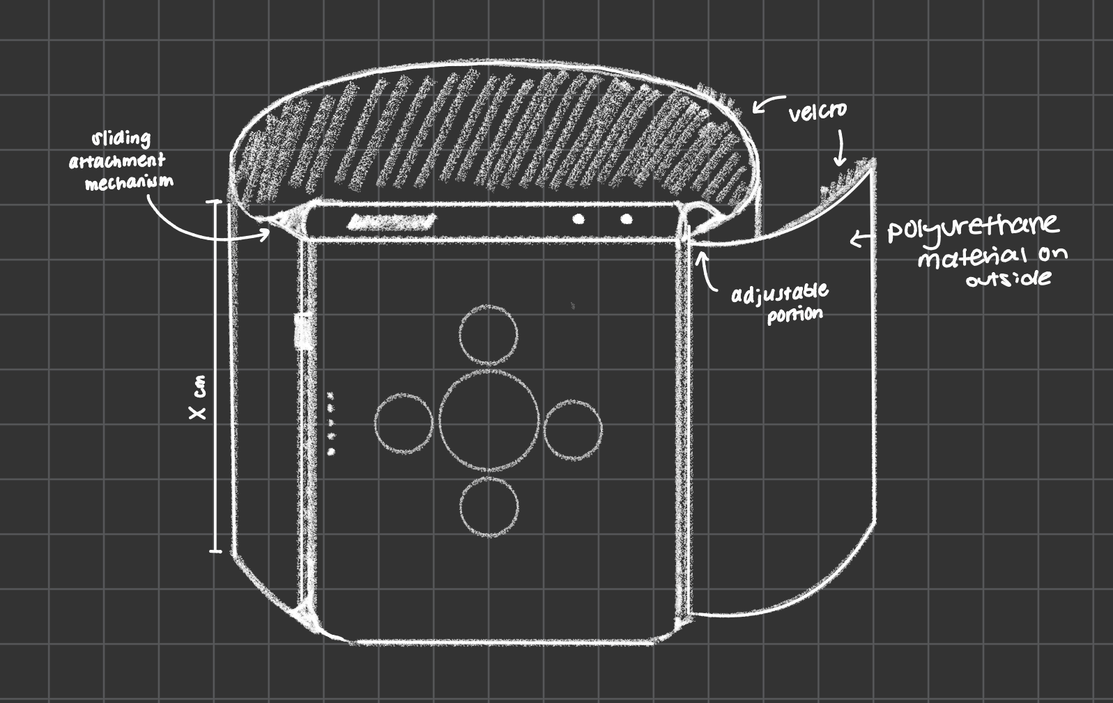
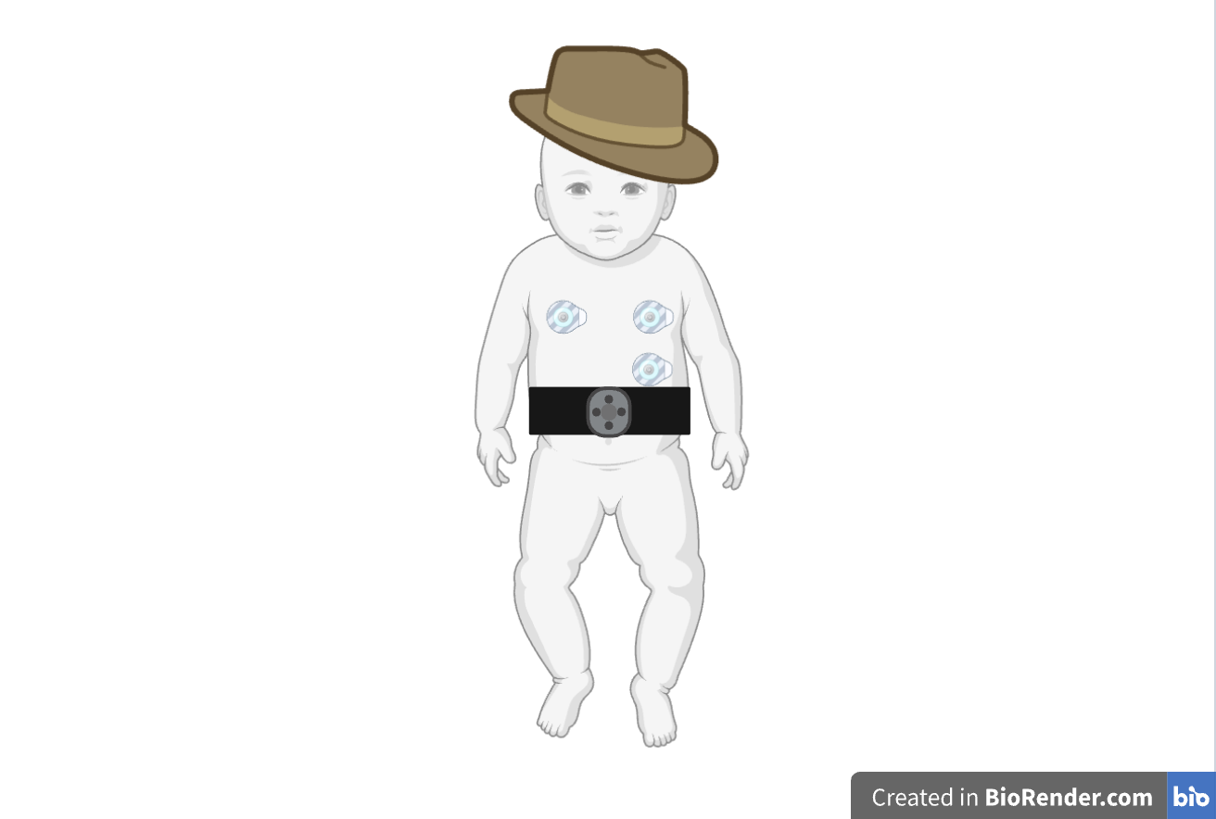
Product Sketch
Notes:
Mythil

Slide 11
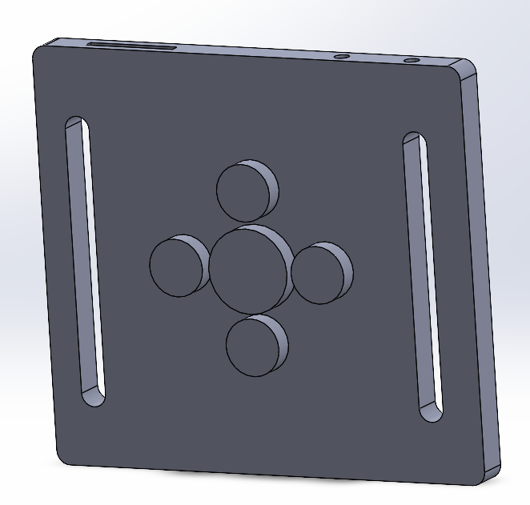
CAD Model & Features
1
4
2
5
6
3
Charging Port
Thermo-Polyurethane Body
Rechargeable lithium ion battery for multiple uses
Can be sterilized with EtO (ethylene oxide) after each use
Pressure Sensor
Soft Pneumatic Cells
Ensures force does not exceed 0.5 - 1.0 N, sensors are needed, activates if abdomen is distended
To generate clockwise movement, soft cells are used
Pressure Relief System
Fabric Belt Slots
To avoid excess pressure buildup, pressure relieving valves are built
Insertion site for soft polyurethane belt for anti-chafing security
Notes:
Mythili

Slide 12
How GastroWave Works
Step 1 - Turn on the device
Turn on the power to activate controller
05
Step 5 - Turn off the device
Device is turned off
01
04
Step 4 - Repeat
Device can be kept turned on until satisfactory results are achieved
Step 2 - Pump activates
Internal micro-pump is activated
02
03
Step 3 - Pneumatic cell movement
Cell 1 pops up, rotates, goes back in. Repeated for each cell to complete one cycle.

Slide 13
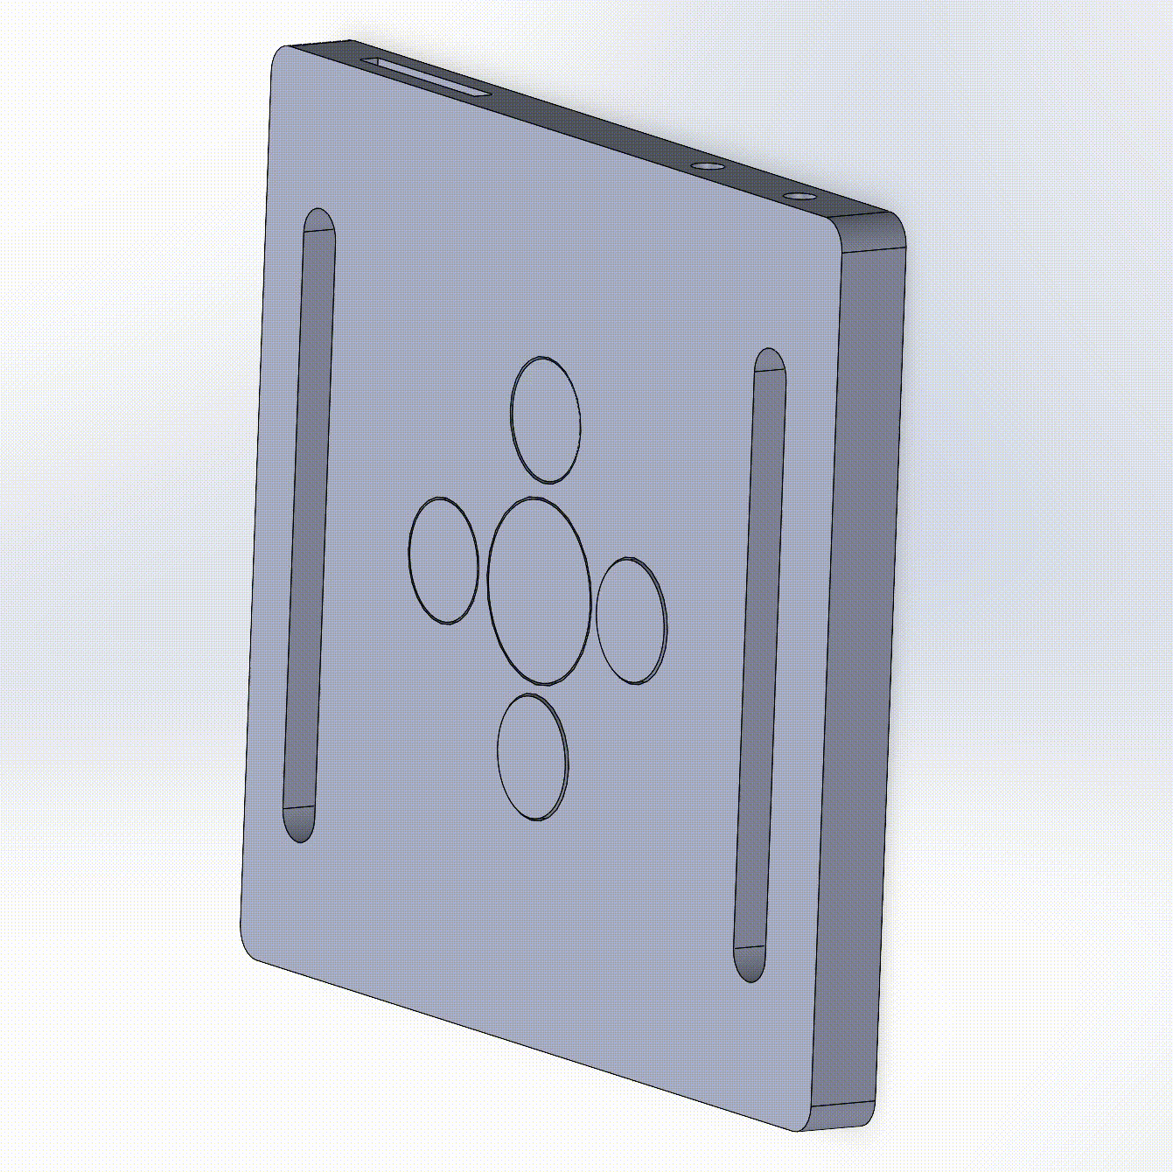
CAD Animation
Clockwise motion to simulate peristalsis and emulate physical massage.
Note: Rotation of pneumatic cells is not shown due to rendering limitations

Slide 14
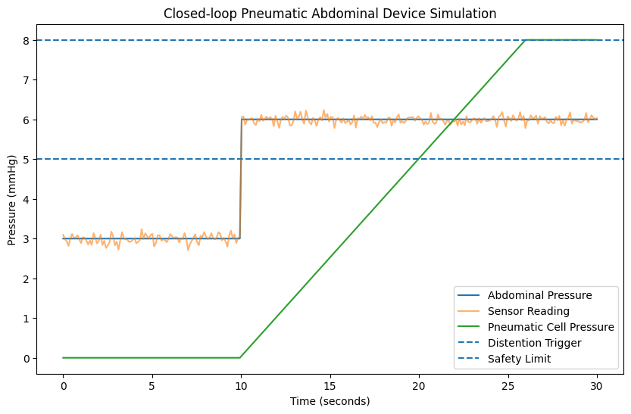
Python Simulation for Closed-Loop Control
What this simulation shows:
Baseline pressure (~3 mmHg)
Distention event (~6 mmHg)
Pump activation when threshold exceeded
Pneumatic pressure buildup
Automatic shutdown at safety limit
Validates closed-loop safety control.
The simulation demonstrates that GastroWave can detect abdominal distention, activate stimulation, and automatically stop before reaching unsafe pressure levels.
Notes:
“This simulation shows how the device responds to abdominal distention. Baseline abdominal pressure is around 3 mmHg, and when it rises above the 5 mmHg distention threshold, the pressure sensor activates the pneumatic cells to provide gentle abdominal stimulation. The system also includes a safety cutoff at 8 mmHg to ensure the pressure applied remains safe for premature infants.”

Slide 15
Inclusivity
Sizing & Adjustability
• Target Weight: (500 - 800 g infants)
• Abdominal circumference: 16–20 cm
• Designed for extremely premature infants (<28 weeks gestation)
• Reduced pneumatic pressure to accommodate fragile abdominal tissue
Small: 7.5-9 cm² contact area
• Target Weight: (800 g - 1.5 kg infants)
• Abdominal circumference: 20–24 cm
• Standard NICU premature infant range
• Balanced stimulation pressure to promote gastric motility
Medium: 9-10.5 cm² contact area
• Target Weight: (1.5 - 2.5 kg infants)
• Abdominal circumference: 24–28 cm
• Late-preterm or recovering NICU infants
• Maintains consistent stimulation coverage across larger abdomen
Large: 10.5-12 cm² contact area

Slide 16
Minimum Viable Product Criteria
Area of Device
Battery Life
Weight
7.5 cm² - 12 cm²
Rechargeable
At least 10 hours of function before recharging
Maximum ~ 50 g
No. of Cycles Before Failure
Cell Time
Others
30,000 cycles before failure
Inflation: <8 sec
Deflation: <4 sec
Heat Resistant
Biocompatible
Sterilizable (EtO)
Leak Resistant

Slide 17
03
Competition

Slide 18
Current Treatment/ Gold Standard
Level 4 - Severe
Surgery
(Rare)
Increasing
Acid-suppressive therapy
Level 3 - Concerning
Feeding Modification
Level 2 - Moderate
Burping & Upright Seating
(Gold Standard)
Level 1 - Mild

Slide 19
Pugh Matrix with Current Solutions
Criteria | Baseline: Upright Seating and Burping | Acid-Suppressive Therapy | Diet Modification | GastroWave
Safety | 0 | -1 | 0 | 1
Effectiveness | 0 | 1 | 0 | 1
Non-Invasiveness | 0 | 1 | -1 | 1
Cost | 0 | -1 | -1 | 1
No Infection/ Side-Effects | 0 | -1 | -1 | 1
Ease of use | 0 | 0 | 0 | 1
Notes:
wendy

Slide 20
Impact on Premature Infant Care
01
04
05
02
03
06
Weight Gain
Reduced Nurse Workload
Improved gastric emptying helps premature infants absorb nutrients and gain weight more effectively. [20]
Standardized reflux management reduces the need for constant repositioning and manual intervention. [19]
Improved Sleep
Improved Feeding Tolerance
Fewer reflux episodes reduces discomfort and allows infants to maintain longer, stable sleep cycles. [18]
Gentle abdominal stimulation promotes gastric motility, helping infants tolerate feeding with fewer regurgitation events. [21]
Reduced Medication Dependence
Lower Chance of Aspiration
Non-pharmacological solutions reduces reliance on acid- suppressive medications and their potential side effects. [20]
Reducing reflux decreases the risk of milk entering the airway, preventing aspiration and respiratory complications. [20]
Notes:
AT

Slide 21
Feasibility
Skin Electrode Abdomen Stimulator [7]
Uses electrode, pulse generator and control unit to stimulate abdominal movement
FDA-approved Abdominal TENS Stimulation Belt [27]
Non-invasive electrical stimulation activates abdominal muscles to promote gastrointestinal motility
Harness to Maintain Position
Harnesses and straps that help maintain upright positions
Our innovation integrates gastric stimulation with pressure feedback control.
Notes:
wendy

Slide 22
04
Regulatory

Slide 23
Path to FDA Clearance
Classification: Class II
Pathway: De Novo
High-risk patient population, must provide evidence that no harm is done and prove efficacy of safety measures [23]
Confirm classification by submitting 513(g) for FDA feedback [26]
No predicate device similar enough for 510(k) clearance, but not high-risk enough to need pre-market approval
Submission Considerations:
NSE Predicate: TENS Muscle Stimulation Belt [27]
Clinical trials to show safety and efficacy
Prove minimum viable product criteria are met
Notes:
NSE → non-substantially equivalent

Slide 24
ISO Standards Guiding GastroWave Development
Standard | Why It Applies | Engineering Validation Benchmarks
ISO 10993 | Biocompatibility for neonatal skin contact | Skin contact materials tested per biocompatibility standards
ISO 14971 | Risk management for abdominal pressure & monitoring interference | Max abdominal pressure ≤ 1 N
ISO 11607 | Sterile packaging & ethylene oxide sterilization | Device sterilization via ethylene oxide
ISO 13485 | Quality control during manufacturing | Manufacturing traceability & quality control implemented
IEC 60601-1 | Electrical safety and electromagnetic compatibility with NICU monitoring equipment | Electrical safety validated
Notes:
ISO 10993: Biocompatibility of Medical Devices
Ensures polyurethane fabric and skin-contact components are safe for prolonged neonatal skin contact
Required cytotoxicity, sensitization, and irritation testing before clinical use
ISO 14971: Medical Device Risk Management
Guides identification and mitigation of device risks
Example risks addressed:
Excess abdominal pressure
Interference with NICU monitoring equipment
Skin irritation in premature infants
ISO 13485: Medical Device Quality Management Systems
Governs design control, manufacturing, and traceability
Ensures consistent production quality for NICU-grade devices
ISO 80601-2-56: Clinical Thermometers / Temperature Monitoring Equipment
Relevant due to proximity to NICU temperature monitoring probes
Ensures device does not interfere with patient monitoring systems
ISO 11607: Sterilization of Medical Device Packaging
Ensures ethylene oxide sterilization compatibility and sterile packaging

Slide 25
05
Market Analysis

Slide 26
Target Market & Audience
Target Market
Premature Infants < 28 Weeks
Target Audience
Primary Customer
Hospitals with NICU units
Initial deployment
Urban hospitals in the U.S.
Expansion
Rural U.S and Global NICUs in low- and middle-income countries
Notes:
AT

Slide 27
TAM, SAM, SOM
$19.4M
$9.7M
$630K
Total Addressable Market (TAM)
Serviceable Available Market (SAM)
Serviceable Obtainable Market (SOM)
Total market demand if all premature infants with GERD used the device
Market demand focusing only on premature infants with GERD in NICU
Realistic market demand focusing only on premature infants with GERD in NICU in Urban America in only one city (~5%)
10% of total births are preterm = 370,000 premature infants/year
51% preterm infants are admitted to NICU = 194,000 infants
50% chance of GERD = 97,000 infants
$100 per device
SAM = $9.7 million/year
50% chance of GERD = 97,000 infants
5% adoption rate in first year in urban America (5% of 65%) = 6,300 infants
$100 per device
SOM = $630,000/year
10% of total births are preterm = 370,000 premature infants/year
50% chance of GERD = 194,000 infants
$100 per device
TAM = $19.4 million/year

Slide 28
TAM, SAM, SOM - Summary
TAM
All premature infants with GERD
$19.4M
SAM
NICU treated infants
$9.7M
SOM
First city rollout
$630K

Slide 29
Bill of Materials
Component | Price | Notes
Air Pump and Vacuum DC Motor [15] | $7.95 per pump/motor | Could use multiple pads with one pump
TPU Bladder Film | $6.16 per 25 cm^2 sheet | Sheet would be sectioned into 4 pads connected to a single motor
Medical Grade PVC Tubing | ~$1.99 per foot | Bulk orders could further reduce prices
TP4056 (Li-Ion Charger) | ~$7.49 per pack of 5
Notes:
AK

Slide 30
Bill of Materials (Cont.)
Component | Price | Notes
Polyurethane Laminated Fabric [13] | ~$7.45 per yard in bulk | Need less than 0.025 yards^2 for one unit
Li-Ion Coin Cell Battery | $2.92 | Sheet would be sectioned into 4 pads connected to a single motor
Hook-and-Loop (Velcro) Fasteners [14] | $9.47 for 4 ft | Bulk rolls can reduce pricing to <$0.5 per foot
Notes:
AK

Slide 31
Cost to Assemble + Distribute
Component | Price | Notes
Sewing + Assembly Labor | $5–$8 per garment in large-scale factories | Labor typically represents 20–30% of fabric production cost [28]
Estimated Total Manufacturing Price | ~$51.43 total | Includes 12% overhead to account for additional costs
Regulatory and Distribution Costs | +50% (Regulatory), +30% (Distributor Markup), ~$92.57 PPU | R&D/Clinical Trials/FDA approval can cost millions over years
Notes:
AK

Slide 32
IP/Patent Strategy
Provisional Patent
Cheaper to file
Gives 12 months for logistics
Idea Protection
File Utility Patent
Utility of soft pneumatic cell technology to tackle GERD
Step 2
Step 1
Step 3
Find Sources to Fund and File Patent
Patents can be expensive, participate in more competitions, funding rounds or join incubator/accelerator programs
Find IP lawyer/firms

Slide 33
Exit Strategy
Get Acquired
Benefits -
Lesser Capital Required than IPO
Access to Hospital Network, R&D, Manufacturing and Supply Chains
Medium Companies
Large Companies
Masimo
Natus Medical
Atom Medical
Inspiration Health Group
Medtronic
Philips
Drager
G.E Healthcare

Slide 34
Reference & Appendix
06

Slide 35
References
[1] World Health Organisation, “Preterm birth,” Who.int, May 10, 2023. https://www.who.int/news-room/fact-sheets/detail/preterm-birth/
‌
[2] I. Gulati and S. Jadcherla, “GERD in the NICU Infant: Who needs to be treated and what approach is beneficial?,” Pediatric Clinics of North America, vol. 66, no. 2, Apr. 2019, doi: https://doi.org/10.1016/j.pcl.2018.12.012.
‌
[3] S. R. Jadcherla, J. L. Slaughter, M. R. Stenger, M. Klebanoff, K. Kelleher, and W. Gardner, “Practice Variance, Prevalence, and Economic Burden of Premature Infants Diagnosed With GERD,” Hospital Pediatrics, vol. 3, no. 4, pp. 335–341, Oct. 2013, doi: https://doi.org/10.1542/hpeds.2013-0036.
‌
[4] E. C. Eichenwald, “Diagnosis and Management of Gastroesophageal Reflux in Preterm Infants,” Pediatrics, vol. 142, no. 1, p. e20181061, Jun. 2018, doi: https://doi.org/10.1542/peds.2018-1061.
‌
[5] M. Tolba, A. Mesbah, A. Abd El-Bassat, A. Mohamed Zoair, N. Hablas, and K. Talaat, “Hemodynamics assessment in critically ill children with increased intra-abdominal pressure,” Egyptian Pediatric Association Gazette, vol. 73, no. 1, Oct. 2025, doi: https://doi.org/10.1186/s43054-025-00447-7.
‌
[6] I. Gulati and S. Jadcherla, “GERD in the NICU Infant: Who needs to be treated and what approach is beneficial?,” Pediatric Clinics of North America, vol. 66, no. 2, Apr. 2019, doi: https://doi.org/10.1016/j.pcl.2018.12.012.
[7]J. Yin and Jiande DZ Chen, “Noninvasive electrical neuromodulation for gastrointestinal motility disorders,” Expert Review of Gastroenterology & Hepatology, vol. 17, no. 12, pp. 1221–1232, Nov. 2023, doi: https://doi.org/10.1080/17474124.2023.2288156.
[8]J. R. Lightdale and D. A. Gremse, “Gastroesophageal Reflux: Management Guidance for the Pediatrician,” PEDIATRICS, vol. 131, no. 5, pp. e1684–e1695, Apr. 2013, doi: https://doi.org/10.1542/peds.2013-0421.
[9]R. M. Patel and P. W. Denning, “Therapeutic Use of Prebiotics, Probiotics, and Postbiotics to Prevent Necrotizing Enterocolitis,” Clinics in Perinatology, vol. 40, no. 1, pp. 11–25, Mar. 2013, doi: https://doi.org/10.1016/j.clp.2012.12.002.
[10]R. Rosen et al., “Pediatric Gastroesophageal Reflux Clinical Practice Guidelines: Joint Recommendations of the North American Society for Pediatric Gastroenterology, Hepatology, and Nutrition and the European Society for Pediatric Gastroenterology, Hepatology, and Nutrition,” Journal of pediatric gastroenterology and nutrition, vol. 66, no. 3, pp. 516–554, 2018, doi: https://doi.org/10.1097/MPG.0000000000001889.
[11]T. C. Kwok, S. Ojha, and J. Dorling, “Feed thickener for infants up to six months of age with gastro-oesophageal reflux,” Cochrane Database of Systematic Reviews, Dec. 2017, doi: https://doi.org/10.1002/14651858.cd003211.pub2.

Slide 36
References (Cont.)
[12]“SafetyStore.com First Aid Kits, Emergency Preparedness, Disaster Response,” Safetystore.com, 2017. https://www.safetystore.com/2-Tube-Replacement-Bladder-Adult-each.html (accessed Mar. 07, 2026).
[13]“White PUL Fabric Wholesale, Rolls from $US 7.45/yard,” Kinderel Organic Fabrics, 2025. https://www.kinderel.com/products/white-pul-fabric-wholesale-rolls-from-us-7-45-yard (accessed Mar. 07, 2026).
[14]“VELCRO 15 ft. x 2 in. Industrial Strength Tape 90198,” The Home Depot, 2026. https://www.homedepot.com/p/VELCRO-Brand-4-ft-x-2-in-Industrial-Strength-Tape-90593/202261920 (accessed Mar. 07, 2026).
[15]“Amazon.com,” Amazon.com, 2025. https://www.amazon.com/McKesson-Blood-Pressure-Inflation-01-875NGM/dp/B07K311V8V (accessed Mar. 07, 2026).
[16]C. Sevcencu, “Gastrointestinal Mechanisms Activated by Electrical Stimulation to Treat Motility Dysfunctions in the Digestive Tract: A Review,” Neuromodulation: Technology at the Neural Interface, vol. 10, no. 2, pp. 100–112, Mar. 2007, doi: https://doi.org/10.1111/j.1525-1403.2007.00098.x.
[17]I. Gulati and S. Jadcherla, “GERD in the NICU Infant: Who needs to be treated and what approach is beneficial?,” Pediatric Clinics of North America, vol. 66, no. 2, Apr. 2019, doi: https://doi.org/10.1016/j.pcl.2018.12.012.
[18]S. R. Jadcherla, J. L. Slaughter, M. R. Stenger, M. Klebanoff, K. Kelleher, and W. Gardner, “Practice Variance, Prevalence, and Economic Burden of Premature Infants Diagnosed With GERD,” Hospital Pediatrics, vol. 3, no. 4, pp. 335–341, Oct. 2013, doi: https://doi.org/10.1542/hpeds.2013-0036.
[19]in Infants, “Acid Reflux in Infants and Children (GERD in Infants and Children),” Mymed.com, 2026. https://www.mymed.com/diseases-conditions/acid-reflux-in-infants-and-children-gerd-in-infants-and-children (accessed Mar. 07, 2026).
[20]“Infant reflux,” Middlesex Health, 2024. https://middlesexhealth.org/learning-center/diseases-and-conditions/infant-reflux(accessed Mar. 07, 2026).
[21] Akhobadze, G R et al. “Identification, management and complications of intra-abdominal hypertension and abdominal compartment syndrome in neonatal intensive care unit (a single centre retrospective analysis).” Georgian medical news ,192 (2011): 58-64.

Slide 37
References (Cont.)
[22] Leandro, “Class I and Class II Medical Device: What’s the Difference?,” Vantage Medtech, Sep. 22, 2022. https://vantagemedtech.com/class-1-and-class-2-medical-device-difference/
[23] J. A. Martin and M. J. K. Osterman, Increases in Neonatal Intensive Care Admissions in the United States, 2016–2023, National Center for Health Statistics, NCBI Bookshelf. [Online]. Available: https://www.ncbi.nlm.nih.gov/books/NBK613750/. Accessed: Mar. 7, 2026.
[24] National Center for Health Statistics, “Births and Natality,” Centers for Disease Control and Prevention. [Online]. Available: https://beta.cdc.gov/nchs/fastats/births.htm. Accessed: Mar. 7, 2026.
[25] National Center for Health Statistics, “Birthweight and Gestation,” Centers for Disease Control and Prevention. [Online]. Available: https://beta.cdc.gov/nchs/fastats/birthweight.htm. Accessed: Mar. 7, 2026.
[26] U.S. Food and Drug Administration, “FDA and Industry Procedures for Section 513(g) Requests for Information under the Federal Food, Drug, and Cosmetic Act,” FDA, Jun. 28, 2021. https://www.fda.gov/regulatory-information/search-fda-guidance-documents/fda-and-industry-procedures-section-513g-requests-information-under-federal-food-drug-and-cosmetic
[27]“510(k) SUMMARY,” 2014. Accessed: Mar. 08, 2026. [Online]. Available: https://www.accessdata.fda.gov/cdrh_docs/pdf13/K130723.pdf
[28] ILO, “Data and statistics | International Labour Organization,” www.ilo.org, Apr. 16, 2024. https://www.ilo.org/data-and-statistics
‌

Slide 38
Appendix - Workflow of the GastroWave
Distension Categories:
Baseline: 2–4 mmHg
Distention trigger: +1–2 mmHg change
Maximum allowed stimulation: 6 mmHg
Emergency cutoff: 8 mmHg
Source: [22]
Pressure Sensor Applies Measured Pressure
Power from Li-Ion Battery
Pressure Too High?
‘Inflate’ Pneumatic Cells Sequentially
No
Pressure Sensor Measures Abdomen
Yes
Activate Pump
Continue Stimulation
Yes
Distension?
Stop Pump and Release Air
No
Continue Monitoring

Slide 39
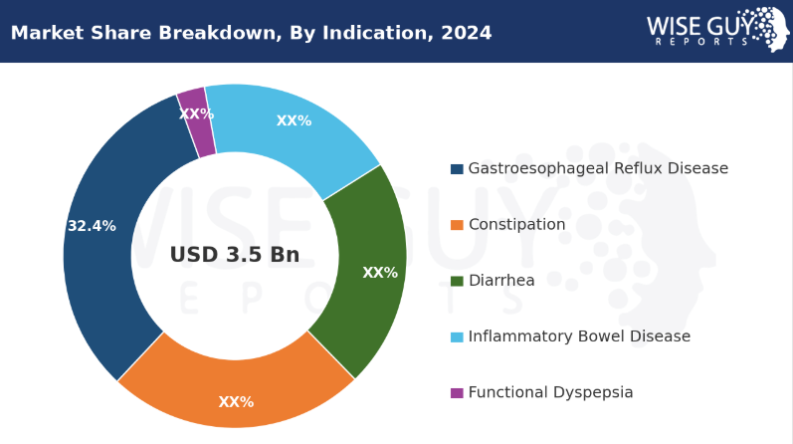
Appendix - Gastrowave Market Penetration

Slide 40
Thank You!
Questions?

