Slide 1
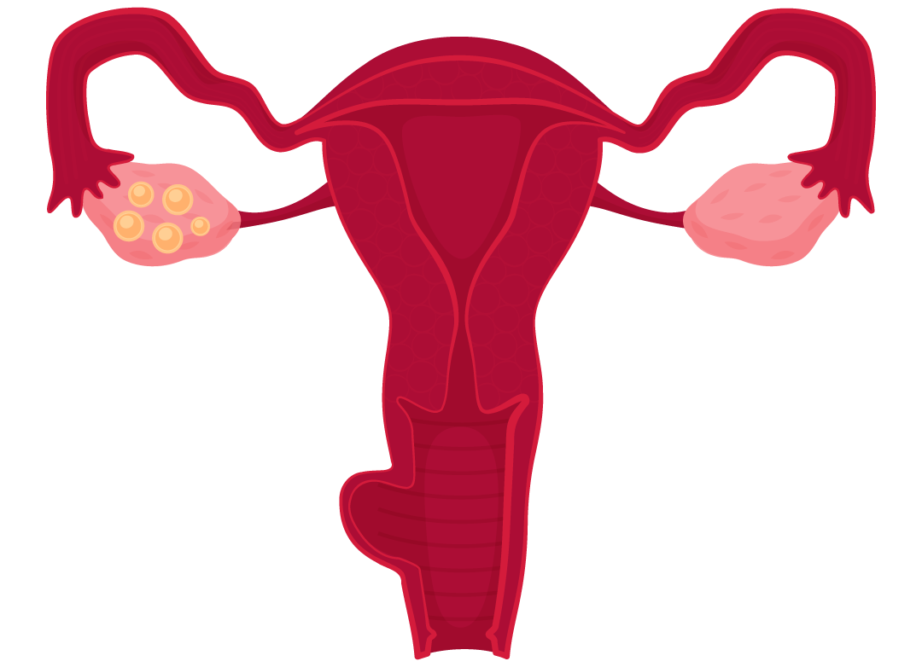
Sling: Women’s Health
Featuring: The Control Kit
Notes:
Mary Grace

Slide 2




Samika Gandhi
Anokhi Sheth
01
The Team
Anaya Bawiskar
MaryGrace Wahby
Notes:
Mary Grace

Slide 3
02
The Problem
Notes:
So the problem

Slide 4
Women’s Health – A Global Crisis!
Women’s Health is the diagnosis and treatment of physical, mental and emotional conditions suffered by a woman.
How serious is it ?
  48.1% women aged 15-49 in the United States use contraceptives [3]
  There are 6 million unplanned American pregnancies per year – imagine how many on a global scale [2]
Notes:
Let’s take a look at the severity of the issues that women face on the daily
With over 48% of women using a variety of contraceptive methods, there are still over 6 million unplanned pregnancies in the United states.
Think about that on a global scale
EMOTIONAL IMPACT
Women’s Health is a significant problem area. To demonstrate,

Slide 5
Women’s Health – A Global Crisis!
Taxpayers spend
$12 billion annually
on unintentional
pregnancies
[13]
Notes:
Over $12 billion dollars annually are spent on unintentional pregnancies by taxpayers (emphasize billion)
Women’s Health is a significant problem area. To demonstrate,
EMOTIONAL EMPHASIS

Slide 6
What is Birth Control?
The practice of preventing unwanted pregnancies, especially by use of contraception.

Slide 7
Customer Discovery
Access
Awareness
Comfort
Uptake of birth control implants in rural, low-income areas
Lack of Trained Providers
Education
Misconceptions
30-45 minutes spent convincing patients
“Fighting social media myths”
Cultural /social norms and beliefs
Women who have never had a vaginal delivery
Anxiety/ worry can lead to pain
Use of numbing medicine
Notes:
Lack of Access: In one customer discovery interview, an obgyn in rural India remarked that in 15 years of gynaecology practice, she had never seen a birth control implant. This lead us to question the status in rural areas in the US.
Make sure we mention who we talked to
Awareness: One obgyn we talked to was seeing patients on the younger side. She said that patients come in with misconceptions about birth control that are fueled by social media, which results in a mental block against birth control. The obgyn in a rural area reported spending 30-45 minutes of time during appointments to get patients to even consider using birth control because of the stigma surrounding it.
Comfort: For IUDs, insertion can be painful for women, especially those who have never had a vaginal delivery. The provider we talked to expressed that because she is more experienced with a younger population, she uses numbing medicine and relaxation techniques. Providers who are not experienced with younger patients or those who delivered by a C-section may be less likely to using numbing medicine.

Slide 8


[8]
2022
Notes:
https://powertodecide.org/what-we-do/contraceptive-deserts

Slide 9
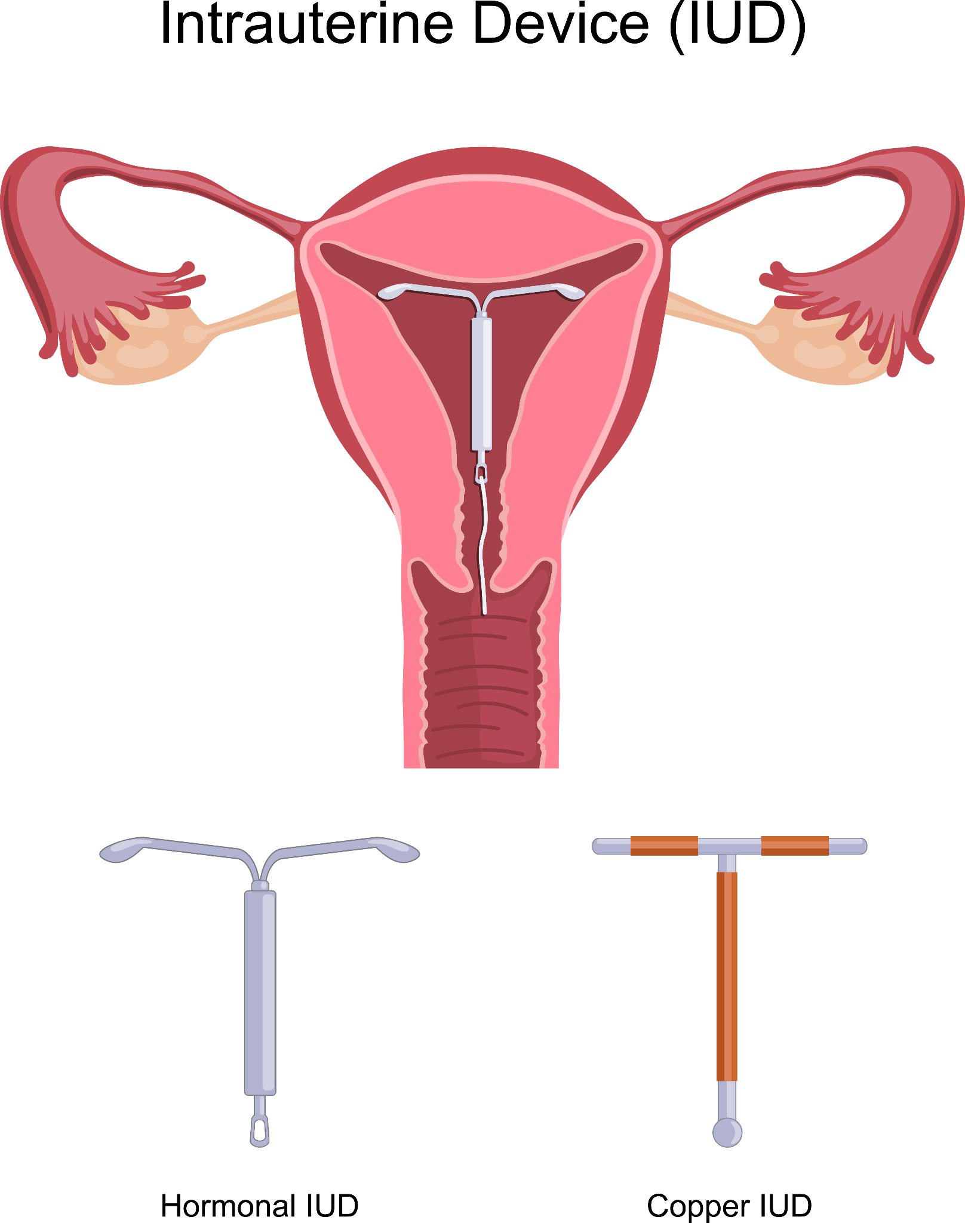
An Example:
Intrauterine Device (IUD)
What is it?
IUDs are small T-shaped devices make to be inserted into the uterus to prevent pregnancy.
Copper IUD:
Creates a cytotoxic environment, killing sperm before they reach the fallopian tubes,
Hormonal IUD:
Releases progestin, which causes thickening of the cervical muscles to block the passage of sperm cells.

Slide 10
Why IUD?
Remaining Problems
No systemic side effects
99.9% success avoiding pregnancy
Discomfort ends a few hours after insertion
Most women find insertion “severely painful” [4]
Pain management methods for gynecological procedures are not taught in OB/GYN rotations [12]
Little education on how to detect malpositioning

Slide 11
Lack of awareness and training surrounding Long Acting Reversible Contraception negatively impacts uptake and accessibility, particularly in rural, low-income areas.
Notes:
Lack of awareness and training surrounding Long Acting Reversible Contraception negatively impacts uptake and accessibility, especially in rural, low-income areas.

Slide 12
03
Solutions
Resources for continued learning and practice of insertion and counseling skills for different types of birth control.
The Control Kit
  Includes reusable models for practicing insertion and removal
  Educational pamphlets for patient and provider
  Competency checklists
Online Resource
  Scenario Practice consistent with updated eligibility guidelines
  Addressing misconceptions
  Comprehensive educational material
  Online Forum
Notes:
So, what are our solutions? Our solutions consist of two main components, the control kit as well as an online resource
The control kit serves to give providers a hands on means of practicing IUD insertion and removal methods while also giving instantaneous feedback
It also includes educational pamphlets for both the patient and the provider to ensure both are well-informed regarding their respective responsibilities
For patients, it would consist of descriptions of different contraceptive methods and how they work as well as a pros and cons lists comparing different methods to help patients weigh their options
For providers, it would mean competency checklists they could use alongside the hands-on practice that would include common mistakes and the do’s and don'ts of insertion and removal
Birth control kit
Something to educate both patients and providers
CDC Medical Wligibility criteria
Online forum for women can share experiences, physicians can answer questions, creating community and raising awareness (verified responses so people feel comfortable using their advice)

Slide 13
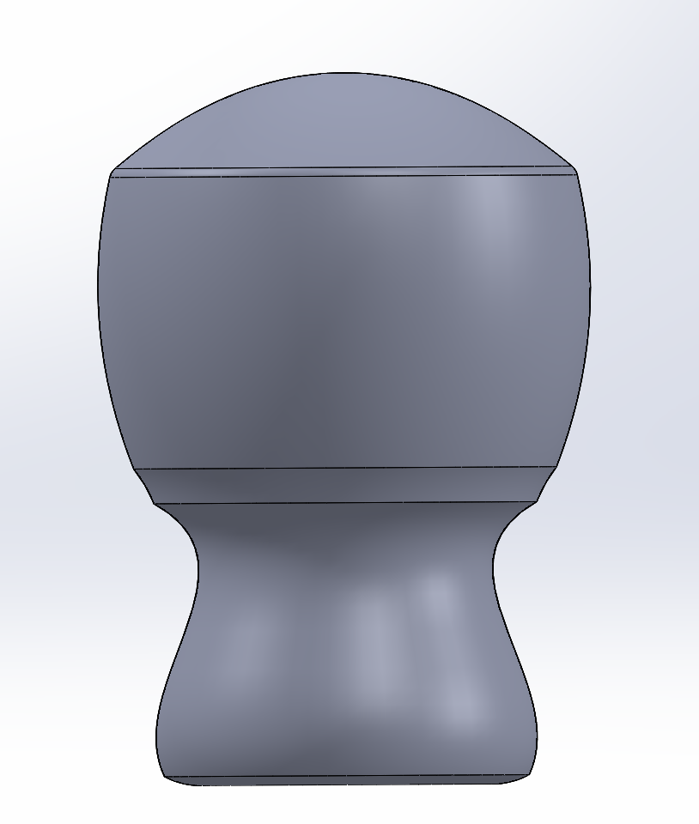
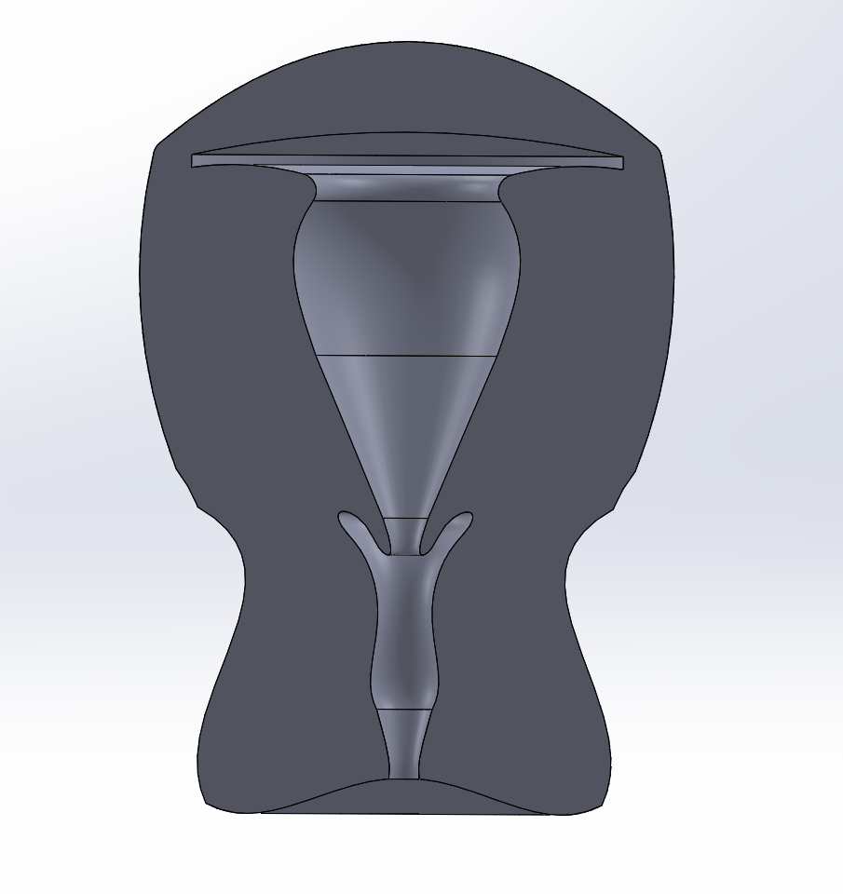
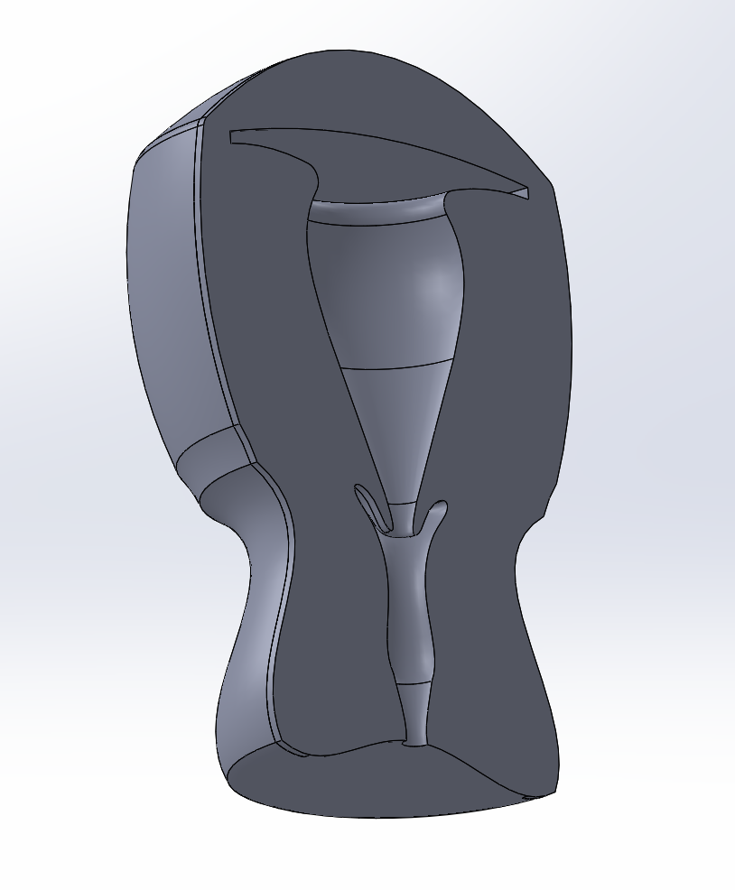
03
Solutions
Example of what training materials in the Control Kit would look like
The below would be used to practice IUD insertion. The uterine cavity would be lined with agarose hydrogel to show pressure points during insertion.
Back
Front
Side
Notes:
Birth control kit
Something to educate both patients and providers
CDC Medical Wligibility criteria

Slide 14
04
Market
Customer Base
Early Adopters
Physicians
Medical Schools
Family Planning Clinics
International Aid Organizations
School Based Health Centers
Physicians in rural or low-income areas
Medical Schools with a rural health focus
School Health Centers in areas with high dropout rates due to pregnancy
Primary Care Physicians
Notes:
https://www.ncbi.nlm.nih.gov/pmc/articles/PMC7385555/
https://www.ncbi.nlm.nih.gov/pmc/articles/PMC8032203/
School Based Health Centers: Ability to impact adolescents
Uninsured, Low Income, Underserved Population
Primary Care: unique reach to rural areas

Slide 15
04
Market
School Based Health Centers (US, 2020)
  Addressing misconceptions and providing training for LARC counseling and insertion improved staff knowledge
  Comfort in Liletta IUD insertion increased from 16% to 27% [9]
Primary Care (US, 2020)
  Provision increased 22.5% to 35% for IUDs and 31.5% to 49% for implants.
  Same-day IUD insertion increased 26% to 35%
  Knowledge of IUD eligibility rose from 69% to 84% [10]
Notes:
https://www.ncbi.nlm.nih.gov/pmc/articles/PMC7385555/
https://www.ncbi.nlm.nih.gov/pmc/articles/PMC8032203/
School Based Health Centers: Ability to impact adolescents
Uninsured, Low Income, Underserved Population
Primary Care: unique reach to rural areas

Slide 16
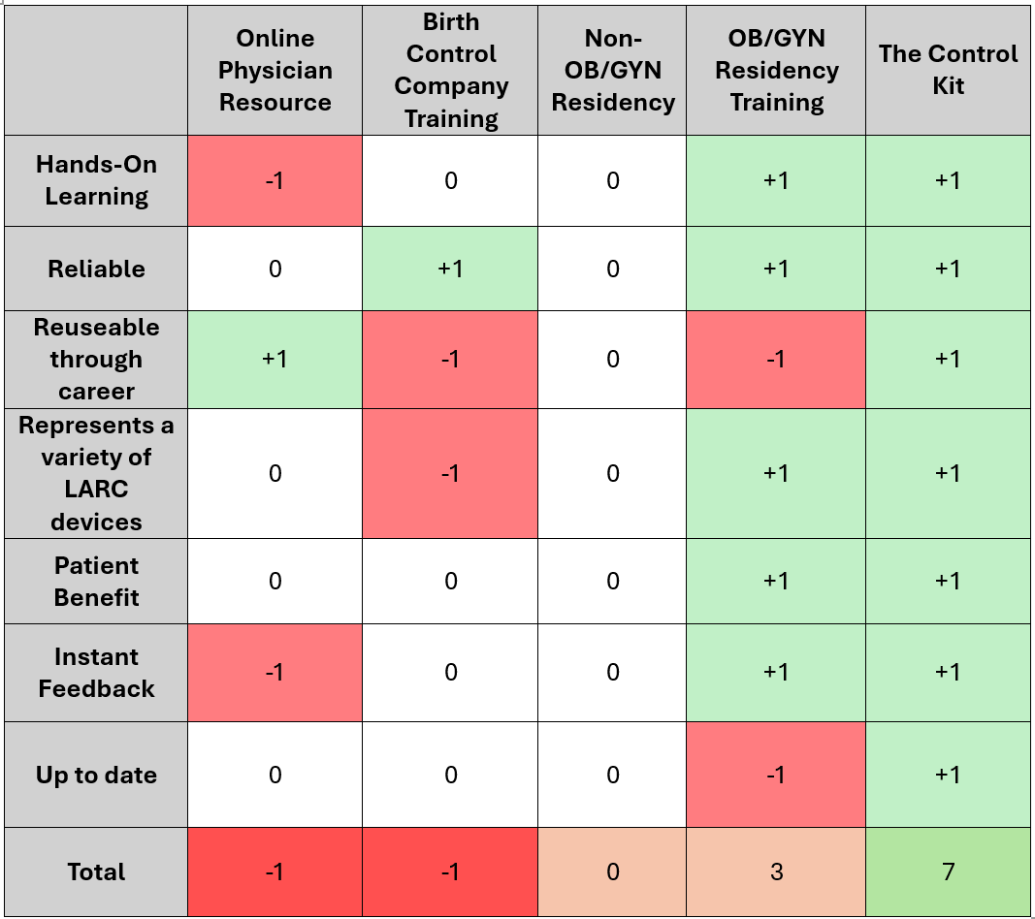
05
Competition
Notes:
PUGH MATRIX
Online educational resources
Lack of hands-on experience.
Don’t know which ones are reliable.
There is no one place where all information can be found.
Birth Control Company Trainings
Mirena, Paragard, Nexplanon
Specific to one type
Not continued
Previous training during residency
Not getting constant practice so they need to occasionally brush up on their skills as to not cause errors, an example being improper positioning placement of the IUD
Train on new forms

Slide 17
Unique Value Proposition
Offering continual and updated practice inserting different types of birth control with educational materials on each type.

Slide 18
06
Potential Business Models
How?
One-time purchase of training kits
Subscription to online resources
Where?
Focus first in urban centers
Move to rural/international markets
Notes:
The one time purchase is meant to inform both patients and providers
Not meant to teach doctors in rural areas as they already know how to insert them the different types
Meant to keep them up to date with different methods of contraception and also provide them a means to practice on their
With the membership, they can get continued, reliable access to news about birth control and stay up to date on methods and any other useful information that may come out

Slide 19
07
Plan
Continued Customer Discovery
01
Development of prototype
02
05
Market analysis
Finalizing the training tools
03
06
After expo: Pitching product to Texas A&M College of Medicine Rural Medicine Program
Market discovery
04
Notes:
Prototype ddevelpment
Market discovery
Continued customer discovery
Market analysis
After expo: going to a&m rural rotation program and pitch a product

Slide 20
References
[1] O. Hilas, "Contraception Use Among U.S. Women," U.S. Pharmacist, vol. 48, no. 9, p. 14, Sep. 2023.
[Online]. Available: https://www.uspharmacist.com/article/contraception-use-among-us-women.
[Accessed Apr. 16, 2024].
[2] "World Health Organization, 'Maternal mortality,' WHO, [Online]. Available:
https://www.who.int/news-room/fact-sheets/detail/maternal-mortality. [Accessed:
25 January, 2024]."
[3] "Centers for Disease Control and Prevention, 'Contraceptive Use,' CDC FastStats, [Online].
Available: https://www.cdc.gov/nchs/fastats/contraceptive.htm. [Accessed: 25 January, 2024]."
[4] E. A. Lopes-Garcia et al., "Assessment of pain and ease of intrauterine device placement
according to type of device, parity, and mode of delivery," in The European Journal of
Contraception & Reproductive Health Care, vol. 28, no. 3, pp. 163-167, 2023, doi:
10.1080/13625187.2023.2189500.
[5] L. Vogel, "Canadian women opting for less effective birth control," in CMAJ: Canadian Medical
Association Journal, vol. 189, no. 27, pp. E921-E922, 2017, doi: 10.1503/cmaj.1095446.

Slide 21
References
[6] "NHS Inform, 'Contraceptive implant,' [Online]. Available:
https://www.nhsinform.scot/healthy-living/contraception/contraceptive-implant/. [Accessed:
26 January, 2024]."
[7] "NHS Inform, 'Contraceptive injection,' [Online]. Available:
https://www.nhsinform.scot/healthy-living/contraception/contraceptive-injection/. [Accessed:
26 January, 2024].
[8] Power to Decide, "Contraceptive Deserts," Power to Decide, [Online]. Available:
https://powertodecide.org/what-we-do/contraceptive-deserts. [Accessed Apr. 16, 2024].
[9] Comfort, Alison B et al. “Improving Capacity at School-based Health Centers to Offer Adolescents
Counseling and Access to Comprehensive Contraceptive Services.” Journal of pediatric and adolescent
gynecology vol. 34,1 (2021): 26-32. doi:10.1016/j.jpag.2020.07.010
[10] Harper, Cynthia C et al. “Implementation science: Scaling a training intervention to include IUDs and
implants in contraceptive services in primary care.” Preventive medicine vol. 141 (2020): 106290.
doi:10.1016/j.ypmed.2020.106290

Slide 22
References
[11] A. Connolly, "IUD Placement," J. Ultrasound Med., [Online]. Available:
https://www.mfmnyc.com/wp-content/uploads/2022/05/2021-IUD-Placemernt-Connolly-JUM-2.pdf.
[Accessed Apr. 16, 2024].
[12] K. Sullivan, "Why Aren't Doctors Managing Pain During Gynecologic Procedures?" Medscape, October
30, 2023. [Online]. Available: https://www.medscape.com/viewarticle/997872?form=fpf. [Accessed Apr.
16, 2024].
[13] E. Monea and A. Thomas, "The High Cost of Unintended Pregnancy," Brookings, July 12, 2011. [Online].
Available: https://www.brookings.edu/articles/the-high-cost-of-unintended-pregnancy/. [Accessed Apr.
16, 2024].
[14] "Contraception - intrauterine devices (IUD)," Better Health Channel, [Online]. Available:
https://www.betterhealth.vic.gov.au/health/healthyliving/contraception-intrauterine-devices-iud.
[Accessed Apr. 16, 2024].

Slide 23
Give women control over their health with…
The
The
Control
Control
Kit
Kit

Slide 24
Thank you!
Questions?

