Slide 1

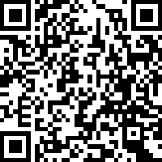

PARTICIPATE IN OUR
INDIVIDUAL DIFFERENCES STUDY
PURPOSE
This study examines individual differences, which examines how you orient with and attend to your environment.
ARE YOU A PEOPLE PERSON, A THING PERSON, OR BOTH?
ELIGIBILITY
Students enrolled in a first-year undergraduate bachelor's degree program at Queen's University.
https://queensu.qualtrics.com/jfe/form/SV_cuMwmrf4E17NGC2
WHAT'S INVOLVED?
One-time online survey
Approximately 10 minutes
Complete from anywhere
COMPENSATION
Participants may choose to enter an appreciation draw.
This study has received ethical approval by the Queen's University General Research Ethics Board (GREB)
Version: 1.1 Date 2026-AUG-31
Jason Harris
Department of Electrical and Computer Engineering
Queen's University
Email: harris.jason@queensu.ca

