Slide 1
AWS – ELASTIC FILE SYSTEM
BY
Keshav Kummari

Slide 2
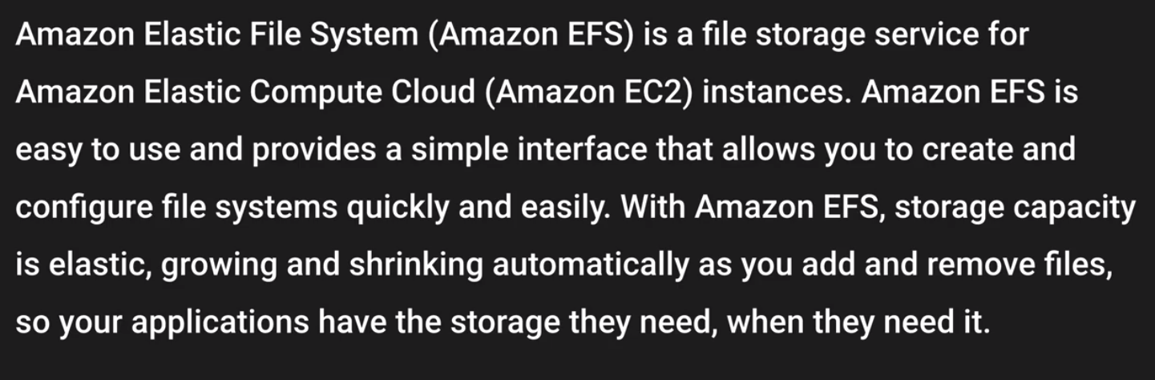
EFS – Elastic File Sytsem

Slide 3
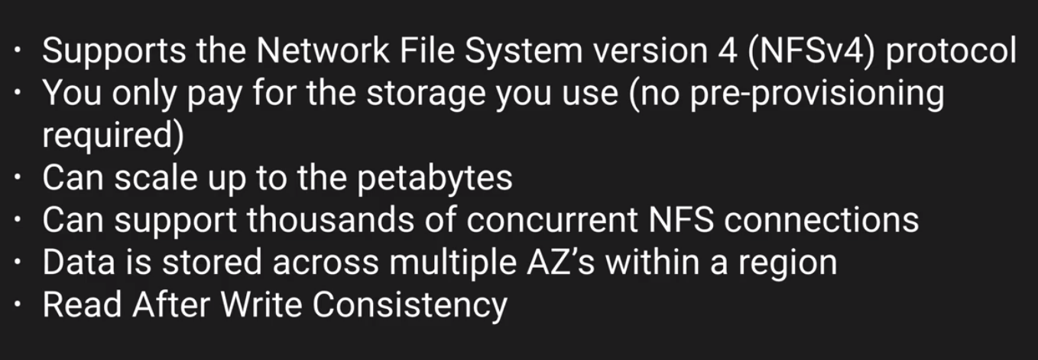
Features of EFS

Slide 4
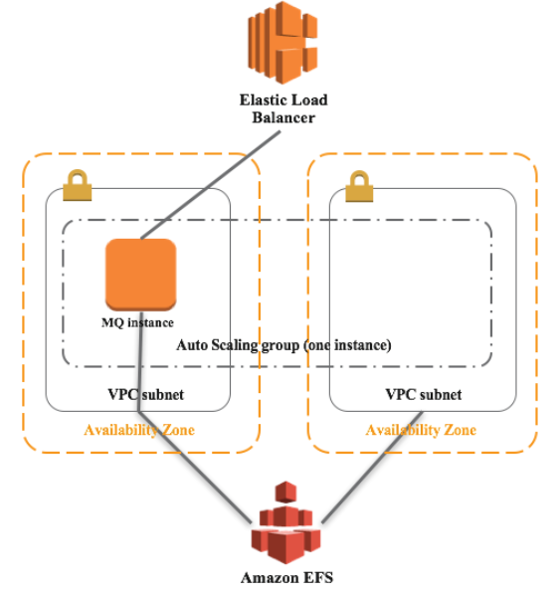
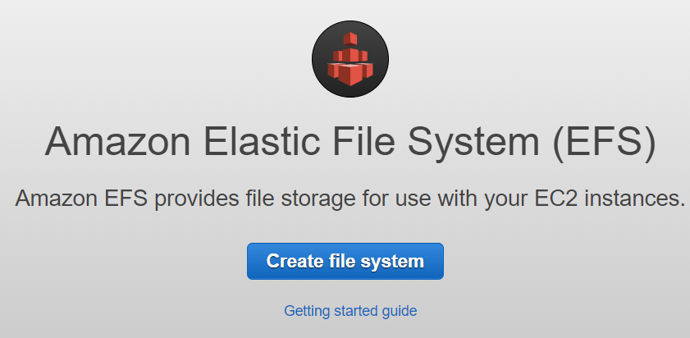
EFS – LAB

Slide 5
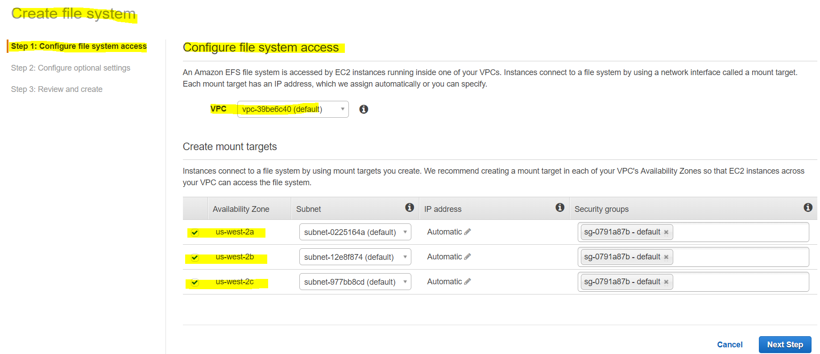
STEP-1

Slide 6
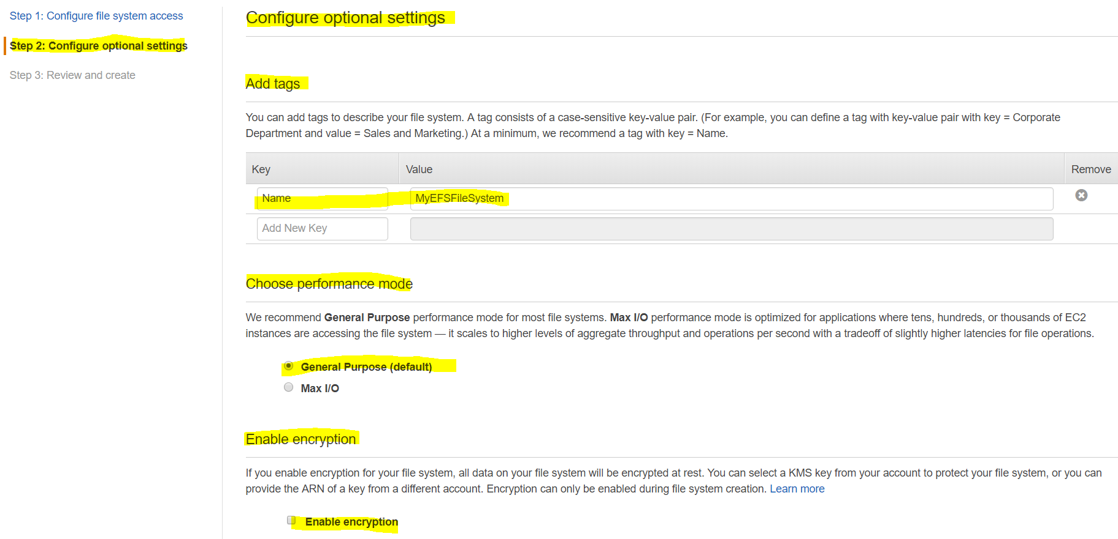
Step-2

Slide 7
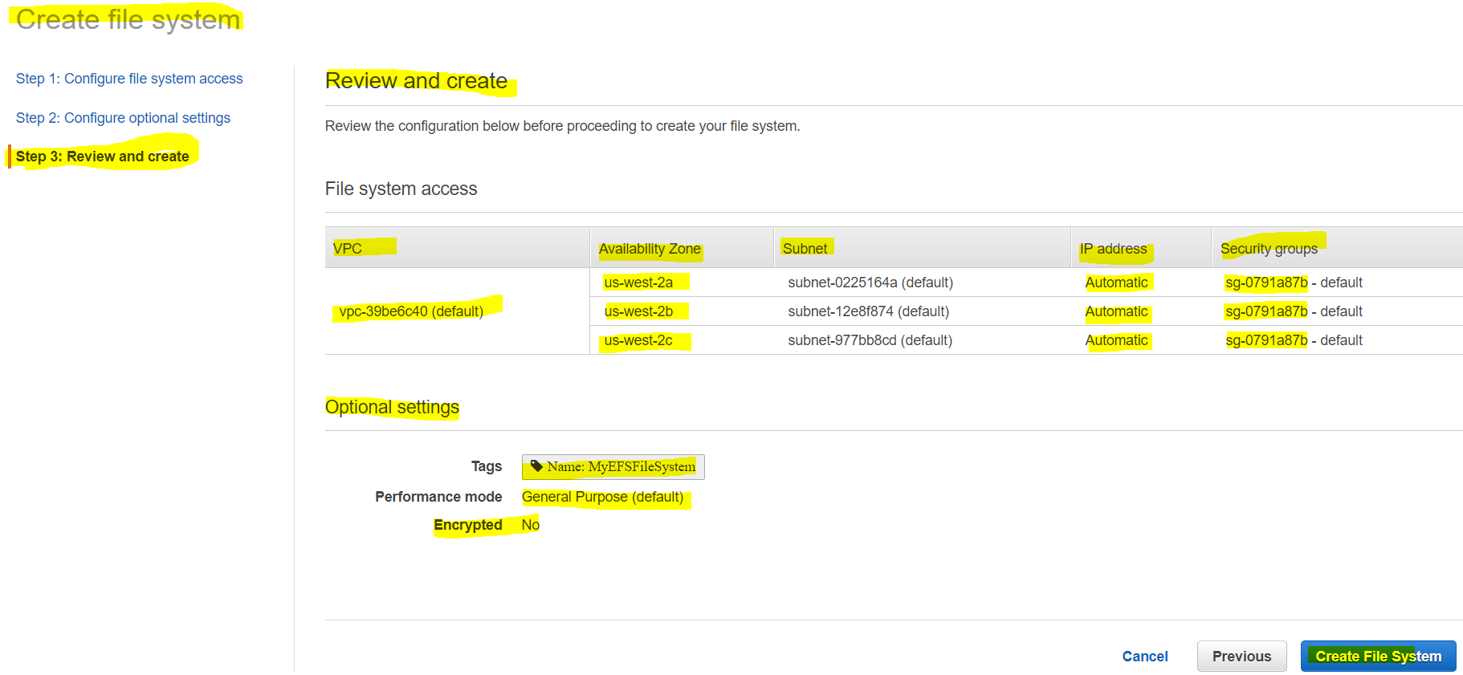
Step-3

Slide 8
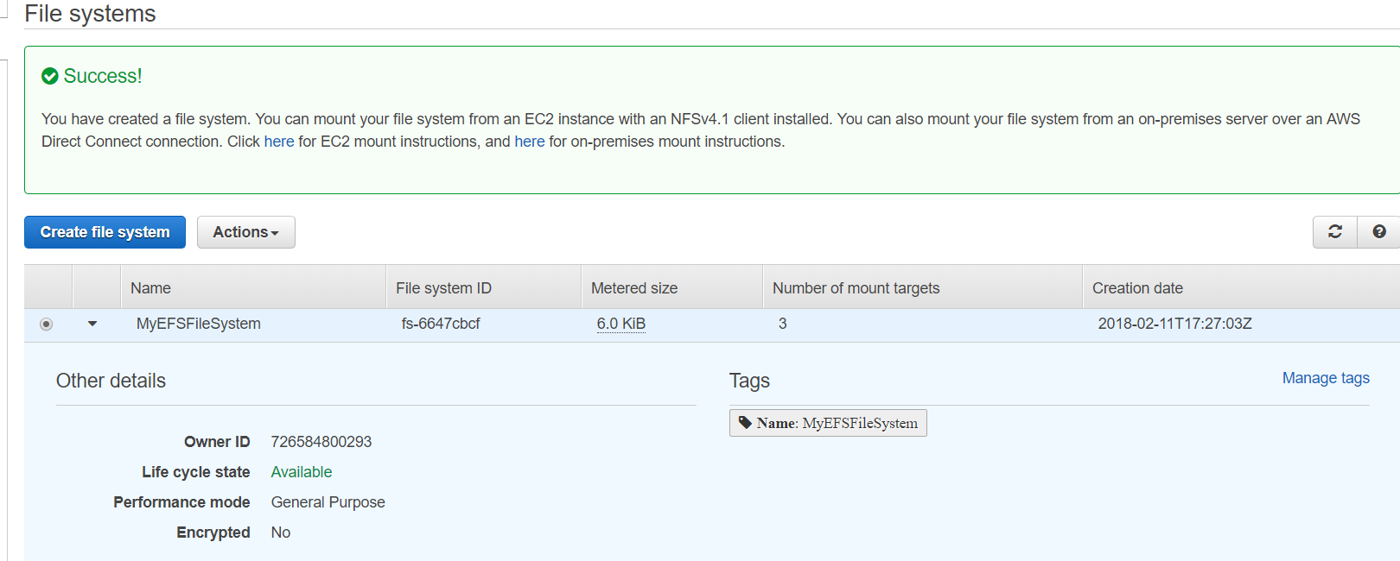
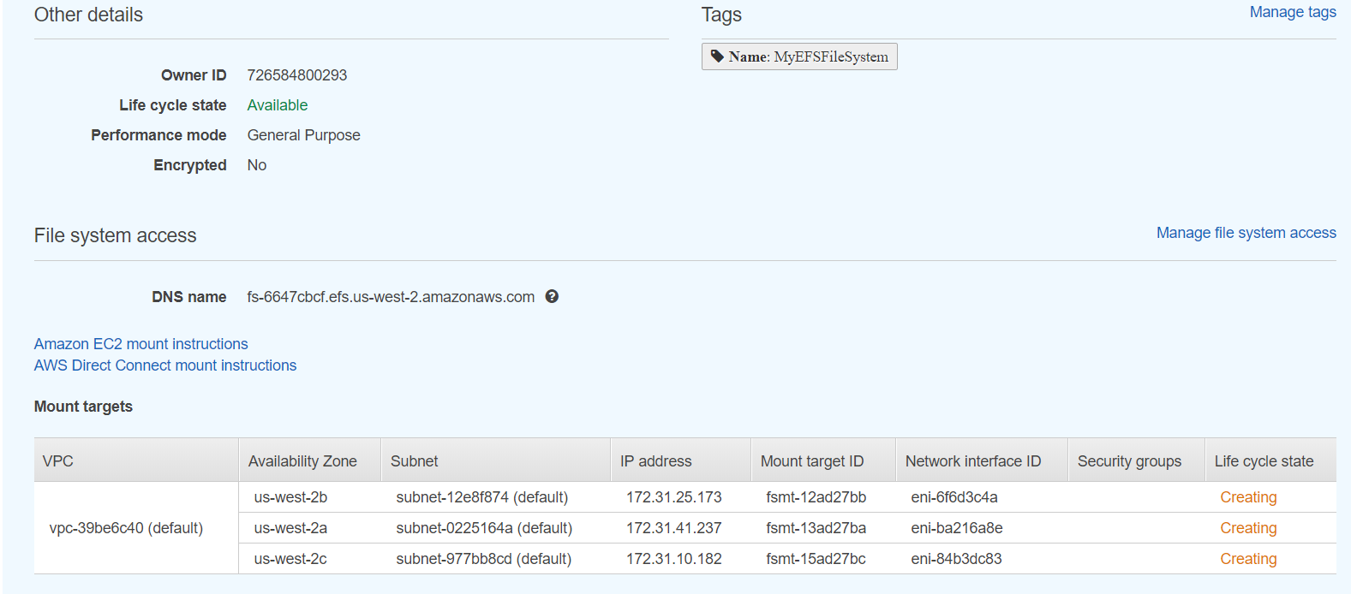
EFS are creating now!

Slide 9
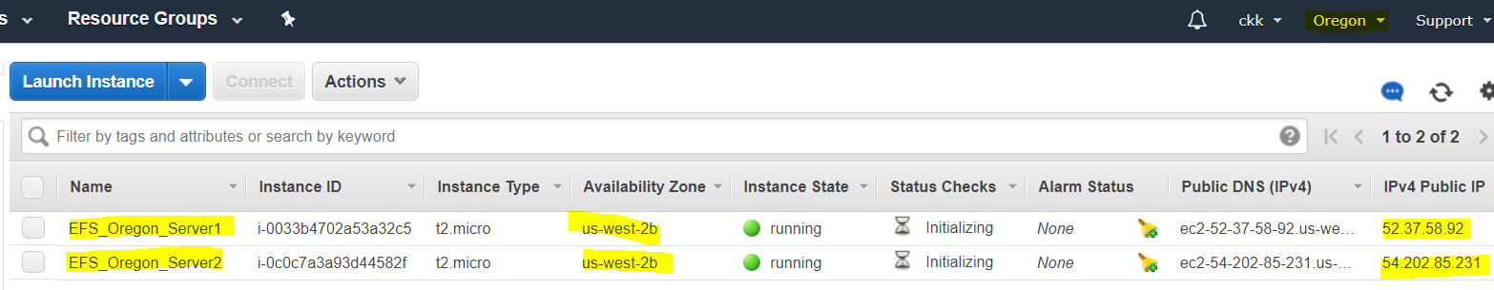
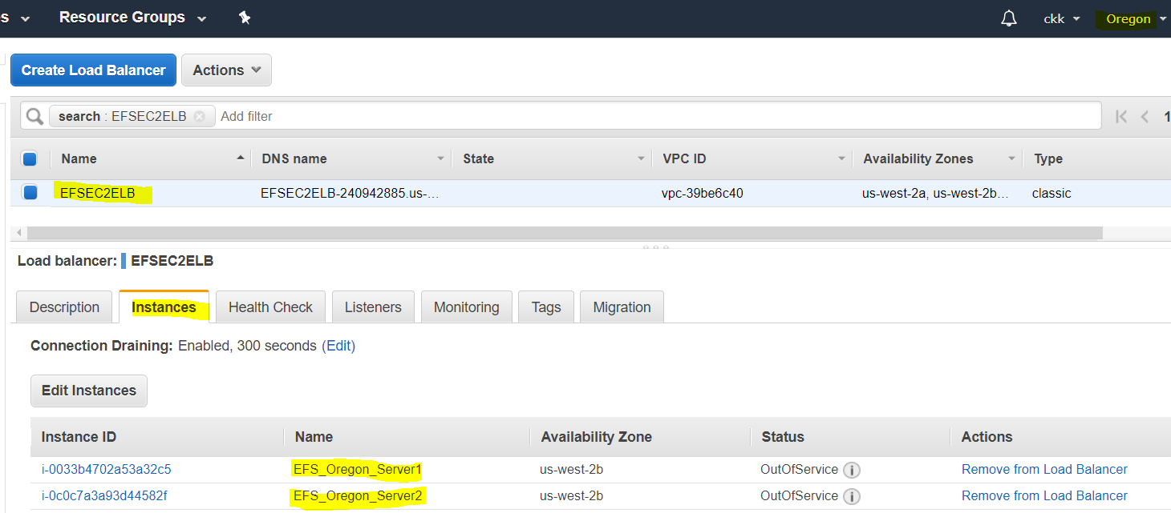
Go to two different AZ and Create two Ec2 Instances

Slide 10
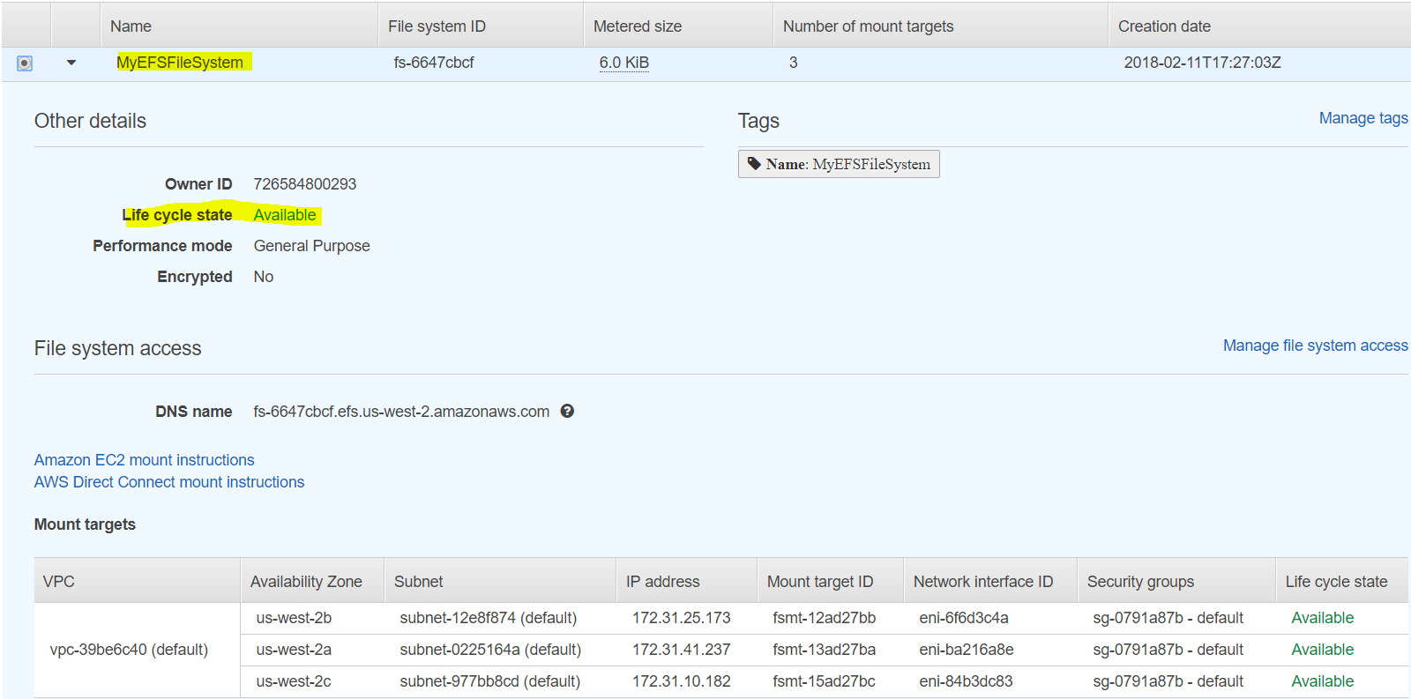
Cross check the EFS

Slide 11
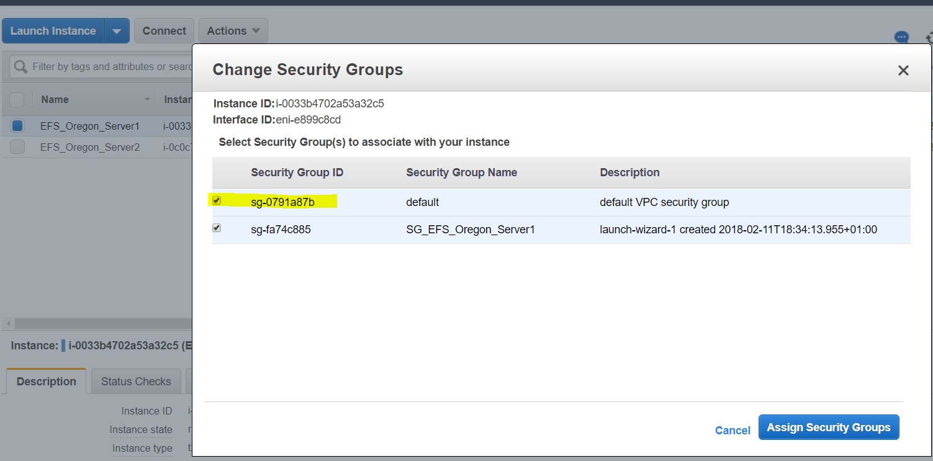
Before connectiong Ec2 instances from Gitbash or putty, add the vpc security group to ec2 instances

Slide 12
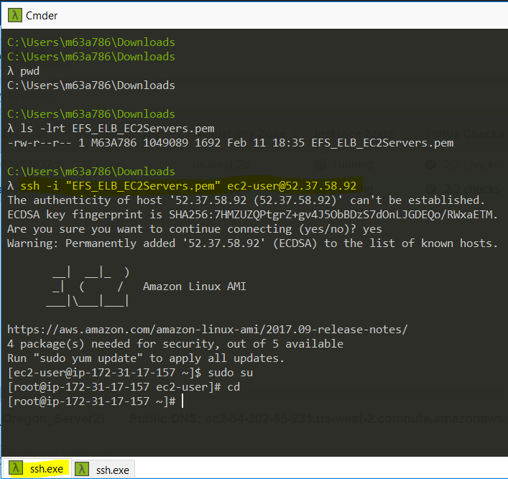
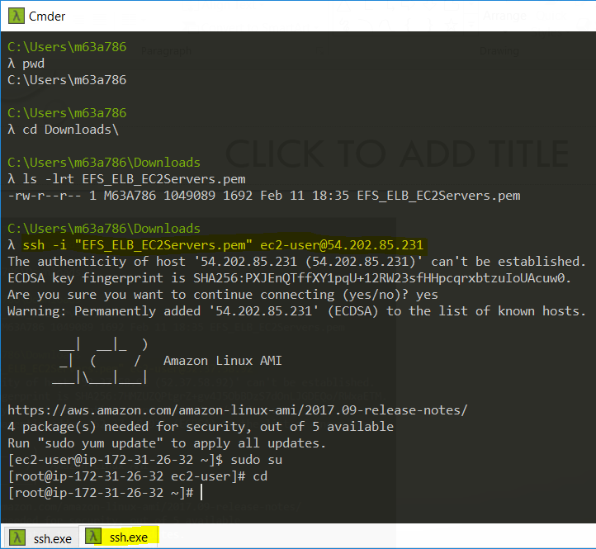
Connect 2 Ec2 instances from terminal

Slide 13
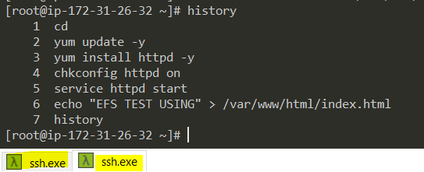
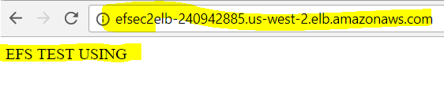


Download – Install – Configure & Test the WebServer on both the Ec2 instances

Slide 14
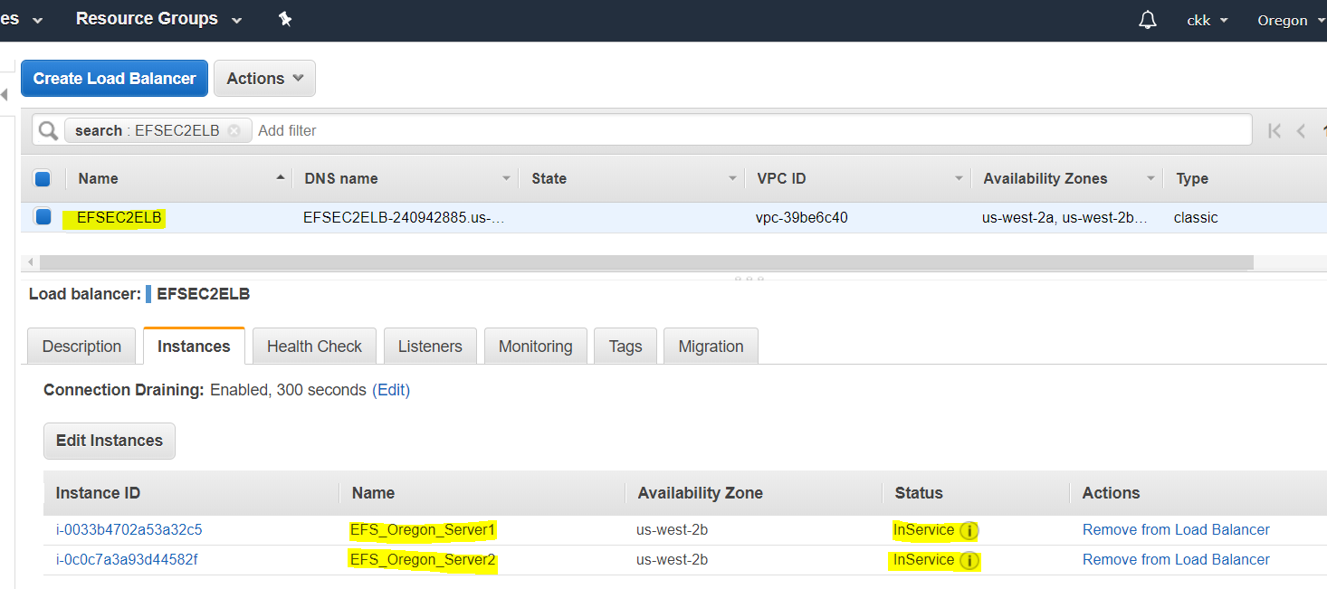
Cross check the Ec2 instances on ELB

Slide 15
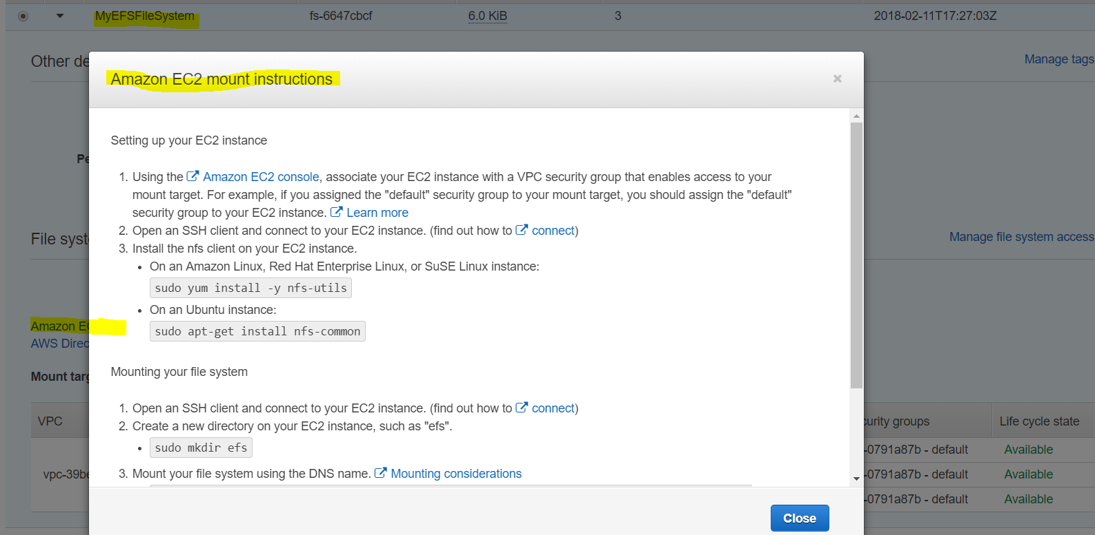
Go to EFS and Click on Mount Point

Slide 16
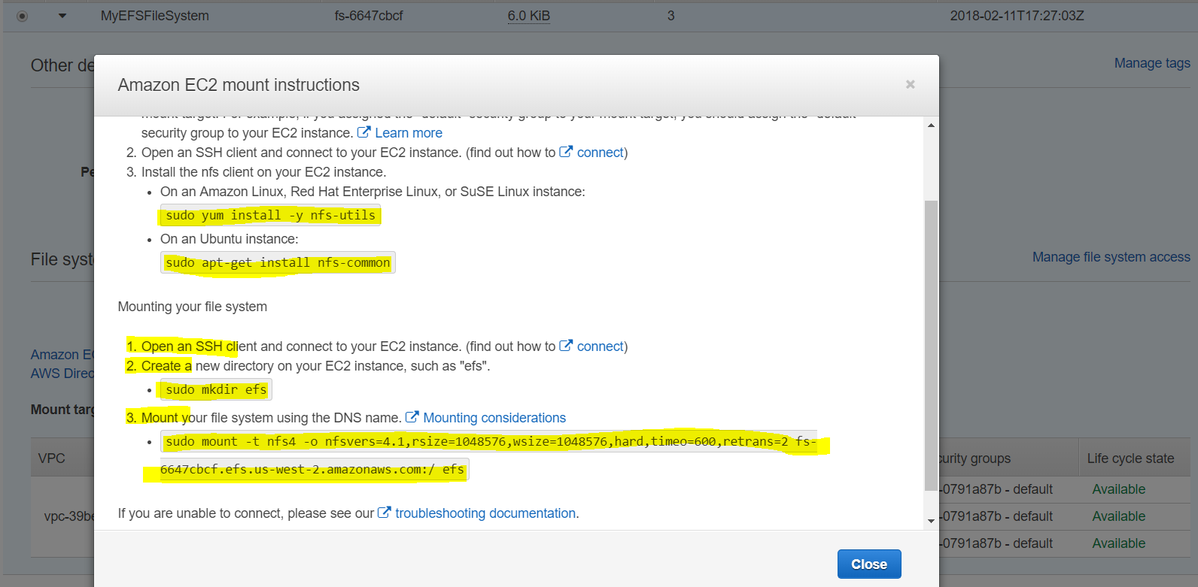
Commands

Slide 17
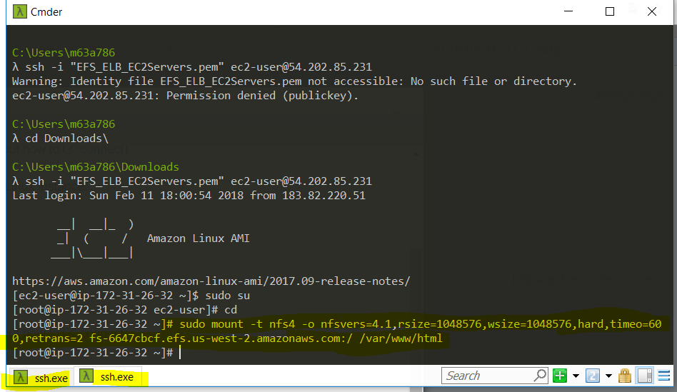
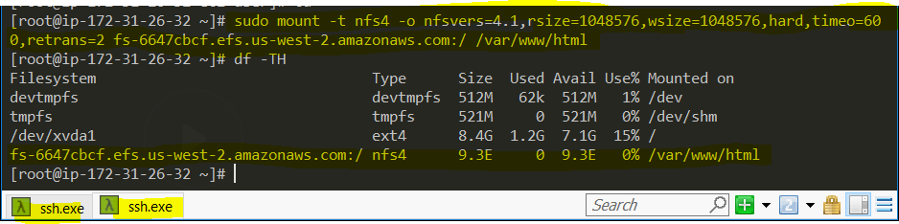
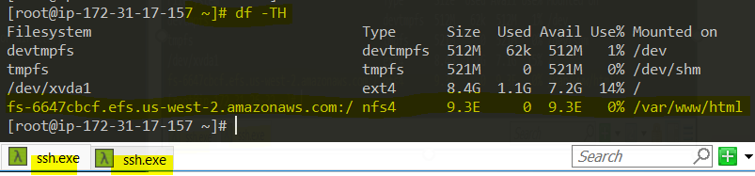
Now, we are mouting EFS on Ec2 instances

Slide 18
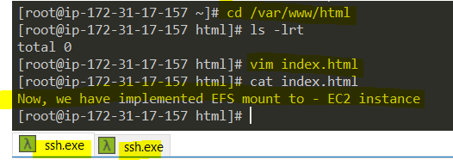
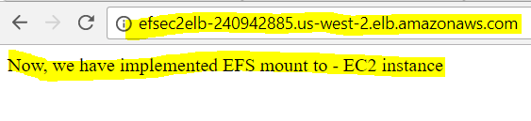
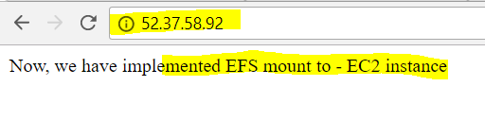

Go to One Ec2 instance and add a index.html file and cross check on browser on two ec2 and elb as well

