Slide 1
Big Data and the Broken Promise of Anonymisation
Martyn Thomas CBE FREng
Livery Company Professor of Information Technology

Slide 2
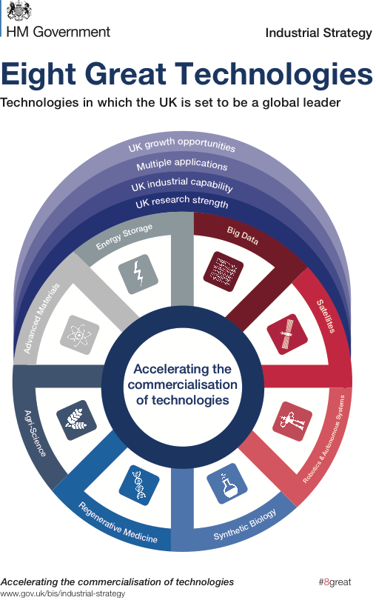
Big Data
One of the Government’s Eight Great Technologies
2,500,000,000 Gigabytes of data are created every day
90% of all the data in the world were created in the last 2 years

Slide 3
Big Data
High Volume
Great Variety of data types
High Velocity of streaming data that needs to be processed almost instantly
  Twitter “fire-hose”: 400m tweets a day - analysed by hedge funds, news media, law enforcement, security services ...

Slide 4
Personal Data
Some data are not about any individual
  the large hadron collider: 30 million gigabytes/year
A lot of data is personal in unexpected ways - phone data, for example
  a record of where the phone has been, when and for how long, what other phones called or were called or were called, sent or received texts
Credit card transactions are around 70 data items
  customer, the credit card, the goods purchased, the retailer, the time, location, whether the PIN was input, the currency, the tax amounts, transaction codes and identifiers … much more for online purchases

Slide 5
Phone Metadata
The Stanford Experiment: See Data and Goliath by Bruce Schneider
phone metadata from 500 volunteers
One contacted a home improvement shop, locksmiths, a hydroponics dealer and a head shop
One called a hospital, a medical lab, a pharmacy, and several short calls to a monitoring hotline for a heart monitor
One called her sister at length, then calls to an abortion clinic, further calls two weeks later, and a final call a month later.
A cannabis grower, a heart patient, an abortion …
This is just metadata not content. It’s very revealing. Who should be able to see it?
Compare everyone’s records and you know who are meeting, who are sleeping together, who goes to which addiction groups, political rallies or churches, which companies are being visited by insolvency or take-over specialists and much, much more.
CIA: “we kill people based on metadata”

Slide 6
Companies and Personal Data
Visa: 128 Billion transactions in 2015
Facebook: Law student Max Schrems obtained a copy of all his data. Facebook sent him a 1200 page PDF: including all the items on his newsfeed, all the photos and pages he had ever clicked on or liked, all the friends he could see and all the advertising that he had ever viewed
Phone companies retain text messages for varying times. In 2010, AT&T held them for 7 years, according to Bruce Schneier
Our cyber-enable world has radically changed the relationship between individuals and companies.
What data about us should companies be able to collect, store, process, share, sell …?

Slide 7
Personal Data and Privacy
“No one shall be subjected to arbitrary interference with his privacy, family, home or correspondence, nor to attacks upon his honour and reputation. Everyone has the right to the protection of the law against such interference or attacks
Article12 of the Universal Declaration of Human Rights

Slide 8
Nothing to hide, nothing to fear?
Most people want to control their privacy
  draw curtains, keep medical records private, shred bank statements
Many people need to control their privacy
  victims of rape or other trauma,
  people escaping abusive relationships
  people who may be discriminated against (HIV positive, previous mental illness, spent convictions, recovering addicts)
  people at risk of “honour” violence from their families for breaking cultural norms
  Adopters, protecting their adopted children from the birth families that abused them
  witness protection, undercover police, some social workers and prison staff ….
It is unthinking or callous to see other people’s privacy as unimportant.
Data is forever and your circumstances or society’s attitudes may change

Slide 9
The Value of Big Data
Facebook is valued at $333B, making $1.5B profit in the past 3 months, mostly from advertising
Most of Facebook’s value comes from personal data
We shall discuss the implications, ad-blockers and the minefield of informed consent in my next lecture, on 18 October.

Slide 10
Data “is the new oil”
Data is just like crude. It’s valuable, but if unrefined it cannot really be used. It has to be changed into gas, plastic, chemicals, etc to create a valuable entity that drives profitable activity; so must data be broken down, analyzed for it to have value. The issue is how do we marketers deal with the massive amounts of data that are available to us? How can we change this crude into a valuable commodity – the insight we need to make actionable decisions?
Clive Humby, at a conference at Kellogg School that was reported by Michael Palmer.

Slide 11
Big Data Analysis a vital asset
genome data and health records for disease prevention and new treatments
phone data for crime detection
credit card transactions to detect fraud
financial transactions to detect money laundering
prescription data to understand regional differences
tax data to understand the economy and detect fraud

Slide 12
Open Data data that anyone can access, use and share
Supported by the Open Data Institute, founded by Sir Tim Berners-Lee and Sir Nigel Shadbolt
Open Data must have a licence that says it is free to use (and that may require acknowledgement of the source or that derived data must also be open)
The UK Government has released over 22,000 datasets under the Open Government Licence
https://data.gov.uk/

Slide 13
Example UK Government Open Datasets
detailed road safety data about the circumstances of personal injury road accidents in GB from 1979 including the types (including Make and Model) of vehicles involved;
planned roadworks carried out on the Highways Agency network

Slide 14
Example UK Government Open Datasets (there are thousands more)
hourly observations for approximately 150 UK weather stations, daily site specific and 3 hourly site specific forecasts for approximately 5000 UK locations
National Statistics Postcode Lookup (NSPL) for the United Kingdom
unclaimed estates held by the Bona Vacantia Division
All MOT tests and outcomes, including make and model of vehicle, odometer reading and reasons for failure, since 2005
Accident and Emergency (A&E) Attendance data, drawing on over 18 million detailed records per year

Slide 15
“Open Data is part of the Critical National Infrastructure”
Each dataset is a single point of failure for all the services that use it
No-one oversees the growing dependency
No-one can have overall responsibility for open data security, integrity and availability
There is a similar situation with GPS, analysed in a study by the RAEng

Slide 16
The Data Dilemma
Extracting value whilst preserving privacy
UK DPA: “personal data” means data which relate to a living individual who can be identified—
(a) from those data, or
(b) from those data and other information which is in the possession of, or is likely to come into the possession of, the data controller
But the EU Directive says reasonably likely to be used by “data controller or any other person”
- during the lifetime of the data

Slide 17
Anonymisation
Statistical analyses are anonymous “70 percent of American smokers want to quit” does not expose personal data
Data about individuals can be anonymous, but it becomes very difficult when more than a few facts are included even if these facts are not specific and some of them are wrong (eg Netflix)
“Data can be either useful or perfectly anonymous but never both” Paul Ohm.

Slide 18
4 ways to anonymise
Replace - substitute identifying numbers
Suppress - omit from the released data
Generalise - for example, replace birth date with something less specific, like birth year
Perturb - make random changes to the data

Slide 19
Anonymisation is difficult
it takes surprisingly few details to identify someone with a high degree of probability. In America, 61% of the population in 1990 and 62% in 2000 were uniquely identified by their approximate address (their ZIP code), their gender and their birth date

Slide 20
Some simple maths
There are roughly 7.5 Billion people in the world. Log (base 2) of 7.5 Billion is about 32.8. So we need 33 bits of data to uniquely identify everyone in the world. That is their information entropy (grossly simplified, see www.33bits.org)
Each independent fact you know about someone reduces their entropy by log (base 2) of the improbability of that fact in the population. Gender is log (2) = 1 bit; star sign is log (12) = 3.585 bits, birthday (not year) is log (365) = 8.5 bits, working for the NHS (1.5m people) = 12 bits
So birthday + NHS employee already reduces the entropy from 33 bits to 12.5 bits

Slide 21
Example 1: AOL Search Data August 2006
To stimulate research into the value of search data, AOL released the anonymised search records of 658,000 users over a three month period from March to May 2006

Slide 22
AOL anonymisation
AOL had tried to anonymise the data they released by removing the searcher’s IP address and replacing the AOL username with a unique random identifier linking of the searches by any individual, so that the data was still useful for research
It did not take long for two journalists to identify user 4417749, who had searched for people with the last name Arnold, “homes sold in shadow lake subdivision gwinnett county georgia" and “pine straw in lilburn ga.” as Thelma Arnold, a widow living in Lilburn, Georgia
Her other searches provide a poignant and deeply personal view of her life, dfficulties and desires

Slide 23
AOL faced strong criticism
The violation of privacy was widely condemned
AOL described their action as a “screw up”
They took down the data, but it was too late. The internet never forgets. Several mirror sites had already been set up.

Slide 24
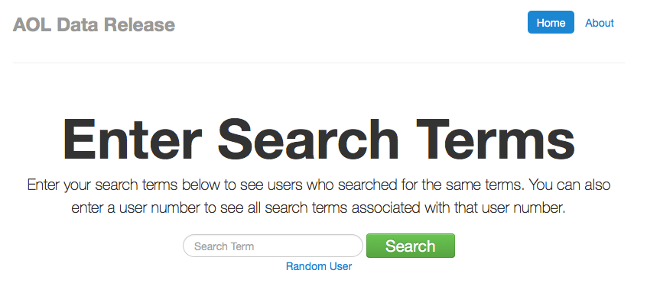
http://www.not-secret.com

Slide 25
http://www.not-secret.com
About Us
What Is This?
In August 2006, AOL publicly released the search activity of over 650,000 users over a three-month period. While intended for research purposes, the so-called AOL search data leak resulted in these records being shared and preserved on the Internet for all to see. Searchable interfaces to this data exist elsewhere on the Internet. This version is intended to be simple, no-frills, and free of NSFW content on the landing page. Some content is explicit, so please be cautious about searching or viewing the AOL database in settings where explicit content may be prohibited or frowned upon.

Slide 26
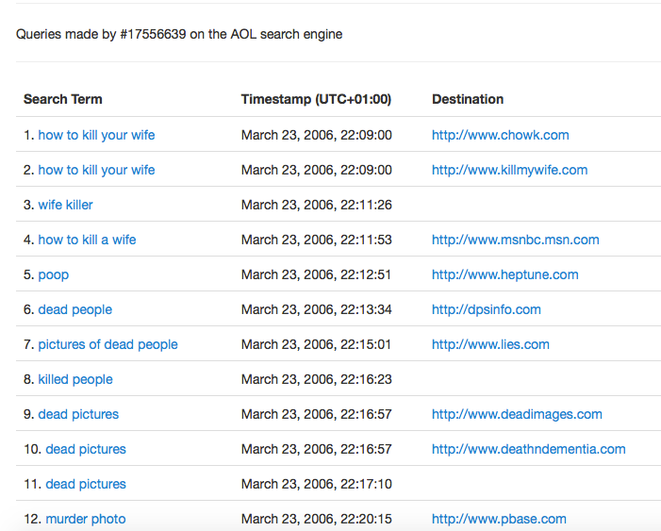

Slide 27
Search data
Other users searches were similarly revealing; user 114037 seems to have been contemplating wife swapping, for example.
Assume that your search data and your IP address are retained by most search engines and websites that have search boxes. Google has told the EU that it anonymises IP addresses after 9 months by removing the last octet (170.123.456.XXX)
If you want to remain more private, use www.startpage.com “StartPage, and its sister search engine Ixquick, are the only third-party certified search engines in the world that do not record your IP address or track your searches”.

Slide 28
Example 2:
The Netflix™ Prize
In October 2006, Netflix launched a $1m prize for an algorithm that was 10% better than its existing algorithm Cinematch
participants were given access to the contest training data set of more than 100 million ratings from over 480 thousand randomly-chosen, anonymous customers on nearly 18 thousand movie titles.
How much information would you need to be able to identify customers?

Slide 29
Netflix
Netflix said “to protect customer privacy, all personal information identifying individual customers has been removed and all customer ids have been replaced by randomly-assigned ids. The date of each rating and the title and year of release for each movie are provided. No other customer or movie information is provided.”
Two weeks after the prize was launched, Arvind Narayanan and Vitaly Shmatikov of the University of Texas at Austin announced that they could identify a high proportion of the 480,000 subscribers in the training data.

Slide 30
Narayanan and Shmatikov’s results
How much does the attacker need to know about a Netflix subscriber in order to identify her record in the dataset, and thus completely learn her movie viewing history? Very little.
For example, suppose the attacker learns a few random ratings and the corresponding dates for some subscriber, perhaps from coffee-time chat.
With 8 movie ratings (of which we allow 2 to be completely wrong) and dates that may have a 3-day error, 96% of Netflix subscribers whose records have been released can be uniquely identified in the dataset.
For 64% of subscribers, knowledge of only 2 ratings and dates is sufficient for complete deanonymization, and for 89%, 2 ratings and dates are enough to reduce the set of records to 8 out of almost 500,000, which can then be inspected for further deanonymisation.

Slide 31
Why are Narayanan and Shmatikov’s results important?
They were results from probability theory, so they apply to all sparse datasets. (They tested the results later, using the Internet Movie Database IMDb as a source of data).
Psychologists at Cambridge University have shown that a small number of seemingly innocuous Facebook Likes can be used to automatically and accurately predict a range of highly sensitive personal attributes including: sexual orientation, ethnicity, religious and political views, personality traits, intelligence, happiness, use of addictive substances, parental separation, age, and gender).

Slide 32
Example 3:
Medical Records in Massachusetts
In the 1990s, the Group Insurance Commission (GIC), a Government agency in Massachusetts, started to release records to researchers that summarised the hospital visits of approximately 135,000 state employees and their families. All explicit identifiers, such as name, address, and Social Security number were removed, so the data were falsely believed to be anonymous and was then given freely to researchers and industry.
Latanya Sweeney, Director of the Data Privacy Laboratory at Carnegie-Mellon University, obtained the data and compared it with the public voter registration records.
One case stood out. William Weld was governor of Massachusetts at that time and his medical records were in the GIC data. Governor Weld lived in Cambridge Massachusetts. According to the Cambridge Voter list, six people had his particular birth date; only three of them were men; and, he was the only one in his 5-digit ZIP code.

Slide 33
ZIP codes and Postcodes
There are 43,000 ZIP codes in the USA, which has a population of 323,730,000. That’s roughly 7,500 people per Zip code.
A UK Postcode such as BA2 4PY is made up of the following elements: BA is the area. There are 124 postcode areas in the UK, 2 is the district. There are approximately 20 Postcode districts in an area, 4 is the sector.There are approximately 3000 addresses in a sector. PY is the unit. There are approximately 15 addresses per unit.
Partly anonymised BA2 4xx therefore identifies about 3000 addresses, about the same as a US 5-digit ZIP code.

Slide 34
The Massachusetts case is a simple join operation on two databases. Many more complex analyses can be carried out easily
Medical
records
Voter
records
gender
DoB
Zip

Slide 35
Summary and Conclusions
privacy is a legal right that is essential to the safety or wellbeing of many individuals and their families
if data is released that contains details about individuals, then these individuals’ identities can often be found
because people have relationships, each person that is identified adds to the ease with which further individuals can be identified
as more data is collected, stored and shared, the ability to anonymise personal data is further weakened. Yet big data is important for personalising services, improving efficiency and stimulating innovation
the definition of personally identifiable information at the centre of data protection laws and regulations is too fluid to be useful.
Paul Ohm concluded that Data can be either useful or perfectly anonymous but never both and it is hard to disagree, so the current basis for regulating data protection is probably unsustainable although the need to protect privacy remains. We need to find a different approach

