Slide 1

Global Energy Consumption Analysis Using SQL
Presented by
G Leeladri Reddy

Slide 2
About me
I am a recent Graduate in Bachelor of Technology
I want to be a data scientist to build a models that can solve real-world problems.
LinkedIn : www.linkedin.com/in/gandudi-leeladri-reddy
GitHub- https://github.com/gandudileeladrireddy

Slide 3
Agenda
Problem Statement
Objective of the Project
ER Diagram
schema
Key analysis
Key Insights from Global Consumption Analysis
Challenges
Conclusion

Slide 4
Problem Statement
Energy consumption is increasing globally, and this growth is not equal across countries, often leading to higher carbon emissions. At the same time, economic development and population growth influence how much energy each nation consumes.
However, for international organizations and governmental bodies, it's difficult to identify which nations are growing sustainably and which are lagging in efficiency. Without proper analysis of energy, GDP, emissions, and population data, it's impossible to quantify the trade-off between economic growth and environmental Sustainability.

Slide 5
Objective of the Project:
Through SQL queries, the project examines how different countries produce and consume energy, how emissions change over time, how population growth impacts the environment, and how economic factors like GDP relate to energy usage.
The goal is to turn raw global data into meaningful insights that help evaluate environmental performance, compare countries, and support better decision-making in sustainability and energy management.

Slide 6
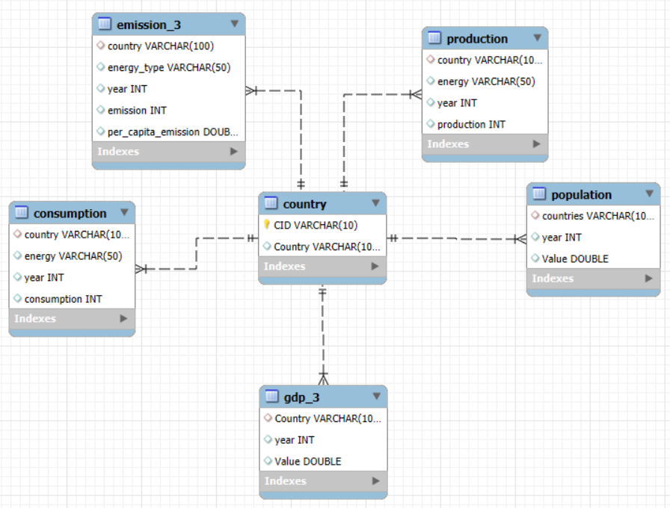
ER Diagram

Slide 7
Schema
Table Name | No. of Columns | No. of Records | Primary key | Unique key | Foreign Key
Country | 2 | 231 | CID | country | -
Population | 3 | 1000 | - | - | country
gdp_3 | 3 | 1000 | - | - | country
Production | 4 | 5294 | - | - | country
Consumption | 4 | 5277 | - | - | country
Emission_3 | 5 | 3515 | - | - | country

Slide 8
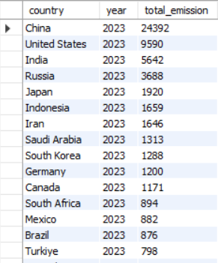
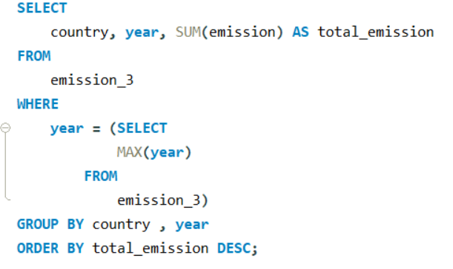
Key Analysis
What is the total emission per country for the most recent year available?

Slide 9
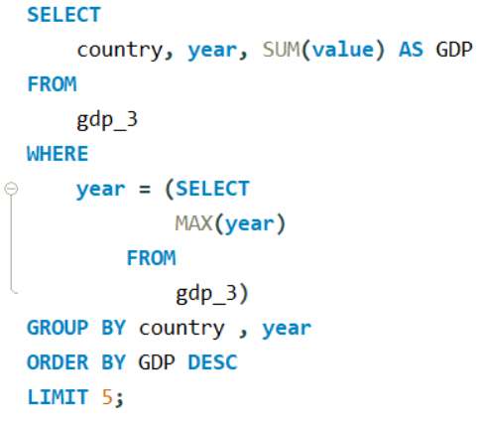
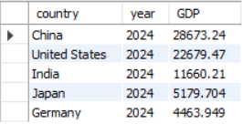
What are the top 5 countries by GDP in the most recent year?

Slide 10
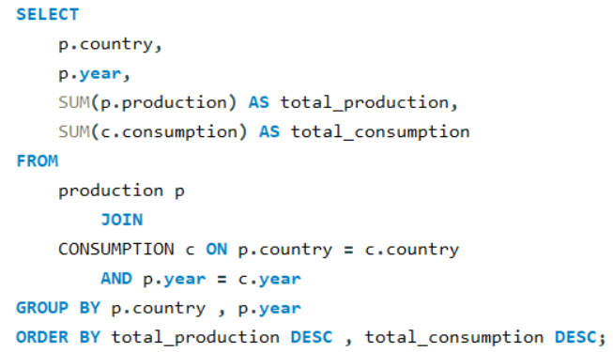
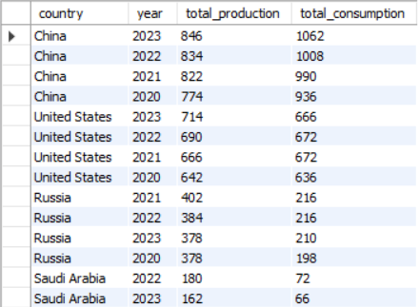
Compare energy production and consumption by country and year.

Slide 11
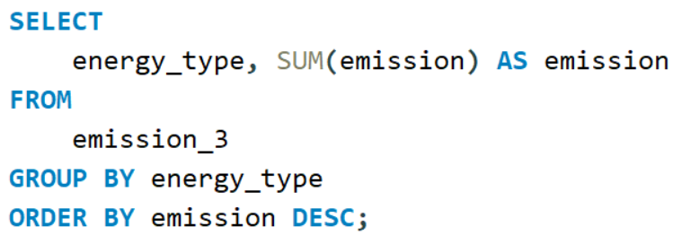
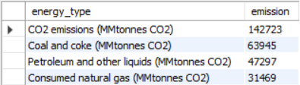
Which energy types contribute most to emissions across all countries?

Slide 12
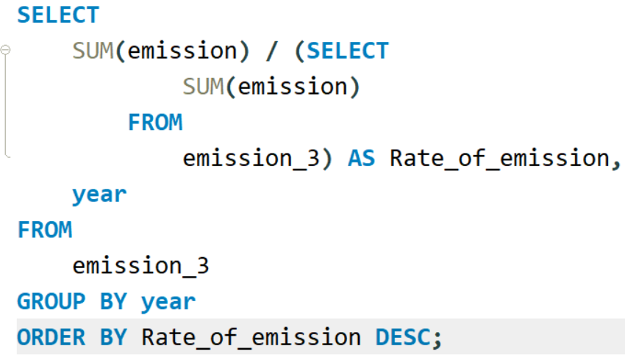
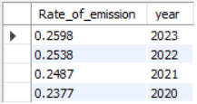
How have global emissions changed year over year?

Slide 13
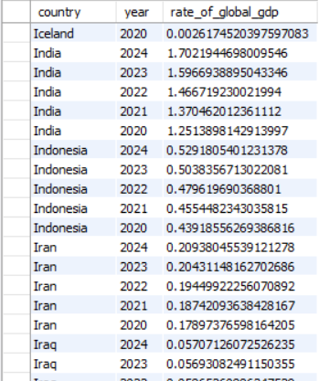
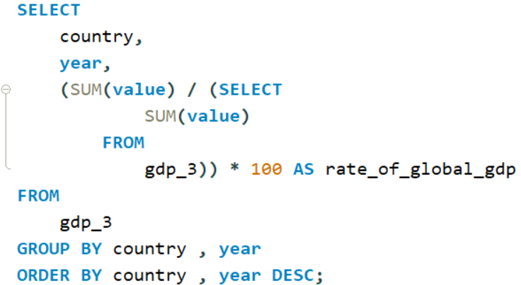
What is the trend in GDP for each country over the given years?

Slide 14
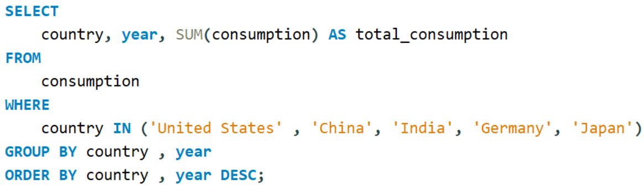
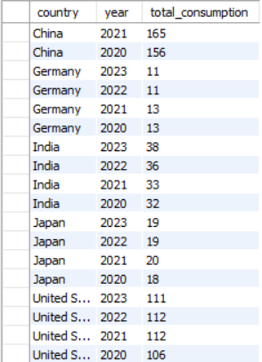
Has energy consumption increased or decreased over the years for major economies?

Slide 15
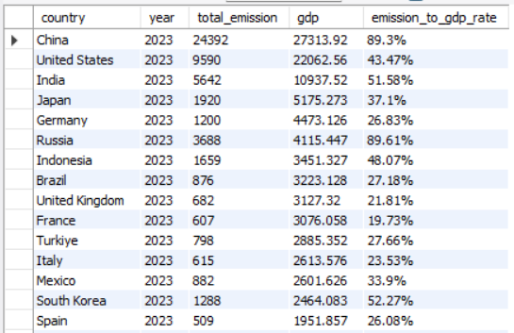
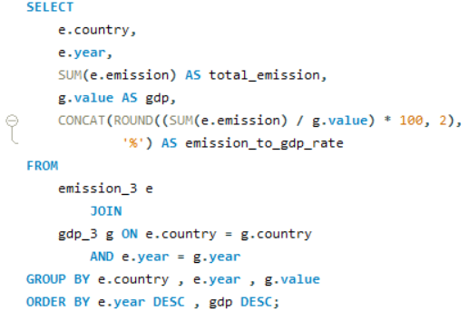
What is the emission-to-GDP ratio for each country by year?

Slide 16
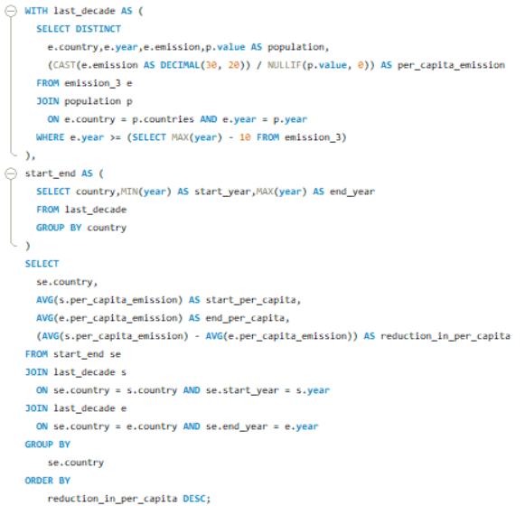
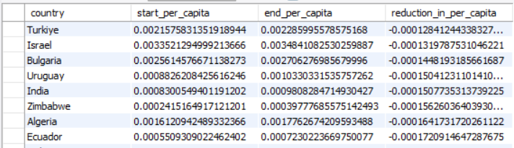
Which countries have improved (reduced) their per capita emissions the most over the last decade?

Slide 17
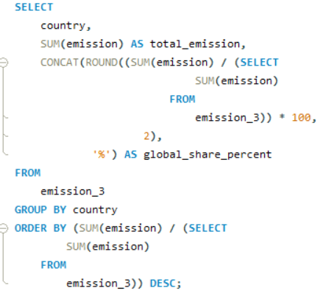
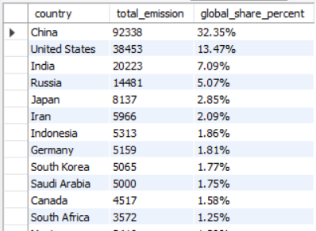
What is the global share (%) of emissions by country?

Slide 18
Key Insights From Global Energy Consumption
Positive Trends: A few countries have managed to reduce their per capita emissions over the last decade, signaling progress toward cleaner energy use.
Energy Imbalance: Several countries show a significant gap between energy production and consumption, highlighting dependence on imports or surplus for exports.
Emission Hotspots: Fossil fuel-based energy types remain the largest contributors to global emissions, with coal and oil dominating.
Sustainability Challenge: The global shift toward renewable energy is growing but still lags behind the scale of fossil fuel dependency.
Population Pressure: High-population countries like India and China have the highest overall energy demand, driving global consumption.

Slide 19
Challenges
SQL Constraint & Query Optimization: Overcame SQL version constraint (Error 1235) requiring complex Derived Table Joins.
Complex Logic Debugging: Debugged intricate logic for time-series analysis (YoY change) and managed multi-table joins to ensure accuracy for insights like emission-to-GDP ratios.
Data Integrity & Cleaning: Consistently resolved common SQL errors (1055, 1146) for compliance; essential data cleaning addressed missing values, duplicates, and inconsistent formats.
Query Efficiency and Reporting: Wrote efficient SQL queries for large datasets, managing complex relationships to calculate derived metrics, and successfully translated raw SQL outputs for reporting and presentation.

Slide 20
conclusion
The economic development drive higher energy demand, it also intensifies environmental challenges. Countries that prioritizes renewable energy and efficiency measures shows promising improvements in reducing per capita emissions and economic growth.
To achieve sustainable growth, nations must balancing production, consumption, and environmental responsibility through innovation, policy reform, and international collaboration.

Slide 21

THANK YOU

