Slide 1

Smart Analysis of Used Car Market Trends
-- Decoding Value in the Pre-owned Market
Presented by
Name: Gandudi Leeladri Reddy
Batch: 442

Slide 2
About Me
I am a recent Graduate in Bachelor of Technology
I want to be a data scientist to build a models that can solve real-world problems.
LinkedIn: www.linkedin.com/in/gandudi-leeladri-reddy
GitHub: https://github.com/gandudileeladrireddy

Slide 3
Agenda
Business Problem
Business Objective
Problem Statement
Data Preprocessing
Exploratory Data Analysis (EDA)
Hypothesis Testing
Recommendations
Challenges
Conclusion

Slide 4

Business Problem
The Backstory:
For many Indian families, owning a car is a vital milestone and a necessity for mobility. However, with the rising costs of new vehicles, insurance, and taxes, the pre-owned car market has become the primary gateway to vehicle ownership. This market allows buyers to upgrade their lifestyle by accessing premium models at a fraction of the showroom price.
The Problem:
Despite its growth, the used car market remains a "Black Box" for consumers. Unlike new cars with fixed pricing, second-hand prices are highly inconsistent due to:
Lack of Transparency: Significant price variations for similar models across different sellers and cities.
Information Asymmetry: Buyers struggle to quantify how factors like mileage, owner history, and fuel type should realistically impact the price.
High Friction: The fear of overpaying or buying a "lemon" leads to distrust and inefficient decision-making.

Slide 5

Problem Statement
The Indian used car market is characterized by fragmented data and inconsistent pricing, leaving buyers without a reliable benchmark for fair market value. Consumers often face a "take-it-or-leave-it" scenario where prices are dictated by seller intuition rather than objective data.
This project addresses this gap by building a data-driven analysis system that scrapes real-time listings from CARS24. By extracting and analyzing key variables—such as brand, mileage, fuel type, and age—the project aims to:
Quantify the primary drivers of vehicle depreciation.
Identify pricing anomalies and "best-value" segments.
Empower buyers with transparent insights to make informed, budget-conscious purchasing decisions.

Slide 6
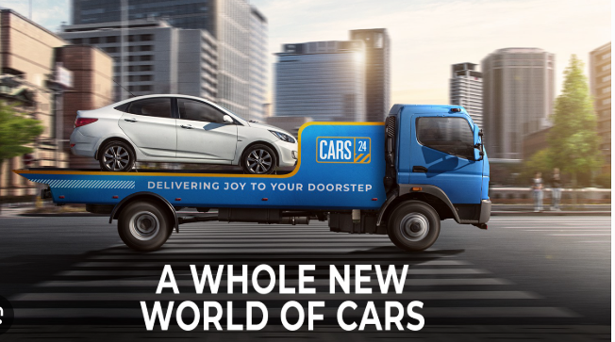
Business Objective
The primary goal is to bridge the information gap between sellers and buyers by transforming raw web data into a transparent pricing framework.
Establish Price Benchmarks: Create a "Fair Market Value" standard to help buyers identify overpriced or underpriced listings.
Quantify Value Drivers: Isolate how specific variables (Brand, Mileage, Age, Fuel Type) directly impact the final asking price.
Optimize Consumer Spend: Guide buyers toward the "Best Value" segments, ensuring they get the highest quality vehicle for their specific budget.
Risk Mitigation: Reduce the financial uncertainty of purchasing second-hand by providing data-backed depreciation insights.
Market Transparency: Empower the Indian middle class with a data-driven tool that replaces seller intuition with empirical evidence.

Slide 7
Data Pre-Processing
  Data Understanding (Raw Dataset):
  This table defines the structure of the unstructured data extracted from CARS24 before the cleaning process began.
Column Name | Description | Sample / Format
car | A composite string containing the Manufacturing Year, Brand, and Model. | 2021 Mahindra Thar
varient | The specific trim level, engine capacity, or edition of the car. | LX D 4*4 MT HT
km | The total distance the vehicle has traveled (scraped as text). | 25,772 km
fuel | The category of fuel the car consumes. | Petrol, Diesel, CNG
transmission | The type of gearbox (Manual or Automatic). | Manual, Auto
registration | The RTO state and district code of the vehicle. | DL-7C, HR-26
price | The listed asking price (scraped as a descriptive string). | ₹9.40 lakh
location | The geographical city where the listing is active. | new-delhi, ghaziabad

Slide 8
Data Pre-Processing
Cleaning & Standardization
Numerical Conversion: Standardized Price (e.g., ₹9.4L → 940,000) and KM (removed "km" and commas) for mathematical analysis.
Missing Values (BH Series): Null registrations were replaced with 'BH' (Bharat Series).
  Logic: Represents high-mobility corporate/govt vehicles; serves as a logical proxy for unlisted state codes.
Feature Engineering
Decomposition: Split raw car text into three specific features: Year, Brand, and Model.
Regional Tagging: Extracted State Codes (e.g., DL, HR, UP) from RTO strings to analyze location-based pricing.
Strategic Filtering
Price Cap (≤ ₹10 Lakhs): Excluded luxury vehicles to focus on the "Sweet Spot" of middle-class affordability.
Mileage Cap (≤ 1.6L KM): Removed "Scrap Yard" cars. Vehicles exceeding this mileage are avoided due to high maintenance costs and low utility.
Final Dataset: Refined from 5,832 to 5,288 high-value entries for targeted analysis.

Slide 9
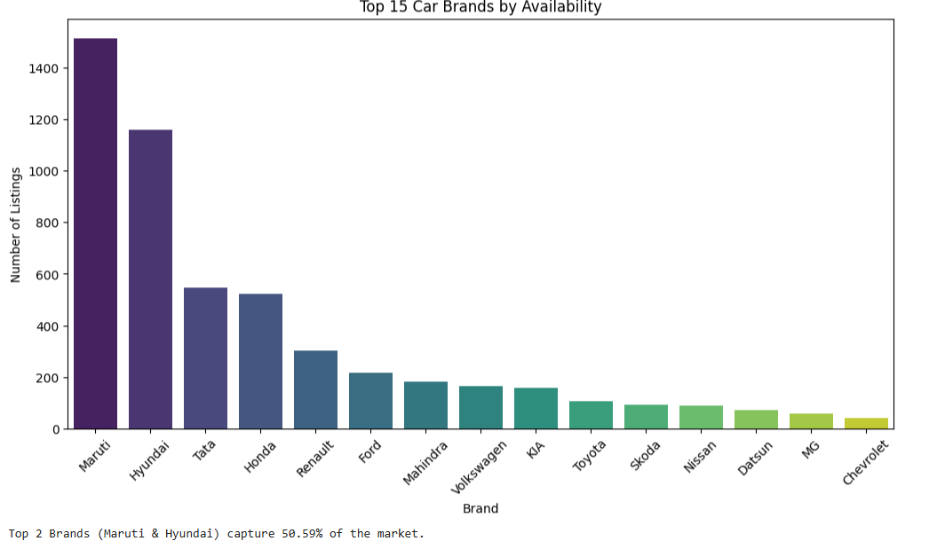
Exploratory Data Analysis
UNI-Variant Analysis
Which car brands are most readily available? Does the market favor specific manufacturers?
Insights:
As seen earlier, Maruti and Hyundai will likely dominate.
If a customer wants a niche brand (like Skoda or Nissan), they have significantly fewer options to choose from.

Slide 10
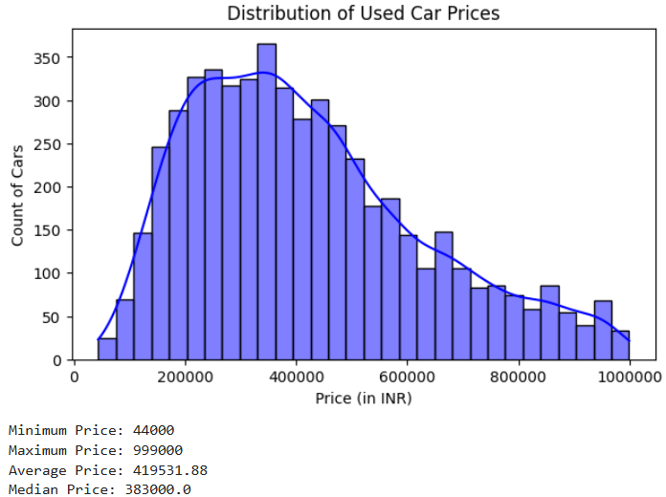
What is the typical price range for a used car in this market? Are there many luxury/expensive cars, or is the market mostly budget-friendly?
Insights:
You will likely see a "tail" on the right side. This confirms the market is Right-Skewed, meaning there are many affordable cars (e.g., under ₹5 Lakh) and very few expensive ones.
The peak of the graph shows the most common budget range (likely ₹3L - ₹5L).

Slide 11
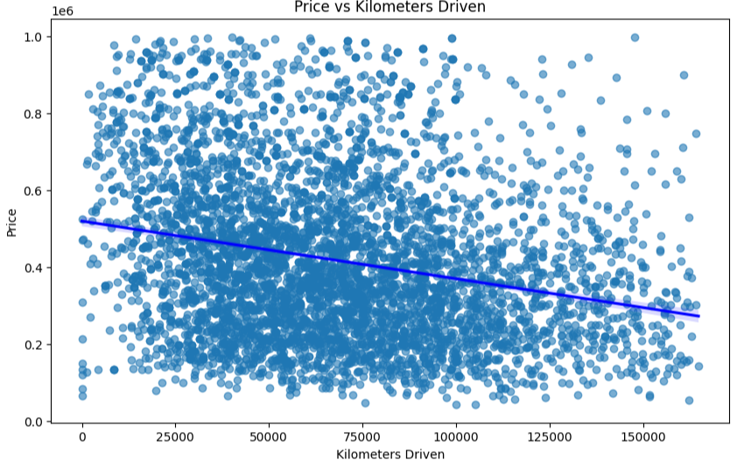
Bi-Variant Analysis
Does high mileage significantly reduce the car's price, or does the brand matter more?
Insight:
Negative Correlation: You will see a trend where price drops as KM increases (points moving down-right).
The "Safe" Zone: Most high-value cars will be clustered under 60,000 KM. Cars with over 1,00,000 KM usually sell for a "scrap" or base price regardless of the brand

Slide 12
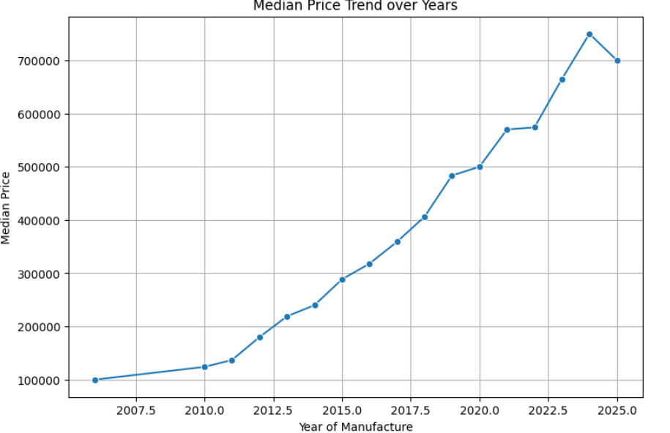
How rapidly does a car lose its value over time? At what age does the price stabilize?
Insight:
Depreciation Curve: You should see a steep upward curve. Cars from 2020-2023 will likely have the highest prices.
Value Retention: Look at the years 2015-2017. If the line flattens out here, it means cars older than 7 years stop losing value quickly, making them good budget buys.

Slide 13
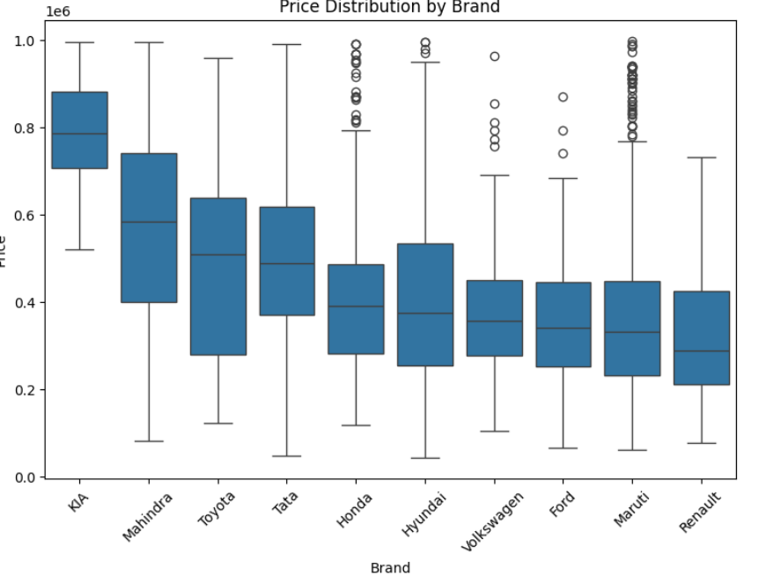
Which brands command a premium price in the second-hand market?
Insight:
Brand Hierarchy: The box plot sorts brands from most expensive (left) to cheapest (right). You will likely see Toyota, Honda, or Volkswagen on the higher end and Datsun or Renault on the lower end.
Price Variation: Longer boxes indicate that the brand has a mix of cheap and expensive models (e.g., Mahindra has both Bolero and XUV700).

Slide 14
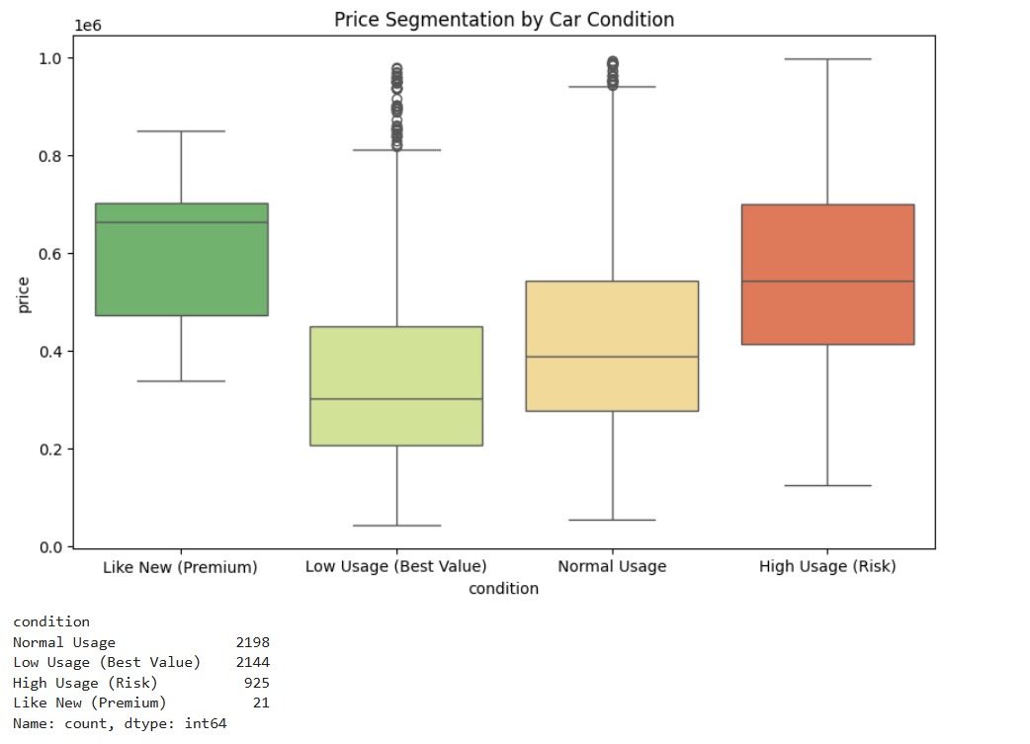
Can we create a custom category to identify Hidden Gems cars that are barely used but available at a second-hand price?
Insights
Low Usage" cars and Normal usage cars are best sellers. They offer the customer a "good-as-new" feel without the premium price

Slide 15
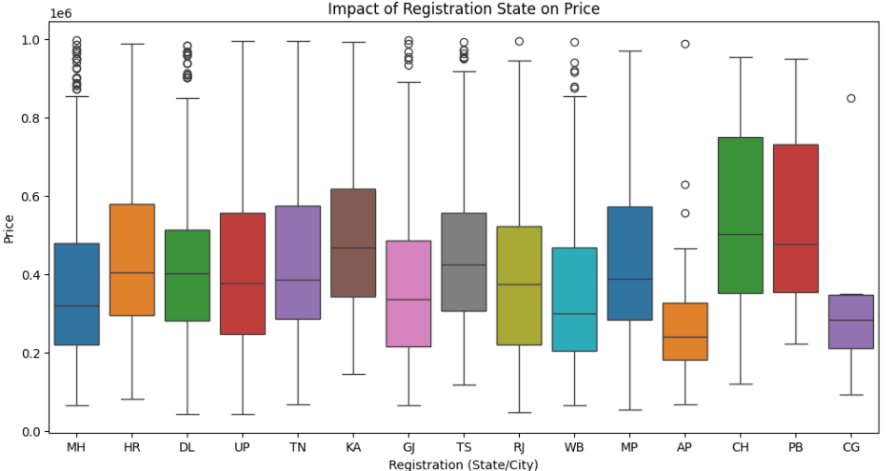
Does the location (RTO) of the car affect its price? Are cars from Delhi or Mumbai priced differently?
Insights:
The visualization confirms that Location is a Price Driver. A car registered in Karnataka commands a premium over an identical car registered in Delhi, driven by tax structures and regulatory lifespan limits

Slide 16
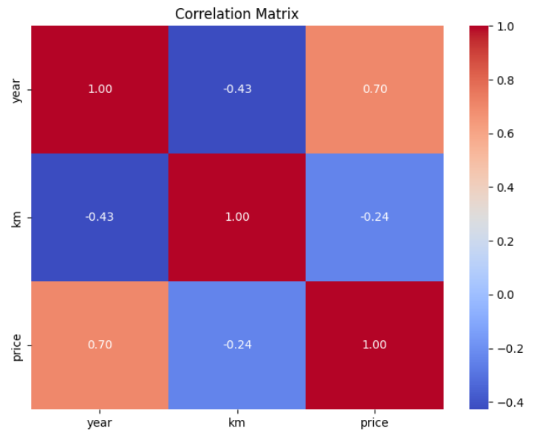
Multi-Variant Analysis
What is the single biggest factor that determines the price of a used car?
Insight:
Dominant Factor: Year has the strongest positive correlation (0.70) with Price. This confirms that age is the primary value driver.
Usage Impact: KM Driven has a negative correlation (-0.24). While significant, it is much weaker than the Year. This means a newer car with high mileage is often worth more than an older car with low mileage.

Slide 17
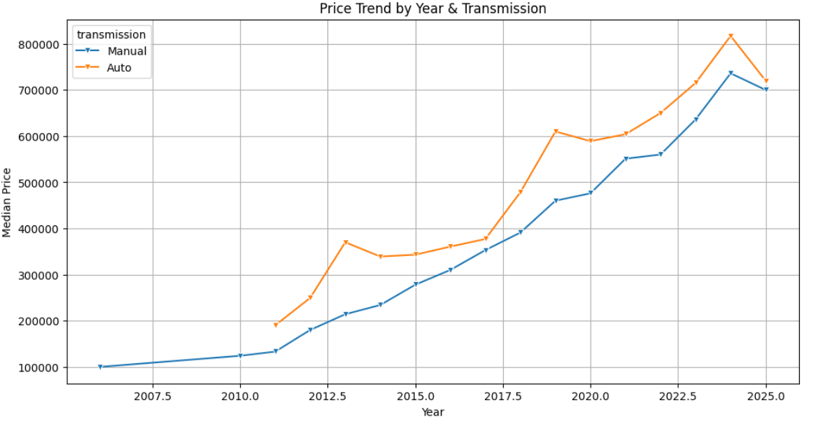
Is the price gap between Automatic and Manual cars consistent, or does it widen for newer models?
Insight:
The "Auto" Premium: Across almost every year, the Automatic (blue line) sits higher than the Manual (orange line).
Widening Gap: Notice the years 2018-2020. The gap widens significantly (e.g., in 2019, Automatics median is ~₹6.1L vs Manuals ~₹4.6L). This suggests that demand for modern automatics is surging, allowing sellers to charge a ~30% premium on recent models.

Slide 18
Hypothesis Testing
Does the Fuel type (Petrol vs Diesel) significantly affect the car price?
H0 (Null): There is no significant difference in the average price between Petrol and Diesel cars. (μ_petrol = μ_diesel)
H1 (Alternate): Theoretical: There is a significant difference in the average price between Petrol and Diesel cars. (μ_petrol ≠ μ_diesel)
Since both sample sizes are >= 30 (n1=4432, n2=1180), we select the **Two-Sample Z-Test**.
P-Value: 1.9924767133445852e-26
Decision: **Reject H0**.
Strength: Very Strong evidence against the Null Hypothesis.
The analysis confirms that Diesel cars are priced significantly higher than Petrol cars.

Slide 19
Is there a significant correlation between KM Driven and Price?
Data Points: n=5223
Variable 1: KM Driven
Variable 2: Price
H0 (Null): There is no correlation between KM Driven and Price. (Correlation Coefficient r = 0)
H1 (Alternate): There is a significant correlation between KM Driven and Price. (r ≠ 0)
Since we are checking the linear relationship between two continuous variables (KM and Price), we select the **Pearson Correlation Test**.
P-Value: 0.008362189233446213
Correlation Coefficient: -0.0345
Decision: **Reject H0**.
Strength: Strong evidence against the Null Hypothesis.
The analysis confirms a **Negative Correlation**.
Insight: As the Kilometers Driven increases, the Price significantly decreases. (Higher usage = Lower Value)

Slide 20
Is the choice of Transmission dependent on Fuel Type?
Data Points: n=5288
Variable 1: Fuel Type (Categorical)
Variable 2: Transmission (Categorical)
H0 (Null): Fuel Type and Transmission are independent. (No relationship)
H1 (Alternate): Fuel Type and Transmission are dependent. (Significant relationship)
Since we are checking the relationship between two categorical variables, we select the **Chi-Square Test of Independence**.
P-Value: 1.32886302607935e-14
Chi-Square Statistic: 67.6961
Degrees of Freedom: 3
Decision: **Reject H0**.
Strength: Very Strong evidence against the Null Hypothesis.
Insight: The choice of transmission is NOT random. Certain fuel types (e.g., Diesel vs Petrol) are statistically more likely to be paired with specific transmission types (Auto vs Manual).

Slide 21
Does the Registration Location significantly affect the Car Price?
Data Points: n=3110 (Subset of Top 5 Locations)
Variable 1: Registration Location (Categorical - Top 5)
Variable 2: Price (Continuous) Groups Compared: ['MH', 'HR', 'DL', 'UP', 'TN’]
H0 (Null): The mean price is the same across all selected locations.
H1 (Alternate): At least one location has a significantly different mean price.
Since we are comparing the means of a numerical variable (Price) across more than two categorical groups (Locations), we select the **One-Way ANOVA Test**.
P-Value: 9.812690524055399e-16
F-Statistic: 19.3445
Decision: **Reject H0**.
Strength: Very Strong evidence against the Null Hypothesis.
Insight: Location matters. The state where a car is registered has a statistically significant impact on its resale price (likely due to tax/regulatory differences).

Slide 22
Recommendations
Target the "Sweet Spot": Prioritize vehicles from the 2018–2020 era; they offer the best balance of modern safety features and avoided "new-car" depreciation.
Brand Selection: Choose Maruti or Hyundai for the lowest maintenance and easiest resale, but look toward Toyota or Mahindra if long-term value retention is the priority.
The Automatic Advantage: While Automatic variants carry a ₹1.5L–₹2L premium, their rising demand makes them a smarter long-term investment for urban resale.
Fuel Efficiency: For high-mileage drivers, CNG variants from top brands are highly recommended as they hold their resale value remarkably well due to low running costs.
Strict Quality Caps: Never exceed the 1.2L–1.5L KM mileage threshold, as the subsequent maintenance "cliff" typically negates any upfront savings on the purchase price.

Slide 23
Challenges
Scraping Dynamic Content: CARS24 uses "Infinite Scrolling" and lazy-loading, requiring Selenium to simulate human interactions and capture the full car list.
Data Inconsistency: Raw data was highly unstructured; the "Car" column bundled Year, Brand, and Model, requiring complex Regular Expressions (RegEx) to parse into usable features.
Domain-Specific Data Gaps: Handling missing registration data required domain knowledge to identify the Bharat (BH) series, ensuring the dataset accurately represented current Indian RTO trends.
Visualization Optimization: Standardizing wide data ranges required using Medians to prevent luxury outliers from skewing trends and implementing consistent color-coding for effective storytelling.

Slide 24
Conclusion
Data-Driven Transparency: Successfully standardized 5,800+ unstructured listings, replacing market intuition with empirical benchmarks for the Indian middle class.
Strategic Market Filtering: Isolated high-utility vehicles by applying a ₹10 Lakh price cap and 1.6L KM mileage limit, effectively removing luxury outliers and high-risk "scrap yard" entries.
Primary Price Drivers: Identified Year of Manufacture and Transmission Type as the strongest predictors of value, reflecting a significant "Automatic Premium" in urban markets.
Optimal Value "Sweet Spot": Established that cars aged 4 to 6 years (2018–2020) provide the ideal balance between modern features and minimized depreciation for budget-conscious buyers.

Slide 25

THANK YOU
&
ANY QUIRES?

