Slide 1
4th International Conference on
INTELLIGENT SYSTEMS & SUSTAINABLE COMPUTING
(ICISSC -2024)
20th-21st December 2024
Paper ID: 130
Improving the Classification of Attacks in IoT Intrusion Detection Systems Using Firefly Hyperparameter Optimization.
Ms.Gandu Lavanya
Assistant Professor, Malla Reddy University

Slide 2
1. ABSTRACT
The abstract explores the integration of the Internet of Things (IoT) with machine learning (ML) algorithms, focusing on the optimization of hyper parameters through the Firefly Algorithm (FA).
The IoT, characterized by a vast network of interconnected devices, generates substantial amounts of data that not only facilitates enhanced decision-making but also poses significant challenges due to the increased risk of cyber attacks.
An intrusion detection system (IDS) is a security mechanism that works mainly in the network layer of an IoT system.

Slide 3
2. Introduction
The IoT describes the networked connection of common devices and systems via the internet, allowing them to gather and share data [1].
An IDS is crucial for IoT environments because of the unique vulnerabilities these devices face. With their often-limited processing power and security capabilities, IoT devices are particularly susceptible to attacks.
Machine learning (ML) can struggle to accurately classify attacks as normal or abnormal due to various factors, including high-dimensional feature spaces, imbalanced datasets, and the evolving nature of cyber threats [2][3].

Slide 4
Continued…
The FA is a NIO (nature-inspired optimization) technique inspired by the flashing patterns of fireflies.
It operates on the principle that fireflies are attracted to one another depending on the brightness of their flashes, which corresponds to the quality of their solutions in optimization problems.
This approach enhances the predictive accuracy and generalization capabilities of ML models applied to IoT data, ultimately improving applications such as intrusion detection system (IDS), and predictive maintenance.

Slide 5
Continued…
NIO can lead to more robust models that better capture the complexities of abnormal behavior, ultimately improving the accuracy and reliability of IDS.
The FA is a NIO technique inspired by the flashing patterns of fireflies. It operates on the principle that fireflies are attracted to one another depending on the brightness of their flashes.

Slide 6
3. Literature review
This research aims to tackle the issue of attack classification for IDS with class imbalance in ML algorithms associated with the multi-step cyber-attacks (MSCA) dataset, enhancing the effectiveness and accuracy of these algorithms in the IoT domain.
Dalal et al.,[4] present the results of applying various ML algorithms and introduce a notably improved neural network method for predicting MSCAs. They developed an Extremely Boosted Neural Network (EBNN) by integrating multiple neural networks into a single framework. Their evaluation of the MSCA dataset shows that the EBNN reaches an outstanding accuracy of 99.72% in its predictions.

Slide 7
Continued…
Alheeti et al.,[5] introduce a smart IDS that utilizes the K-nearest neighbor algorithm to differentiate between normal and anomalous network traffic patterns. They evaluate the system's effectiveness using the MSCA dataset to identify new types of attacks. The trained models achieved an accuracy of 82.59%, enhancing detection performance.
Jamal et al.,[6] proposed a novel hybrid model for IDS in industrial networks, which is an integration of convolutional neural network, and Deep Belief Network with Synthetic Minority Oversampling Technique (SMOTE) and SMOTETomek balancing strategy is proposed. This extensive research work achieves an accuracy rate of 98%.

Slide 8
4. Methodology
The Firefly Algorithm (FA) inspired by the bioluminescent behaviors of fireflies and certain beetles, utilizes their nighttime flashing as a form of communication.
𝑖) fireflies attract one another regardless of gender,
𝑖𝑖) brightness plays a crucial role in their attraction
When fireflies exhibit the same brightness, they move randomly.

Slide 9
Continued…

Slide 10
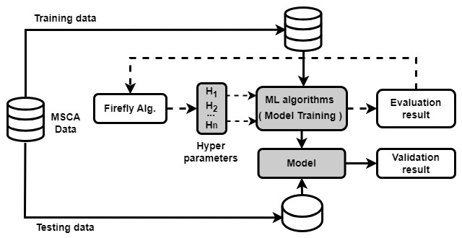
Continued…
Figure 1: System architecture

Slide 11
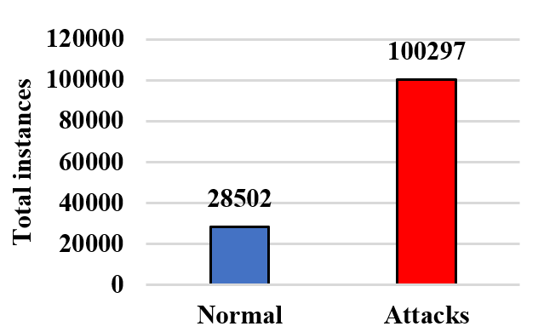
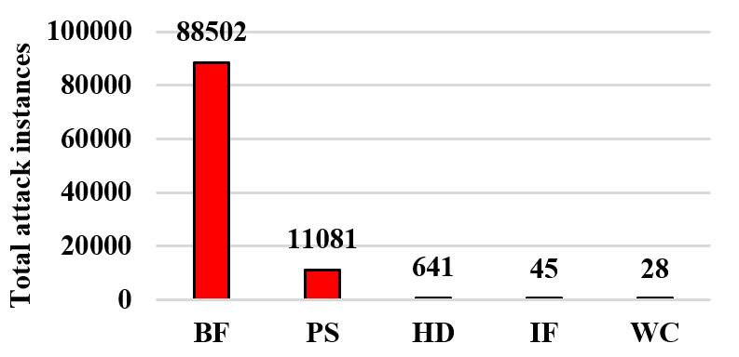
Datasets Description
The dataset consists of 67 features aimed at predicting the network activities. The attack classes are Brute Force (BF), Port Scan (PS), HTTP DDoS (HD), ICMP Flood (IF), Web Crawling (WC). Figure 2 exhibits the target class with total instances with normal activities and remaining as abnormal activities. The feature vectors for the training and validation sets were split in an 80:20 ratio, comprising 103039 instances for training and 25760 for validation.
(A)Target class classification
(B)Attack class classification
Figure 2: Detailed view of dataset

Slide 12
Results and Discussion
Hyper parameter tuning is crucial for improving the performance of IoT IDS due to the complex and dynamic nature of IoT environments.
The FA helps to identify optimal configurations for classifiers, enhancing their accuracy and robustness in detecting anomalies by dynamically adjusting to changing conditions and threat landscapes in IoT infrastructure.

Slide 13
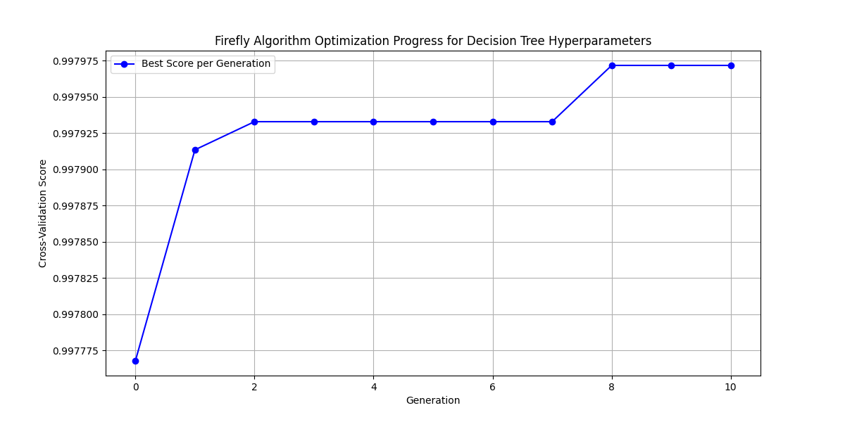
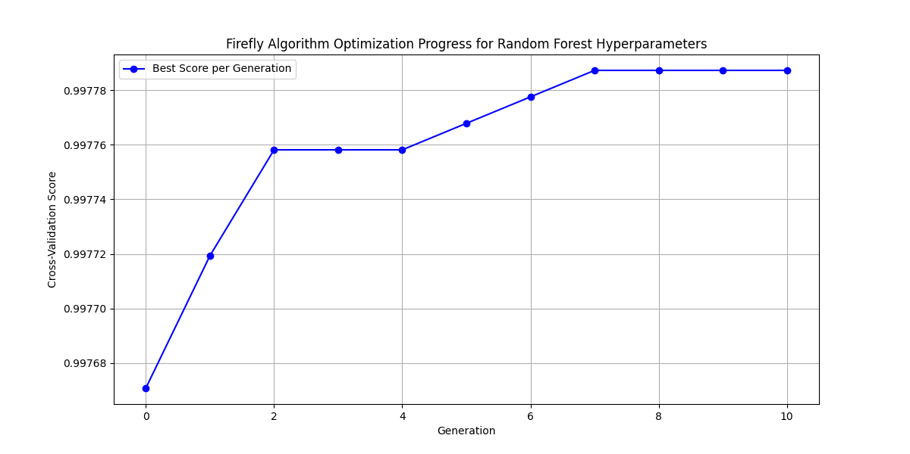
Continued…
Figure 3: Fitness score of DT with fireflies generation
Figure 4: Fitness score of RF with fireflies generation

Slide 14
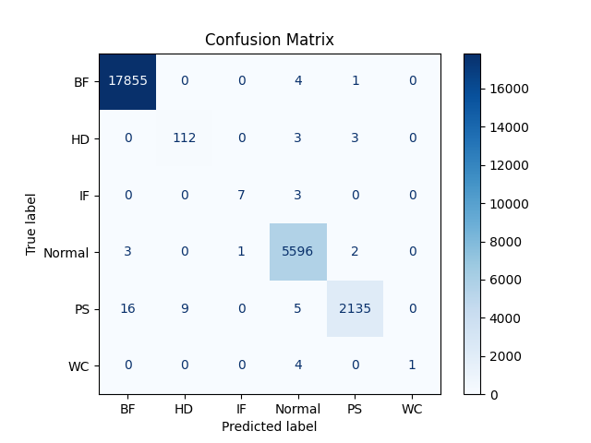


Continued…
(A): RF with tuned parameters
(B): RF with default parameters

Slide 15

Continued…
(C): DT with tuned parameters
(D): DT default parameters

Slide 16
Continued…
Figure 6: Evaluation metrics of the proposed models

Slide 17
Conclusion
In conclusion, both the RF and DT algorithms demonstrated strong performance in classifying attacks following hyper parameter tuning with the FA with an accuracy of 99.82% and 99.79%.
The optimization process significantly enhanced the models' ability to differentiate between normal and abnormal behaviors within the dataset, leading to improved accuracy and reduced false positives.
The FA effectively navigated the hyperparameter space, allowing for the selection of configurations that maximized the models' predictive capabilities

Slide 18
References
[1] M. A. Rahman, A. T. Asyhari, L. S. Leong, G. B. Satrya, M. Hai Tao, and M. F. Zolkipli, “Scalable machine learning-based intrusion detection system for IoT enabled smart cities,” Sustain Cities Soc, vol. 61, p. 102324, Oct. 2020, doi: 10.1016/j.scs.2020.102324.
[2] D. K. K. ; Reddy, J. ; Nayak, B. ; Naik, and G. S. Pratyusha, Deep Neural Network–Based Security Model for IoT Device Network, 1st ed., no. 1. Boca Raton: CRC Press, 2021. doi: 10.1201/9781003032175.
[3]D. K. K. Reddy and H. S. Behera, “CatBoosting Approach for Anomaly Detection in IoT-Based Smart Home Environment,” 2022, pp. 753–764. doi: 10.1007/978-981-16-9447-9_56.
[4] Y. Otoum, D. Liu, and A. Nayak, “DL-IDS: a deep learning–based intrusion detection framework for securing IoT,” Transactions on Emerging Telecommunications Technologies, vol. 33, no. 3, pp. 1–14, 2022, doi: 10.1002/ett.3803.
[5]S. K. Pemmada, K. S. Naidu, and D. K. K. Reddy, “SMOTE Integrated Adaptive Boosting Framework for Network Intrusion Detection,” in Intelligent Systems Reference Library, vol. 60, Springer Science and Business Media Deutschland GmbH, 2024, pp. 1–25. doi: 10.1007/978-3-031-54038-7_1.
[6]J. Nayak, P. S. Kumar, D. K. K. Reddy, B. Naik, and D. Pelusi, “Machine Learning and Big Data in Cyber‐Physical System: Methods, Applications and Challenges,” in Cognitive Engineering for Next Generation Computing, Wiley, 2021, pp. 49–91. doi: 10.1002/9781119711308.ch2.

