Slide 1
Unit-3
UNIT–III
BI Implementation - Key Drivers, Key Performance Indicators and Performance Metrics, BI Architecture/Framework, Best Practices, Business Decision Making, Styles of BI-Event-Driven alerts-A cyclic process of Intelligence Creation. The value of Business intelligence -Value driven and Information use.

Slide 2
Key Drivers of Business Intelligence
Tech Drivers
Business Drivers
Bottom Line
The survey found that the top three drivers underpinning the decision to implement a BI solution are:
The ability of a BI solution to help produce better business decisions via timely, accurate and more comprehensive analysis of available corporate information assets
The ability of BI to identify growth opportunities
The ability of BI to reduce costs and wastage by identifying areas of high expenditure, operational inefficiencies and analyzing transactional records

Slide 3
Underpin strategic adjustments in real-time (or near real-time)
Identify risks and threats
Increase customer profitability
Improve and measure workplace productivity by employee, department or function
Improve operational and supply chain efficiencies

Slide 4
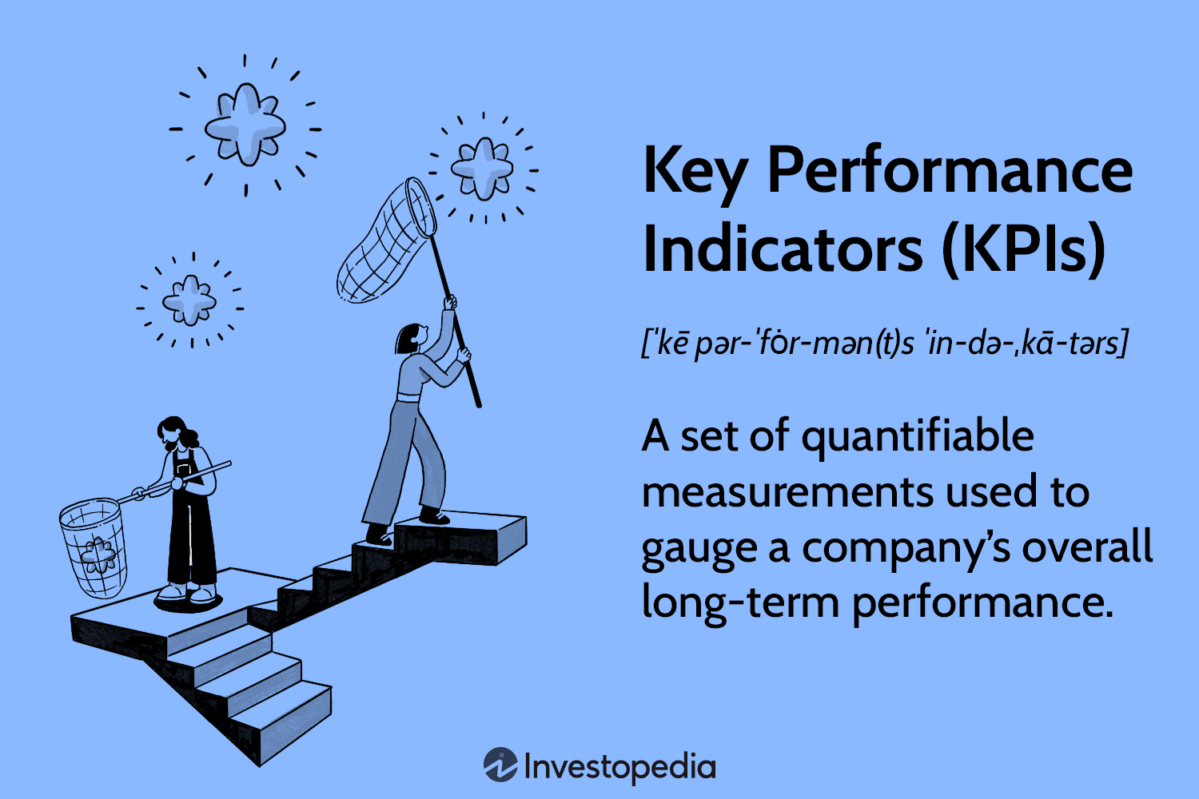
Key Performance Indicators and Performance Metrics

Slide 5
KPI
Key performance indicators (KPIs) measure a company's success vs. a set of targets, objectives, or industry peers. KPIs can be financial, including net profit (or the bottom line, net income), revenues minus certain expenses, or the current ratio (liquidity and cash availability).
What are Key Performance Indicators and metrics?
Key performance indicators are data that show you just how good you are at attaining your business goals. Meanwhile, metrics track the status of your business processes. With KPIs, you will know if you're hitting your overall business targets, while metrics focus on the performance of specific business processes.

Slide 6
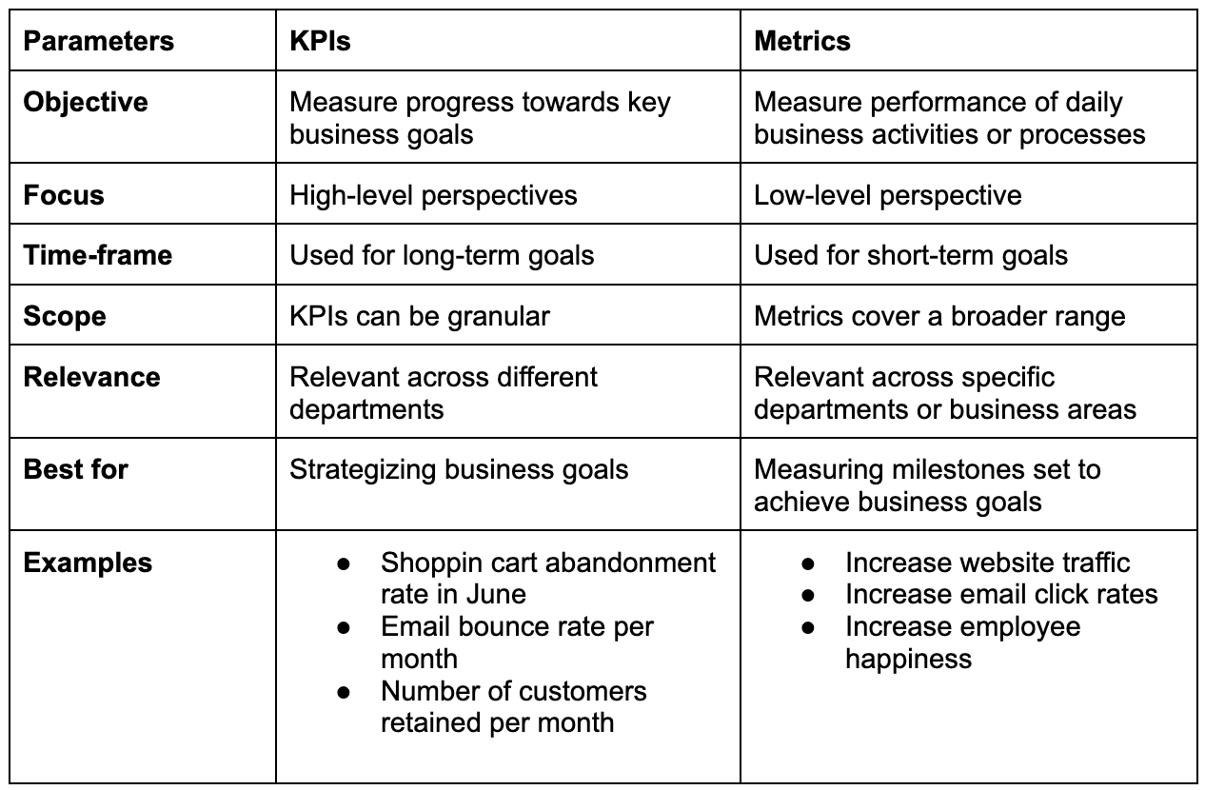
KPI AND METRICS

Slide 7
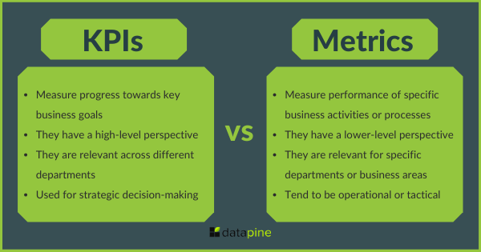
KPI AND METRICS

Slide 8
Power BI – Explain Key Performance Indicators (KPIs) dashboards
The KPIs evaluate an association’s performance in different areas by assessing quantifiable measure values. In businesses, KPIs play an essential part as visual cues that indicate growth by assessing values and measurable pretensions. A KPI always has a base value or measure which is estimated against a target value. That is, comparing the factual performance with the target set. You can estimate the performances in an analysis just by seeing the KPIs.

Slide 9
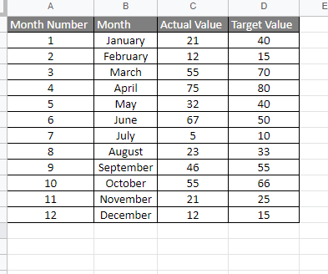
Creating Key Performance Indicators (KPI) Visualization
To Demonstrate KPI we will import an excel sheet to power BI, following steps are to be followed, The dataset used for the visualization is here. Below is the screenshot of the dataset:

Slide 10
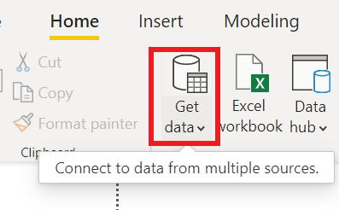
Step 1: Under the Home, Tab Click on Get data.

Slide 11
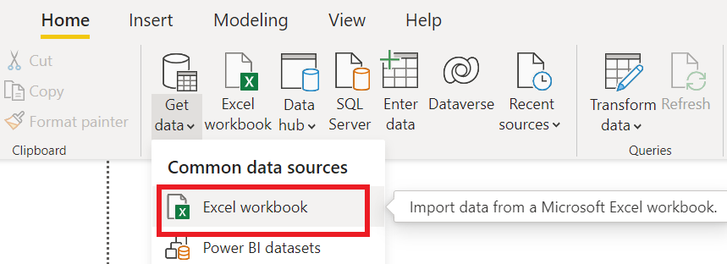
Step 2: Click on Excel Workbook.

Slide 12
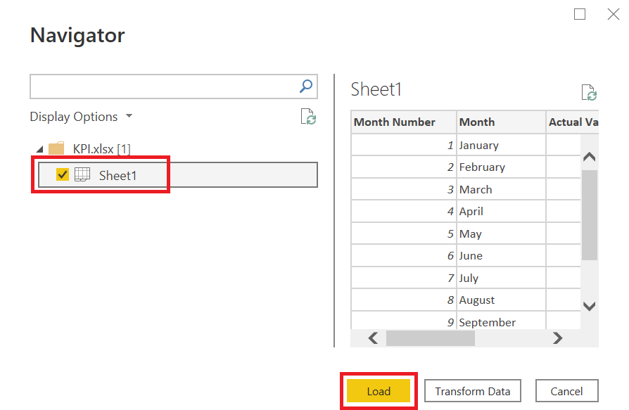
Step 3: Import the data from your machine and select the check boxes shown below.

Slide 13
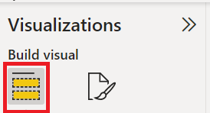
Step 4: Under the visualization Tab. Select Build Visuals.
Step 4: Under the visualization Tab. Select Build Visuals.

Slide 14
Step 5: Now select the KPI icon as shown below.
KPI has 3 fields which are Values, Trend Axis and Target Goal.
Values: It is the actual values against targeted values.
Trend Axis: It will be the month name or number axis line.
Target Goal: target to be achieved.

Slide 15
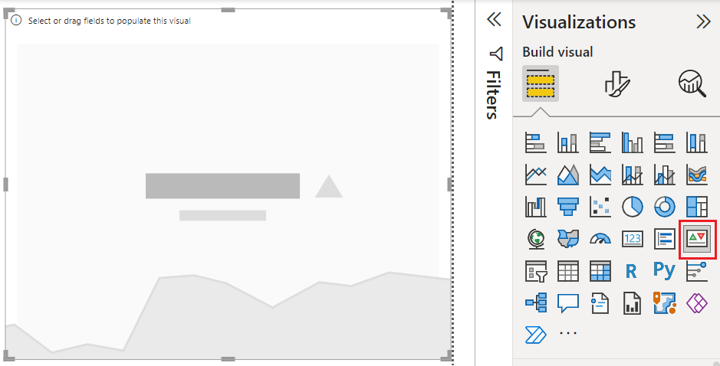

Slide 16
KPI has 3 fields which are Values, Trend Axis and Target Goal.
Values: It is the actual values against targeted values.
Trend Axis: It will be the month name or number axis line.
Target Goal: target to be achieved.

Slide 17
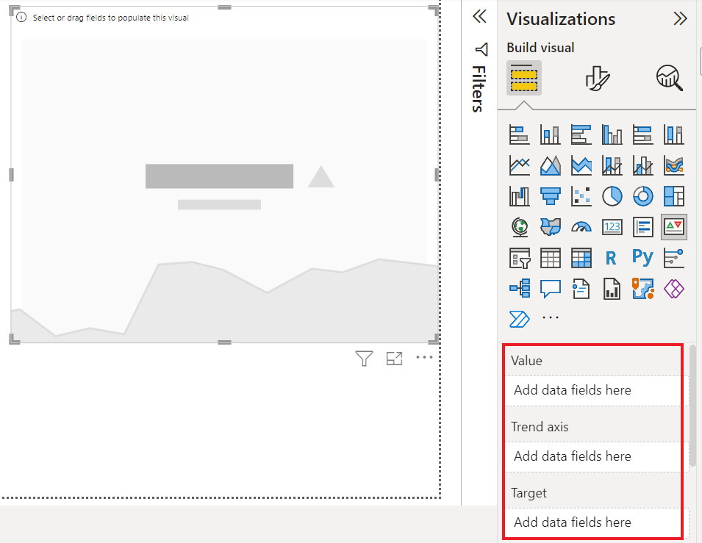

Slide 18
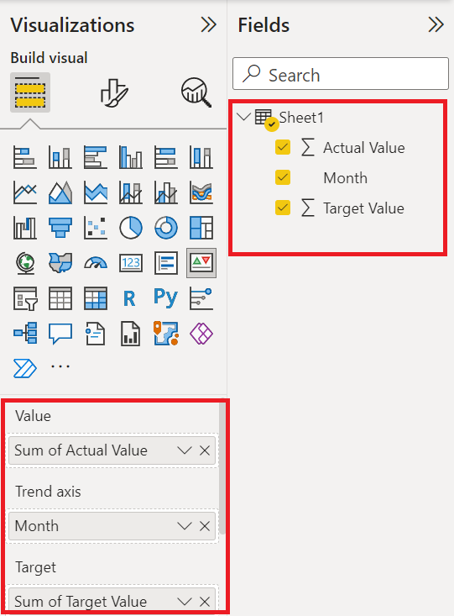
Step 6: Drag and Drop the fields in the respective row as shown below.

Slide 19
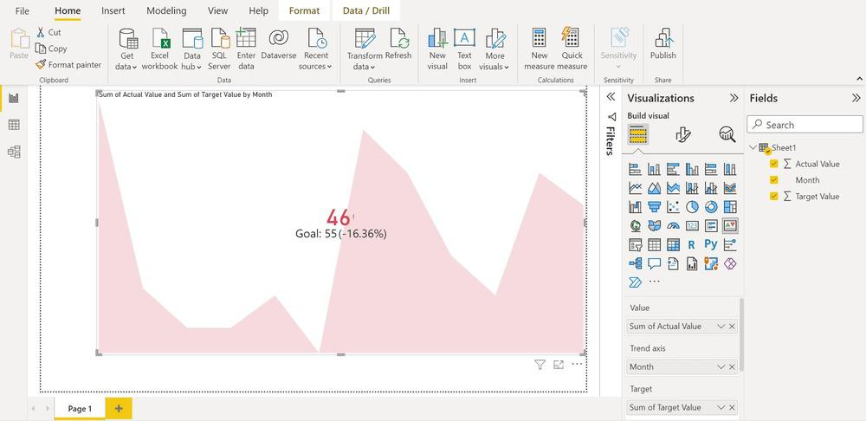
Step 7: Now the Dashboard of Power BI looks like this.

Slide 20
KPI Advantages
KPI Advantages
Monitoring the target: This KPI helps the organization to monitor their performance in a visuals manner
Timely reports: With This KPI the organization will be able to check whether they are able to execute their plan or not
Simplify Process: Modern businesses can use KPIs for their advancement of profit
KPI Disadvantages
Time Taking: It does not offer information on which action can be taken immediately
Implementation: Do not try to overload with more than one data, always start with simple implementation
Uses of KPI
Working with KPIs is easy and you can use them to display inversely complex information. The two main reasons why you should use KPIs in your Power BI are
We use KPIs to measure progress i.e., positive or negative change over time. For illustration – whether you’re getting correct results or not, meeting targets or lagging before.
We also use KPIs to measure the distance to a target or a thing. In this case, you dissect how far behind you’re in meeting your target.

Slide 21
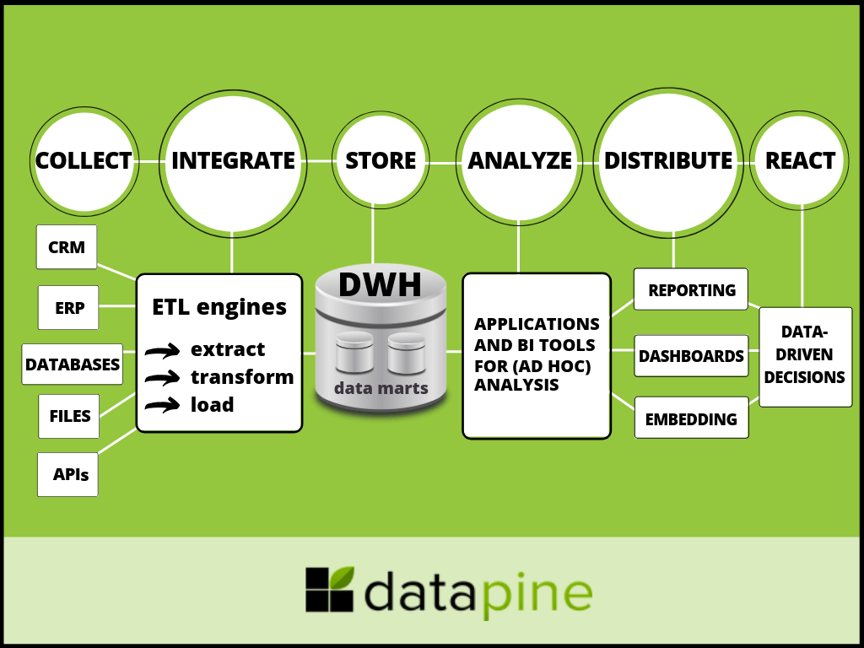

Slide 22
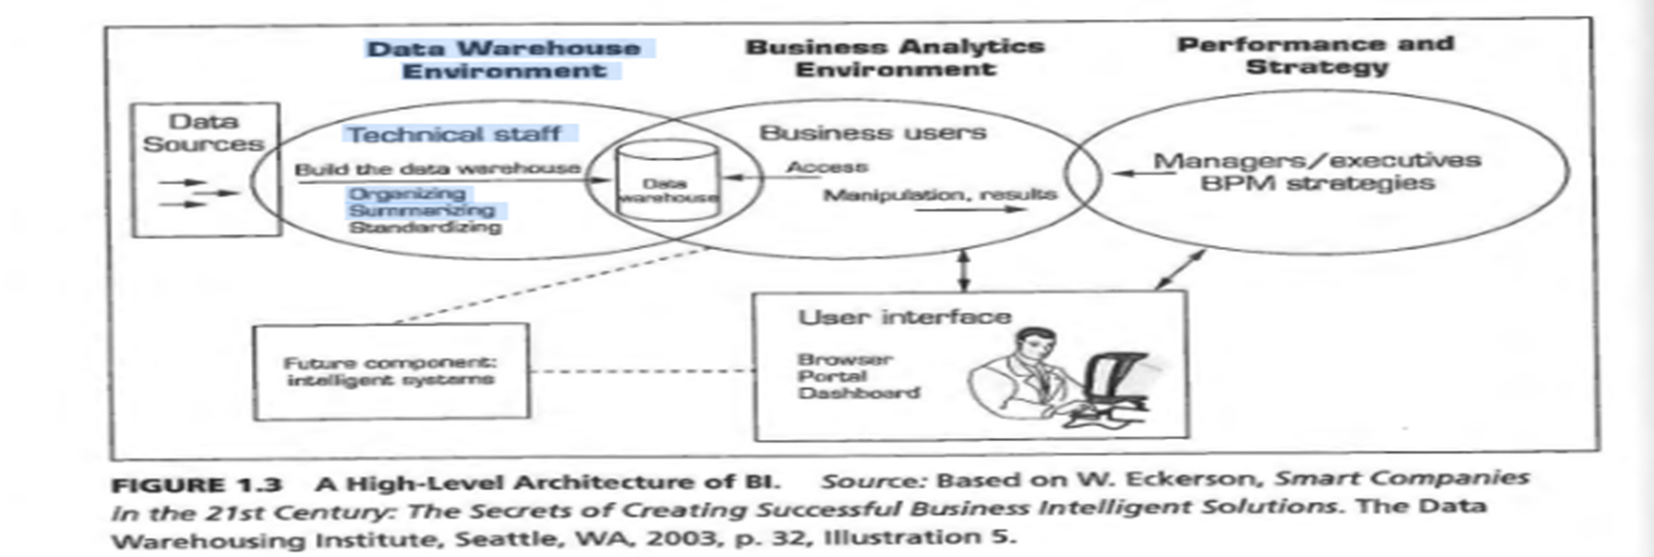
BI Architecture/Framework

Slide 23
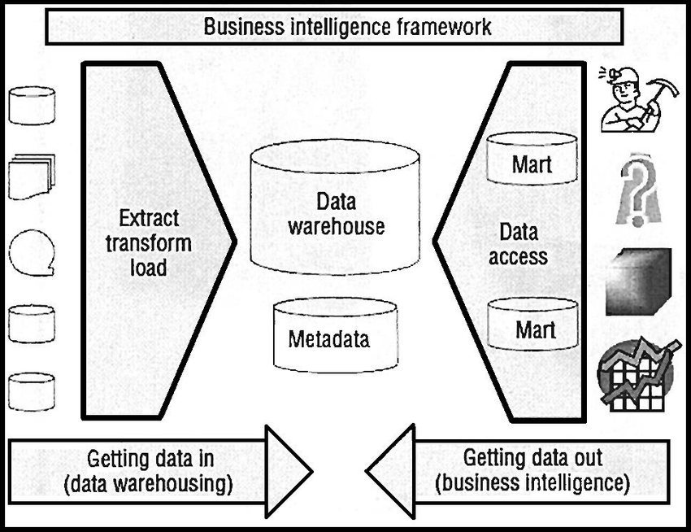

Slide 24
Business Intelligence Best Practice
1 Business Buy-in, Collaboration, and Ownership
2. BI Implementation Strategy
3. Monitor, Learn and Adjust the process
4. Data Validation for Certainty and Accuracy
5. Business Challenge comes first and then the Query
6. Design your Business Intelligence dashboard informative and impactful
7. Up skill the business users

Slide 25
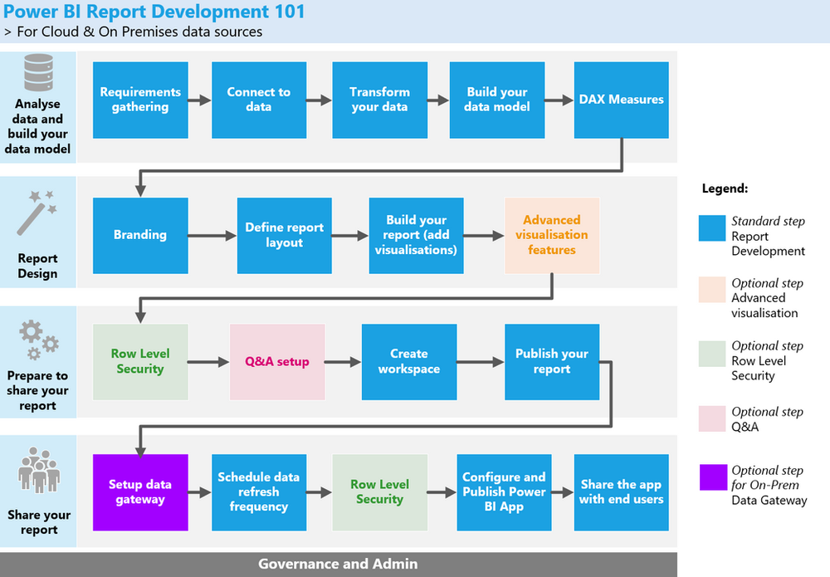
BEST PRACTICES

Slide 26
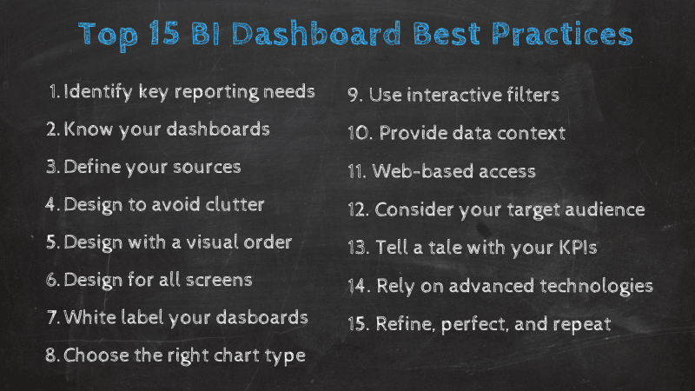
BI BEST PRACTICES

Slide 27
Business Intelligence Best Practices
Business Intelligence Best Practices
Business Buy-in, Collaboration, and Ownership
Aim for complete buy-in from the executive board and take the help of technology heads to explain the benefits and processes. Form an internal network of contributors to enrich the data environment continuously. This network should consist of personnel from every team including Marketing, Sales, Logistics, Finance, Delivery, Management, and Customer Service. The business units must not depend on IT to generate reports and insight.

Slide 28
BI Implementation Strategy
A couple of years ago, a Forbes article by a fintech leader predicted that more than 150 zettabytes of real-time data will need analysis by 2025. The complete potential of data is yet to be discovered. We are dealing with massive loads of data and without a practical Business Intelligence implementation strategy, your ROI might not live up to the TCO (Total Cost of Ownership).

Slide 29
BI
Monitor, Learn and Adjust the process
Unless you have a seasoned team of Data Scientists, you will most likely find some roadblocks at the initial phase of your Data Management and Business Intelligence creation. Don’t let a few hiccups dull your motive, rather take the IT team's help to establish continuous monitoring systems, access your data sources, understand the underlying conditions, and adjust the elements to align your BI strategy to your business goals.

Slide 30
Data Validation for Certainty and Accuracy
A ‘Vote in’ doesn’t directly imply trust over the process. A few business units, their leaders, or some of the key contributors may have a lot of questions about how accurate are the insights that are being produced from the so-called Business Intelligence practices. Organizations need strong Data Validation processes in place to gain true trust from every business user. Design the validation process to be able to detect and prevent problematic data, avert faulty insights, and add agility.

Slide 31
Business Challenge comes first and then the Query
Just because you’ve built a data repository don’t expect the business users to dive right in with queries. Business Intelligence sure is a magic wand that can bring you insight with few clicks but step one is always dissecting the business challenge. First, have a clear list of metrics you want to track and analyze, and then place your query for Insights.

Slide 32
Design your Business Intelligence dashboard informative and impactful
The BI dashboard is one of the most important aspects of your BI reporting. Data Visualization is not only for aesthetic purposes, but also to add simplicity, readability, clarity, and let the users effortlessly find the information. Opt for a dashboard design that presents detailed analysis as needed in a downward flow. Modern Data Architectures emphasize regulations and access control. Take advantage of the access information to display the relevant KPIs and Metrics at the top of each log-in.

Slide 33
Up skill the business users
Up skill the business users
The scarcity of top-notch data scientists is real. But you can turn the most inquisitive employees of your workforce into information analysts. Because they already know the business domain, understand their respective business units, and know what questions to ask. All they need is some training to handle the platforms and unmolded data sets. This could be your first step towards self-service Business Intelligence

Slide 34
Business Decision Making
Business decision making
The 7 steps of the decision making process
Identify the decision, problem, challenge, or opportunity.
Create a set of potential solutions or responses.
Gather relevant information and data.
Evaluate each option and weigh the evidence.
Choose a solution or response that best fits the situation.
Take action and implement the chosen solution or response.
Review your decision and its impact, and course correct if needed.

Slide 35
Examples of event-driven alerts in BI include:
Sales Alert: An alert triggered when sales revenue exceeds a predefined threshold or when a specific product's sales volume declines suddenly.
Performance Alert: An alert generated when a key performance metric, such as website response time or customer satisfaction score, falls outside the acceptable range.
Compliance Alert: An alert triggered when a regulatory or compliance requirement is violated, such as exceeding a certain level of unauthorized access attempts or data breaches.
Supply Chain Alert: An alert generated when inventory levels drop below a certain threshold or when a delay in the supply chain disrupts production.

Slide 36
styles
These 5 Styles of BI are:
1. Enterprise Reporting – Broadly deployed pixel-perfect report formats for operational reporting
and scorecards/dashboards targeted at information consumers and executives.
2. Cube Analysis – OLAP slice-and-dice analysis of limited data sets, targeted at managers and others who need a safe and simple environment for basic data exploration within a limited range of data.
3. Ad Hoc Query and Analysis – Full investigative query into all data, as well as automated sliceand-dice OLAP analysis of the entire database – down to the transaction level of detail if necessary.
Targeted at information explorers and power users.
4. Statistical Analysis and Data Mining – Full mathematical, financial, and statistical treatment
of data for purposes of correlation analysis, trend analysis, financial analysis and projections.
Targeted at the professional information analysts.
5. Alerting and Report Delivery – Proactive report delivery and alerting to very large populations
based on schedules or event triggers in the database. Targeted at very large user populations of
information consumers, both internal and external to the enterprise

Slide 37
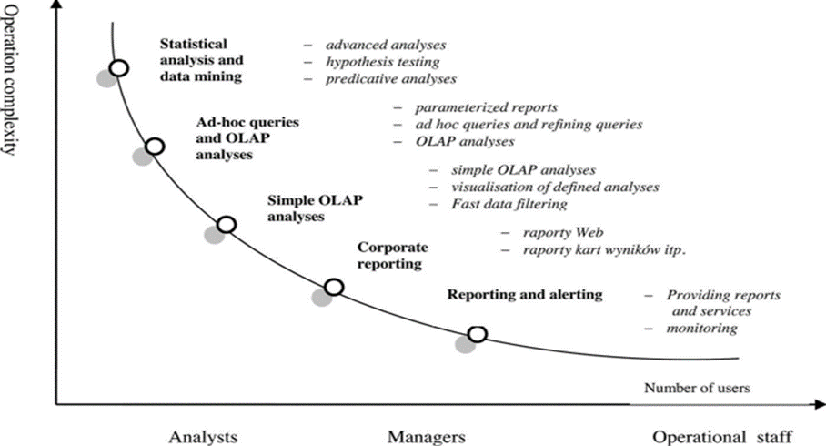

Slide 38
Event-driven alerts in Business Intelligence (BI)
Event-driven alerts Event-Driven Alerts which is a warning or action that is activated when a predefined or unusual event occurs. For example, credit card companies have built extensive predictive analysis models to identify cases of possible fraud and automatically alert credit card customers for verification of transactions when unusual activity is noted (e.g. large purchase in an or foreign location when the customer does not have a history of such transactions). If a customer makes a large deposit, the bank may make an offer of a higher interest rate Certificate of Deposit (CD) or investment automatically. Such alerts are also used in generating promotions based on completion of other in Business Intelligence (BI)

Slide 39
Event driven
Event-driven alerts in Business Intelligence (BI) refer to notifications or triggers that are generated based on specific events or conditions detected in the data. These alerts are designed to inform users or stakeholders about significant changes, anomalies, or predefined thresholds being met or exceeded.

Slide 40
Definition of Events and Triggers
Definition of Events and Triggers: Organizations identify the events or conditions that are relevant to their business operations and performance. These events can be predefined thresholds, deviations from expected values, changes in patterns, or specific data conditions. Triggers are set to detect when these events occur or conditions are met.

Slide 41
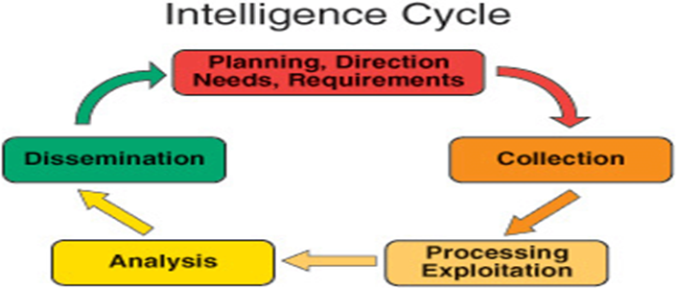
A cyclic process of Intelligence Creation
In business intelligence (BI), the process of intelligence creation is often a cyclic or iterative process. It involves several key steps that are repeated to continuously generate intelligence and improve decision-making. Here's an overview of the cyclic process of intelligence creation in BI:

Slide 42
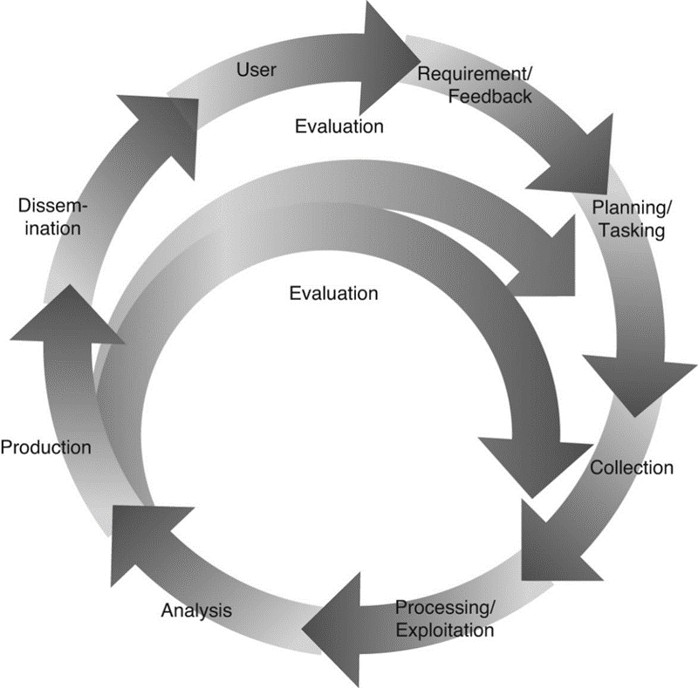

Slide 43
Planning and Requirements

