Slide 1
Unit-3
UNIT–III
BI Implementation - Key Drivers, Key Performance Indicators and Performance Metrics, BI Architecture/Framework, Best Practices, Business Decision Making, Styles of BI-vent-Driven alerts-A cyclic process of Intelligence Creation. The value of Business intelligence -Value driven and Information use.

Slide 2
Key Drivers of Business Intelligence
Tech Drivers
Business Drivers
Bottom Line
The survey found that the top three drivers underpinning the decision to implement a BI solution are:
The ability of a BI solution to help produce better business decisions via timely, accurate and more comprehensive analysis of available corporate information assets
The ability of BI to identify growth opportunities
The ability of BI to reduce costs and wastage by identifying areas of high expenditure, operational inefficiencies and analyzing transactional records

Slide 3
Underpin strategic adjustments in real-time (or near real-time)
Identify risks and threats
Increase customer profitability
Improve and measure workplace productivity by employee, department or function
Improve operational and supply chain efficiencies

Slide 4
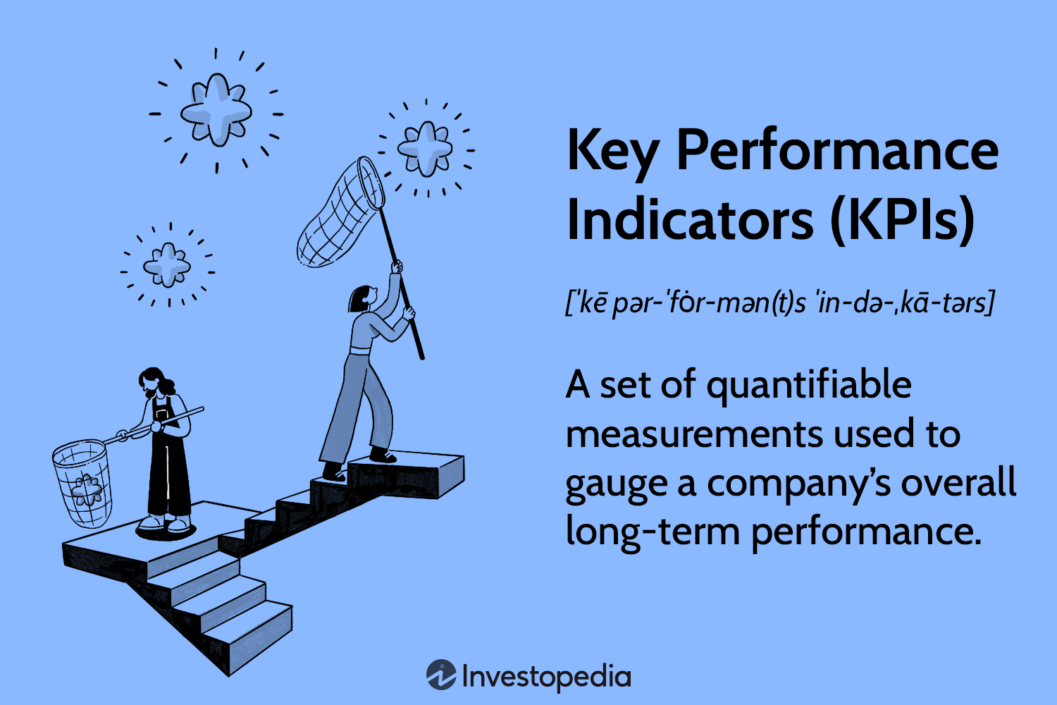
Key Performance Indicators and Performance Metrics

Slide 5
Key performance indicators (KPIs) measure a company's success vs. a set of targets, objectives, or industry peers. KPIs can be financial, including net profit (or the bottom line, net income), revenues minus certain expenses, or the current ratio (liquidity and cash availability).
What are Key Performance Indicators and metrics?
Key performance indicators are data that show you just how good you are at attaining your business goals. Meanwhile, metrics track the status of your business processes. With KPIs, you will know if you're hitting your overall business targets, while metrics focus on the performance of specific business processes.

Slide 6
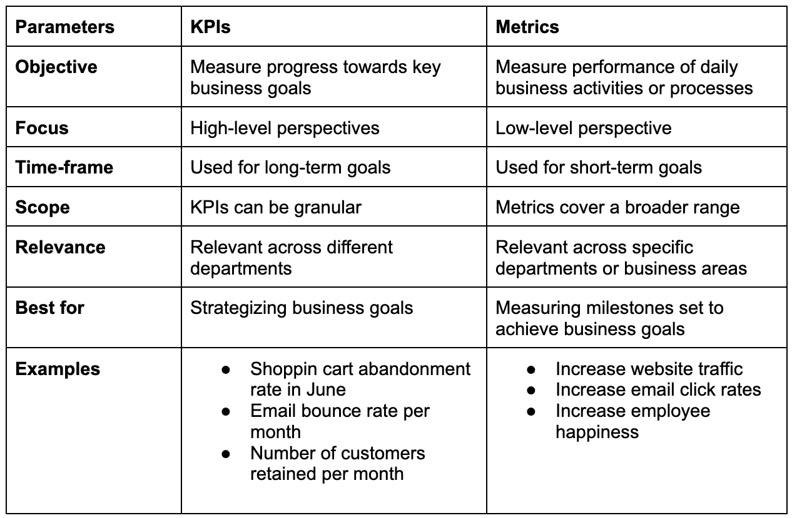

Slide 7
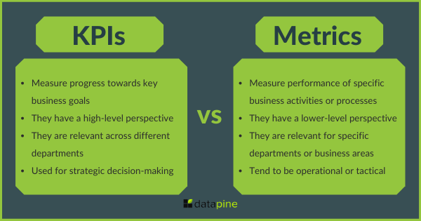

Slide 8
Power BI – Explain Key Performance Indicators (KPIs) dashboards
The KPIs evaluate an association’s performance in different areas by assessing quantifiable measure values. In businesses, KPIs play an essential part as visual cues that indicate growth by assessing values and measurable pretensions. A KPI always has a base value or measure which is estimated against a target value. That is, comparing the factual performance with the target set. You can estimate the performances in an analysis just by seeing the KPIs.

Slide 9
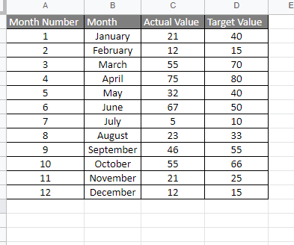
Creating Key Performance Indicators (KPI) Visualization
To Demonstrate KPI we will import an excel sheet to power BI, following steps are to be followed, The dataset used for the visualization is here. Below is the screenshot of the dataset:

Slide 10
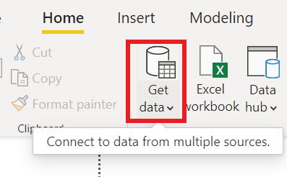
Step 1: Under the Home, Tab Click on Get data.

Slide 11
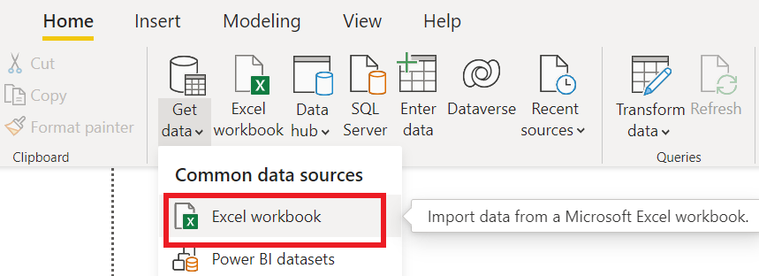
Step 2: Click on Excel Workbook.

Slide 12
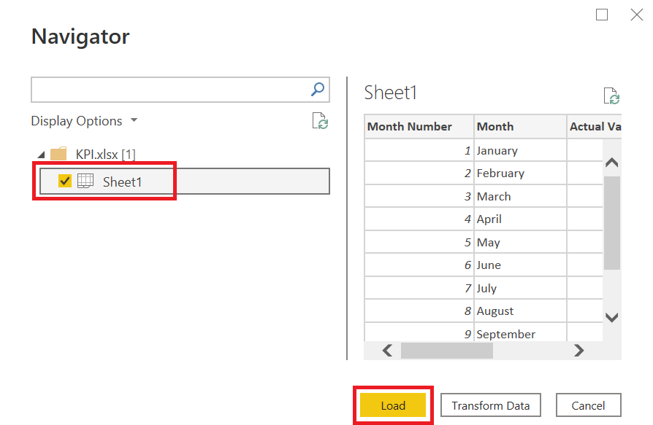
Step 3: Import the data from your machine and select the check boxes shown below.

Slide 13
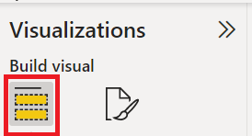
Step 4: Under the visualization Tab. Select Build Visuals.
Step 4: Under the visualization Tab. Select Build Visuals.

Slide 14
Step 5: Now select the KPI icon as shown below.
KPI has 3 fields which are Values, Trend Axis and Target Goal.
Values: It is the actual values against targeted values.
Trend Axis: It will be the month name or number axis line.
Target Goal: target to be achieved.

Slide 15
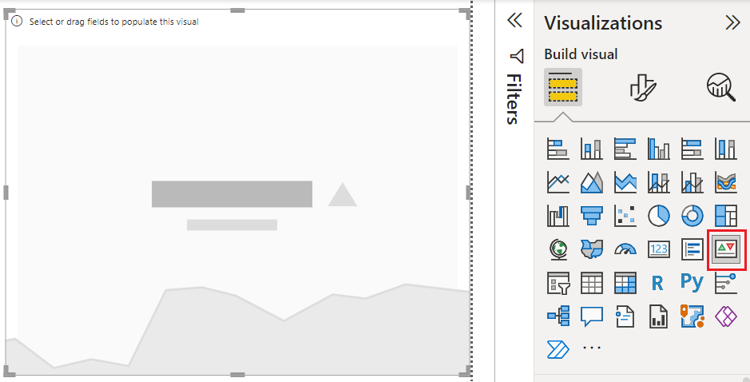

Slide 16
KPI has 3 fields which are Values, Trend Axis and Target Goal.
Values: It is the actual values against targeted values.
Trend Axis: It will be the month name or number axis line.
Target Goal: target to be achieved.

Slide 17
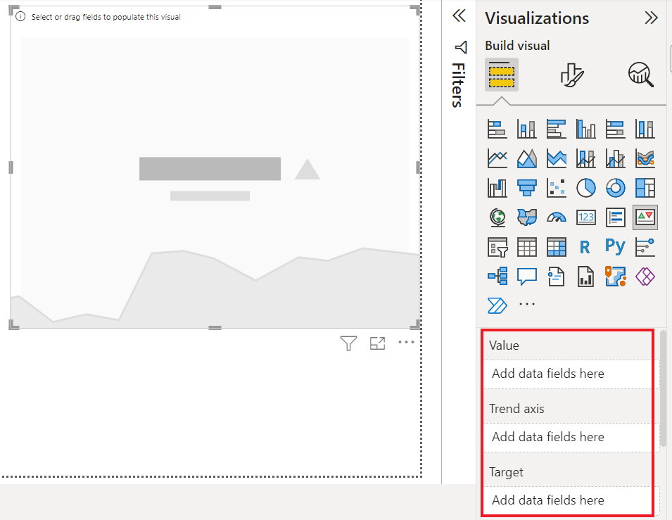

Slide 18
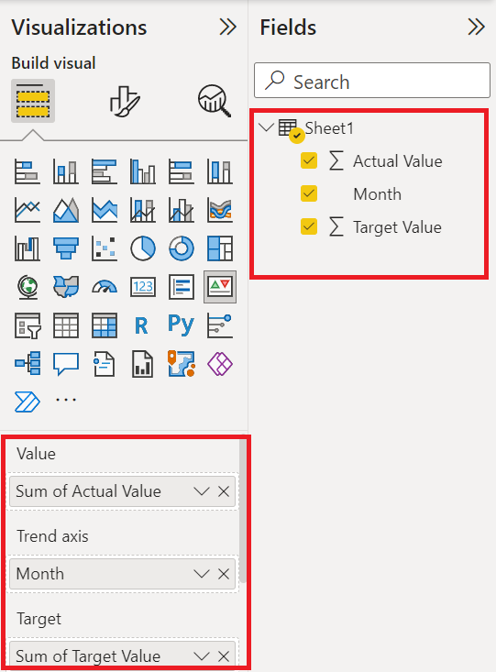
Step 6: Drag and Drop the fields in the respective row as shown below.

Slide 19
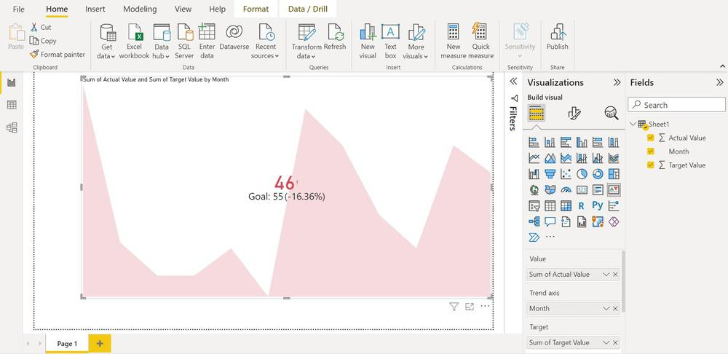
Step 7: Now the Dashboard of Power BI looks like this.

Slide 20
KPI Advantages
KPI Advantages
Monitoring the target: This KPI helps the organization to monitor their performance in a visuals manner
Timely reports: With This KPI the organization will be able to check whether they are able to execute their plan or not
Simplify Process: Modern businesses can use KPIs for their advancement of profit
KPI Disadvantages
Time Taking: It does not offer information on which action can be taken immediately
Implementation: Do not try to overload with more than one data, always start with simple implementation
Uses of KPI
Working with KPIs is easy and you can use them to display inversely complex information. The two main reasons why you should use KPIs in your Power BI are
We use KPIs to measure progress i.e., positive or negative change over time. For illustration – whether you’re getting correct results or not, meeting targets or lagging before.
We also use KPIs to measure the distance to a target or a thing. In this case, you dissect how far behind you’re in meeting your target.

Slide 21
