Slide 1

Data Processing & Analysis – Pig Latin
UNIT - V

Slide 2
Apache Pig
It is a High-level Platform For Creating Programs that run on Apache Hadoop.
It provides a High-level Scripting Language, called Pig Latin, which is similar to SQL
Pig Latin programs are Compiled Into Sequences Of Mapreduce Jobs, which can be executed on a Hadoop cluster.
Pig Latin can be extended Using User-defined Functions (UDFs) which the user can write in Java, Python, JavaScript, Ruby Or Groovy and then call directly from the language.

Slide 3
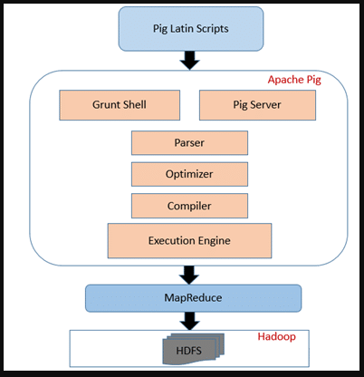
Pig Architecture

Slide 4
benefits of using Apache Pig:
Ease Of Use: Pig Latin is a high-level language that is easy to learn, even for programmers who are not familiar with MapReduce.
Expressiveness: Pig Latin provides a rich set of features for data manipulation and analysis, making it possible to express complex data transformations in a concise and easy-to-understand way.
Parallelism: Pig programs are automatically compiled into sequences of MapReduce jobs, which can be Executed In Parallel on a Hadoop cluster. This makes it possible to process large datasets very quickly.
Flexibility: Pig can be used to process data in a variety of formats, including flat files, relational databases, and Hadoop Distributed File System (HDFS) files.

Slide 5
use cases for Apache Pig:-
Data Cleaning And Preparation: Pig can be used to clean and prepare large data sets for analysis.
This may involve tasks such as removing duplicate records, correcting errors, and converting data to a consistent format.
Data Analysis: Pig can be used to perform a variety of data analysis tasks, such as calculating summary statistics, identifying trends and patterns, and building machine learning models.
Data Integration: Pig can be used to integrate data from multiple sources, such as relational databases, flat files, and log files. This can be useful for creating a unified view of data for analysis.

Slide 6
Purpose of pig:-
Web Analytics
Fraud Detection
Customer Relationship Management (CRM)
Scientific Research
Financial Modeling

Slide 7
Shell
Command-line Interface of an operating system.
The shell gives you the ability to interact with your operating system by typing in commands and receiving output.
Popular shells include Bash, Zsh, and Power Shell.

Slide 8
Apache Pig Grunt
It is an interactive shell that allows users to enter Pig Latin commands directly for execution.
It also provides a shell for users to interact with HDFS and local file system commands.
Grunt is a powerful tool for data processing and analysis.
It can be used to perform a wide range of tasks, including:
Loading and storing data from HDFS, local file systems, and other data sources
Filtering, sorting, and joining data
Performing aggregations and calculations
Generating reports and visualizations
Grunt is also a good way to learn Pig Latin, as it provides immediate feedback on the commands that you enter.

Slide 9
To start the Grunt shell, simply open a terminal window and type the following command:
If you want to connect to a Hadoop cluster, you can use the following command instead:
" pig -x mapreduce “
the following command will load a data file from your local file system:
" A = LOAD '/path/to/datafile.csv' AS (name, age, country); “
the following command will filter the data to only include rows where the age is greater than 18:
" B = FILTER A BY age > 18;

Slide 10
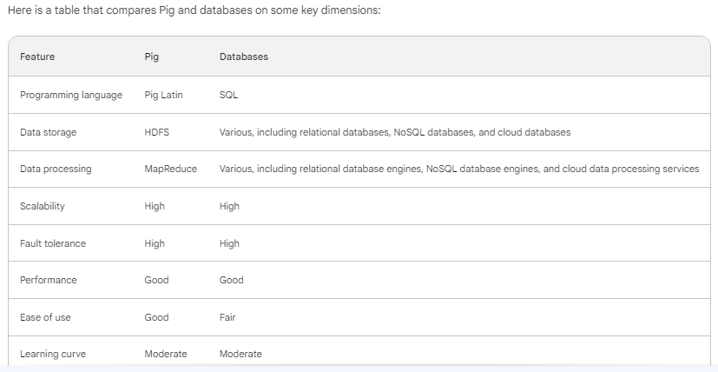
Comparison Pig Vs Databases

Slide 11
advantages of using Pig over databases:-
Pig is easier to use than SQL, especially for users with no prior experience with SQL.
Pig is more flexible than databases, as it can be used to process and analyze data from a variety of sources, including HDFS, local file systems, and relational databases.
Pig is more scalable than databases, as it can be used to process large datasets on Hadoop clusters.

Slide 12
Pig Latin
Apache Pig's Pig Latin is a High-level Programming Language that makes it easy to Process And Analyze large datasets.
Pig Latin scripts are compiled into MapReduce jobs, which are then executed on Hadoop nodes.
Pig Latin is a dataflow language, which means that it describes how data should be processed, but not how it should be implemented.
This makes Pig Latin easy to learn and use, even for users with no prior experience with Hadoop or MapReduce.

Slide 13
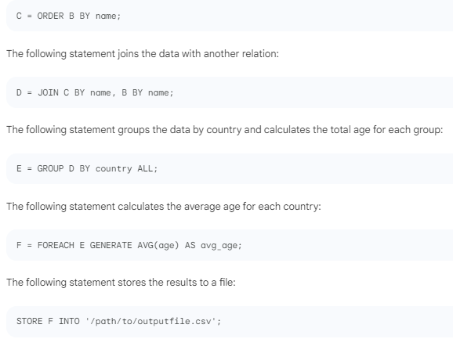

Slide 14
User defined functions
User defined functions (UDFs) are Custom Functions that can be written to perform Complex Data Processing Tasks.
UDFs can be written in Java, Python, JavaScript, Ruby, And Groovy.
Java UDFs are the most efficient and widely used.
To write a UDF, you need to create a Java class that implements the org.apache.pig.EvalFunc interface.
This interface defines a single method, exec(), which is responsible for evaluating the UDF.
The exec() method takes a tuple as input and returns a Pig value as output. The tuple contains the input parameters to the UDF.
The Pig value returned by the exec() method is the output of the UDF.

Slide 15
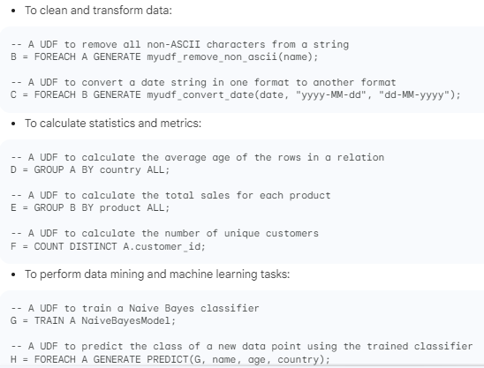

Slide 16
Data processing operators
Apache Pig data processing operators are used to transform data in Pig Latin scripts.
These operators can be classified into the following categories:
Relational Operators: These operators are used to perform common relational operations on data, such as
Loading,
Storing,
Filtering,
Sorting,
Joining And Projecting Data.
Aggregation Operators: These operators are used to perform aggregate calculations on data, such as
Counting,
Summing,
Averaging, And Finding The Minimum And Maximum Values.

Slide 17
Map Operators: These operators are used to perform operations on maps, which are Key-value Pairs.
User-defined Functions (UDFs): UDFs are custom functions that can be written to perform complex data processing tasks.
Bag Operators: These operators are used to perform operations on bags, which are Collections Of Data Elements.

Slide 18
Commonly used data processing operators:
LOAD - Loads data from a file system or other data source into a Pig relation.
STORE - Stores data from a Pig relation to a file system or other data source.
FILTER - Selects Tuples from a Pig relation based on a condition.
ORDER BY - Sorts Tuples in a Pig relation based on one or more columns.
JOIN - Joins two or more Pig relations based on a common column.
GROUP BY - Groups tuples in a Pig relation based on one or more columns.
|

Slide 19
SUM - Calculates the sum of a column in a Pig relation.
AVG - Calculates the average of a column in a Pig relation.
MIN - Finds the minimum value in a column in a Pig relation.
MAX - Finds the maximum value in a column in a Pig relation.
FOREACH - Applies a transformation to each tuple in a Pig relation.
COGROUP - Groups tuples from two or more Pig relations based on a common column and performs a transformation on each group.
DISTINCT - Removes duplicate tuples from a Pig relation.
COUNT - Counts the number of tuples in a Pig relation.

Slide 20
data processing tasks:-
Cleaning And Transforming Data
Calculating Statistics And Metrics
Performing Data Mining And Machine Learning Tasks
Generating Reports And Visualizations
UDFs Can Also Be Used To Integrate Pig With Other Systems, Such As Relational Databases And NoSQL Databases.

