Slide 1
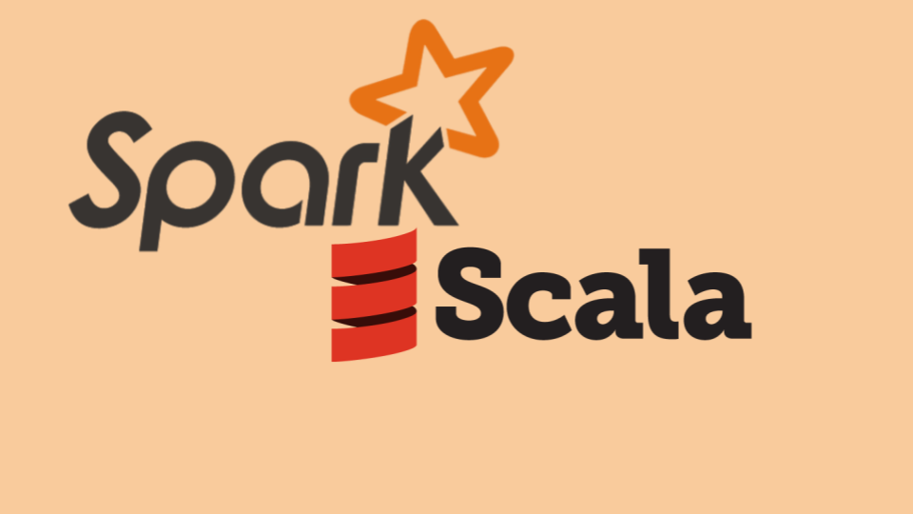
Unit - V

Slide 2
Scala
Scala is a General-purpose Programming Language that supports both Functional And Object-oriented Programming styles.
It is designed to be concise, expressive, and scalable.
Scala is Compiled To Java Byte Code, so it can run on any Java Virtual Machine (JVM).
Scala is often used for
Developing Web Applications
Distributed Systems
Big Data Processing Applications.
It is also used in academia and research for developing new programming language features and tools.

Slide 3
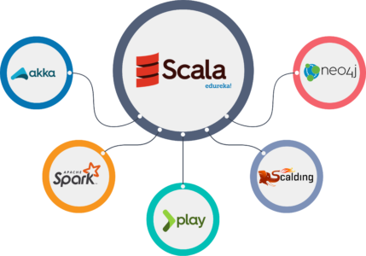
Popular Scala Frameworks And Libraries
Play Framework: A web application framework
Akka: A distributed systems framework
Spark: A big data processing framework
Scalatra: A web framework
Slick: A database access library

Slide 4
Some Of The Key Features Of Scala Include:
Conciseness: Scala is a very concise language, thanks to its powerful expressiveness and support for functional programming.
This makes it possible to write code that is shorter and easier to read than code written in other languages.
Expressiveness: Scala is a very expressive language, thanks to its support for higher-order functions, closures, and pattern matching.
This makes it possible to write code that is more concise and elegant.
Scalability: Scala is a scalable language, thanks to its support for multithreading and asynchronous programming.
This makes it possible to write code that can handle large amounts of data and traffic.
Interoperability: Scala is interoperable with Java, so it can be used to develop applications that run on the JVM.
This makes it easy to integrate Scala code with existing Java code.

Slide 5
Important Thing for Any Programming Language
Environmental Set-up
  Java Development Kit (JDK)
  Scala Compiler
  Integrated Development Environment (IDE) – Graphical Interface
  Once you have installed the necessary software, you can start setting up your Scala development environment.
  Setting the Environmental Variables
  Verifying the Installation
  Configure the IDE
Code - Syntax
Data types

Slide 6
Scala – Environment Setup
To set up a Scala development environment, you will need to install the following:
Java Development Kit (JDK): Scala is a JVM language, so you will need to have a JDK installed on your system.
You can download the JDK from the Oracle website.
Scala Compiler: The Scala compiler is used to compile Scala code into Java byte code.
You can download the Scala compiler from the Scala website.
Integrated Development Environment (IDE): An IDE is a software application that provides a graphical user interface for writing, editing, compiling, and debugging code.
Some popular IDEs for Scala development include IntelliJ IDEA, Eclipse, and Visual Studio Code.

Slide 7
Once you have installed the necessary software, you can start setting up your Scala development environment.
Step 1: Set the JAVA_HOME environment variable
The JAVA_HOME environment variable points to the directory where the JDK is installed. To set the JAVA_HOME environment variable, follow these steps:
Open a terminal window.
Enter the following command:
export JAVA_HOME=/path/to/jdk/installation/directory
Replace /path/to/jdk/installation/directory with the actual path to the JDK installation directory.
Step 2: Set the SCALA_HOME environment variable
The SCALA_HOME environment variable points to the directory where the Scala compiler is installed. To set the SCALA_HOME environment variable, follow these steps:
Open a terminal window.
Enter the following command:
export SCALA_HOME=/path/to/scala/installation/directory
Replace /path/to/scala/installation/directory with the actual path to the Scala compiler installation directory.

Slide 8
Step 3: Set the PATH environment variable
The PATH environment variable lists the directories that the shell will search for executable programs. To add the Scala compiler and the Java bin directory to the PATH environment variable, follow these steps:
Open a terminal window.
Enter the following command:
export PATH=$PATH:$SCALA_HOME/bin:$JAVA_HOME/bin
This will add the Scala compiler and the Java bin directory to the end of the PATH environment variable.
Step 4: Verify the installation
Once you have set the environment variables, you can verify that the Scala compiler is installed correctly by running the following command:
Scala
If the Scala compiler is installed correctly, you should see the Scala REPL start up.

Slide 9
Step 5: Configure your IDE
If you are using an IDE for Scala development, you will need to configure the IDE to use the Scala compiler and the Java JDK.
The specific steps involved in configuring your IDE will vary depending on the IDE that you are using.
Please consult the IDE's documentation for instructions on how to configure it for Scala development.
Once you have configured your IDE, you are ready to start writing Scala code!
Or

Slide 10
Once you have installed the JDK, SBT, and IntelliJ IDEA, you can set up your Scala development environment as follows:
Open IntelliJ IDEA and create a new Scala project.
When prompted, select the Scala version that you want to use.
IntelliJ IDEA will create a new Scala project for you.
To import SBT into your project, right-click on the project node in the Project view and select Import Build.
In the Import Build dialog box, select SBT and click Next.
In the next dialog box, select the SBT version that you want to use and click Finish.
Once you have imported SBT into your project, you can start writing Scala code. To run your Scala code, you can use the SBT console. To open the SBT console, click on the Run tab in IntelliJ IDEA and select SBT Console.

Slide 11
Scala – Basic Syntax
Here is an overview of the basic syntax of Scala:
Variables And Types
To declare a variable in Scala, you use
the val keyword for immutable variables
the var keyword for mutable variables.
The type of the variable is inferred by the compiler, but you can also explicitly specify the type using a colon (:).
For example:
val name = "Alice" // immutable variable of type String
var age = 25 // mutable variable of type Int

Slide 12
2. Functions
To define a function in Scala, you use the def keyword.
The function parameters are listed in parentheses after the function name, followed by an arrow (=>) and the return type of the function.
For Example:
def add(a: Int, b: Int): Int = {
a + b
}
To call a function in Scala, you simply type the function name followed by the function arguments in parentheses. For example:
val result = add(1, 2) // result will be 3

Slide 13
3. Classes and Objects
To define a class in Scala, you use the class keyword.
The class definition includes the class name, followed by a colon (:), followed by the class parameters, if any.
The class body contains the class members, such as fields and methods. For example:
class Person(name: String, age: Int) {
def greet(): Unit = {
println("Hello, my name is " + name)
}
}
Here Are Some Additional Tips For Writing Scala Code:
Scala is a case-sensitive language.
Scala code is indented using spaces, not tabs.
Scala uses the semicolon (;) to separate statements, but semicolons are optional at the end of a line.
Scala uses the curly braces ({ and }) to enclose blocks of code.

Slide 14
Scala – Data Types
Scala has a rich set of data types, including primitive types, reference types, and functional types.
Primitive Types are the basic building blocks of Scala code. They include:
Numeric Types: Byte, Short, Int, Long, Float, Double
Boolean Type: Boolean
Character Type: Char
Reference Types are objects that can be referenced by other objects. They include:
String: A sequence of characters
Array: A fixed-size collection of elements
List: A linked list of elements
Set: A collection of unique elements
Map: A collection of key-value pairs

Slide 15
Functional Types are functions that can be passed around as values and used as arguments to other functions. They include:
Function Types: A function type takes one or more arguments and returns a value
Unit: The unit type is used for functions that do not return a value
In addition to these built-in data types, Scala also allows users to define their own Custom Data Types.

Slide 16
Examples Of How To Use Data Types In Scala
// Primitive Types
val myAge: Int = 2
val myName: String = "Bard"
val myPi: Double = 3.14159
// Reference Types
val myArray: Array[Int] = Array(1, 2, 3, 4, 5)
val myList: List[String] = List("one", "two", "three")
val mySet: Set[Int] = Set(1, 2, 3)
val myMap: Map[String, Int] = Map("one" -> 1, "two" -> 2)
// Functional Types
def addTwoNumbers(a: Int, b: Int): Int = a + b
val myFunction: Int => Int = addTwoNumbers

Slide 17
Scala - Functions
Functions are one of the most important concepts in Scala. They allow you to encapsulate code and reuse it throughout your program.
Functions can also be returned from other functions. This is called recursion.
For example:
def factorial(n: Int): Int = {
if (n == 0) 1
else n * factorial(n - 1)
}
This function calculates the factorial of a number.
It is recursive because it calls itself to calculate the factorial of the number minus one.

Slide 18
2. Functions can be passed as arguments to other functions.
This is called higher-order programming.
For example:
def map(list: List[Int], function: Int => Int): List[Int] = {
list.map(function)
}
This function takes a list of integers and a function that takes an integer as an argument and returns an integer as an argument, and it returns a new list of integers where each element of the new list is the result of applying the function to the corresponding element of the original list.
3. You can also define anonymous functions in Scala. Anonymous functions are functions that do not have a name.
They are defined using the => operator.
For example
val myFunction = (a: Int, b: Int) => a + b

Slide 19
Additional Tips For Working With Functions In Scala:
Scala Functions Are First-class Values - This means that they can be assigned to variables, passed as arguments to other functions, and returned from other functions.
Scala Functions Can Be Curried - This means that a function with multiple parameters can be applied to its parameters one at a time.
Scala Functions Can Be Partially Applied - This means that you can call a function with a subset of its parameters and then pass the remaining parameters later.

Slide 20
Scala – Pattern Matching
Pattern matching is a powerful feature in Scala that allows you to deconstruct data and match it against different patterns.
It is similar to the switch statement in Java and C, but it is much more powerful and flexible.
To use pattern matching, you use the match expression.
The match expression takes an expression as an argument and then compares it against a series of patterns.
If the expression matches one of the patterns, then the code associated with that pattern is executed.

Slide 21
Example 1:-
val dayOfWeek = "Monday"
dayOfWeek match {
case "Monday" => println("Happy Monday!")
case "Tuesday" => println("Have a great Tuesday!")
case "Wednesday" => println("Happy Hump Day!")
case "Thursday" => println("Almost there!")
case "Friday" => println("TGIF!")
case _ => println("Have a great weekend!")
}
This code will print the message "Happy Monday!" to the console.

Slide 22
Example 2:-
val myList = List(1, 2, 3, 4, 5)
myList match {
case Nil => println("The list is empty.")
case head :: tail => println("The first element of the list is " + head)
}
This code will print the message "The first element of the list is 1" to the console

