Slide 1
Apache Spark
UNIT- V

Slide 2
Apache Spark
Apache Spark is an open-source unified analytics engine for Large-scale Data Processing.
It provides high-level APIs in Java, Scala, Python, and R, and an optimized engine that supports general Execution Graphs for data analysis.
It also Supports a rich set of higher-level tools including
  Spark SQL For SQL And Data Frames
  Pandas API On Spark For Pandas Workloads
  MLlib For Machine Learning
  GraphX For Graph Processing
  Structured Streaming For Incremental Computation And Stream Processing.

Slide 3
Spark Is In Companies And Organizations For A Variety Of Data Processing Tasks:-
Data Warehousing And Analytics: Spark can be used to build data warehouses and perform complex analytics on large datasets.
Machine Learning: Spark provides a variety of machine learning libraries that can be used to train and deploy machine learning models.
Graph Processing: Spark can be used to process and analyze large graphs.
Stream Processing: Spark can be used to process and analyze streaming data in real time.

Slide 4
Benefits Of Using Apache Spark:-
Fast: Spark is very fast at processing large datasets. It can be up to 100x faster than Hadoop for certain workloads.
Scalable: Spark can scale to very large datasets and clusters.
Unified: Spark provides a unified platform for batch processing, stream processing, SQL, machine learning, and graph processing.
Easy To Use: Spark has a simple and easy-to-use API.
Open Source: Spark is open source software, which means that it is free to use and modify.

Slide 5
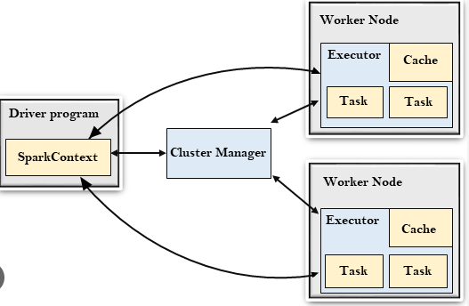
Apache Spark Architecture

Slide 6
Installation Steps
To install Apache Spark, you will need to have the following prerequisites installed:
Java 8 Or Later
Scala 2.12 Or Later
Once you have the prerequisites installed, you can follow these steps to install Apache Spark:
Download the latest version of Apache Spark from the Apache Spark website.
Extract the Spark Archive to a desired location.
Set the SPARK_HOME environment variable to the directory where you extracted the Spark archive.
Add the Spark Binaries to your PATH environment variable.
Verify the Spark installation by running the following command:
spark-shell
If the Spark shell starts up successfully, then Spark is installed correctly.

Slide 7
Additional steps for Windows & Cluster mode:-
Install Python (optional, if you want to use PySpark).
Add the WinUtils executable file to your PATH environment variable.
The WinUtils executable file can be found in the bin directory of the Spark archive.
Additional steps for Cluster Mode:
If you want to use Spark in cluster mode, you will need to install a cluster manager such as Hadoop YARN or Apache Mesos.
Once you have a cluster manager installed, you can configure Spark to use it by setting the SPARK_MASTER environment variable to the address of the cluster manager.

Slide 8
Example:
To configure Spark To Use YARN, you would set the SPARK_MASTER environment variable to yarn-cluster.
Example:
To configure Spark To Use Mesos, you would set the SPARK_MASTER environment variable to mesos://localhost:5050.
Once you have configured Spark To Use A Cluster Manager, you can start a Spark cluster by running the following command:
start-all.sh
This will start the Spark driver and worker nodes.
Once the Spark cluster is started, you can submit Spark jobs to it using the spark-submit command.

Slide 9
Example:
To submit a Spark job that Reads A File From HDFS And Writes It To Another HDFS Location, you would run the following command:
spark-submit --master yarn-cluster --class your_class.YourClass your_jar_file.jar
This will submit the Spark job to the YARN cluster. The Spark job will then be executed on the cluster nodes.

Slide 10
Distributed Datasets - RDD
Apache Spark distributed datasets are a key feature of the Spark framework.
They allow Spark to process large datasets in parallel across multiple nodes in a cluster.
This makes Spark much faster than traditional data processing frameworks such as Hadoop.
Spark distributed datasets are called resilient distributed datasets (RDDs).
It is the fundamental data structure of Apache Spark.
RDDs are immutable, meaning that they cannot be changed once they are created.
This makes them fault-tolerant, meaning that Spark can recover from node failures without losing data.

Slide 11
RDDs can be created from a variety of sources, including:-
External storage systems such as HDFS, Cassandra, and HBase
Existing Scala collections
Parallelized Java collections
Once an RDD is created, it can be transformed using a variety of operations, such as:
Map: Applies a function to each element of the RDD
Reduce: Combines the elements of the RDD into a single value
Filter: Selects a subset of the elements of the RDD
Join: Combines two RDDs based on a common key.

Slide 12
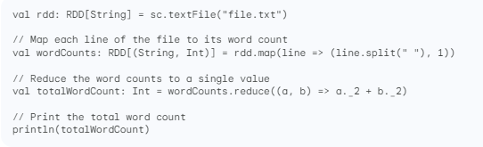
RDDs can also be persisted in memory or on disk, which allows them to be reused across multiple operations.
This can significantly improve the performance of Spark applications.
Here is an example of a simple Spark application that uses RDDs to process a text file:

Slide 13
This application will read the file file.txt from HDFS, split each line into words, and count the number of occurrences of each word.
The word counts will then be reduced to a single value, which is the total number of words in the file.
Finally, the total word count will be printed to the console.
Spark distributed datasets are a powerful tool for processing large datasets in parallel.
They are fault-tolerant, scalable, and easy to use.
Spark Distributed Datasets Are One Of The Reasons Why Spark Is Such A Popular Data Processing Framework.

Slide 14
Shared Variables
Apache Spark provides two types of shared variables:
Broadcast Variables
Accumulators.
Broadcast Variables are used to cache a value in memory on all nodes in the cluster.
This can be useful for large values that need to be shared by many tasks, such as a lookup table or a machine learning model.
To create a broadcast variable, you can use the SparkContext.broadcast() method.
Accumulators are used to aggregate values across multiple tasks.
This can be useful for tasks such as counting the number of elements in an RDD or calculating the sum of the values in an RDD.
To create an accumulator, you can use the SparkContext.accumulator() method.

Slide 15
Shared variables are important in Spark because they allow tasks to communicate with each other and share data.
This can be useful for a variety of tasks, such as
  Machine Learning,
  Graph Processing
  Stream Processing.

Slide 16
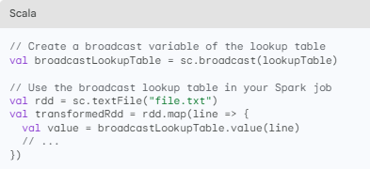
Here are some examples of how to use shared variables in Spark:
Example 1: Using a broadcast variable to cache a lookup table

Slide 17
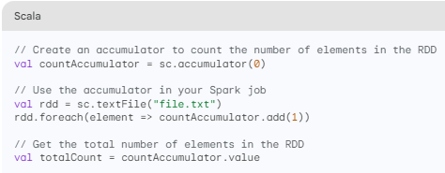
Example 2: Using an accumulator to count the number of elements in an RDD

Slide 18
Shared variables can be a powerful tool for improving the performance and scalability of your Spark applications.
However, it is important to use them carefully, as they can also introduce overhead and complexity.
Here Are Some Tips For Using Shared Variables In Spark:-
Use broadcast variables - cache large values that need to be shared by many tasks.
Use accumulators - aggregate values across multiple tasks.
Be careful not to overuse shared variables, as they can introduce overhead and complexity.
Consider using an alternative approach, such as RDD persistence, if you need to share data between tasks.

Slide 19
Anatomy Of Spark Job Run
A Spark job run is a sequence of steps that Apache Spark takes to process data and produce results.
It is made up of three main components:
  The Driver
  The Cluster Manager
  The Executors
Driver
The driver is the responsible for Co-Ordinating The Execution Of The Job.
It converts the user's code into a logical plan, which is then divided into smaller execution units called tasks.
The driver then schedules these tasks to be executed on the executors.

Slide 20
Cluster Manager
The cluster manager is responsible for Managing The Resources in the Spark cluster.
It allocates resources to the driver and executors, and it monitors their health.
The cluster manager also handles failures, such as when an executor crashes.
Executors
The executors are the ones that Actually Execute The Tasks.
They run on the worker nodes in the cluster, and they are responsible for processing the data and producing results.

Slide 21
Anatomy Of A Spark Job Run:-
A Spark Job Run Typically Follows These Steps:-
The user submits the Spark job to the cluster manager.
The cluster manager allocates resources to the driver and executors.
The driver converts the user's code into a logical plan and divides it into tasks.
The driver schedules the tasks to be executed on the executors.
The executors execute the tasks and produce results.
The driver collects the results from the executors and returns them to the user.

Slide 22
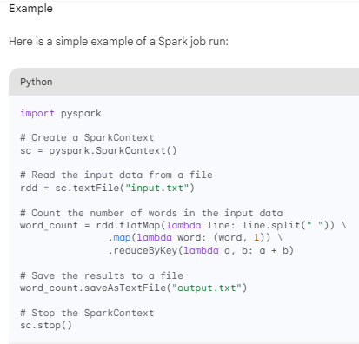
This job will read the input data from the file input.txt, count the number of words in the data, and save the results to the file output.txt.

Slide 23
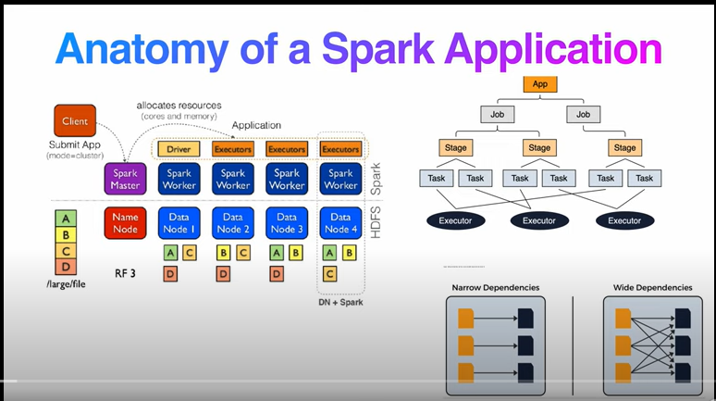

Slide 24
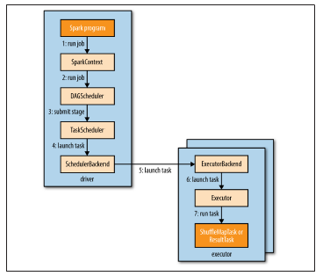
How Spark Runs a job

Slide 25
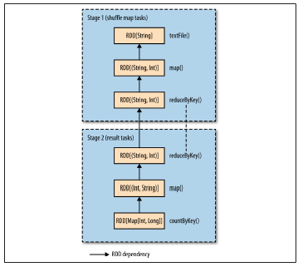
The stages and RDDs in a Spark job for calculating a histogram of word
counts

Slide 26
Anatomy Of A Spark Job
A Spark job is made up of a sequence of transformations and actions. Transformations are operations that create new RDDs from existing RDDs. Actions are operations that return results to the user.
An RDD (Resilient Distributed Dataset) is a distributed collection of data elements. RDDs are partitioned across the worker nodes in the Spark cluster.
This allows Spark to process large datasets in parallel.
Stages And Tasks
A Spark job is divided into stages.
A stage is a group of tasks that can be executed independently of each other. Tasks are the smallest units of work in a Spark job.

Slide 27
Lazy Evaluation
Spark uses lazy evaluation.
This means that Spark does not actually execute any transformations or actions until the user calls an action.
This allows Spark to optimize the execution of the job.
Fault Tolerance
Spark is fault-tolerant.
This means that if an executor fails, Spark can reschedule the tasks that were running on that executor to other executors.
This ensures that the job will complete even if some of the executors fail.

Slide 28
Performance Optimization:-
Spark has a number of features that can be used to optimize the performance of jobs. These features include:
In-Memory Caching: Spark can cache RDDs in memory. This can improve the performance of jobs that need to access the same data multiple times.
Partitioning: Spark can partition RDDs across the worker nodes in the cluster. This allows Spark to process large datasets in parallel.
Narrow And Wide Transformations: Spark distinguishes between narrow and wide transformations.
Narrow transformations can be executed without shuffling data between executors.
Wide transformations require data to be shuffled between executors.
Spark optimizes the execution plan of jobs to minimize the amount of shuffling.

