Slide 1
Big Data Analytics And Applications
Unit - 1

Slide 2
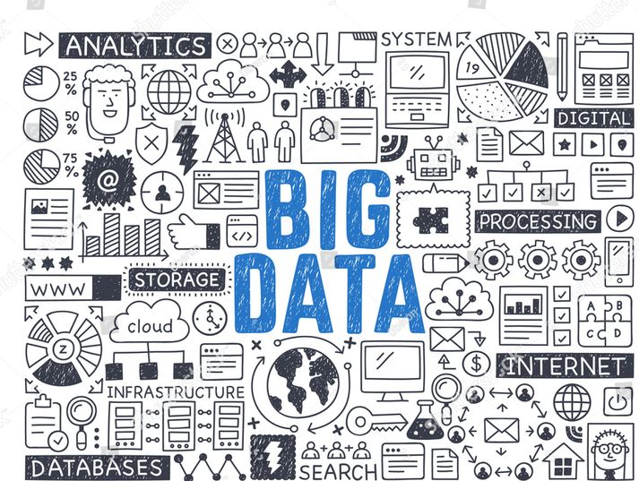
What is Big Data ?
Collection of data in huge volumes, growing exponentially with time.

Slide 3
Need of Big Data
We cannot effectively process or manage the data using traditional data processing tools.
To get insights, patterns & trends for huge data, previously it is not possible.
Industries like healthcare, finance and research also rely on big data to improve operational efficiency.

Slide 4
Range of data
Small –
    Individual Person data
Medium –
    Local Supply Chain
Big –
    National Level Retail Store – D-Mart, Reliance Mart
Vast –
    International Retail Store – Walmart
    Social Media – Facebook, Twitter, YouTube, Instagram
All decisions taken today are data driven decisions only.

Slide 5
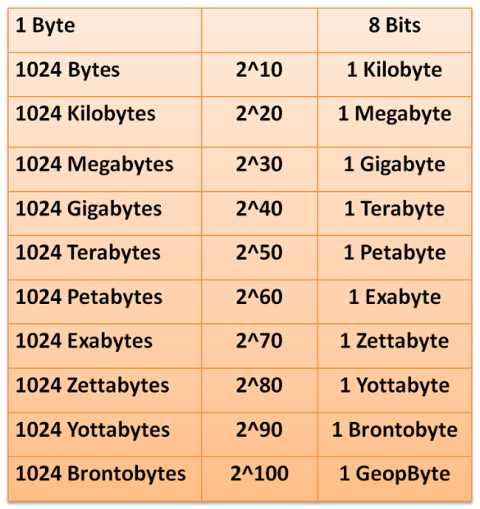
Data Unit Conversions
Low Quality image size = 2KB
High Quality image size = 2MB

Slide 6
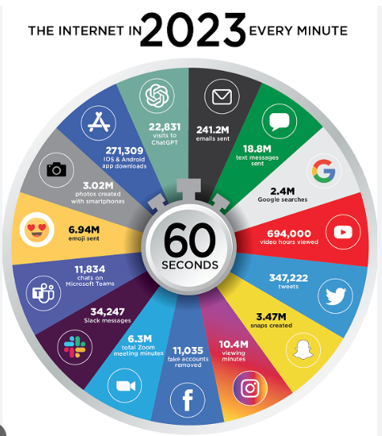
Big Data Every Minute

Slide 7
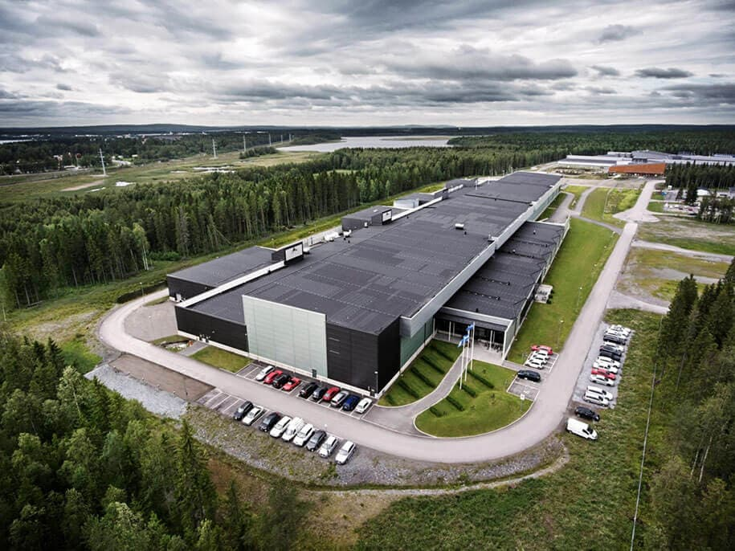
Big Data Storage (Facebook)
18 Data Centers
40 Million Sq. Feet
$ 20 Billion
4 Petabytes / day
(10 lakh GB)
50 crore high quality
images /day

Slide 8
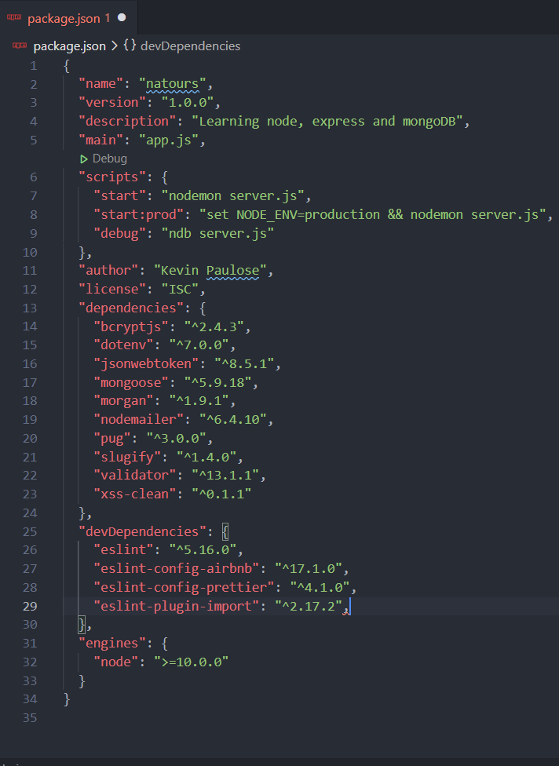
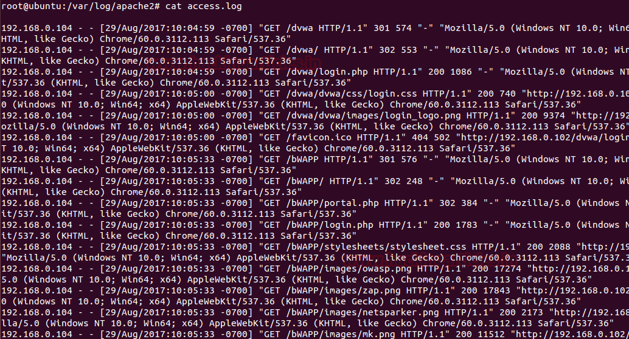
Types of Data
Structured Data - CVS Files, Excel Files
Un-Structured Data – Text, Images, Audio, Video
Semi-Structured Data - xml, Json files, server logs

Slide 9
Characteristics of Big Data
Volume - How much volume of data is getting generated
Variety - How many different varieties of data (Structured, Un-Structured & Semi- Structured Example: Emails, photos,
PDF, images, Audio, Video
Velocity - How fast the data is getting generated.
Veracity - How much data is reliable (Quality & consistent)
Value - How much data is useful that we store, process &
analyze
Variability - How fast the data is changing.

Slide 10
Big Data Framework - Hadoop
Apache Hadoop
    HDFS –
      Hadoop Distributed File System
      It provides data across the cluster (computers that work together)
    Map Reduce-
      To process the data in parallel across the cluster.
      We can use Java, Python programming Languages and Framework like Apache Spark.
    YARN – Yet Another Resource Negotiator
      Resource Allocation for various applications

Slide 11
Apache & Apache Spark
ASF – Apache Software Foundation
It supports wide range of open source software projects
Hadoop is also a part of Apache Foundation only.
Apache Spark:-
Developed as an alternative to Map-Reduce used in Hadoop.
Both will be used for data processing only.
It can handle real-time processing & offers better performance compared to Map-Reduce.
Also a part of Hadoop eco-system.

Slide 12
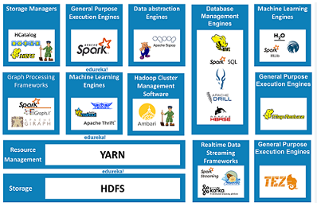
Hadoop Eco-System For Big Data

Slide 13
Data Analytics
Process of analyzing raw data to get insights and find patterns about information by using various techniques and processes.
Types of Data Analytics:-
Descriptive – Just prepare dashboards & track performance.
Predictive – Utilizing historical data & predict the future trends
Prescriptive – suggest strategies & outcomes like Dis-counts, Non-Seasonal items.

Slide 14
Examples of Analytics
Retail and E-Commerce:
  Market Basket Analysis
  Price Optimization
Healthcare:
  Predictive Analytics for Patient Outcomes
  Fraud Detection
  Drug Discovery
Finance and Banking:
  Credit Risk Assessment
  Algorithmic Trading – Stock Market
  Fraud Prevention
Manufacturing and Supply Chain:
  Demand Forecasting

Slide 15
Examples of Analytics
Transportation and Logistics:
  Route Optimization – OLA, UBER
  Vehicle Telematics – Monitor Vehicle Performance
Government and Public Services:
  Crime Analysis - Patterns
  Public Health Surveillance- Diseases
Marketing and Advertising:
  Social Media Analytics – Sentiment Analysis
  Customer Churn Prediction – Customers Retain

Slide 16
Big Data Architecture - Evolution
                Traditional Databases
                (Struggled to handle variety of data generated)
                Data Warehouses
                (Store data from various resources)
                Hadoop and Map Reduce
                (Distributed Storage & Parallel Processing)
                No-SQL Databases
                (for Un-Structured Data- Mongo DB, Cassandra)

Slide 17
Big Data Architecture - Evolution
                In-Memory Computing
                (Faster data processing – Apache Spark)
                Stream Processing)
                (Real time data processing – Apache Kafka)
                Serverless Computing and Cloud Services
                (AWS, GCP, Azure – Scalable Infrastructure )
                AI & ML Integration
                (Frameworks like Tensor flow and Py-Torch are incorporated)

