Slide 1
Big Data Analytics And Applications
Introduction

Slide 2
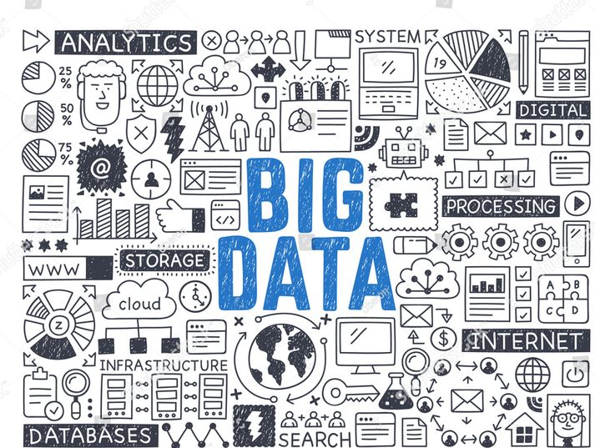
What is Big Data ?
Collection of data in huge volumes, growing exponentially with time.

Slide 3
Need of Big Data
We cannot effectively process or manage the data using traditional data processing tools.
To get insights, patterns & trends for huge data, previously it is not possible.
Industries like healthcare, finance and research also rely on big data to improve operational efficiency.

Slide 4
Range of data
Small –
    Individual Person data
Medium –
    Local Supply Chain
Big –
    National Level Retail Store – D-Mart, Reliance Mart
Vast –
    International Retail Store – Walmart
    Social Media – Facebook, Twitter, YouTube, Instagram
All decisions taken today are data driven decisions only.

Slide 5
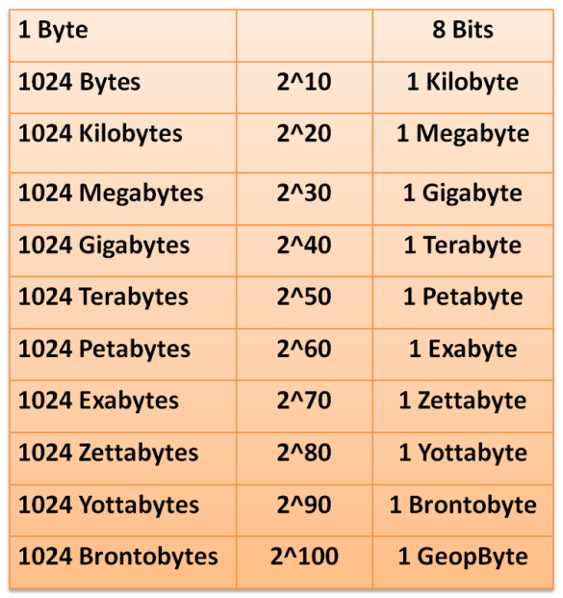
Data Unit Conversions
Low Quality image size = 2KB
High Quality image size = 2MB

Slide 6
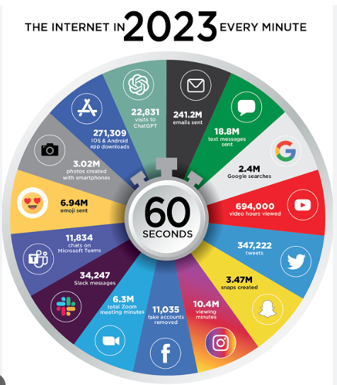
Big Data Every Minute

Slide 7
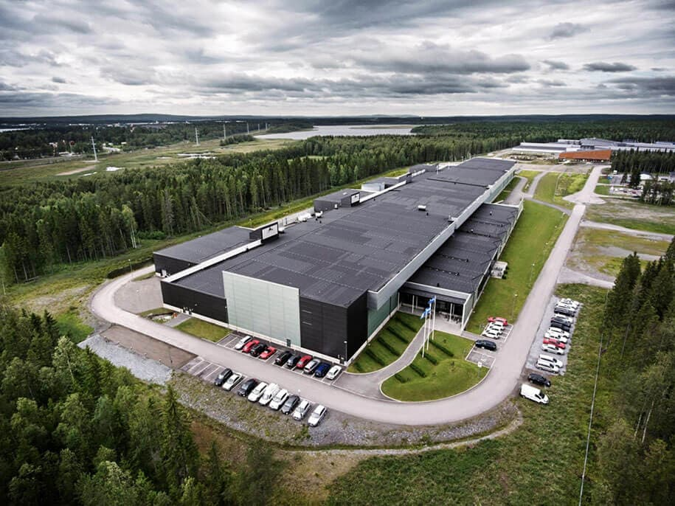
Big Data Storage (Facebook)
18 Data Centers
40 Million Sq. Feet
$ 20 Billion
4 Petabytes / day
(10 lakh GB)
50 crore high quality
images /day

Slide 8
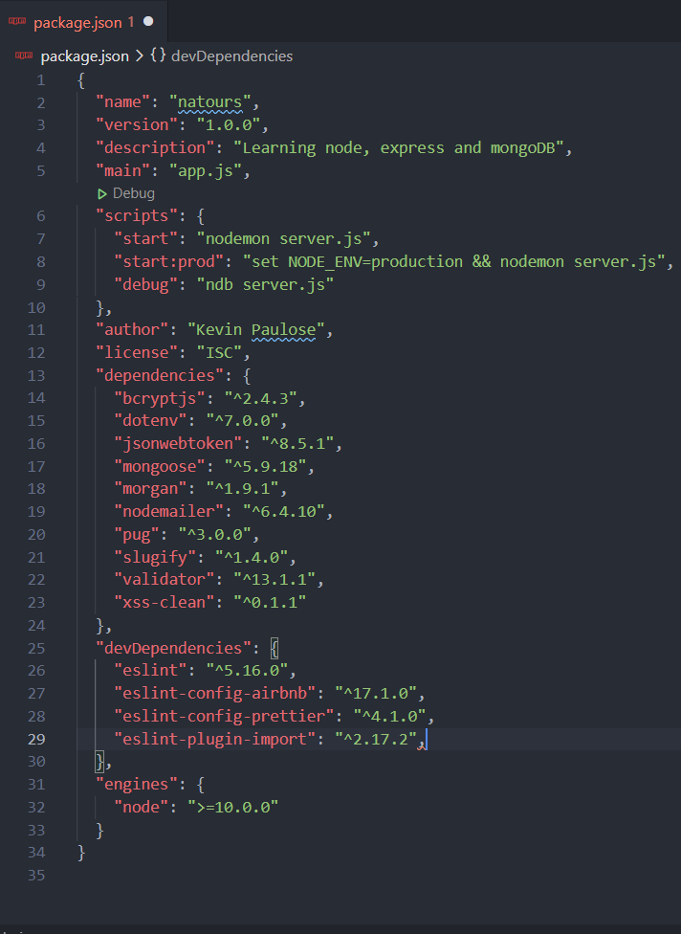
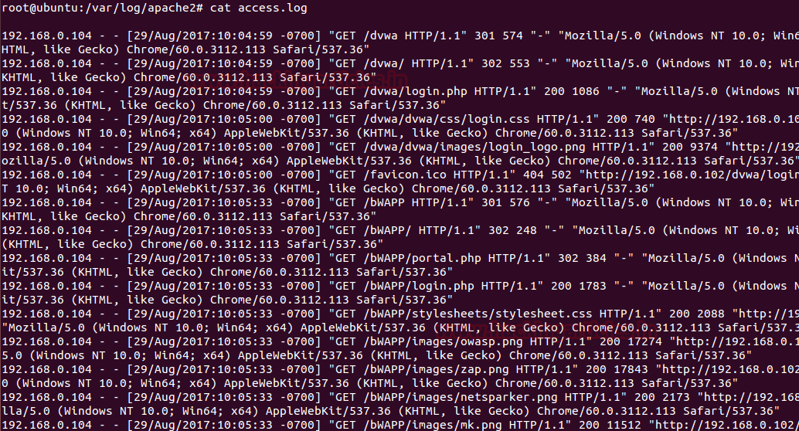
Types of Data
Structured Data - CVS Files, Excel Files
Un-Structured Data – Text, Images, Audio, Video
Semi-Structured Data - xml, Json files, server logs

Slide 9
Characteristics of Big Data
Volume - How much volume of data is getting generated
Variety - How many different varieties of data (Structured, Un-Structured & Semi- Structured Example: Emails, photos,
PDF, images, Audio, Video
Velocity - How fast the data is getting generated.
Veracity - How much data is reliable (Quality & consistent)
Value - How much data is useful that we store, process &
analyze
Variability - How fast the data is changing.

Slide 10
Big Data Framework - Hadoop
Apache Hadoop
    HDFS –
      Hadoop Distributed File System
      It provides data across the cluster (computers that work together)
    Map Reduce-
      To process the data in parallel across the cluster.
      We can use Java, Python programming Languages and Framework like Apache Spark.
    YARN – Yet Another Resource Negotiator
      Resource Allocation for various applications

Slide 11
Apache & Apache Spark
ASF – Apache Software Foundation
It supports wide range of open source software projects
Hadoop is also a part of Apache Foundation only.
Apache Spark:-
Developed as an alternative to Map-Reduce used in Hadoop.
Both will be used for data processing only.
It can handle real-time processing & offers better performance compared to Map-Reduce.
Also a part of Hadoop eco-system.

Slide 12
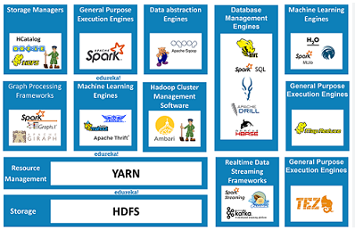
Hadoop Eco-System For Big Data

