Slide 1
Big Data Analytics And Applications
Unit - 1
Part -1

Slide 2

What is Big Data ?
Collection of data in huge volumes, growing exponentially with time.

Slide 3
Need of Big Data
We cannot effectively process or manage the data using traditional data processing tools.
To get insights, patterns & trends for huge data, previously it is not possible.
Industries like healthcare, finance and research also rely on big data to improve operational efficiency.

Slide 4
Range of data
Small –
    Individual Person data
Medium –
    Local Supply Chain
Big –
    National Level Retail Store – D-Mart, Reliance Mart
Vast –
    International Retail Store – Walmart
    Social Media – Facebook, Twitter, YouTube, Instagram
All decisions taken today are data driven decisions only.

Slide 5
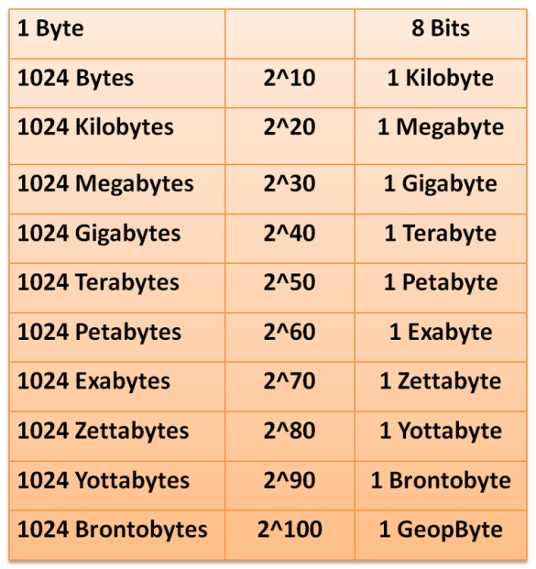
Data Unit Conversions
Low Quality image size = 2KB
High Quality image size = 2MB

Slide 6
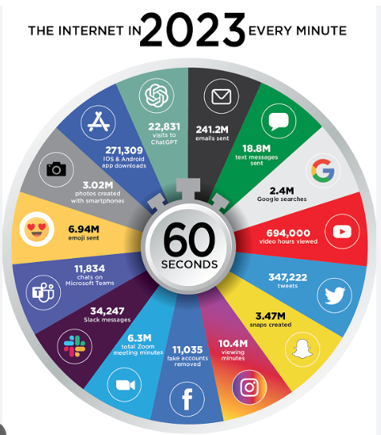
Big Data Every Minute

Slide 7
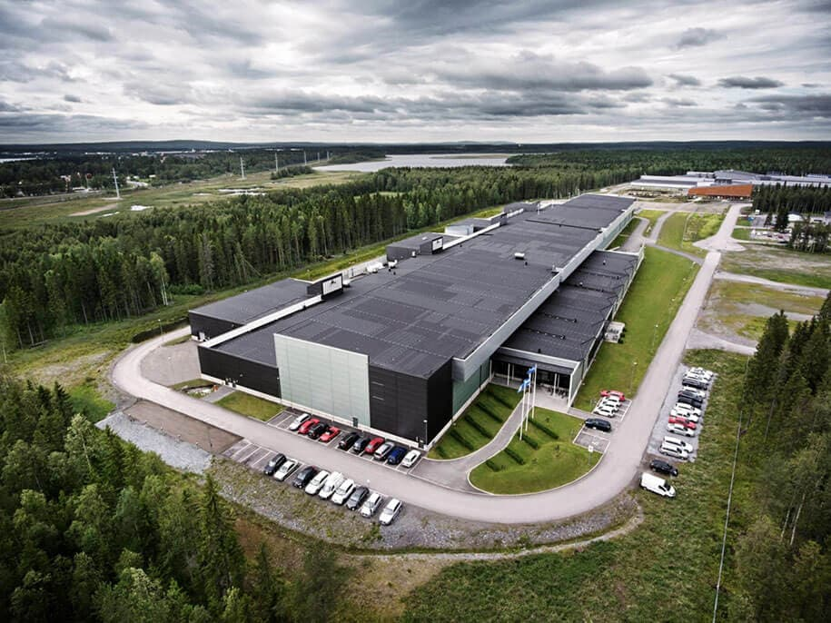
Big Data Storage (Facebook)
18 Data Centers
40 Million Sq. Feet
$ 20 Billion
4 Petabytes / day
(10 lakh GB)
50 crore high quality
images /day

Slide 8
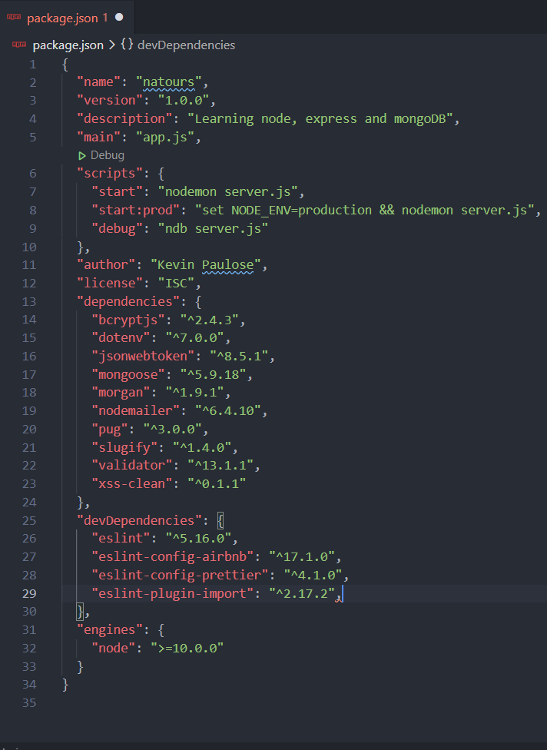
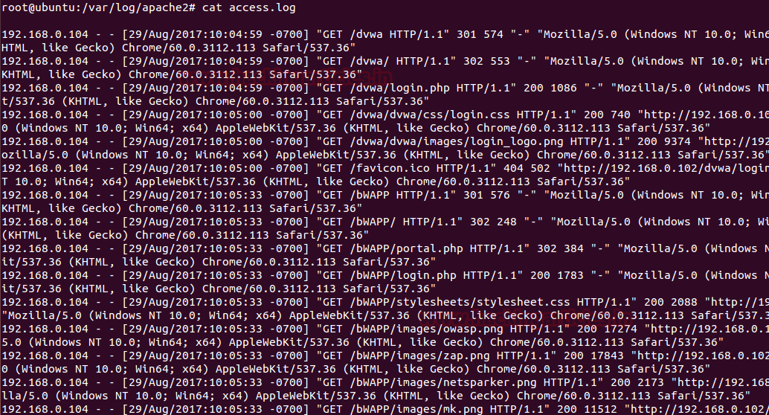
Types of Data
Structured Data - CVS Files, Excel Files
Un-Structured Data – Text, Images, Audio, Video
Semi-Structured Data - xml, Json files, server logs

Slide 9
Characteristics of Big Data
Volume - How much volume of data is getting generated
Variety - How many different varieties of data (Structured, Un-Structured & Semi- Structured Example: Emails, photos,
PDF, images, Audio, Video
Velocity - How fast the data is getting generated.
Veracity - How much data is reliable (Quality & consistent)
Value - How much data is useful that we store, process &
analyze
Variability - How fast the data is changing.

Slide 10
Big Data Framework - Hadoop
Apache Hadoop
    HDFS –
      Hadoop Distributed File System
      It provides data across the cluster (computers that work together)
    Map Reduce-
      To process the data in parallel across the cluster.
      We can use Java, Python programming Languages and Framework like Apache Spark.
    YARN – Yet Another Resource Negotiator
      Resource Allocation for various applications

Slide 11
Apache & Apache Spark
ASF – Apache Software Foundation
It supports wide range of open source software projects
Hadoop is also a part of Apache Foundation only.
Apache Spark:-
Developed as an alternative to Map-Reduce used in Hadoop.
Both will be used for data processing only.
It can handle real-time processing & offers better performance compared to Map-Reduce.
Also a part of Hadoop eco-system.

Slide 12
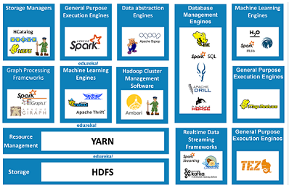
Hadoop Eco-System For Big Data

Slide 13
Data Analytics
Process of analyzing raw data to get insights and find patterns about information by using various techniques and processes.
Types of Data Analytics:-
Descriptive – Just prepare dashboards & track performance.
Predictive – Utilizing historical data & predict the future trends
Prescriptive – suggest strategies & outcomes like Dis-counts, Non-Seasonal items.

Slide 14
Examples of Analytics
Retail and E-Commerce:
  Market Basket Analysis
  Price Optimization
Healthcare:
  Predictive Analytics for Patient Outcomes
  Fraud Detection
  Drug Discovery
Finance and Banking:
  Credit Risk Assessment
  Algorithmic Trading – Stock Market
  Fraud Prevention
Manufacturing and Supply Chain:
  Demand Forecasting

Slide 15
Examples of Analytics
Transportation and Logistics:
  Route Optimization – OLA, UBER
  Vehicle Telematics – Monitor Vehicle Performance
Government and Public Services:
  Crime Analysis - Patterns
  Public Health Surveillance- Diseases
Marketing and Advertising:
  Social Media Analytics – Sentiment Analysis
  Customer Churn Prediction – Customers Retain

Slide 16
Big Data Architecture - Evolution
                Traditional Databases
                (Struggled to handle variety of data generated)
                Data Warehouses
                (Store data from various resources)
                Hadoop and Map Reduce
                (Distributed Storage & Parallel Processing)
                No-SQL Databases
                (for Un-Structured Data- Mongo DB, Cassandra)

Slide 17
Big Data Architecture - Evolution
                In-Memory Computing
                (Faster data processing – Apache Spark)
                Stream Processing)
                (Real time data processing – Apache Kafka)
                Serverless Computing and Cloud Services
                (AWS, GCP, Azure – Scalable Infrastructure )
                AI & ML Integration
                (Frameworks like Tensor flow and Py-Torch are incorporated)

Slide 18
Hadoop Architecture & Hadoop Clustering
Unit -1
Part -2

Slide 19
Hadoop Architecture & Components
Data Storage - HDFS – Hadoop Distributed File System
Resource Management - YARN – Yet Another Resource Negotiation
Processing the Data - Map-Reduce
Data Collection & ingestion – Sqoop & Flume
Queries – Pig (Scripting) & Hive (SQL Queries)
Processing real time streaming data - Apache Spark

Slide 20
Hadoop Architecture & Components
Machine Learning Applications - Mahout
Management & Monitoring – Apache Ambari
Streaming – Kafka (builds) & Apache Storm (Process at a very high speed)
Security – Apache Range & Apache Knox
Work Flow System – Oozie – work flow scheduler to manage Hadoop jobs

Slide 21
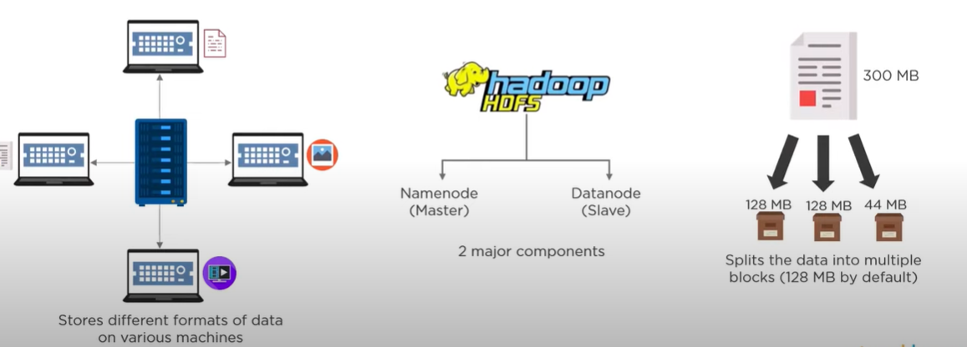
HDFS – Hadoop Distributed File System

Slide 22
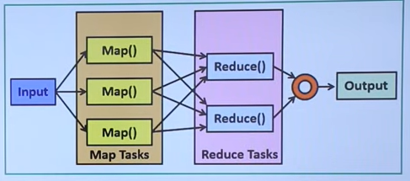
Map Reduce – Processing the data

Slide 23
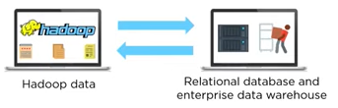
Sqoop - Data Collection – Structured Data
Sqoop is used to share the data between Hadoop and Relational databases, data ware-houses.

Slide 24
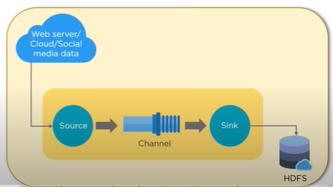
Flume – Data Collection- Un-Structured Data
Flume is a Distributed service for collecting, aggregating and moving large amounts of log data.
It will ingest online streaming data from social media, log files & web server in-to HDFS

Slide 25
Queries
Pig – used to analyze the data in Hadoop.
      Provides a platform for building data flow for ETL ( Extract, Transform & Load) – Data Transformation
Hive – Reading, Writing & managing large datasets which are in a distributed storage using SQL – Query structured data.
      Provides user defined functions for data mining, document indexing, log processing,.. etc

Slide 26
Apache Spark – Processing – Scala
Open source distributed computing engine.
Mainly used for Processing and Analyzing huge volumes of real time data like stock market and banking data.
Works 100x faster than Map Reduce.
Provides In-Memory computation of data.
It can also work individually outside of Hadoop eco-system with it’s own YARN.
By using Py-spark it can also access Python Libraries.

Slide 27
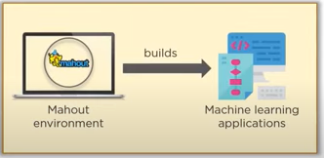
Mahout – Machine Learning
Used to produce free implementations scalable machine learning algorithms focused primarily on linear algebra.

Slide 28
Management & Monitoring- Apache Ambari
It is responsible for keep track of running applications and their statuses.
Just like a Body-Guard.
It provides a central management service to start, stop and configure Hadoop services.

Slide 29
Streaming – Kafka – Scala & Java
Kafka –
Builds real-time streaming data-pipelines that reliably get data between applications.
    Kafka uses messaging system for transferring data from one application to Another application
Builds real-time streaming applications & these applications may transform the data in-to streams.

Slide 30
Streaming – Strom - Clojure
Storm –
It is a processing engine that process real-time streaming data at a very high speed.

Slide 31
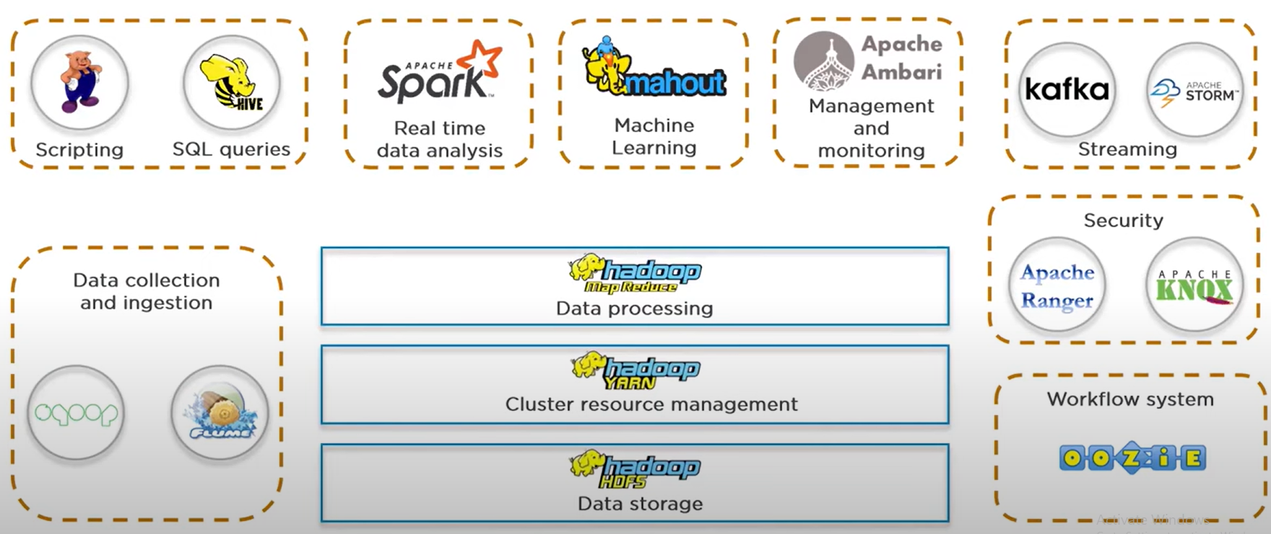
Hadoop Architecture

Slide 32
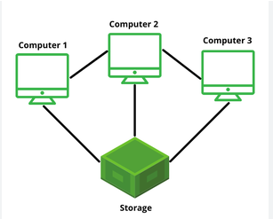
Cluster
Group of inter-connected computers, servers (nodes), or any other computing devices that work together as a single unit to perform various tasks. - Playing Cricket

Slide 33
Hadoop Clustering
Setting and configuring a cluster of computers – Computer Lab.
    Configuring involves several steps to set-up environment correctly for distributed data processing.
      1. Hardware requirement – memory, storage, processing power for each node
      2. Network set-up – Nodes can communicate
      3. Operating System – Linux, Windows, Mac
      4. Java Installation – Hadoop built using java
      5. Hadoop Installation – env. variables like HADOOP_NAME & PATH

Slide 34
Hadoop Clustering - Configuring
      6. Configuration files – For any software application we need these files to store settings, preferences & parameters XML, YAML, JSON
      7. SSH Set-Up –
      Secure Shell or Secure Socket Shell –
      it is a Protocol (rules) that enables 2 computers to communicate.
      8. HDFS, YARN, Map-Reduce
      9. Testing
      10. Security Set-up
      11. Monitoring and Optimization

Slide 35
Advantages
Scalable
Cost Effective
Flexible – can process any data
Fast
Resilient to failure – have back-up option

Slide 36
Hadoop Cluster Architecture
Hadoop Cluster Architecture
      HDFS
      YARN
HDFS – Hadoop Distributed File System
    Name Node – Master Node – Contains Meta Data
    Secondary Name Node – Buffer to Name Node
    Data Node – Slave Node – Store Data

Slide 37
Hadoop Cluster Architecture - HDFC
1. Name Node
  Contains meta-data of name node.
  Responsible for managing health node.
  it always receives heart-beat at a particular interval of time.
  if heart-beat fails, name node will assign to other data node.
  also receives status update of the task assigned.
2. Data Node –
  Responsible for storing the data.
  slaves of Name Node.
3. Secondary Name Node –
  Supports to primary name node.
  Acts as a buffer

Slide 38
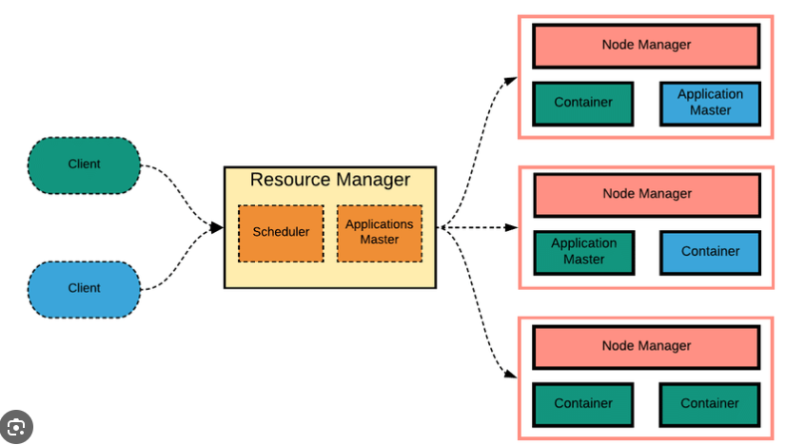
Hadoop Cluster Architecture - YARN
YARN – Yet Another Resource Negotiator
    Node Manager
    App Master
    Container

Slide 39
Hadoop Cluster Architecture - YARN
Resource Manager
    It manages and allocates cluster resources.
    It keeps track of available resources and schedules tasks on different nodes
    Scheduler - Totally dedicated to allocating resources to different applications.
    Application Master - Manages the lifecycle of individual applications, negotiating resources for them and ensuring they run successfully

Slide 40
Hadoop Cluster Architecture - YARN
Node Manager
    Each node in the cluster runs a Node Manager, which is responsible for monitoring resource usage on that node, managing containers, and reporting back to the Resource Manager.
App master
    Negotiates the resources between Resource Manager and Node Manager.
Container
    Collection of reserved amount of resources allocated by the Resource Manager and to work with the allocated task by node manager.

Slide 41
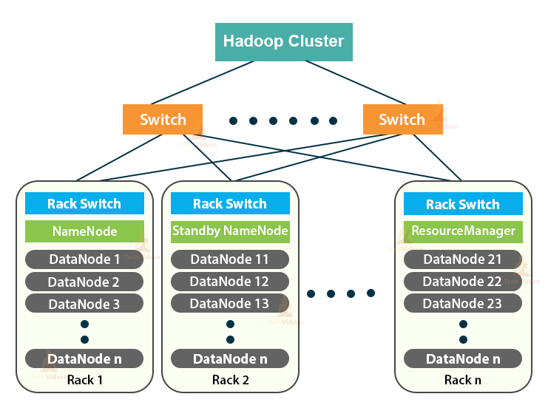
Hadoop Cluster Architecture
Each Rack contain Data Nodes and only 1 rack contain Name Node.
They communicate each other with help of switch.

Slide 42
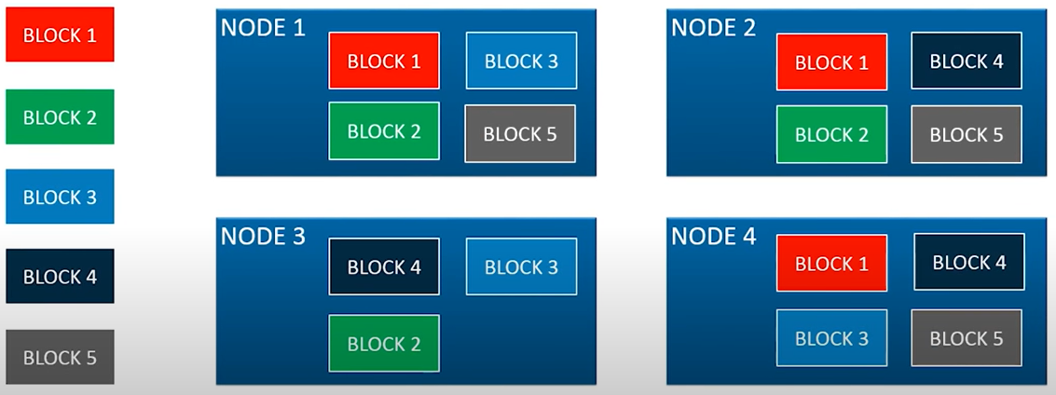
Rack Awareness Algorithm

