Slide 1
Hadoop Architecture & Hadoop Clustering
Unit 1

Slide 2
Hadoop Architecture & Components
Data Storage - HDFS – Hadoop Distributed File System
Resource Management - YARN – Yet Another Resource Negotiation
Processing the Data - Map-Reduce
Data Collection & ingestion – Sqoop & Flume
Queries – Pig (Scripting) & Hive (SQL Queries)
Processing real time streaming data - Apache Spark

Slide 3
Hadoop Architecture & Components
Machine Learning Applications - Mahout
Management & Monitoring – Apache Ambari
Streaming – Kafka (builds) & Apache Storm (Process at a very high speed)
Security – Apache Range & Apache Knox
Work Flow System – Oozie – work flow scheduler to manage Hadoop jobs

Slide 4
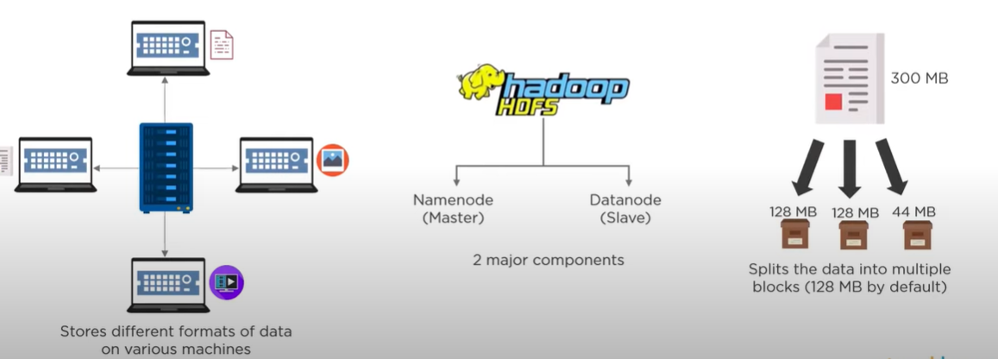
HDFS – Hadoop Distributed File System

Slide 5
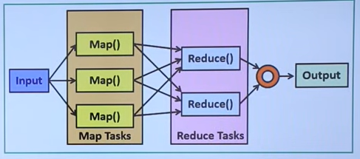
Map Reduce – Processing the data

Slide 6
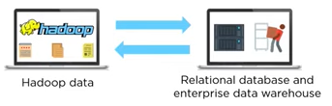
Sqoop - Data Collection – Structured Data
Sqoop is used to share the data between Hadoop and Relational databases, data ware-houses.

Slide 7
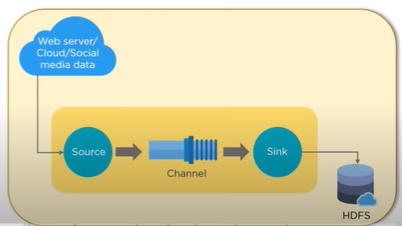
Flume – Data Collection- Un-Structured Data
Flume is a Distributed service for collecting, aggregating and moving large amounts of log data.
It will ingest online streaming data from social media, log files & web server in-to HDFS

Slide 8
Queries
Pig – used to analyze the data in Hadoop.
      Provides a platform for building data flow for ETL ( Extract, Transform & Load) – Data Transformation
Hive – Reading, Writing & managing large datasets which are in a distributed storage using SQL – Query structured data.
      Provides user defined functions for data mining, document indexing, log processing,.. etc

Slide 9
Apache Spark – Processing – Scala
Open source distributed computing engine.
Mainly used for Processing and Analyzing huge volumes of real time data like stock market and banking data.
Works 100x faster than Map Reduce.
Provides In-Memory computation of data.
It can also work individually outside of Hadoop eco-system with it’s own YARN.
By using Py-spark it can also access Python Libraries.

Slide 10
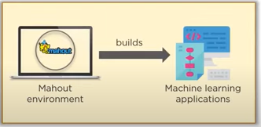
Mahout – Machine Learning
Used to produce free implementations scalable machine learning algorithms focused primarily on linear algebra.

Slide 11
Management & Monitoring- Apache Ambari
It is responsible for keep track of running applications and their statuses.
Just like a Body-Guard.
It provides a central management service to start, stop and configure Hadoop services.

Slide 12
Streaming – Kafka – Scala & Java
Kafka –
Builds real-time streaming data-pipelines that reliably get data between applications.
    Kafka uses messaging system for transferring data from one application to Another application
Builds real-time streaming applications & these applications may transform the data in-to streams.

Slide 13
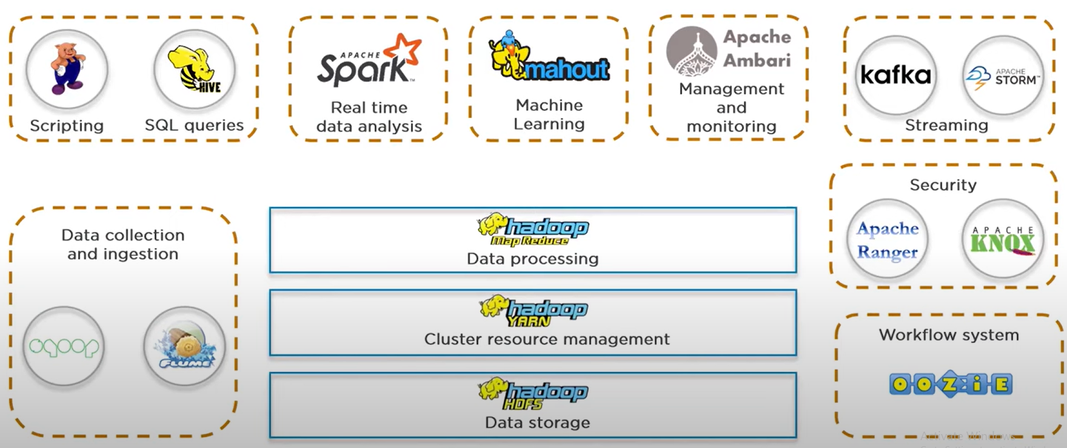
Hadoop Architecture

Slide 14
Streaming – Strom - Clojure
Storm –
It is a processing engine that process real-time streaming data at a very high speed.

Slide 15
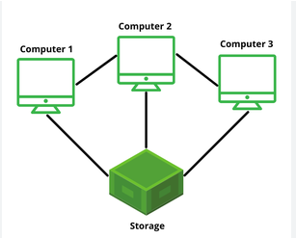
Cluster
Group of inter-connected computers, servers (nodes), or any other computing devices that work together as a single unit to perform various tasks. - Playing Cricket

Slide 16
Hadoop Clustering
Setting and configuring a cluster of computers – Computer Lab.
    Configuring involves several steps to set-up environment correctly for distributed data processing.
      1. Hardware requirement – memory, storage, processing power for each node
      2. Network set-up – Nodes can communicate
      3. Operating System – Linux, Windows, Mac
      4. Java Installation – Hadoop built using java
      5. Hadoop Installation – env. variables like HADOOP_NAME & PATH

Slide 17
Hadoop Clustering - Configuring
      6. Configuration files – For any software application we need these files to store settings, preferences & parameters XML, YAML, JSON
      7. SSH Set-Up –
      Secure Shell or Secure Socket Shell –
      it is a Protocol (rules) that enables 2 computers to communicate.
      8. HDFS, YARN, Map-Reduce
      9. Testing
      10. Security Set-up
      11. Monitoring and Optimization

Slide 18
Advantages
Scalable
Cost Effective
Flexible – can process any data
Fast
Resilient to failure – have back-up option

Slide 19
Hadoop Cluster Architecture
Hadoop Cluster Architecture
      HDFS
      YARN
HDFS – Hadoop Distributed File System
    Name Node – Master Node – Contains Meta Data
    Secondary Name Node – Buffer to Name Node
    Data Node – Slave Node – Store Data

Slide 20
Hadoop Cluster Architecture - HDFC
1. Name Node
  Contains meta-data of name node.
  Responsible for managing health node.
  it always receives heart-beat at a particular interval of time.
  if heart-beat fails, name node will assign to other data node.
  also receives status update of the task assigned.
2. Data Node –
  Responsible for storing the data.
  slaves of Name Node.
3. Secondary Name Node –
  Supports to primary name node.
  Acts as a buffer

Slide 21
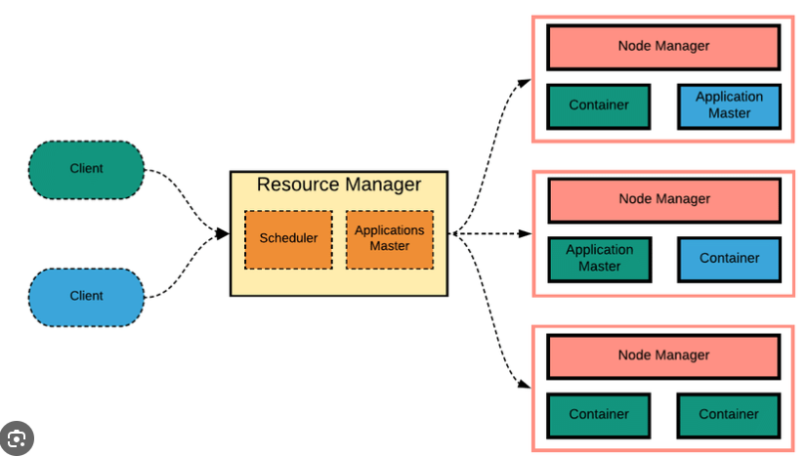
Hadoop Cluster Architecture - YARN
YARN – Yet Another Resource Negotiator
    Node Manager
    App Master
    Container

Slide 22
Hadoop Cluster Architecture - YARN
Resource Manager
    It manages and allocates cluster resources.
    It keeps track of available resources and schedules tasks on different nodes
    Scheduler - Totally dedicated to allocating resources to different applications.
    Application Master - Manages the lifecycle of individual applications, negotiating resources for them and ensuring they run successfully

Slide 23
Hadoop Cluster Architecture - YARN
Node Manager
    Each node in the cluster runs a Node Manager, which is responsible for monitoring resource usage on that node, managing containers, and reporting back to the Resource Manager.
App master
    Negotiates the resources between Resource Manager and Node Manager.
Container
    Collection of reserved amount of resources allocated by the Resource Manager and to work with the allocated task by node manager.

Slide 24
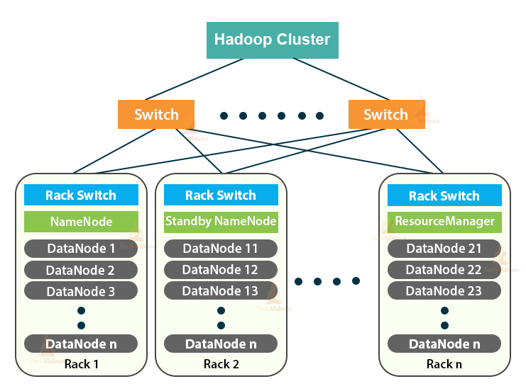
Hadoop Cluster Architecture
Each Rack contain Data Nodes and only 1 rack contain Name Node.
They communicate each other with help of switch.

Slide 25
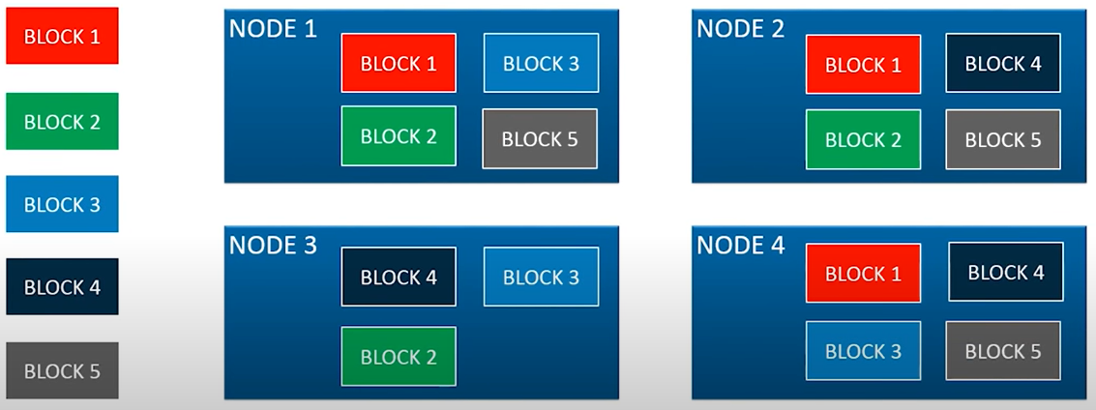
Rack Awareness Algorithm

