Slide 1
Anatomy of Map Reduce Job Run

Slide 2
The anatomy of a MapReduce job run can be divided into the following steps:
Client Submits The Job: The client submits the MapReduce job to the YARN Resource Manager.
The resource manager allocates the necessary resources (containers) to the job and launches the MapReduce Application Master.
All the Containers are managed by Node Manager
Application Master Coordinates The Job: The application master splits the input data into splits and assigns them to map tasks.
It also monitors the progress of the map and reduce tasks and restarts any failed tasks.
Map Tasks Process The Input Data: The map tasks process their assigned input splits and Generate Intermediate Key-value Pairs.

Slide 3
Shuffle Phase: The shuffle phase Sorts The Intermediate Key-value Pairs from the map tasks and groups them by key.
Reduce Tasks Process The Intermediate Data: The reduce tasks process the intermediate key-value pairs from the shuffle phase and Generate The Final Output.
Application Master Completes The Job: Once all of the reduce tasks have completed, the application master merges the output from the reduce tasks and writes it to the distributed file-system.

Slide 4
Client JVM: The client Java Virtual Machine is the Java process that submits the MapReduce job.
Client node: The client node is the machine where the client JVM Is Running.
ResourceManager: The ResourceManager is responsible for Allocating Resources (containers) to MapReduce jobs.
Resource Manager Node: The resource manager node is the machine where the Resource Manager Is Running.
NodeManager: The NodeManager is responsible for Managing Containers On A Machine.
Node manager node: The node manager node is the machine where the Node Manager Is Running.
MRAppMaster: The MRAppMaster is a Java process that is responsible for coordinating the Execution Of The Map Reduce Job.
Task JVM: The task JVM is a Java process that is responsible for Executing A Mapper Or Reducer Task.
Yarn Child: The Yarn Child is a Java process that is responsible for Running The Task JVM.
Shared Filesystem: The shared filesystem is a distributed filesystem, such as HDFS, that is used to store the input and output data for the MapReduce job

Slide 5
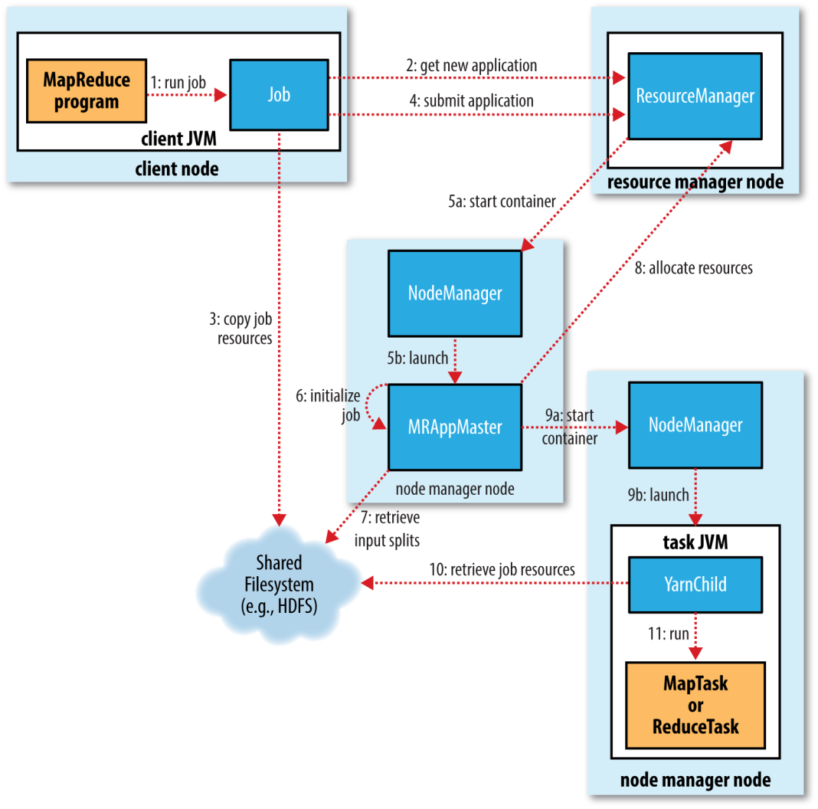
How Hadoop Runs a Map Reduce Job
Job submission
Job Initialization
Task Assignment
Task execution

Slide 6
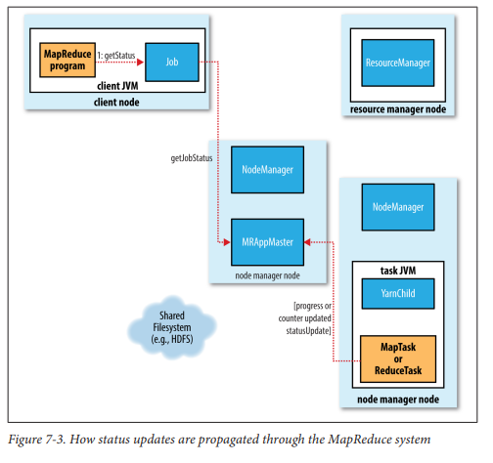
Progress & Status Update
The status updates are propagated through the MapReduce system as follows:
The task JVM sends status updates to the Yarn Child.
The Yarn Child sends status updates to the MRAppMaster.
The MRAppMaster sends status updates to the ResourceManager.
The ResourceManager sends status updates to the client JVM.

Slide 7
Job Completion
Application Master receives a notification for a job is completed.
It changes job status to successful.
Application master and the task container also clean up their working state.

