Slide 1
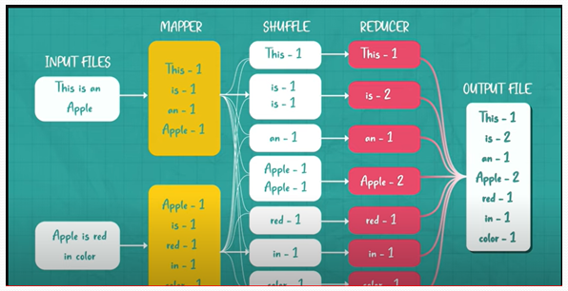
Map Reduce – Shuffle & Sort

Slide 2
In a MapReduce job, the input data is divided into smaller chunks, which are processed by the mappers in parallel.
The mappers output key-value pairs, which are shuffled and sorted by the framework.
The reducers then process the sorted key-value pairs and generate the final output.
Shuffle and Sort Phase
The shuffle and sort phase is a critical component of MapReduce.
It is responsible for transferring the Shuffled intermediate outputs of the mappers to the reducers and sorting them by key.

Slide 3
Map Side
On the map side, the shuffle process begins by partitioning the intermediate key-value pairs into buckets based on their keys.
The buckets are then serialized and written to a local disk.
Reduce Side
On the reduce side, the shuffle process begins by reading the serialized intermediate key-value pairs from the local disk of each mapper.
The pairs are then sorted by key and merged into a single stream.

Slide 4
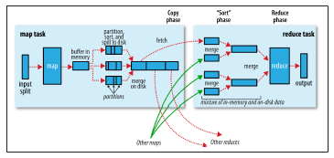
Shuffle and sort in MapReduce

Slide 5
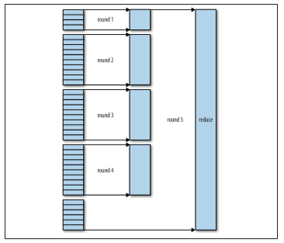
Efficiently merging 40 file segments with a merge factor of 10

Slide 6
Configuration Tuning – Adjusting Parameters
The performance of the shuffle and sort phase can be tuned by Adjusting A Number Of Configuration Parameters, such as:
io.sort.mb: The maximum amount of memory to use for sorting intermediate key-value pairs in memory.
io.sort.factor: The number of intermediate files to merge into a single file before writing to disk.
io.sort.spill.percent: The percentage of the memory used for sorting that triggers spilling to disk.

Slide 7
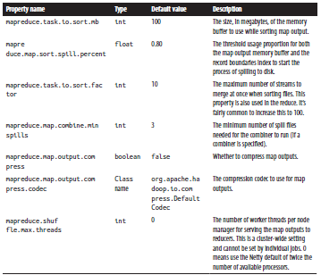
Map Side Tuning Properties

Slide 8
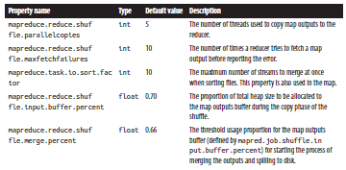
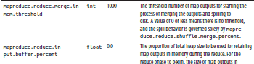
Reduce-side Tuning Properties

