Slide 1
Task Execution
Task Execution Environment
The MapReduce framework executes mapper and reducer tasks in a Separate JVM Process.
This process inherits the environment of the parent TaskTracker process.
The user can specify additional options to the child JVM via the
Mapreduce.Map.Java.Opts,
Mapreduce.Reduce.Java.Opts
configuration parameters.

Slide 2
The two essential components of the MapReduce framework are
JobTracker
TaskTracker
Job Tracker is responsible for Scheduling And Monitoring MapReduce jobs.
Task Tracker is responsible for executing Individual Mapper And Reducer Tasks.

Slide 3
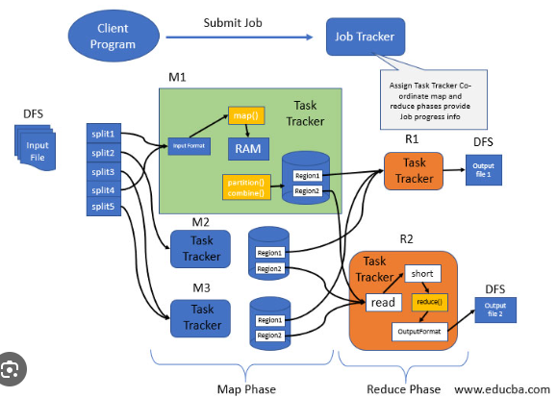
MapReduce Architecture

Slide 4
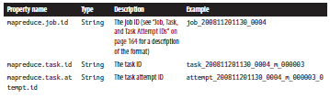

Task Environment Properties

Slide 5
Speculative Execution – Killing The Slowest Copies
Speculative execution is a technique used to improve the performance of MapReduce jobs by Running Multiple Copies Of The Same Task And Killing The Slowest Copies.
The MapReduce framework determines which tasks to speculate on based on their progress and the overall state of the job.
Speculative execution can be Enabled Or Disabled by setting the mapreduce.map.speculative,
mapreduce.reduce.speculative
configuration parameters.

Slide 6
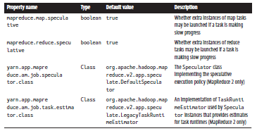
Speculative Execution Properties

Slide 7
Output Committers – Output is Durable& Consistent
The output committer is responsible for writing the output of a MapReduce job to the Hadoop Distributed File System (HDFS).
The MapReduce framework provides a number of built-in output committers, but the user can also implement their own custom output committer.
The output committer is responsible for ensuring that the output of the job is durable and consistent (output files are Not Corrupted And That They Are Properly Synchronized with the HDFS metadata)

Slide 8
Task Execution Flow
The following is a simplified overview of the task execution flow in MapReduce:
The JobTracker assigns a mapper or reducer task to a TaskTracker.
The TaskTracker starts a new JVM process to execute the task.
The Task Execution Environment is initialized with
  The Input And Output Splits
  The Mapper Or Reducer Class
  The Configuration Parameters
  The Reporter Object

Slide 9
The task is executed.
The Output Committer is used to write the output of the task to HDFS.
The task execution environment is cleaned up.
If Speculative Execution is enabled, the JobTracker may start multiple copies of the same task and kill the slowest copies.

