Slide 1
Unit-3
Part-3
Map Reduce Types And Formats

Slide 2
Map Reduce Types
These types are used to represent the input, intermediate, and output data of the MapReduce job.
The following are the main types used in MapReduce:
Input Key And Value Types: These types represent the Input Data To The MapReduce Job.
The key type is typically a unique identifier for each input record, and the value type is the data associated with the record.
Intermediate Key And Value Types: These types represent the Output Of The Mapper And Input To The Reducer.
The intermediate key and value types can be different from the input key and value types.
Output Key And Value Types: These types represent the Output Of The Reducer.
The output key and value types can be different from the input and intermediate key and value types.

Slide 3
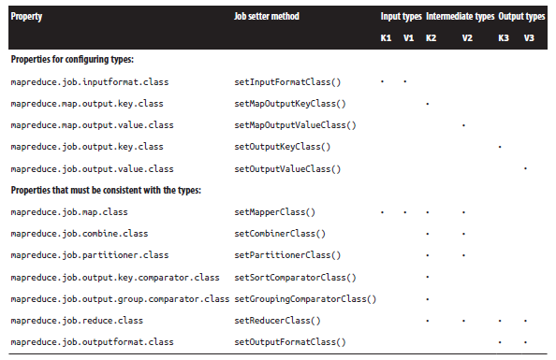
Configuration of Map Reduce types in new API

Slide 4
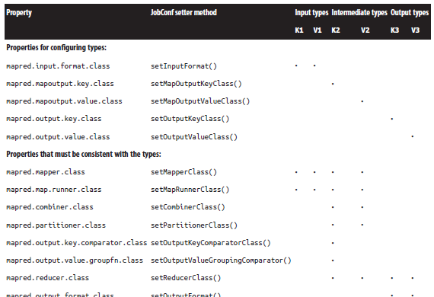
Configuration of Map Reduce types in old API

Slide 5
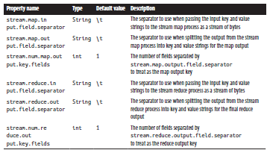
The Default Map Reduce Job
Streaming Separator Properties

Slide 6
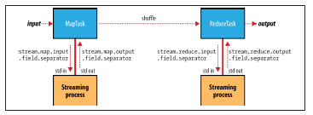
Separators are used in a streaming Map Reduce Job

Slide 7
Map Reduce Types
MapReduce is a programming model and processing framework that can be categorized into different types based on variations and use cases.
Here are several types of MapReduce:
Batch MapReduce:
  This is the traditional form of MapReduce and is used for batch processing of large datasets.
Streaming MapReduce:
  Streaming MapReduce extends the MapReduce model to handle real-time data processing.
Recursive MapReduce:-
  Recursive MapReduce is used for problems that involve recursive subtasks.
Incremental MapReduce:-
  Incremental MapReduce processes only the new or changed data since the last run.

Slide 8
Multi-Step MapReduce:-
  Some complex data processing tasks require multiple MapReduce jobs in sequence.
Hybrid MapReduce:-
  Hybrid MapReduce combines the MapReduce model with other processing models, such as in-memory processing or data streaming.
MapReduce on Cloud Services:-
  Cloud-based MapReduce services, like Amazon EMR and Google Data prep, provide MapReduce capabilities in a cloud environment.
  They offer scalability, flexibility, and ease of use for running MapReduce jobs on cloud infrastructure.
Iterative Map Reduce: Continue Until One condition becomes false
  Some algorithms, like graph processing or machine learning algorithms, require multiple iterations over the same dataset.

Slide 9
MapReduce types are the Data Types that are used for the input and output of the map and reduce functions.
The most common MapReduce types are:
Text: This type is used for text data, such as log files, web pages, and email messages.
Int: This type is used for integer data, such as product IDs, customer counts, and transaction amounts.
Long: This type is used for long integer data, such as timestamps and file sizes.
Float: This type is used for floating-point data, such as product prices and customer ratings.
Double: This type is used for double-precision floating-point data, such as scientific data and financial data.
MapReduce also supports custom types, which can be used for more complex data structures, such as JSON objects and XML documents.

Slide 10
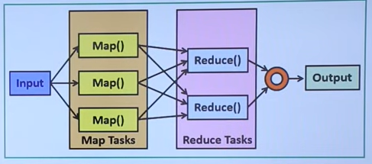
Map Reduce Working Mechanism

Slide 11
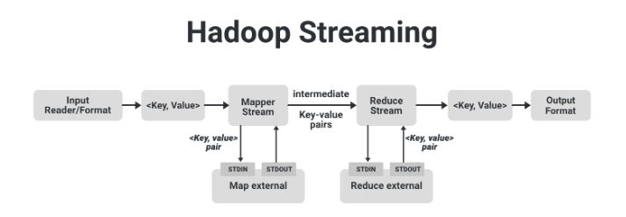
Map Reduce

Slide 12
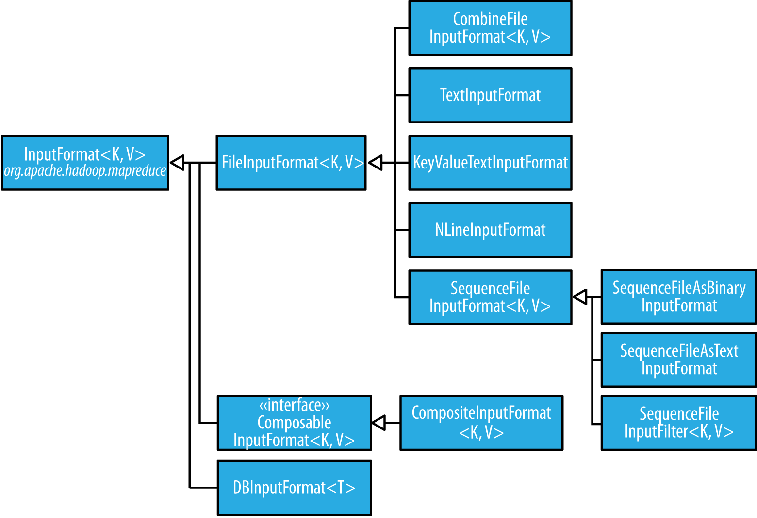
Input Format Class Hierarchy

Slide 13
Map Reduce - Input Formats
In Hadoop MapReduce and similar distributed data processing frameworks, input data is typically read from various sources and formats.
The choice of input format depends on the structure of the data and the requirements of the processing job.
Here are some common input formats used in Map Reduce:-
Text Input
1. Text Input Format:
  This is the default input format in Hadoop Map Reduce.
2. Key-Value Text Input Format:
  This format is similar to TextInputFormat but interprets each line as a key-value
3. NLine Input Format
4. XML

Slide 14
Binary Input:-
1. Sequence-File Input Format:
  Sequence files are Binary Files used to store key-value pairs efficiently.
  It allows for efficient Serialization And Deserialization Of Complex Data Structures.
2. Sequence File As Text Input Format
3. Sequence File As Binary Input Format
4. Fixed Length Input Format
Multiple Input:-
Same Data in Different Formats
DB Input Format:-
  DB Input Format allows Map-Reduce jobs to read data Directly From Relational Databases.

Slide 15
Input Splits & Records:-
FileInputFormat - Base Class For All Implementations
FileInputFormat Input Paths – Offers 4 Static convenience methods for setting job’s input paths
FileInputFormat Input Splits – Splits Only files larger than HDFS Blocks.
Small Files & CombineFileInputFormat -
NonSplitTable TextInputFormat – Some applications don’t want the files to split
WholeFileInputFormat – Reading whole file as a record
Text-Input Format with Custom Record-Reader:
  You can create custom Record-Readers to parse and Process Input Data In Specific Formats.
  This approach is flexible and allows you to handle Non-standard Data Formats effectively.
Custom Input Formats:-

Slide 16
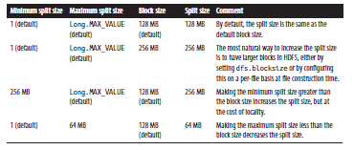

Examples of how to control the split size
File Split Properties

Slide 17
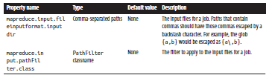
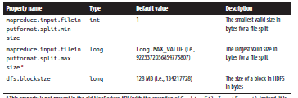
Input Path and Filter Properties
Properties for controlling split size

Slide 18

Logical records and HDFS blocks for TextInputFormat

Slide 19
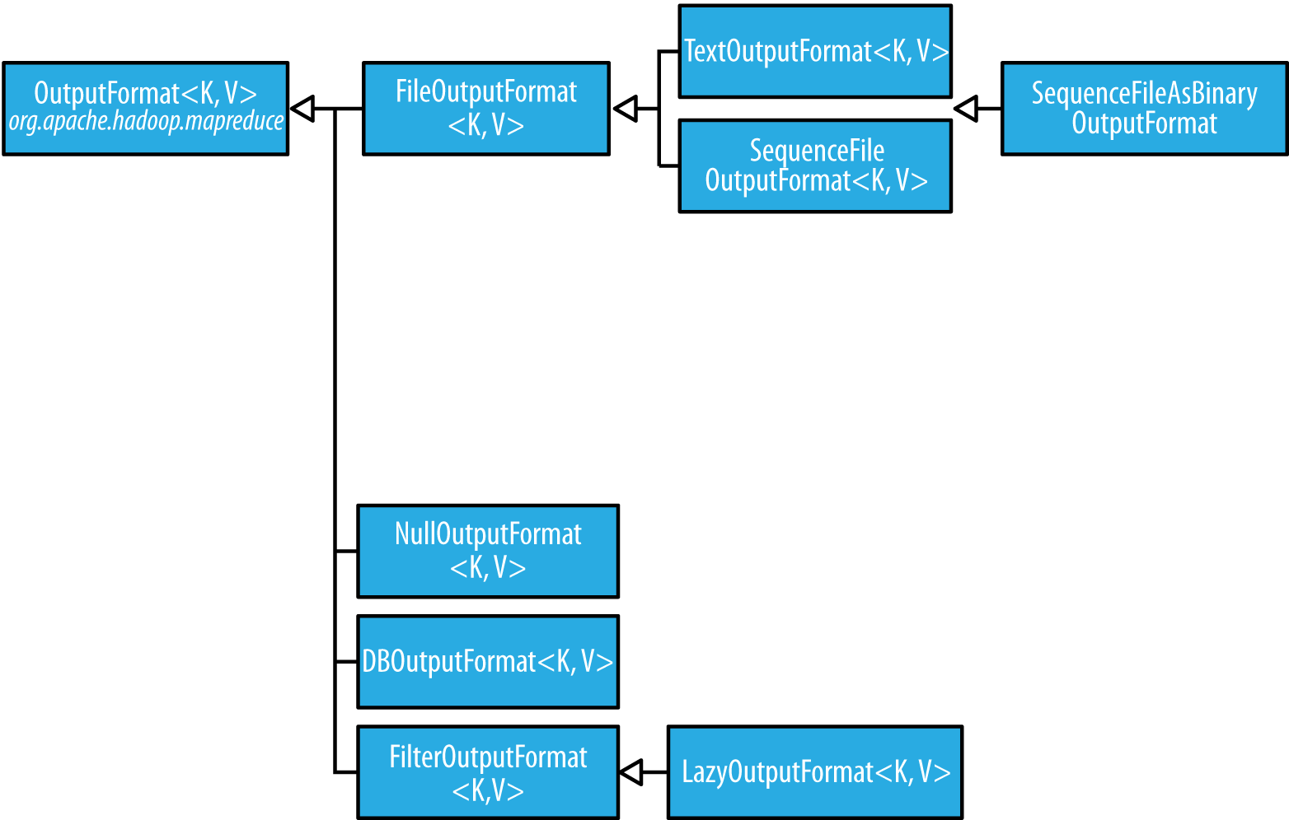
Output Format Class Hierarchy

Slide 20
Map Reduce - Output formats
The output of Map Reduce jobs can be stored in various formats to suit different use cases and requirements.
Here are some common output formats used in MapReduce:
Text Output Format:-
  This is the Default Output Format in Hadoop Map Reduce.
Binary Output:-
1. SequenceFile Output Format:-
  Sequence files are Binary Files used to store key-value pairs efficiently.
2. SequenceFile As Binary Output Format
3. Map File Output Format

Slide 21
Multiple Outputs:-
  It's useful when you want to produce Multiple Outputs with Different Formats or to separate data based on criteria.
Database Output (e.g., DB Output Format):-
  MapReduce jobs can write Output Data Directly To Relational Databases using output formats like DB Output Format.
Lazy Output:-
Some application prefer that empty files not to be created
Custom Output Formats:-

