Slide 1

UNIT - IV
HBase
Hadoop Database
Column-Oriented NoSQL Database That Runs On Top Of HDFS

Slide 2
Data Model and Implementation
It is designed for Storing and Retrieving large amounts of data with low latency (Measures Delay).
Column Oriented Distributed Database –
  Data is stored in Individual Columns and indexed by a unique Row Key
  The Intersection of Rows and Columns is known as cell
  Each cell has Time Stamp Identifier called Version
The HBase data model is based on the following concepts:-
Table: logical grouping of data. It is made up of rows and columns,
Rows: A row is a single record in a table. Each row is identified by a Unique Row Key.
Column Families: A column family is a collection of Related Columns.
Columns: A column is a single piece of Data In A Row.
Cells: A cell is the intersection of a row, column family, and column.
.

Slide 3
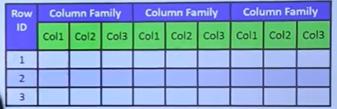
In Short HBase:
A Table is a collection of rows.
The Row is a collection of Column Families.
Column Family is a collection of Columns.
The column is a collection of Key-Value pairs.
.

Slide 4
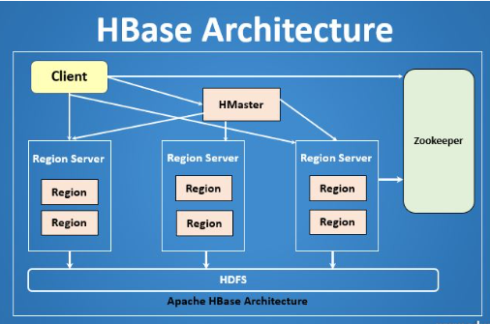
HBase tables are horizontally partitioned into regions.
Each region is served by a single region server.
HBase automatically splits and merges regions as needed to maintain load balance.

Slide 5
Implementations of HBase
HBase is an open-source project, and there are a number of different implementations available:-
The most popular implementation is the Apache HBase project
Other Implementations Of HBase Include:-
Cloudera HBase: A commercial implementation of HBase from Cloudera.
Hortonworks HBase: A commercial implementation of HBase from Horton works.
Google Dataproc HBase: A managed HBase service from Google Cloud Platform.
Amazon DynamoDB: A NoSQL database service from Amazon Web Services that is similar to HBase.

Slide 6
Use Cases for HBase:-
HBase is a good choice for a variety of use cases, including:-
Real-time Analytics: HBase can be used to Store And Analyze Real-time Data, such as sensor data or financial data.
Log Aggregation: HBase can be used to Aggregate And Store Log Data from a variety of sources.
Social Media Applications: HBase can be used to Store And Retrieve Data for social media applications, such as User Profiles, Posts, And Messages.
E-commerce Applications: HBase can be used to Store And Retrieve Data for e-commerce applications, such as Product Catalogs, Customer Orders, And Inventory Levels.
Conclusion:-
HBase is a powerful tool for managing and analyzing big data. It is a good choice for applications that need to perform real-time queries on large amounts of data.

Slide 7
HBase Clients - Programs
HBase clients are programs that allow you to interact with an HBase cluster.
There are a number of different HBase clients available, each with its own strengths and weaknesses.
The most popular HBase client is the Java client API. .
However, it can be complex to use, especially for beginners.
Other HBase Clients Include:
HBase shell: A Command-line Interface for interacting with HBase.
The HBase shell is easy to use, but it does not provide the same level of functionality as the Java client API.
Thrift Client: A Thrift client is a Language-agnostic Client for interacting with HBase.
Thrift clients are available for a variety of programming languages, including Java, Python, And Ruby.
REST Client: A REST client is a Web-based Client for interacting with HBase.
REST clients can be used to access HBase from any programming language that supports HTTP Requests.
In addition to the above clients, there are a number of Third-party HBase Clients available.
These clients often provide additional features, such as support for specific programming languages or frameworks.
.

Slide 8
Choosing an HBase client
The best HBase client for you will depend on your Specific Needs.
If you are new to HBase, I recommend starting with the HBase Shell.
It is easy to use and provides a good introduction to the basic concepts of HBase.
If you need more Advanced Functionality, you may want to consider the Java client API or a third-party HBase client.
When choosing a client, be sure to consider the following factors:-
Programming Language: Choose a client that supports the programming language you are using.
Features: Consider the features that are important to you, such as support for specific data types or transactions.
Ease Of Use: Choose a client that is easy to use and learn.
Community Support: Choose a client with a large and active community, so that you can get help if you need it.

Slide 9
HBase Examples
Here are some examples of how HBase can be used:
Real-time Analytics: HBase can be used to store and analyze real-time data, such as sensor data or financial data.
For Example, a company could use HBase to store and analyze sensor data from its manufacturing plant to identify potential problems before they occur.
Log Aggregation: HBase can be used to aggregate and store log data from a variety of sources.
For Example, a company could use HBase to store and analyze log data from its web servers, application servers, and database servers to identify trends and troubleshoot problems.

Slide 10
Social Media Applications: HBase can be used to store and retrieve data for social media applications, such as user profiles, posts, and messages.
For Example, a social media company could use HBase to store and retrieve user profiles, posts, and messages so that users can quickly and easily find the information they are looking for.
E-commerce Applications: HBase can be used to store and retrieve data for e-commerce applications, such as product catalogs, customer orders, and inventory levels.
For Example, an e-commerce company could use HBase to store and retrieve product catalogs so that customers can quickly and easily find the products they are looking for.

Slide 11
Praxis – Managing HBase Cluster
Praxis is a Web-based User Interface for managing HBase clusters.
It provides a variety of features, including:
HDFS Integration
Praxis provides a Visual Representation Of The HDFS Filesystem, making it easy to see where HBase data is stored and how it is distributed.
UI
Praxis has a User-friendly Interface that makes it easy to perform common HBase tasks, such as
Creating And Managing Tables.
Loading And Querying Data.
Monitoring Cluster Performance.

Slide 12
Metrics
Praxis provides a variety of metrics that can be used to Monitor The Health And Performance Of HBase Clusters.
These metrics include things like the
Number Of Active Regions,
The Number Of Requests Being Processed
The Average Latency Of Requests.
Counters:
Praxis also provides a variety of counters that can be used to Track The Activity Of HBase Clusters.
These counters include things like
The Number Of Reads And Writes Performed,
The Number Of Errors Encountered, And
The Number Of Regions That Have Been Split Or Merged.

Slide 13
Conclusion
Praxis can be used to manage HBase clusters of all sizes, from small development clusters to large production clusters.
It is a valuable tool for anyone who needs to manage or monitor HBase clusters.

Slide 14
Data Model -
Implementation of HBase-
HBase Clients -
Examples of HBase-
Praxis -

