Slide 1
The study on Factors Associated with Usage of Mobile Banking Applications
M.K.G.Sandeepani
209376F

Slide 2
Introduction
Mobile banking is defined as “a channel whereby the customer interacts with a bank via mobile device, such as mobile phone and Personal Digital Assistant (PDA)
M-banking services created a new, convenient and fast delivery channel for customers to enjoy banking services from anywhere, anytime.
This study will attempt to address unfounded factors while helping to lay a roadmap for proper implementation of mobile banking

Slide 3
Objective
The overall objective of the study was to determine factors affecting for mobile banking technology in Sri Lanka
Do the descriptive analysis and identify the insight of mobile banking application usage
Conduct the statistical inference technique to identify the factors affecting for the usage of mobile banking application

Slide 4
Sampling Procedures, Data collection and Analysis
The study focused on Mobile banking application users within Sri Lanka
Data were collected by using online questionnaire(Google form)
Total number of responses are 180
Analyzed using both descriptive and inferential statistics

Slide 5
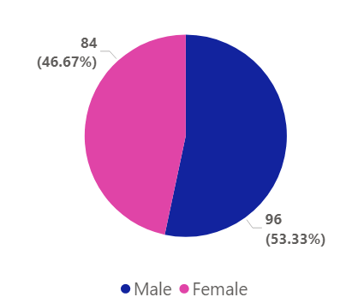
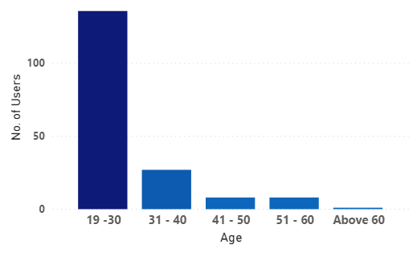
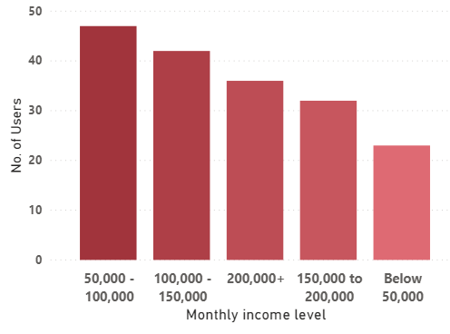
Descriptive Analysis
Gender
Age group
Income Level
Most of the M-banking users are male
Most of the M-banking users are in 19-30 Age group
Most of the M-banking user’s income level is 50K-100K

Slide 6
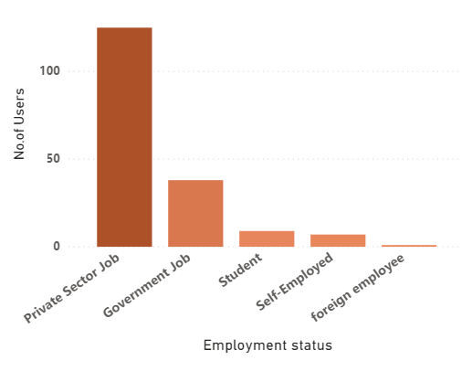
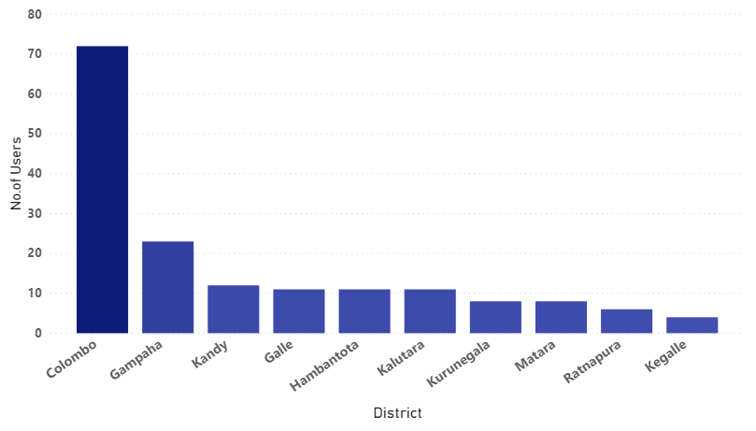
Descriptive Analysis Cont.
Employment Status
Users Geography distribution(Top 10)
Most of the M-banking users are working in private sector
Most of the M-banking users are from Colombo

Slide 7
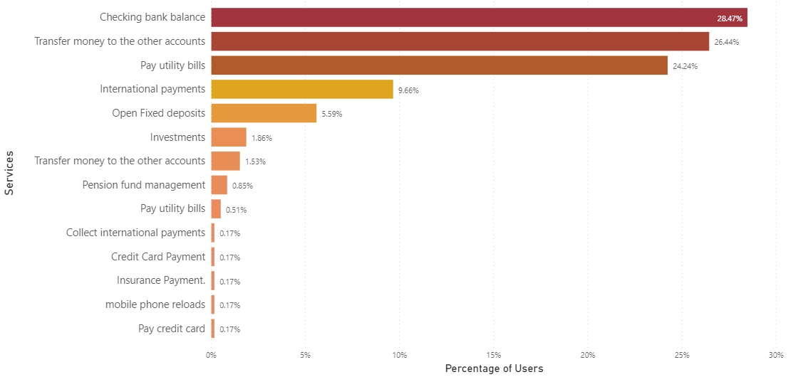
Descriptive Analysis Cont.
Services obtained through Mobile Banking Applications
Most of the people use the mobile banking for checking balance and transfer money to the other accounts. Rarely use to reload mobile phone and pay credit cards

Slide 8
What percentage of males/females use the mobile banking application in Sri Lanka?
The survey on 180 users are conducted and found that 96 users are male, and 84 users are female.
Calculate the Confidence interval for the proportion of mail users and female users separately
We are 95% sure that the true percentage of male users of mobile banking application in Sri Lanka is 46.05% and 60.62%
We are 95% sure that the true percentage of female users of mobile banking application in Sri Lanka is 39.38% and 53.95%

Slide 9
Checking whether income level makes tendency to use mobile banking Apps from Private Sector
P1 = Proportion of Private mobile banking app users with high-income (income greater than Rs 100,000) P2 = Proportion of Private mobile banking app users with less-income(income equal or less than Rs 100,000)
Hypothesis test
H0:P1 = P1
Ha:P1 ≠ P1
The value of z is 2.5504. The value of p is 0.01078. The result is significant at p < .05
Since the P-value (0.01078) is less than the significance level (0.05), we reject the null hypothesis.
So income level makes tendency to use mobile banking Apps from Private Sector
Z test for difference in Proportion
P Value = 0.01078

Slide 10
Checking whether Education level is associate with the Usability of the application
H0: There is no association between the education level and usability of the application
 | Very dissatisfied | Not Satisfied | Neutral | Satisfied | Very Satisfied
A/L | 2 | 1 | 1 | 1 | 3
Diploma | 5 | 2 | 4 | 4 | 2
Degree or above | 10 | 16 | 42 | 63 | 24
The chi-square statistic is 16.5379. The p-value is .035298. The result is significant at p < .05.
So we can reject the null hypothesis and conclude there is a relationship between education level and usability

Slide 11
Checking whether there is a difference between Satisfaction score for Recommenders vs Non-Recommenders
Usability
- Mean satisfaction score for Usability is 3.39
Understandability
- Mean satisfaction score for Understandability is 3.4
Time Saving
- Mean satisfaction score for Time Saving is 3.98
Security
- Mean satisfaction score for Security is 3.42

Slide 12
μ1 = Mean satisfaction score for selected factor for recommenders μ2 = Mean satisfaction score for selected factor for Non-recommenders
Mean Difference of Satisfaction score between recommenders and Non-recommenders significant for the Usability.
Hypothesis is to test
H0: μ1 = μ2 Ha: μ1 ≠ μ2
two-sample t-test Difference between two population means
Satisfaction Factor | P value | Significant or not
Usability | 0.0105 | Significant
Understandability | 0.0938 | Not Significant
Time Saving | 0.0706 | Not Significant
Security | 0.4343 | Not Significant

Slide 13
Thank you

