Slide 1
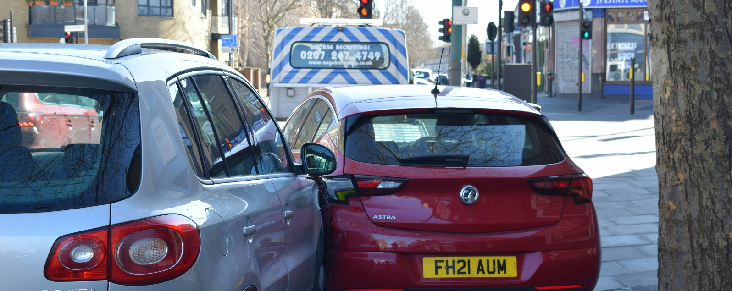
Analysis of Road Traffic Accident

Slide 2
Presentation Outline
Introduction
Data cleaning and processing
Descriptive statistics of relevant columns
Dashboard
Statistical analysis
Recommendations

Slide 3
Introduction
Road accidents continue to pose a significant public safety concern, with various factors—including weather conditions, road surface quality, speed limits, and traffic control measures—contributing to the severity of such incidents.
This presentation is prepared to discuss the statistical analysis performed and dashboard created for better understanding of the data and making recommendations for road safety improvements

Slide 4
Data cleaning and processing
Checking blanks and Errors
Removing duplicates
Data transformation
Data consistency with respect to data type, format and values used.

Slide 5
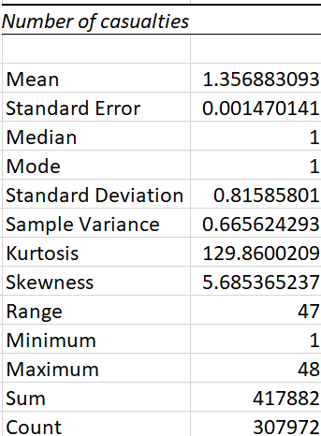
Descriptive statistics for casualties
Mean: 1.36
Median: 1
Standard Deviation: 0.82
Skewness: 5.69
Conclusion: Most accidents in the dataset involve a single injury, with multi-casualty events being rare but raising the average. This indicates that general accident prevention is key, as even typical incidents lead to harm.

Slide 6
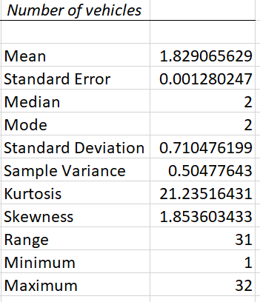
Descriptive statistics (Number of vehicles)
Mean: 1.82
Median: 2
Standard Deviation: 0.71
Skewness: 1.85
Conclusion: The overwhelming majority of accidents in this dataset are two-vehicle collisions. This strongly suggests that safety interventions should be focused on scenarios where two vehicles interact.

Slide 7
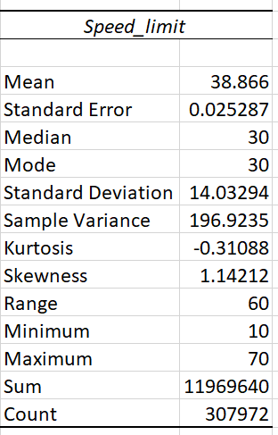
Descriptive statistics (Speed Limit)
Mean: 38.87
Median: 30
Standard Deviation: 14.03
Skewness: 1.14
Conclusion: This strongly suggests that some interventions measures should be reduction of speed limit in high-risk areas.

Slide 8
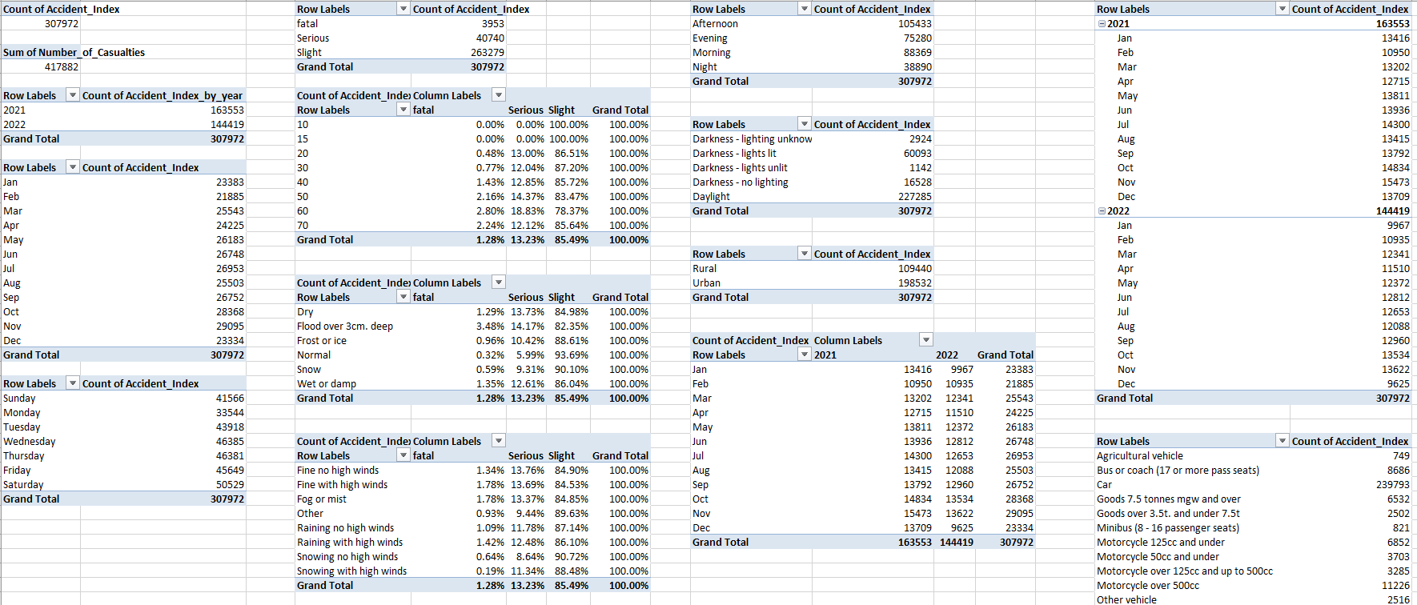
Statistical Analysis

Slide 9
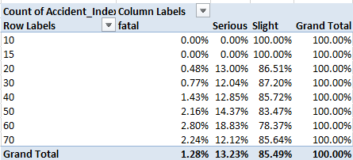
Statistical Analysis
Impact of speed limits on accident severity
Percentage of accidents decrease slightly while the percentages of serious and fatal accidents gradually increase
Higher speed is a contributing factor to severe outcomes

Slide 10
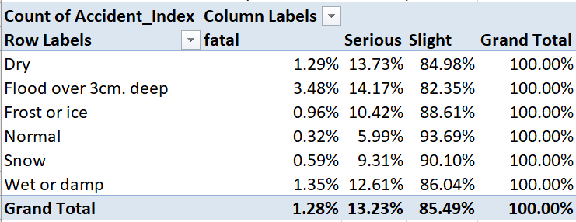
Statistical Analysis
Impact of road conditions on accident severity
Approximately 15.02% of accidents are either serious or fatal for dry roads serving as baseline
High risk conditions are flood over 3cm deep road conditions and wet and damp road with likelihood
of fatal and serious accidents at 17.65%
and 13.96% respectively

Slide 11
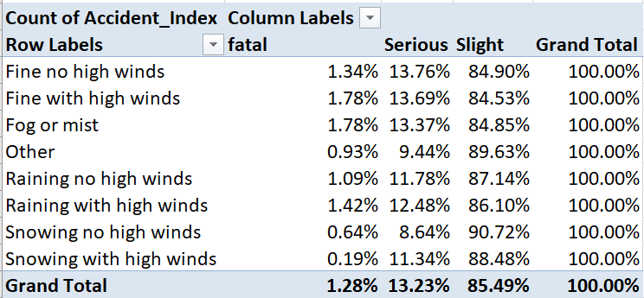
Statistical Analysis
Impact of weather on accident severity
Fine no high winds contribute 15.10% accidents that result in serious injury and fatality
High risk conditions weather conditions are associated with adverse visibility and atmospheric conditions
Likelihood of serious or fatal accidents rises to 15.15%
in foggy conditions and 15.47% fine with high windy
conditions

Slide 12
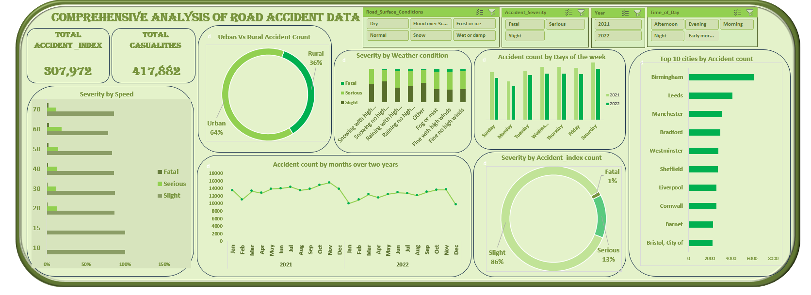
Dashboard

Slide 13
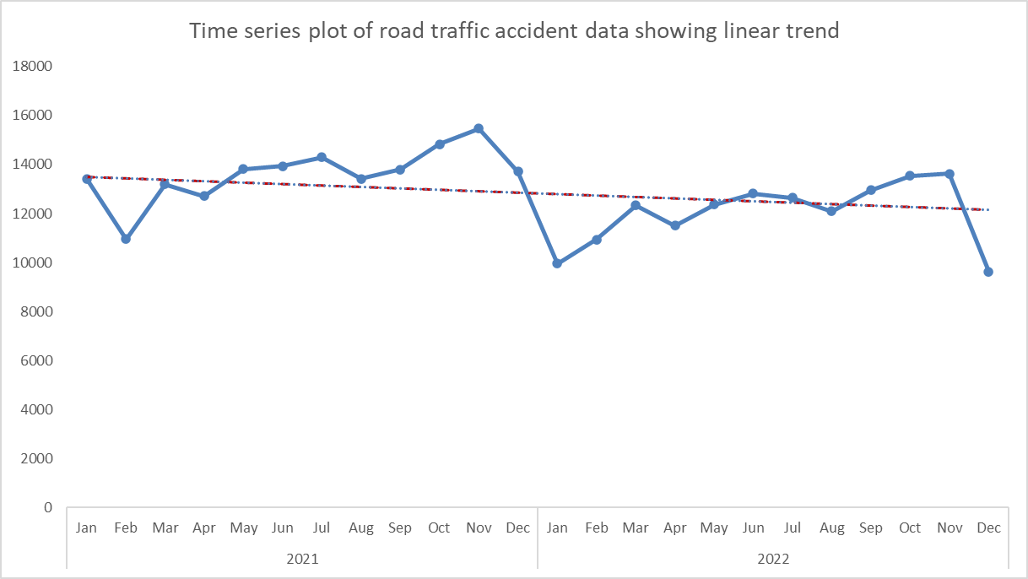
Statistical Analysis
Trend analysis and forecasting
Downward trend – average decrease in accident for the period under study
Seasonality evident with a drop in April and a spike in November for both years
.

Slide 14
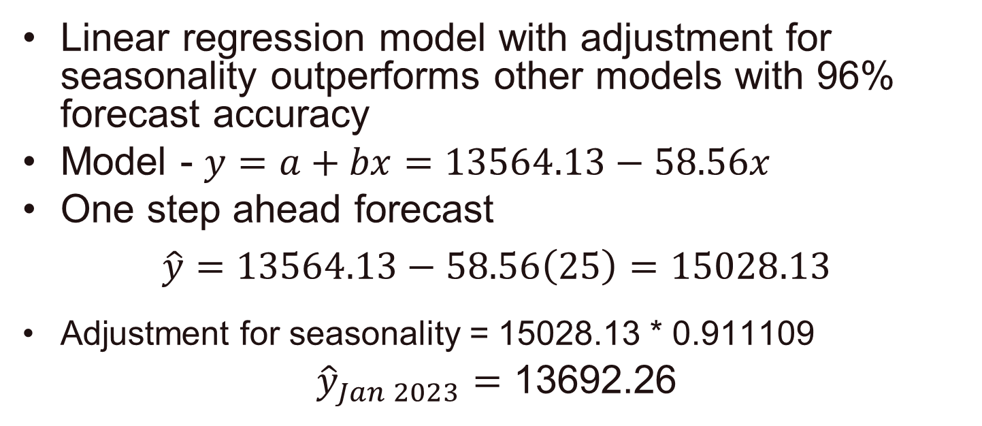
Statistical Analysis
Exploring other forecasting models
Linear regression model with adjustment for seasonality outperforms other models with 96% forecast accuracy
Model - $y=a+bx=13564.13−58.56x$
One step ahead forecast
$$\hat{y}=13564.13−58.56\left(25\right)=15028.13$$
Adjustment for seasonality = 15028.13 * 0.911109
${\hat{y}}_{Jan 2023}=$ 13692.26

Slide 15
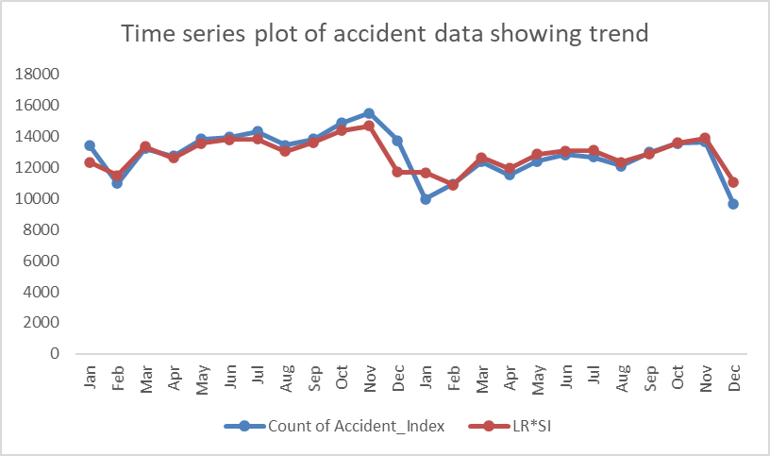
Statistical Analysis

Slide 16
Statistical Analysis
Correlation analysis
Number of Casualties and Number of Vehicles (Correlation: 0.234)
Number of Casualties and Speed limit (Correlation: 0.137)
Number of Vehicles and Speed limit (Correlation: 0.080)
Conclusion
All three variables show positive but weak correlation
Weak relationship suggests that:
The number of vehicles does not strongly predict the number of casualties.
Speed limit has very little direct influence on the
number of casualties in this dataset.
Higher speed limits don't directly influence vehicle numbers

Slide 17
Recommendations
Policy
Speed Limit Review
Enforcement
Infrastructure improvement
Improved Lighting at Night
High-Friction Surfacing
Improved Drainage
Public awareness
Junction and Vehicle-Specific Campaigns
Wet Weather Driving

