Slide 1
Dynamic Resource Allocator using router data

Slide 2
What are we solving- Setup
In a compute cluster, there can be multiple application running inside a virtual machine (VM). These virtual machines are hosted on a physical server E.g, a linux server.
A Datacenter typically have multiple types of physical servers. For current problem scope we will restrict the class of server to be- small, medium and large size servers. This classification can be done based on the physical resources on the server e.g., CPU, memory and network cards attached to the server.
A compute cluster typically have a resource allocator which assign a physical server to a virtual machine. This allocation can be a static pre-defined allocation which can be determined based on estimated load on servers during virtual machine launch time.
A pictorial view of this setup is depicted in the next slide.

Slide 3
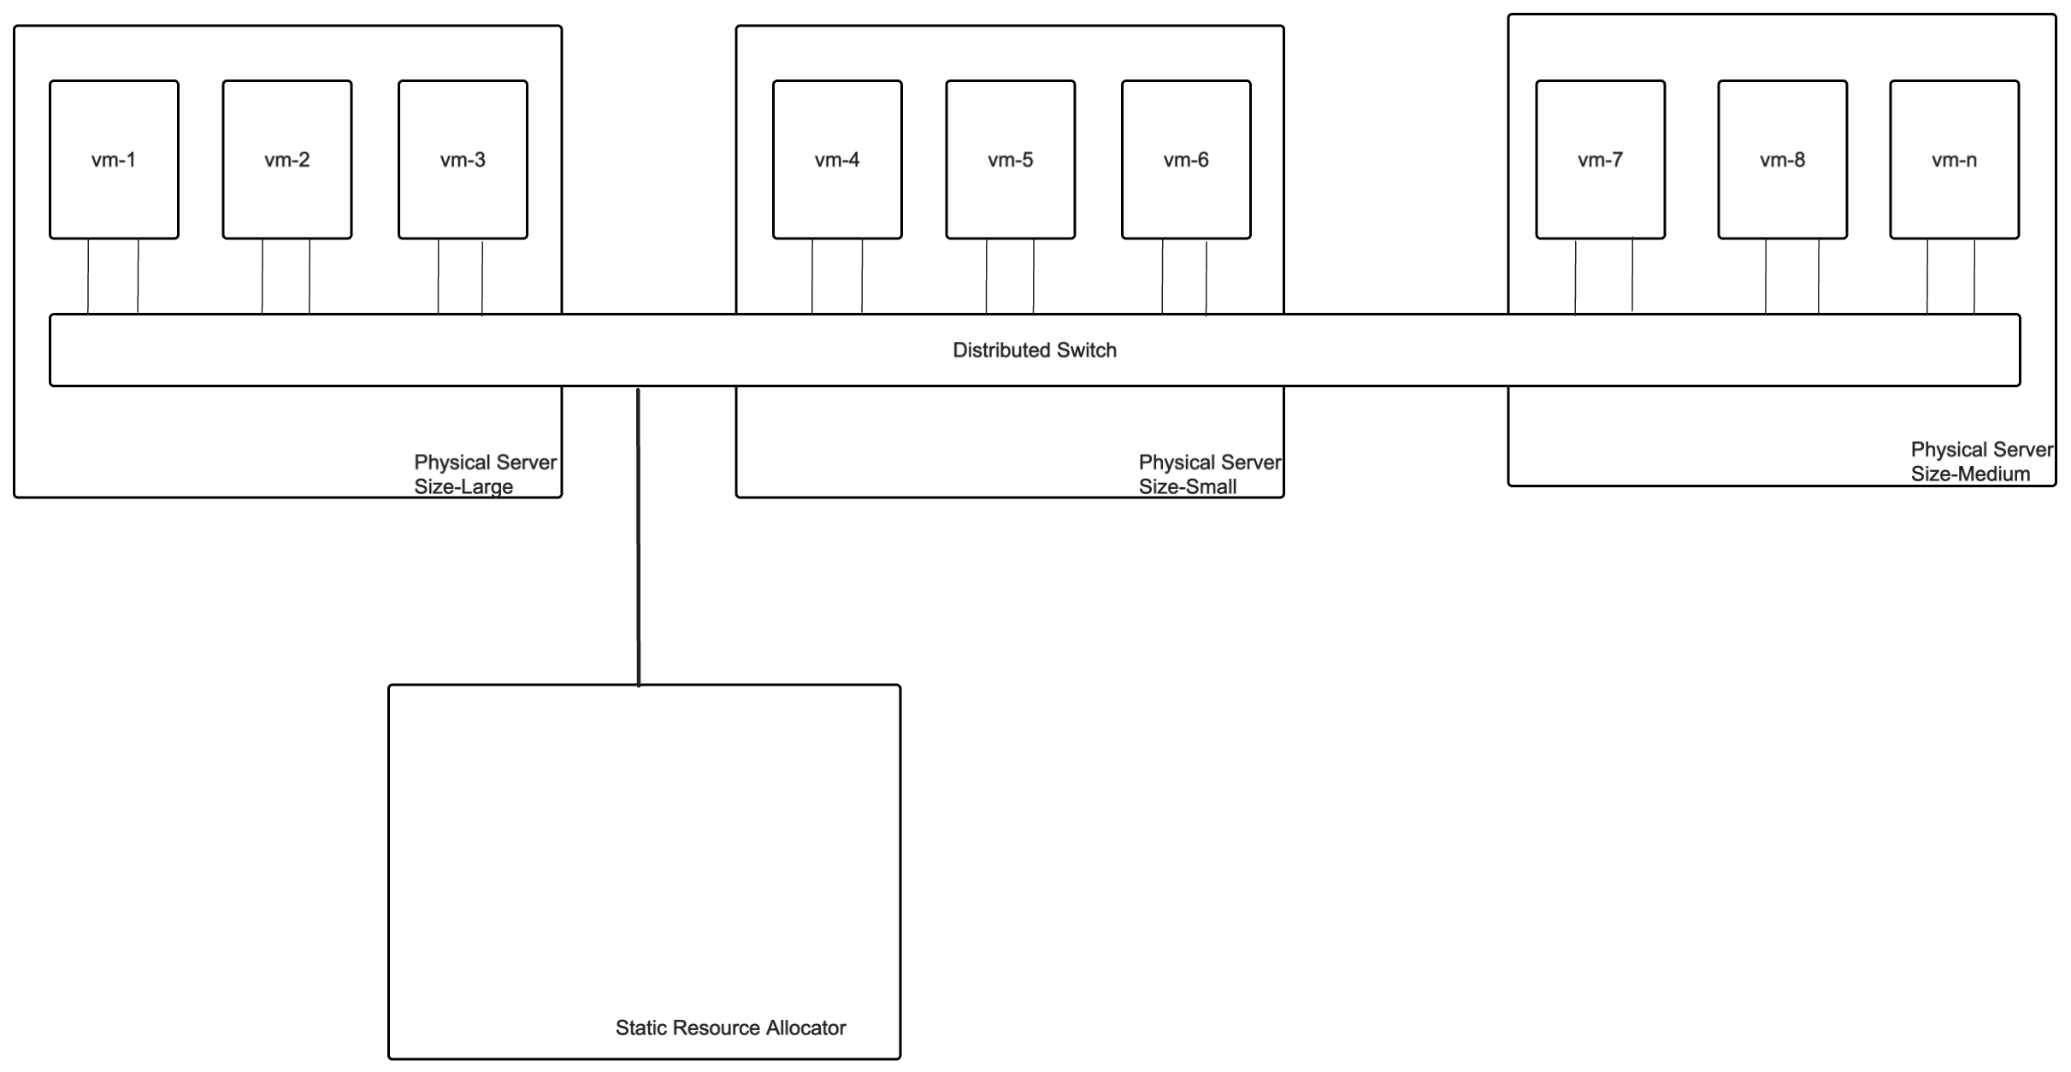

Slide 4
What we are solving- problem description
Instead of pre-assigning virtual machine to a physical server, we can model resource requirements of a virtual machine based on the historical pattern of the resources consumed by the virtual machine. This pattern can be represented by timeseries graph of resources used by VM in the past. Based on this model, we can predict future resource requirement of the virtual machine.
Using this prediction, we can better assign virtual machine to the physical server. This problem assume there are solutions available to dynamically move a running VM from one physical server to another based on model’s prediction.
A conceptual view of the solution is depicted in the next slide.

Slide 5
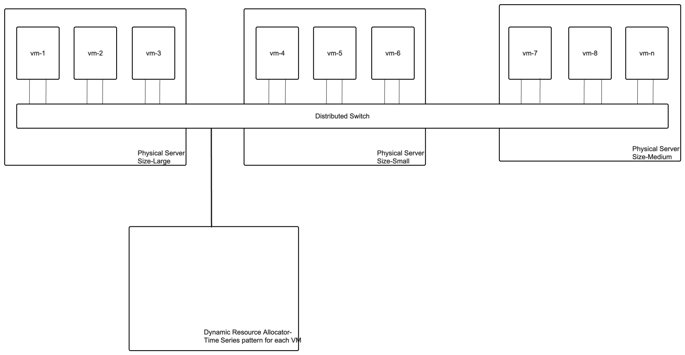

Slide 6
Why it is important
This technique will help to optimize the use of physical servers
It will prevent over subscription of a physical server as it may help to pervert server overloading.

Slide 7
What can we do to achieve this- Parameters
There can be multiple parameters which can be used to determine optimal resource allocation.
E.g.,
There can be time intervals where a VM might need more resources e.g., an application running inside a VM may need to access more data during a weekday compared to a weekend or vice-versa. Model can be trained for this pattern which can predict the same and thus help resource allocator to move VMs between “large” and “small” size servers.
Grouping of VMs with similar network access. E.g., VM can be assigned to different groups in an organization e.g., Engineering group, sales and marketing group etc. It can be expected engineering group will use similar services and thus can be grouped together and similarly for sales and marketing team grouping. A model can learn this pattern and group VMs together.
Grouping of VMs with application serving geographically close locations E.g., depending on time-zone or holiday season there will be some time where a set of VMs will be more active compared to rest of the times.

Slide 8
What we plan to do- Network access
We plan to learn network access pattern of VMs and based on network access pattern, we plan to classify VM or forecast network access requirement for the VM
We plan to use techniques as leant in a recommendation system to learn the access pattern for the network data coming out and going inside of the VM. We will use clustering technique to classify/groups sets of VM.
By grouping a set of VMs, resource allocator can use this information to place similar VM in a single type of server.
Note– this may be one of the parameter that dynamic resource allocator will use. Resouce allocation is a complex problem, and we plan to focus on only one aspect of the solution.

Slide 9
Data to be used-
https://www.kaggle.com/code/ernie55ernie/time-series-visualization-of-network-activity?select=Mirai_Botnet.csv
Target- From the above data- we want to assign VM to the physical server based on following parameter described in the initial slides-
>>Grouping of VMs with similar network access. E.g., VM can be assigned to different groups in an organization e.g., Engineering group, sales and marketing group etc. It can be expected engineering group will use similar services and thus can be grouped together and similarly for sales and marketing team grouping. A model can learn this pattern and group VMs together.

Slide 10
Initial data analysis
I picked a network traffic data from Kaggle-https://www.kaggle.com/code/ernie55ernie/time-series-visualization-of-network-activity?select=Mirai_Botnet.csv
I used PCA clustering technique to group network services in a cluster. A network service is represented by the destination IP address of the traffic streams.
An IP address consists of a network address and a host address using octet value of the IP address, I split the destination IP address in the octet and used octet as the PCA classification feature (python notebook is uploaded in the git repo).

Slide 11
PCA clustering- destination IP address
Using octet in the destination IP address, we clustered IP address using IP address’s octet value
From the dataset and PCA on destination address, we get 8 clusters of services. Cluster is shown in the next slide
Next task-
After creating clusters of destination IP address, we can use classification technique e.g, n-nearest neighbor on the traffic coming out of VM to see which cluster that VM can be mapped to and assign the physical server accordingly.

Slide 12
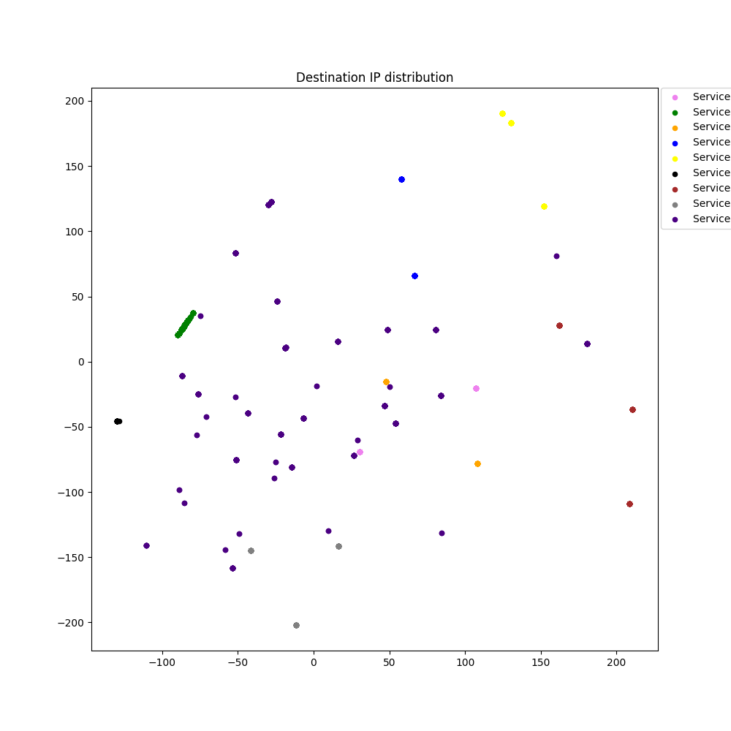

Slide 13
Results
After using PCA clustering on the destination IP address of network traffic, I was able to use k-nearest neighbor gridsearchCV to find optimial mapping of test data and determine which cluster the test data maps too.
Destination IP address represents the service that network traffic is directed to and src ip represent the VM from which the network traffic is originated and hence, we can use this clustering to group VMs which access similar network services.
Grouping VM and placing them in a single physical server will help to define policies of grouped VM and with caching algorithm overall performance can be improved.

Slide 14
Thanks

