Slide 1


“Anterior and Nasal Transposition of Inferior Oblique Muscle” A Case Report.
POSTER
Dr. Sasikala Elizabeth
Medical Consultant, Aravind Eye Hospital
Coimbatore
No Financial Interests
STRAIGHT 2020

Slide 2
ABSTRACT
20 year-old lady presented with residual esotropia, dissociated vertical deviation (DVD) and inferior oblique over-action.
She underwent horizontal rectus muscle surgery and anterior and nasal transposition(ANT) of Inferior oblique(IO) muscle.
Postoperatively she was orthotropic and showed resolution of DVD and inferior oblique over-action providing an excellent motor outcome.

Slide 3
INTRODUCTION
Characteristic of DVD:
Spontaneous upward drifting of one or both eyes when binocularity is blocked; when fixation is regained, the upward drift slowly returns to the primary position without any re-corrective movement in the contralateral eye.¹
Surgical procedures for treating DVD
Superior rectus muscle recession with or without posterior fixation suture
Inferior rectus (IR) muscle resection
Inferior oblique (IO) muscle dis-insertion
IO recession and inferior oblique muscle anterior transposition (ATIO).²
The optimal placement of IO has been debated.
Stager et al proposed transposition of the inferior oblique nasal to the nasal border of the inferior rectus insertion as an option for correction of DVD.³
We present the effective outcome of ANT for a case of DVD with concurrent IOOA

Slide 4
CASE REPORT
A 20-year old lady presented with complaints of upward deviation of right eye(RE) and residual esotropia.
On reviewing her previous surgical records, she had prior left eye(LE) horizontal rectus muscle surgery along with LE ATIO done one year ago.
On Examination: Best corrected visual acuity RE 20/20, LE(-1.25 DSph) 20/20.
Orthoptic evaluation with prism bar cover test fixing at 6 m distance, 60 Prism Diopter(PD) esotropia. With base down prism cover test 16 PD RE DVD and 3 PD LE DVD in primary position.
There was no significant pattern difference. She had RE IOOA graded +3.(Figure 1- 9 gaze: preoperative photograph).
She had alternate suppression(W4DT) and did not have stereopsis.

Slide 5
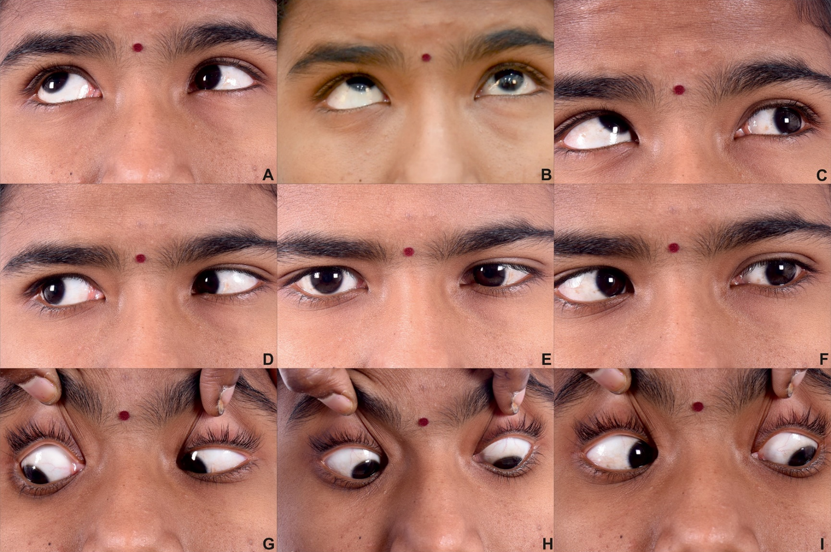
Figure 1 : 9 gaze preoperative photograph showing residual esotropia(E), right eye over-elevation in adduction(B) and right eye inferior oblique overaction (C)

Slide 6
CASE REPORT- Surgical technique
Under LA - Limbal conjunctival peritomy done, right medial rectus recessed by 5.5mm. Lateral rectus(LR) and IR were isolated using Stevens hook.
After hooking and isolating right IO, full thickness locking bites were taken using double armed 6-0 vicryl suture. Care was taken to include all the inferior oblique fibers. A hemostat was placed beyond the suture, closer to the IO insertion.
Following this the muscle was cut in front of the hemostat. While reattaching the IO for ANT, the posterior fibers were attached 1 mm nasal to the nasal border of IR insertion and then the anterior fibers were attached 3 mm nasal to the first suture. (Figure 2- Intraoperative picture showing ANT of IO).
LR resection of 8mm was completed. Conjunctiva was closed with interrupted 8-0 vicryl sutures.

Slide 7
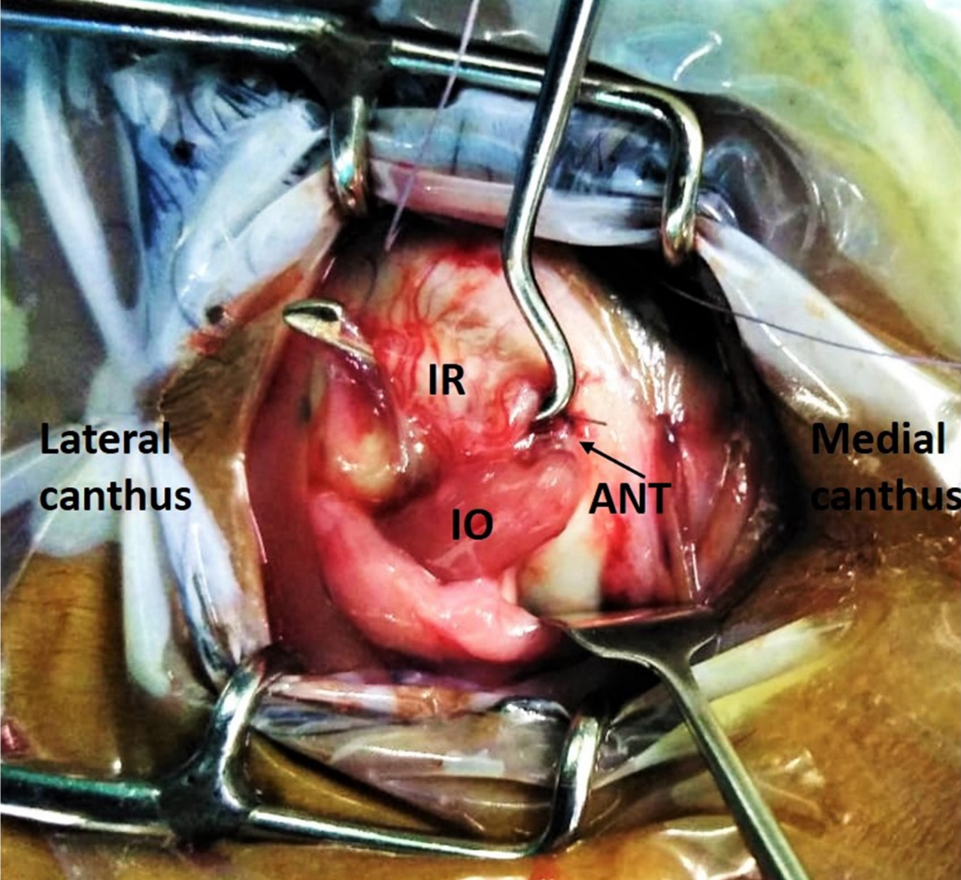
Figure 2 : Intraoperative photograph. Black arrow indicating final position of right eye inferior oblique(IO) placed anterior and nasal to inferior rectus(IR)

Slide 8
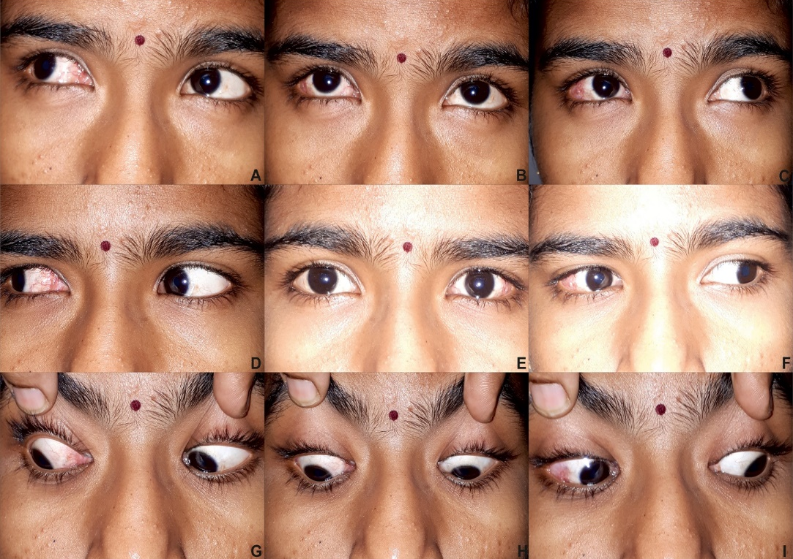
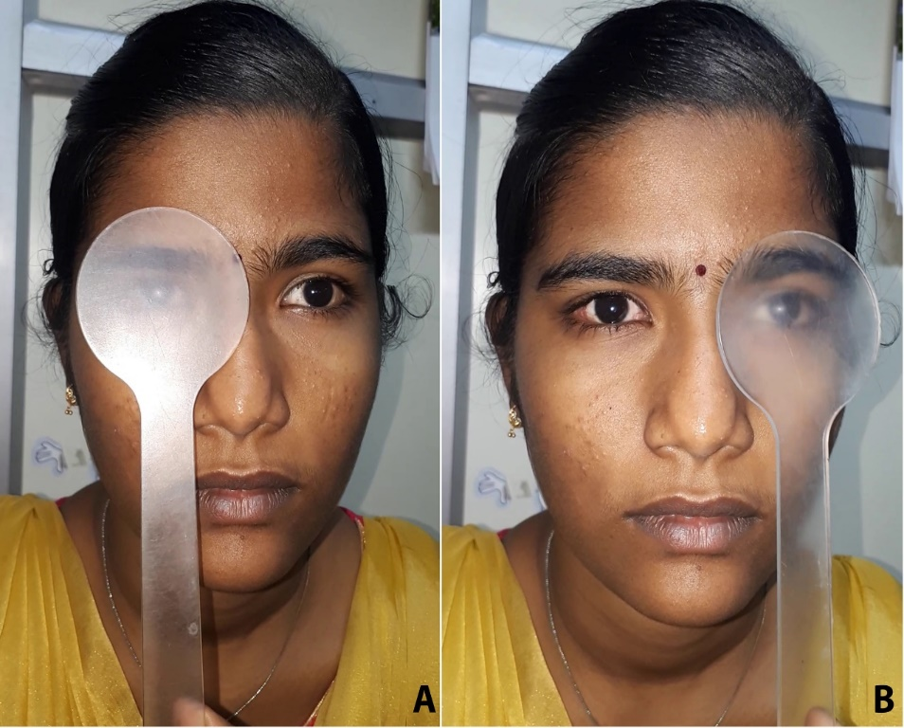
Post-ope: 4 PD E & 3 PD DVD in OU in primary position for distance.
(Figure 3- Post-op: 9 gaze photo & Figure 4- Post op resolution of DVD)
She had complete resolution of RE over elevation in adduction.
Figure 3: Post op 9 gaze photo showing orthotropia(E) & resolved over elevation in adduction of right eye(C)
Figure 4: Post op photo showing resolution of DVD under the speidelman occluder

Slide 9
DISCUSSION
Several surgical management strategies had been described to control DVD. ATIO remains the standard treatment for DVD and IOOA⁴.
Stager et al in 2001 proposed transposing IO not only anteriorly but also nasally to the nasal border of IR³.
In this technique, the IO is positioned anterior to x axis and nasal to y axis, which changes IO from an elevator and extorter to a depressor and intorter in adduction and improves all components of DVD.⁵
A study by Engman et al⁷ for ATIO, obtained an excellent outcome in only 25% of patients with >15 PD of DVD suggesting that ATIO- the standard procedure, can be less effective in patients with larger amounts of DVD.

Slide 10
DISCUSSION
Fard et al⁶ studied in 10 patients the outcomes after ANT of the IO muscle for DVD with IOOA.
For patients who had less than 15 PD of preoperative DVD, 100% had an excellent outcome (Post Op DVD 0-5 PD).
Among patients with pre op DVD of more than 15 PD, 53% had an excellent outcome and 47% had a fair outcome (Post Op DVD 6-10 PD); Three of 20 eyes developed (–1) under-elevation in adduction after surgery.
These patients presented with bilateral asymmetric IOOA of 1+ and 3+ and DVD asymmetry of more than 10 PD.

Slide 11
DISCUSSION
Farid et al⁸ compared the results of ATIO vs ANT IO in management of DVD associated with IOOA in 21 patients.
Among eyes with pre-operative DVD of >14 PD who underwent ATIO, none had excellent outcome, 44% had a good outcome and 56% had a fair outcome.
In eyes who had preoperative DVD >14 PD who underwent ANT, 37.5% had an excellent outcome and 62.5% had a good outcome; in the same study, eye with DVD < 14 PD who had ANT 100% had excellent outcome.
Post-operative hypotropia was reported in 2 out of 19 eyes as complication of ANT procedure. They proved ANT to be equally effective to ATIO.
IOAT stands as the standard procedure for managing DVD with IOOA.
Bilateral ANT can be safely chosen as procedure of choice in eyes with bilateral large symmetrical DVD >14 PD and symmetrical IOOA.
So, proper case selection and long term follow up are required while choosing ANT.

Slide 12
CONCLUSION
ANT procedure can be considered as a safe option for large DVD with IOOA with minimal complications.
Management of DVD is case based. Proper measurement of DVD and planning appropriate procedure will provide optimal outcome.
REFERENCE:
Von Noorden GK, Campos EC. Binocular Vision and Ocular Motility. Mosby: St Louis, MO, USA, 2002, pp 378–385
Esswein MB, von Noorden GK, Coburn A. Comparison of surgical methods in the treatment of dissociated vertical deviation. Am J Ophthalmol 1992; 113: 287–290.
Stager DR Sr, Beauchmp GR, StagerDR Jr, Anterior and nasal transposition of inferior oblique muscle: A preliminary case report on a new procedure. Binocul Vis Strabismus 2001;16:43-4
GonzalezC, KleinB. Myectomy and anterior transposition of the inferior oblique: a new surgical procedure and its results in 49 operations. Binoc Vis Eye Muscle Surgery Qtrly 1993; 8: 249–258
Hussein MA, Stager DR Sr, Beauchmp GR, StagerDR Jr, Felius J. Anterior and nasal transposition of the inferior oblique muscles in patients with missing superior oblique tendons. J AAPOS 2007;11:29-33.
Fard MA. Anterior and nasal transposition of the inferior oblique muscle for dissociated vertical deviation associated with inferior oblique muscle overaction. J AAPOS 2019;14:35-38.
Engman JH, Egbert JE, Summers CG, Young TL. Efﬁcacy of inferior oblique anterior transposition placement grading for dissociated vertical deviation. Ophthalmology 2001; 108: 2045–2050.
Farid MF. Anterior transposition vs anterior and nasal transposition of inferior oblique muscle in treatment of dissociated vertical deviation associated with inferior oblique overaction. Eye (2016), 1-7

