Slide 1
TITLE
An app-based solution that grants market access to micro and small enterprises.

Slide 2
This challenge focuses on enhancing the market presence and operations of micro and small enterprises (MSEs), which are vital components of local economies. MSEs often face limitations in resources and technology, hampering their growth potential. The solution involves the development of a user-friendly mobile app platform to empower MSEs. The app aims to facilitate direct interactions with customers, streamline logistics, ensure secure transactions, offer data insights, and provide resources for capacity building. It prioritises scalability, regional adaptability, and data security, with the ultimate goal of revolutionising MSE operations, fostering growth, resilience, and increased economic contributions to local communities. By addressing these critical aspects, this initiative seeks to unlock the potential of MSEs, enabling them to overcome barriers and significantly contribute to local economies, ultimately transforming the way they operate and interact with larger markets.
ABSTRACT

Slide 3
Our project aims to create a game-changing app that connects micro and small enterprises with the market they need to thrive. By offering a user-friendly platform for businesses to showcase their offerings and consumers to discover and support them, we're committed to empowering local entrepreneurs and fostering economic growth.
INTRODUCTION

Slide 4
PROPOSED SYSTEM
Centralized Marketplace App
Vendor & Buyer Onboarding and Verification
Product/Service Listings
Advanced Search and Filters
Geolocation Integration
Secure Payment Processing
Customer Reviews and Ratings
Customer Support

Slide 5
EXISTING SYSTEM
BIGBASKET:
Online Grocery Delivery: Big Basket is an online grocery delivery platform that focuses on providing users with a convenient way to order groceries and household essentials. Users can browse through a wide range of grocery items, add them to their cart, and schedule delivery. Big Basket primarily operates on a "buy and deliver" model, where customers purchase items, and the platform handles the delivery logistics. The platform integrates local and regional sellers to fulfill orders.

Slide 6
DRAWBACKS OF EXISTING SYSTEM
This model may not inherently support the direct exchange of products
Requires lot of storage to store the products, and may leads to wastge if not sold
Not negotiable by the sellers to quote their own price
cannot buy large number of goods at a time

Slide 7
ARCHITECTURE
User-Facing Components : Mobile App or Web App
Database : User data, Product images and videos
Payment Gateway Integration : For secure payments
Analytics and Reporting : Tools to track user behavior
Security and Compliance : Authentication and encryption
Third-Party Integrations : For Geomapping, Socialmedia, Marketing tools
Load Balancers : To distribute incoming traffic
Monitoring and Error Handling : To reduce the error
Data Backup and Disaster Recovery

Slide 8
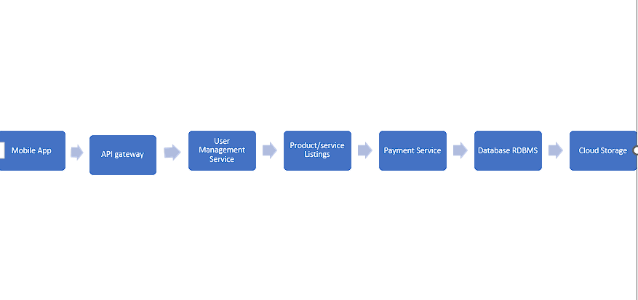
Architecture...

Slide 9
SOFTWARE REQUIREMENTS
Operating System
Development Tools
Programming Languages
Database Management System
API Development Tools
Cloud Services
Security Tools
Analytics and Monitoring Tools

Slide 10
HARDWARE REQUIREMENTS
Development Machines
Server Infrastructure
Mobile Devices for Testing
Backup and Redundancy
Load Balancers
Security Equipment

