Slide 1

Data Structure Discrete Mathematics Knight’s Travail
Division : A
Batch No. : A1
Group No. : 06

Slide 2
Team Members
01
02
03
04
Aditya Gaikwad
Ganesh
271002
22010088
271018
22010331
Harshit Kumar Singh
Ishwar Zatke
271021
22011072
271022
22010600

Slide 3
---Problem Statement---
“Choose a search algorithm for finding the shortest path that a knight can use. Applying the appropriate search algorithm to find the best possible move from the starting square to the ending square”

Slide 4
Introduction
We all know a knight moves two steps front and a step in other side or vice-versa in a chess games. This gives it eight positions to get on the square on the board.
We can use BFS to track its path taking minimum steps to reach the target position.
We can use queue with BFS method to track the path as it doesn’t reach again to same position.
We assigned the coordinates of the square of chess board.
We had included an GUI to display the board and the minimum step’s path for the knight to reach target the position.

Slide 5
ISSUES AND CHALLENGES
Understanding the implementation of the problem statement using BFS algorithm was a bit tricky at first.
Making GUI of chess board using graphics.h file was a challenge.

Slide 6
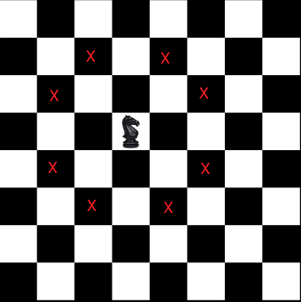
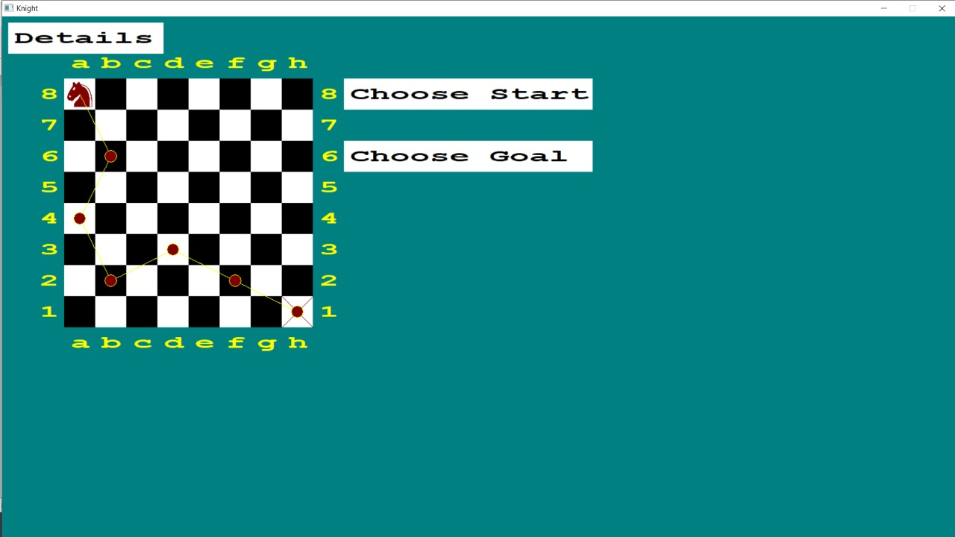
Knight’s Chances
Proposed Work
Minimum Path to travel

Slide 7
Breadth First Search
A traversing algorithm where you should start traversing from a selected node and traverse the graph layerwise thus exploring the neighbour nodes .
You must then move towards the next-level neighbour nodes.
You are required to traverse the graph breadthwise as follows:
First move horizontally and visit all the nodes of the current layer.
Move to the next layer

Slide 8
BFS- Working

Slide 9
: Algorithm :
1. Create an empty queue and enqueue the source cell having a distance of 0 from the source (itself).
Loop till queue is empty:
Dequeue next unvisited node.
If the popped node is the destination node, return its distance.
Otherwise, we mark the current node as visited. For each of eight possible movements for a knight, enqueue each valid movement with +1 distance
3.We can find all the possible locations the knight can move to from the given location by using the queue that stores the relative position of knight movement from any location.

Slide 10
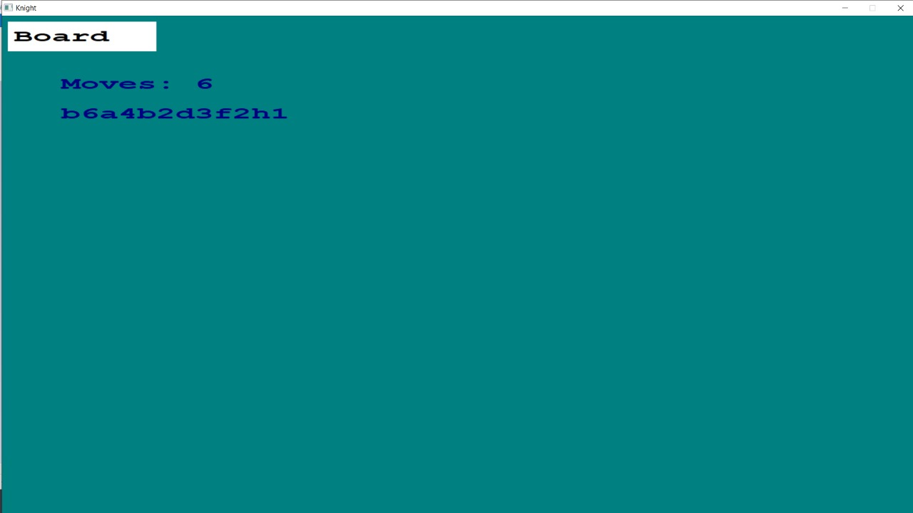
: Output :
Thus, using graphics we can see the path and also got the number of steps by knight to reach target position

Slide 11
--- Conclusion ---
01
02
03
04
Breadth First search was used to find the child node which was treated as the position of the knight after a step
Queue was used in BFS to store the position of the square which knight stepped after a step
Thus, graph theory was used to implement the algorithm in the program. Graphics was used in the program to implement the knight’s travail
Thus, we learned about implementation of graph for finding the minimum steps taken by knight to reach a target

Slide 12
-- References --
https://en.wikipedia.org/wiki/Breadth-first_search
https://www.programmingsimplified.com/c/graphics.h

Slide 13
Thank You !!!

