Slide 1
Lambton College WIL PROJECT
Mountain Analytics using Python and ML
Ganesh chaulagain(838561)
Hukamdeep Singh(C0834020)

Slide 2
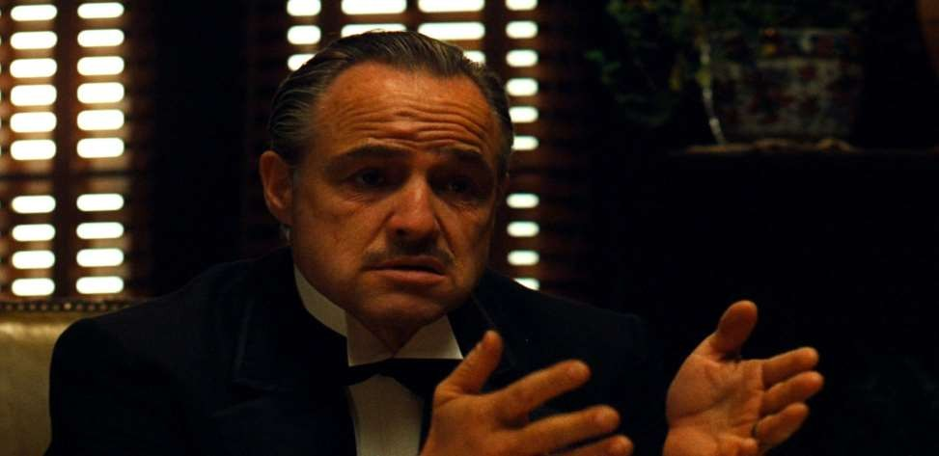

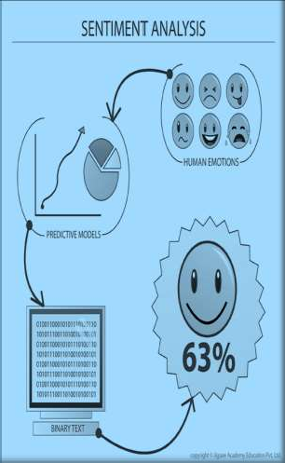




So tell me…
Which movie should I watch?
Accurate Rating
Good Recommendation Minimum Search
Quick Review classification
Rich User Engagement Personalization
Opinion Extraction Better Promotion

Slide 3
WHAT IS SENTIMENT ANALYSIS?
▶ It is classification of the polarity of given text in a document ,sentence or phrase.
▶ The goal is to determine whether the expressed opinion in the text is
positive , negative or neutral.
▶ Enable us to track attitudes and feeling on web based on blog posts, comments , reviews and tweets on differ topics
▶ Gives insight into the emotions behind the words.
▶ Recommendation of the movie genres.

Slide 4





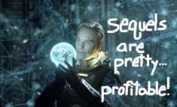
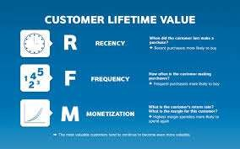

Can we do better? …………
YES!
$3000/wk * 50wks/yr=
$1,50,000/ year
Eliminate need of manual ratings
1000 reviews per movie 20 movies in a week
Whopping $ 3000 per movie!! Just to rate them!
Improve the success of Sequels
70% success rate for a blockbuster’s sequel 20 sequels on an average in a year Expected Revenue from sequel = $ 1400 million/year
At mere 1% of revenues as commission for improvement(90%)=
$200 mn*1% = $2 mn
Expanding the subscriber’s Lifetime value: Present user churn rate @ 50% accuracy= 25% LTV = ARPA x gross profit margin / customer churn
Average LTV = $8x11%/25% = $ 3.2/user
Ad revenue on recommendation websites
10 million unique users monthly Average revenue per engagement = $ 0.5
Current Revenue from 50% accuracy = $ 60 million
Increase LTV by 7 times for an rating improvement from 50%
to 85%
Potential Savings at 85% accuracy = $1.018 million

Slide 5
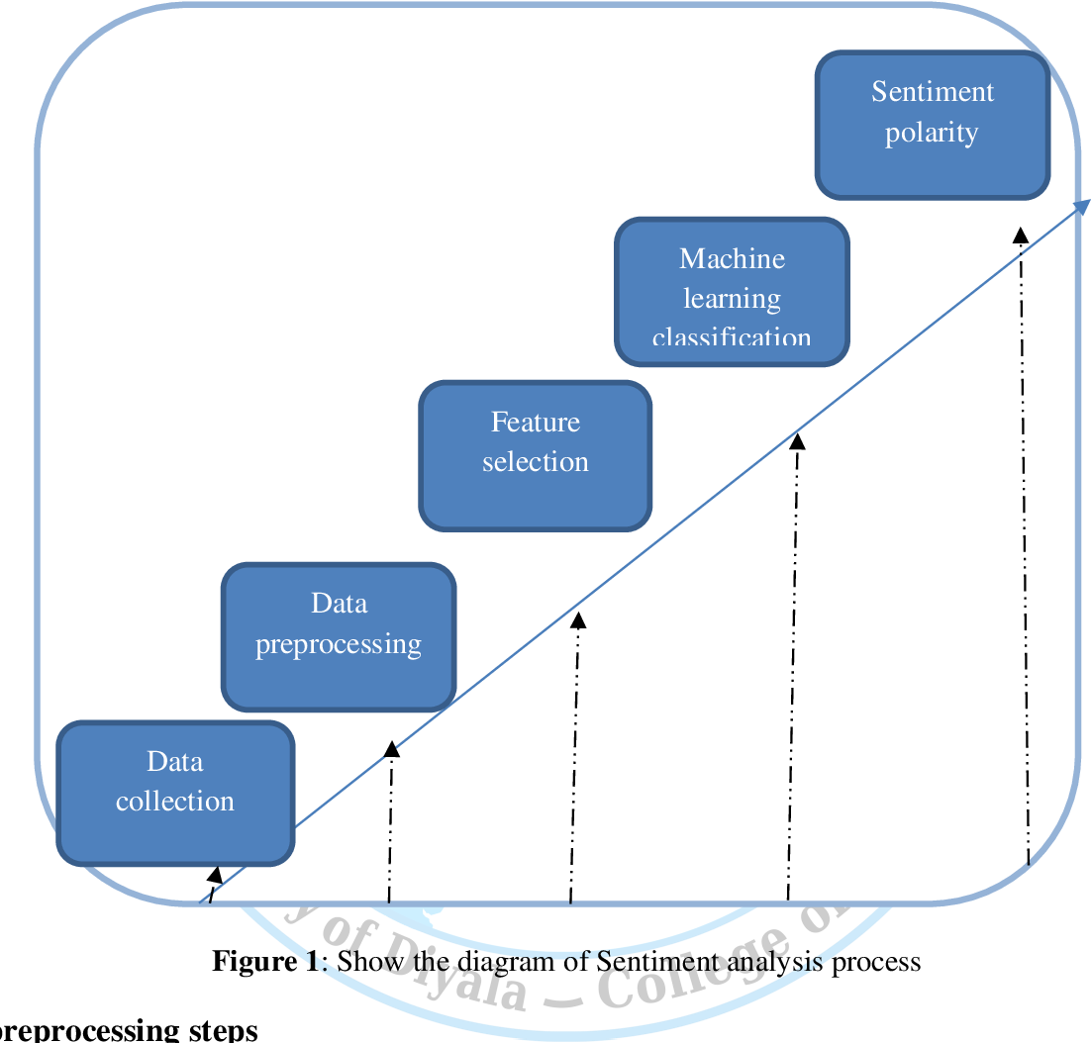
OVERVIEW OF WORKING OF SENTIMENT ANALYSIS

Slide 6
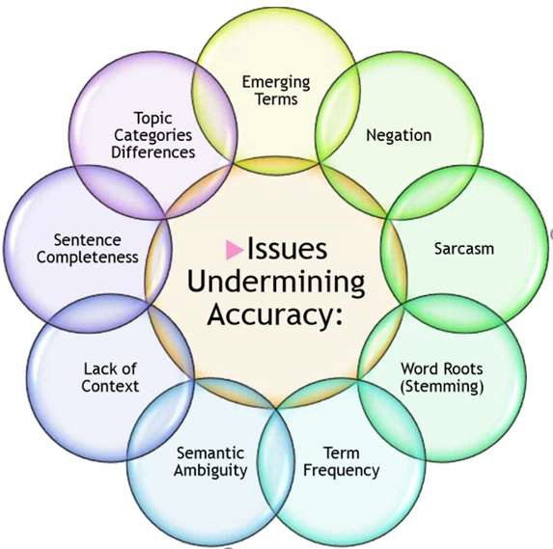
CHALLENGES:

Slide 7











GUESS THE REVIEW SENTIMENT!!
Review | Guess the sentiment | Rotten tomatoes’ |  | Our prediction
The movie is so thoughtlessly assembled
Director Tom Dey demonstrated a knack for mixing action and idiosyncratic humor in his charming 2000 debut Shanghai Noon , but Showtime 's uninspired send-up of TV cop show cliches mostly leaves him shooting blanks
Roman Polanski directs The Pianist like a surgeon mends a broken heart; very meticulously but without any passion
` Synthetic ' is the best description of this well-meaning , beautifully produced film that sacrifices its promise for a high- powered star pedigree
A film of empty , fetishistic violence in which murder is casual and fun

Slide 8
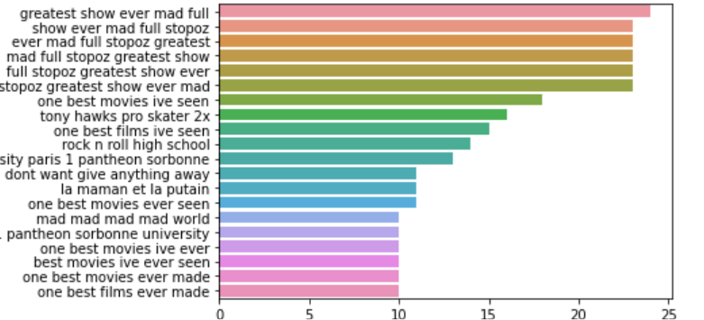
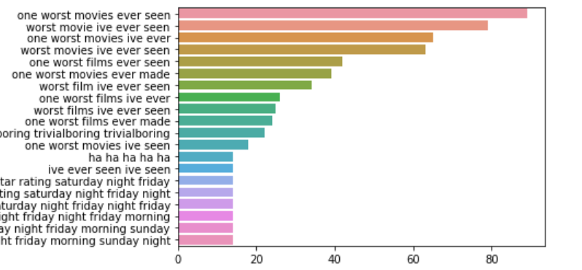
POSITIVE VS NEGATIVE

Slide 9
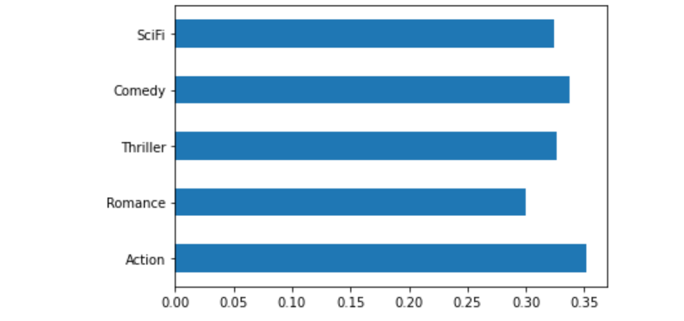
Recommendations

Slide 10




WAY FORWARD
3) Algorithmic Improvement :
Improve Algorithms to interpret ambiguous phrases
eg: This is great – this is not great - this could be
great - if this were great – this is just great
Can we make it more robust?
2) Category expansion:
Expose the sentiment analysis as API for consumption by books, entertainment and ecommerce websites
Can we expand
the market scope?
Suggest right movie for improving
TRP
No precise method behind screening movies on TV network - Flat rate based on popularity at box office
Can we reuse our model?

Slide 11
THANK YOU

