Slide 1

PREDICTIVE TEXT
Daniel I. 01FB15ECS086
Durga Akhil M. 01FB15ECS097
Ganesh K. 01FB15ECS104
Rahul R. Bharadwaj 01FB15ECS366

Slide 2
Problem Statement
To create a system which, given input as a part of a complete English sentence, can predict :
next word in the sentence
generate the next sequence of words.

Slide 3
Dataset
1. Corpus of Contemporary American English (COCA)
The Corpus of Contemporary American English (COCA) is the largest freely-available corpus of English, and the only large and balanced corpus of American English.
Instance count: Each of the n-gram datasets contains the following number of n-grams:
2-gram: 1,020,386
3-gram: 1,020,010
4-gram: 1,034,308
5-gram: 1,044,269
This was the primary dataset for testing the goodness of fit for every other dataset as it was exhaustive. We also trained using this dataset for next-word prediction as well as generating text.

Slide 4
Dataset
2. Wikipedia Corpus
About dataset: This corpus contains the full text of Wikipedia, and it contains 1.9 billion words in more than 4.4 million articles.
Attributes: Wikipedia Corpus contains Wikipedia pages scraped and dumped into text files. Since it is only for testing, we used random articles with a total of 2286765 words.
Usage: The corpus is pre-processed using following steps:
Read all the lines of the input file.
Remove all unwanted characters and punctuations.
Remove lines with very few words.
Convert everything to lower-case.
Run a sliding window on the words
This was the primary dataset with which we used to learn the model and apply goodness of fit test.

Slide 5
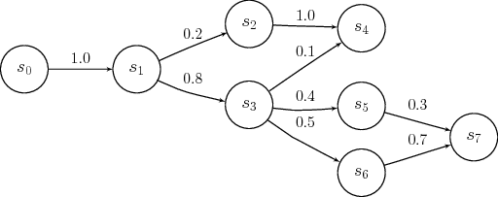
ML Techniques:
Markov Chain
A Markov chain is "a stochastic model describing a sequence of possible events in which the probability of each event depends only on the state attained in the previous event."
A common method of reducing the complexity of n-gram modeling is using the Markov Property.
The Markov Property states that the probability of future states depends only on the present state, not on the sequence of events that preceded it.

Slide 6
ML Techniques:
Recurrent Neural Networks:
RNNs make use of sequential information. A traditional neural network assumes that all inputs (and outputs) are independent of each other.
Since our project is to predict text, it is crucial to know the information from previous states, i.e. the previous words to predict the next word.
RNNs are called recurrent because they perform the same task for every element of a sequence, with the output being depended on the previous computations.
RNNs thus have a “memory” element to capture information from previous calculations.

Slide 7
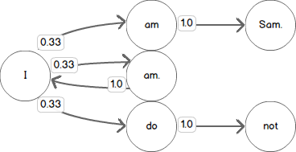
Design:
Markov Chains
Consider bigram model: Input: "I am Sam. Sam I am. I do not like green eggs and ham."
Listing the bigrams starting with the word I results in: I am, I am., and I do.
If we were to use this data to predict a word that follows the word I we have three choices and each of them has the same probability (1⁄3) of being a valid choice.

Slide 8
Design:
Recurrent Neural Networks
In order to train our recurrent neural network, we use a large text file (we have used the Harry Potter books) as input. This large text file undergoes preprocessing and is stored in the form of two arrays X and Y defined as:
X: which is a three dimensional array of the form X[i, t, char_indices[char]] where i is the index of each sentence, t is the index of each letter in each sentence and char_indices[char] indicates the letter encountered. Therefore, X is like the given input matrix.
Y: which is a two dimensional array of the form Y[i, char_indices[next_chars[i]]] where i is the index of each sentence and char_indices[next_chars[i]] indicates the letter which is encountered after encountering SEQUENCE_LENGTH (set to 40) characters of the sentence. Therefore, Y is like the expected output matrix.

Slide 9
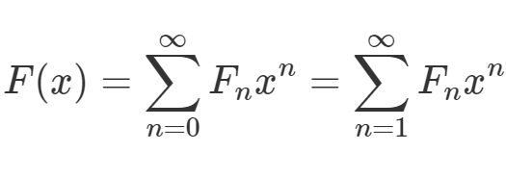
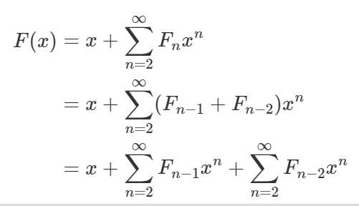
We begin by defining the generating function for the Fibonacci numbers as the formal power series whose coefficients are the Fibonacci numbers themselves:
We then separate the two initial terms from the sum and subsitute the recurrence relation for F_{n} into the coefficients of the sum:

Slide 10
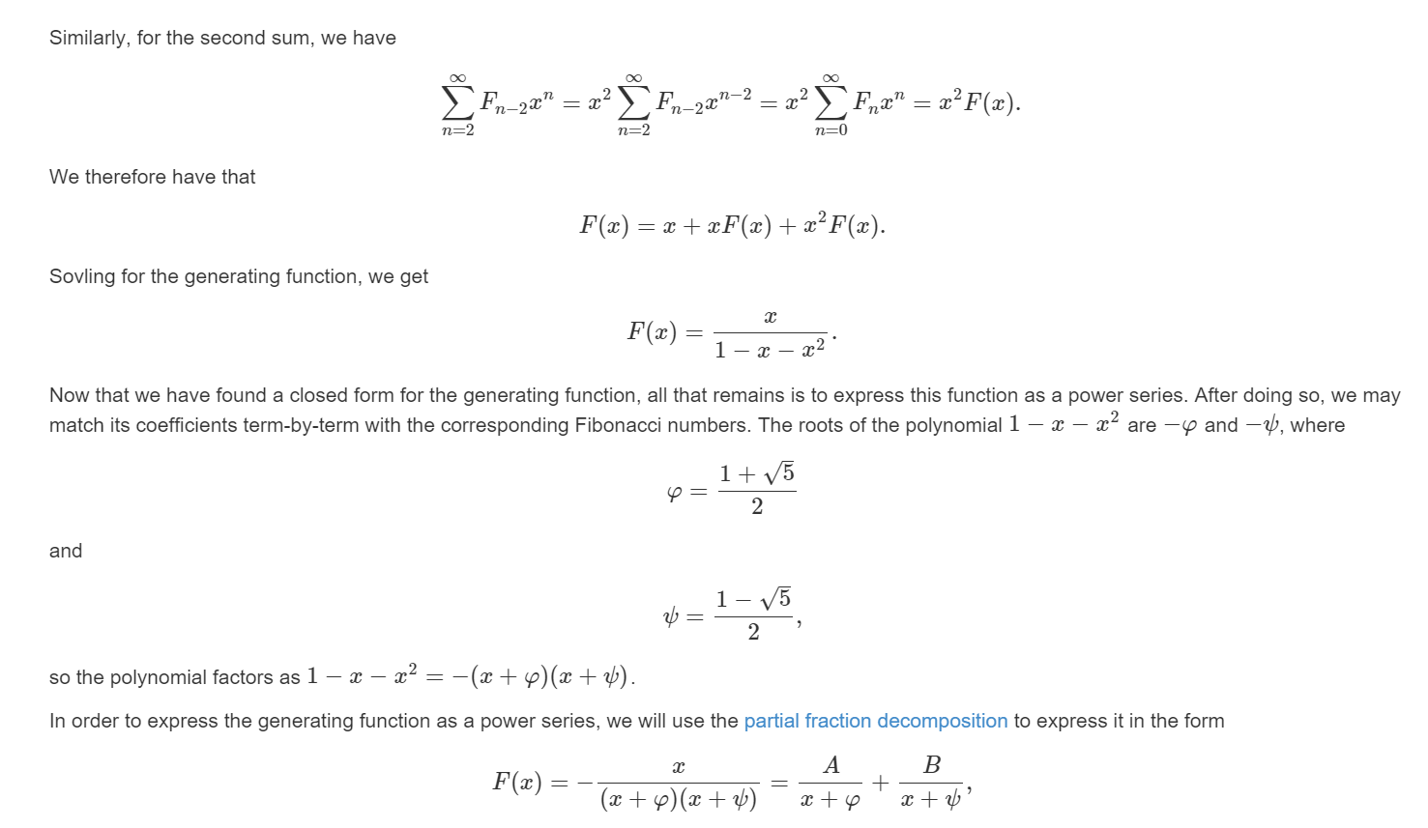

Slide 11
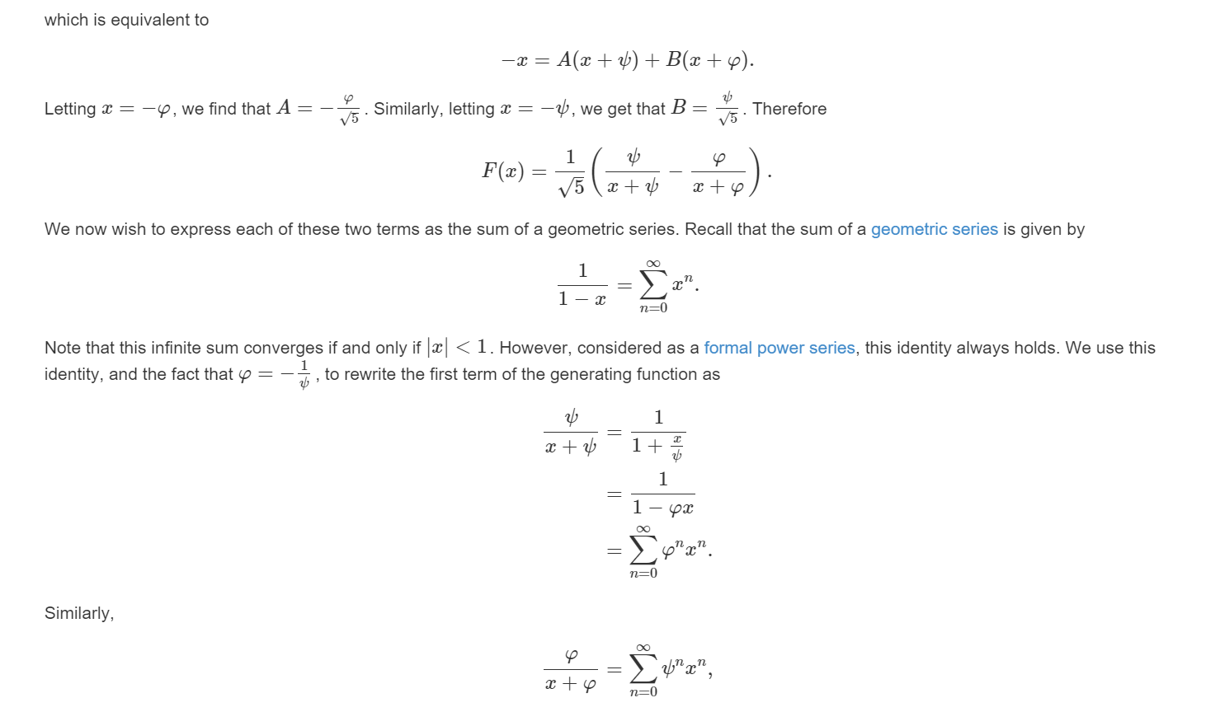

Slide 12
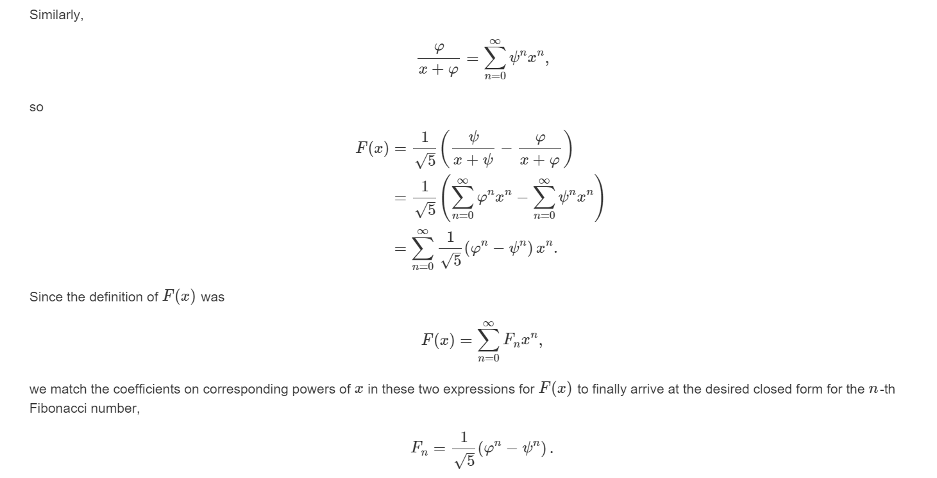

Slide 13
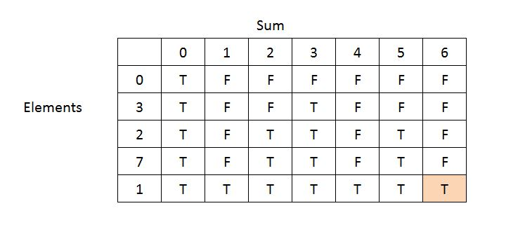
Subset Sum Problem

Slide 14
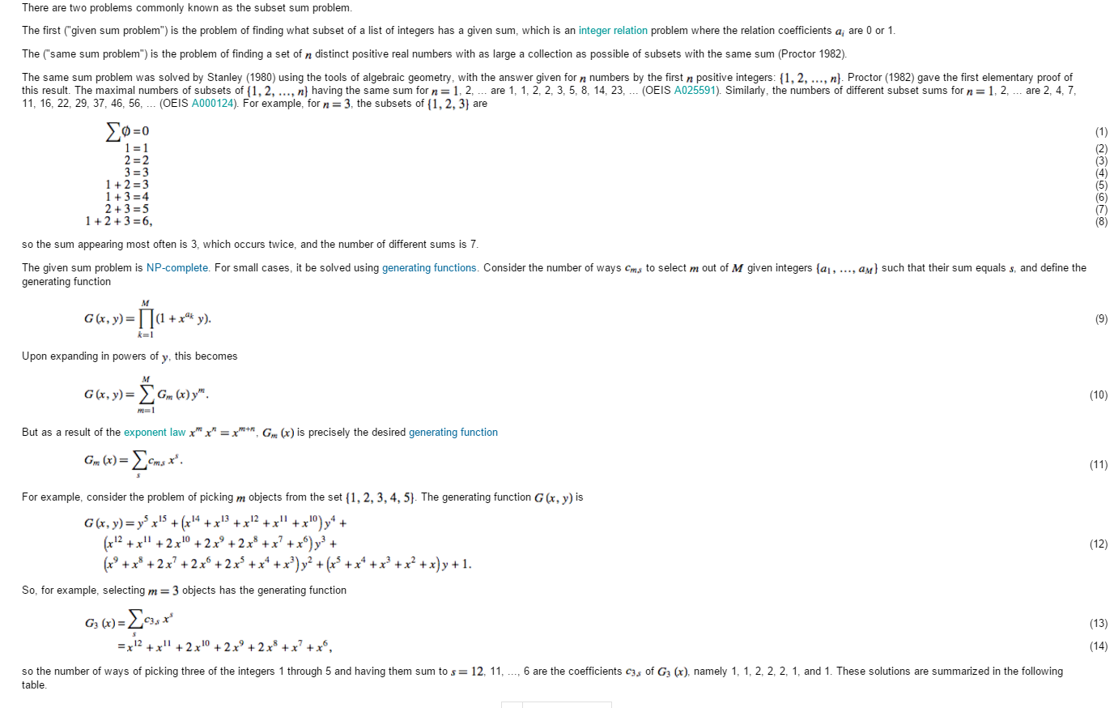

Slide 15
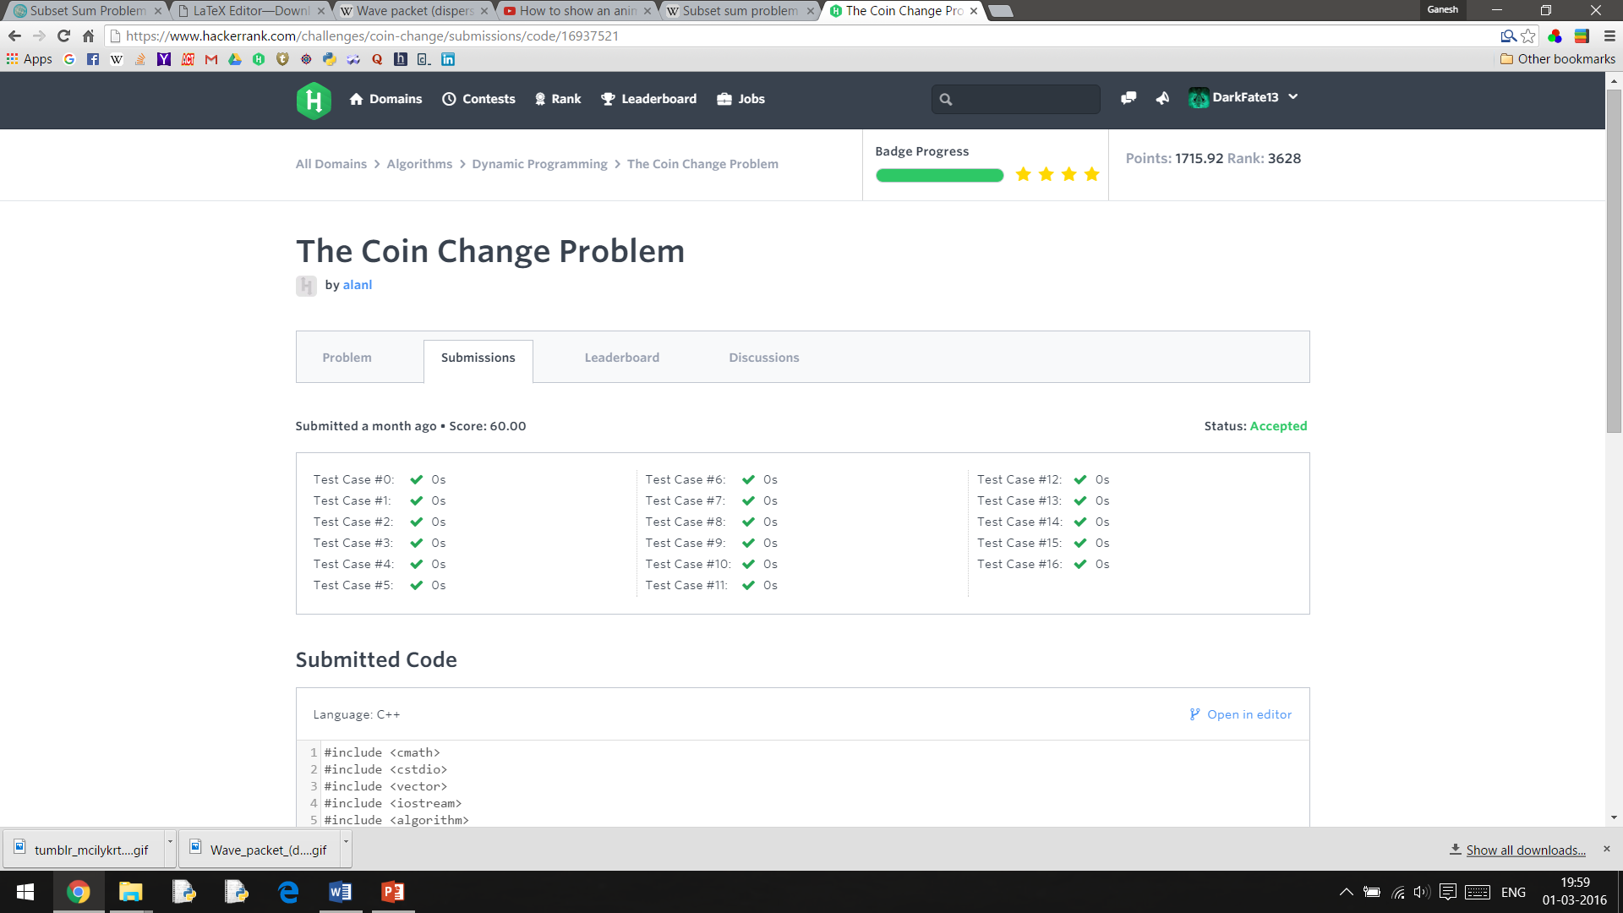

Slide 16
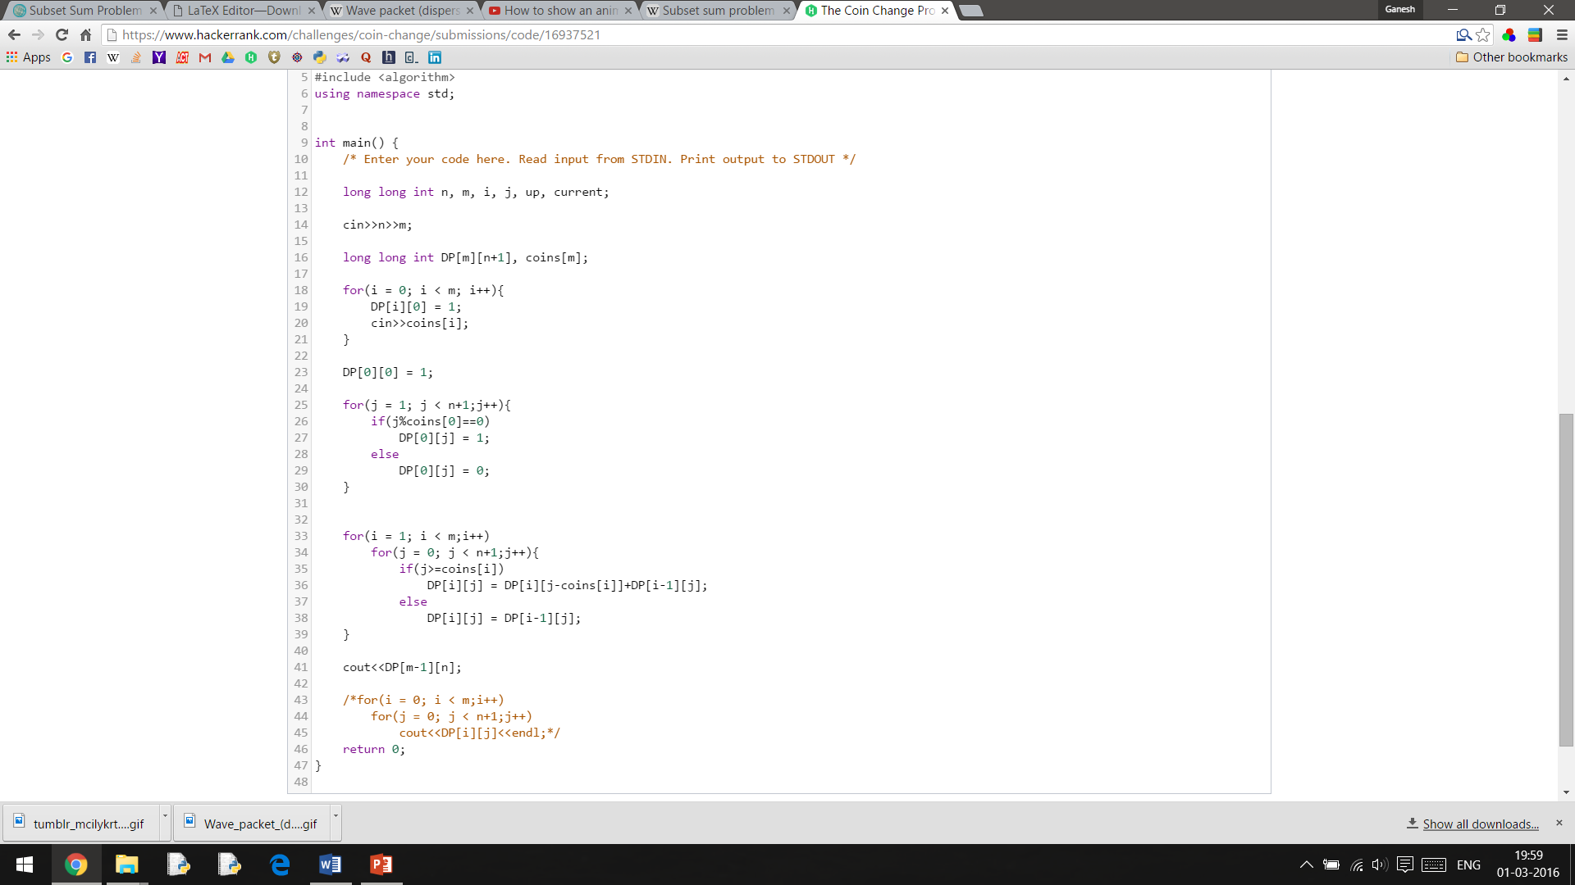

Slide 17
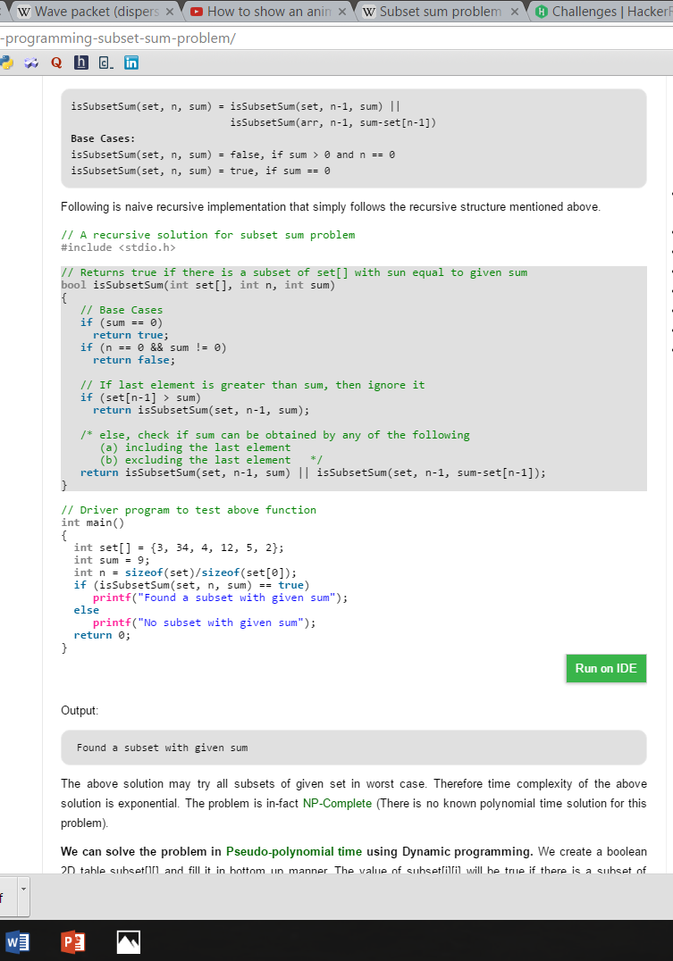

Slide 18


