Slide 1
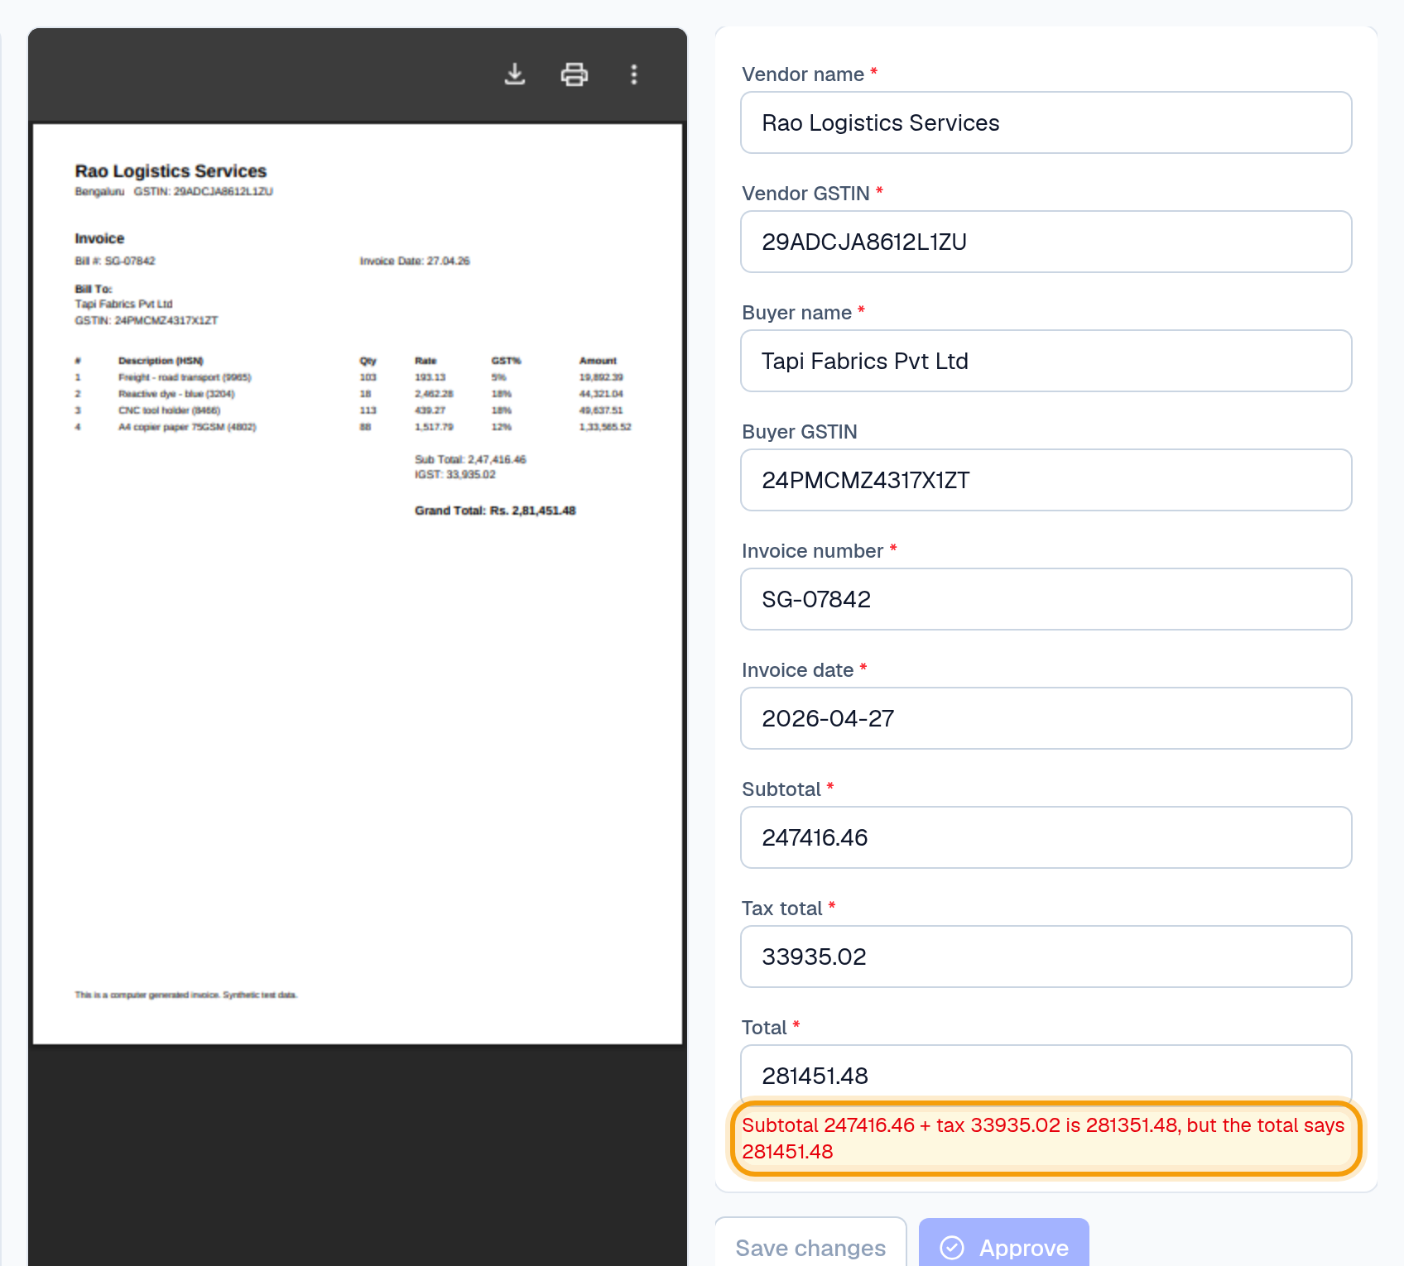
FOR CA FIRMS · SURAT
Client bills in.
Checked data out.
KnowledgeHub AI reads your clients' invoices, checks them against your rules, and gives your team a review screen where nothing goes out unapproved.
Ganesh Rajput · KnowledgeHub AI
Notes:
Thank them. Say: 'Before I show anything, can I ask how your office handles client bills today?' Ask the discovery questions from the playbook first (about 5 minutes). Then present.

Slide 2
THE MONTH-END REALITY
Every month, for every client
What we hear from CA offices:
1
2
3
4
Bills arrive everywhere
Typed in by hand
Mistakes found late
Deadlines don't move
WhatsApp photos, emails, PDFs and paper, often at month-end.
Vendor, GSTIN, invoice number, amounts: client after client.
Wrong totals, invalid GSTINs, the same bill entered twice.
GSTR-1 on the 11th, GSTR-3B on the 20th, and no trail of who changed what.
Question for you: how many hours did your team spend on purchase bills last month?
KnowledgeHub AI
2 / 16
Notes:
Don't lecture: ask the question at the bottom and listen. Write down the step that takes longest and anything that went wrong recently (missed credit, late filing, a notice).

Slide 3
HOW IT WORKS
One flow, inside one platform
Each client is a separate workspace. Originals are never changed. Every action is recorded.
01
02
03
04
05
06
Upload
Read
Check
Review
Approve
Export
PDFs, scans, WhatsApp photos, merge & split
OCR + invoice reader
Your rules, per client
Fix anything, every change logged
Nothing leaves unchecked
Excel today, Tally next
Plus: ask questions across a client's documents; every answer shows its source page.
Check and Review are where we're different: your rules decide what gets flagged, and every correction is recorded.
KnowledgeHub AI
3 / 16
Notes:
Point at Check and Review: that's the difference from plain OCR tools.

Slide 4
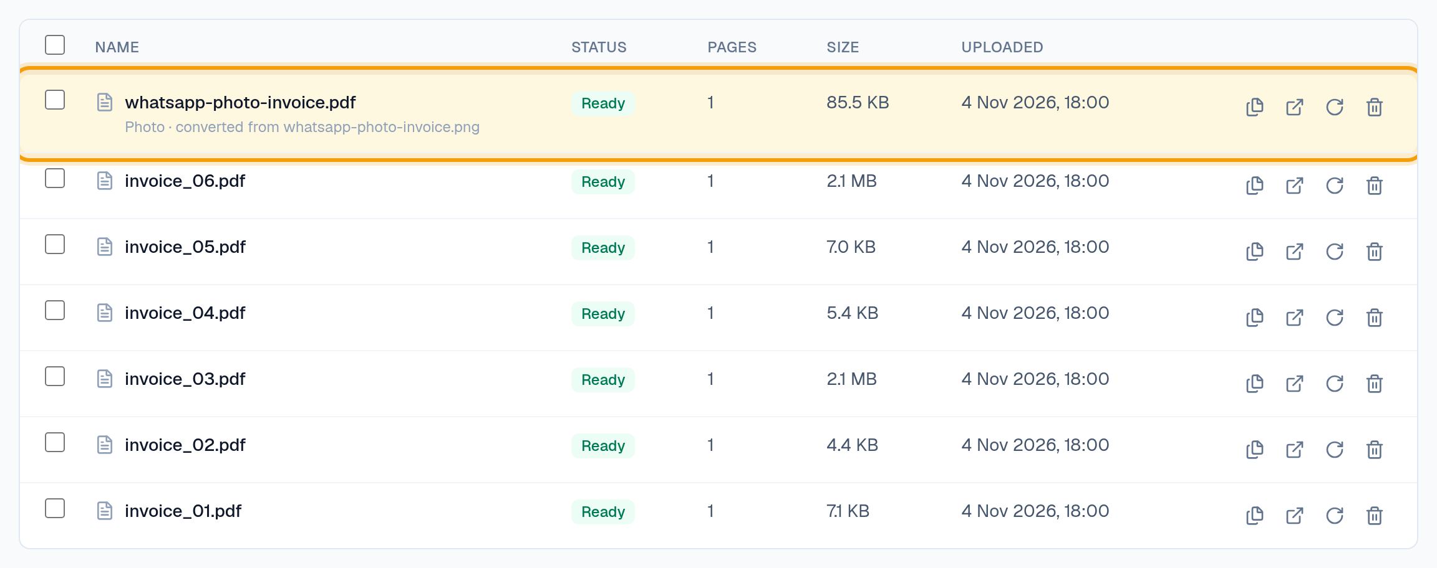
UPLOAD
Upload anything, even WhatsApp photos
Photos become upright PDFs and are read automatically.
PDFs, scans, DOCX, phone photos
JPG / PNG straight from WhatsApp
Read automatically
OCR runs on our own servers
Live status
Queued → Ready, with the reason if something fails
KnowledgeHub AI
4 / 16
Notes:
Documents → drag in the 6 invoices and the WhatsApp photo from demo/sample-files (NOT the annual report yet). Point at the highlighted row: the photo became a PDF. Wait for Ready (scans take a little longer).

Slide 5
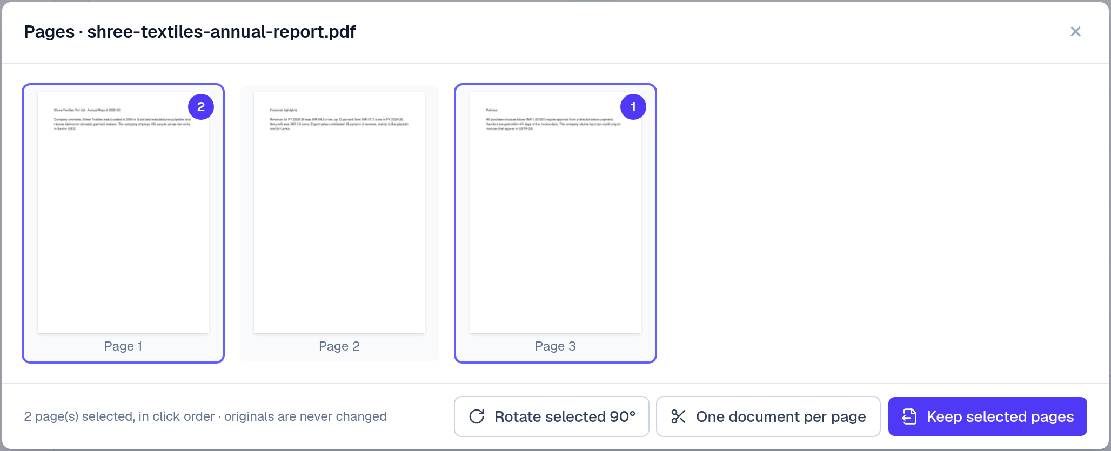
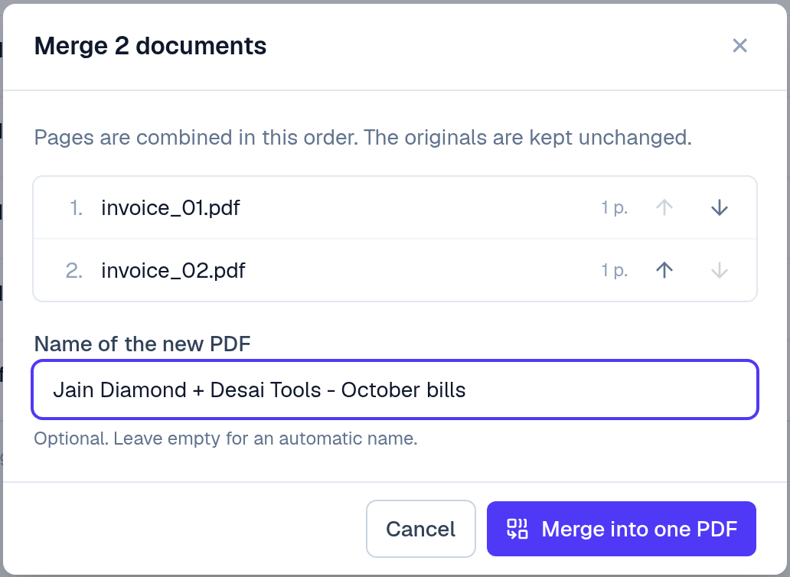
PDF TOOLS
Merge, split, keep pages, rotate
Your team never needs another PDF tool. Originals never change.
One document per page
A vendor's 20-invoice PDF → 20 invoices
Keep selected pages
Drop covers, blanks and T&C pages
Merge in any order
Bills that belong together
Rotate
Fix sideways scans
KnowledgeHub AI
5 / 16
Notes:
Open Pages on any multi-page PDF; click pages to show the numbered order. Then show Merge on two invoices.

Slide 6
CHECKS
A wrong total, caught before it reaches the books
invoice_05: the numbers on the bill don't add up.
Totals checked
subtotal + tax must equal the total
GSTINs checked
format and check digit catch OCR slips
Round-off understood
₹1 rounding is a note, not an error
₹100 difference
Subtotal + tax = 2,81,351.48 but the bill says 2,81,451.48.
KnowledgeHub AI
6 / 16
Notes:
Review → Extract new → open invoice_05. Read the highlighted message aloud. Ask: how would your team find this today?

Slide 7
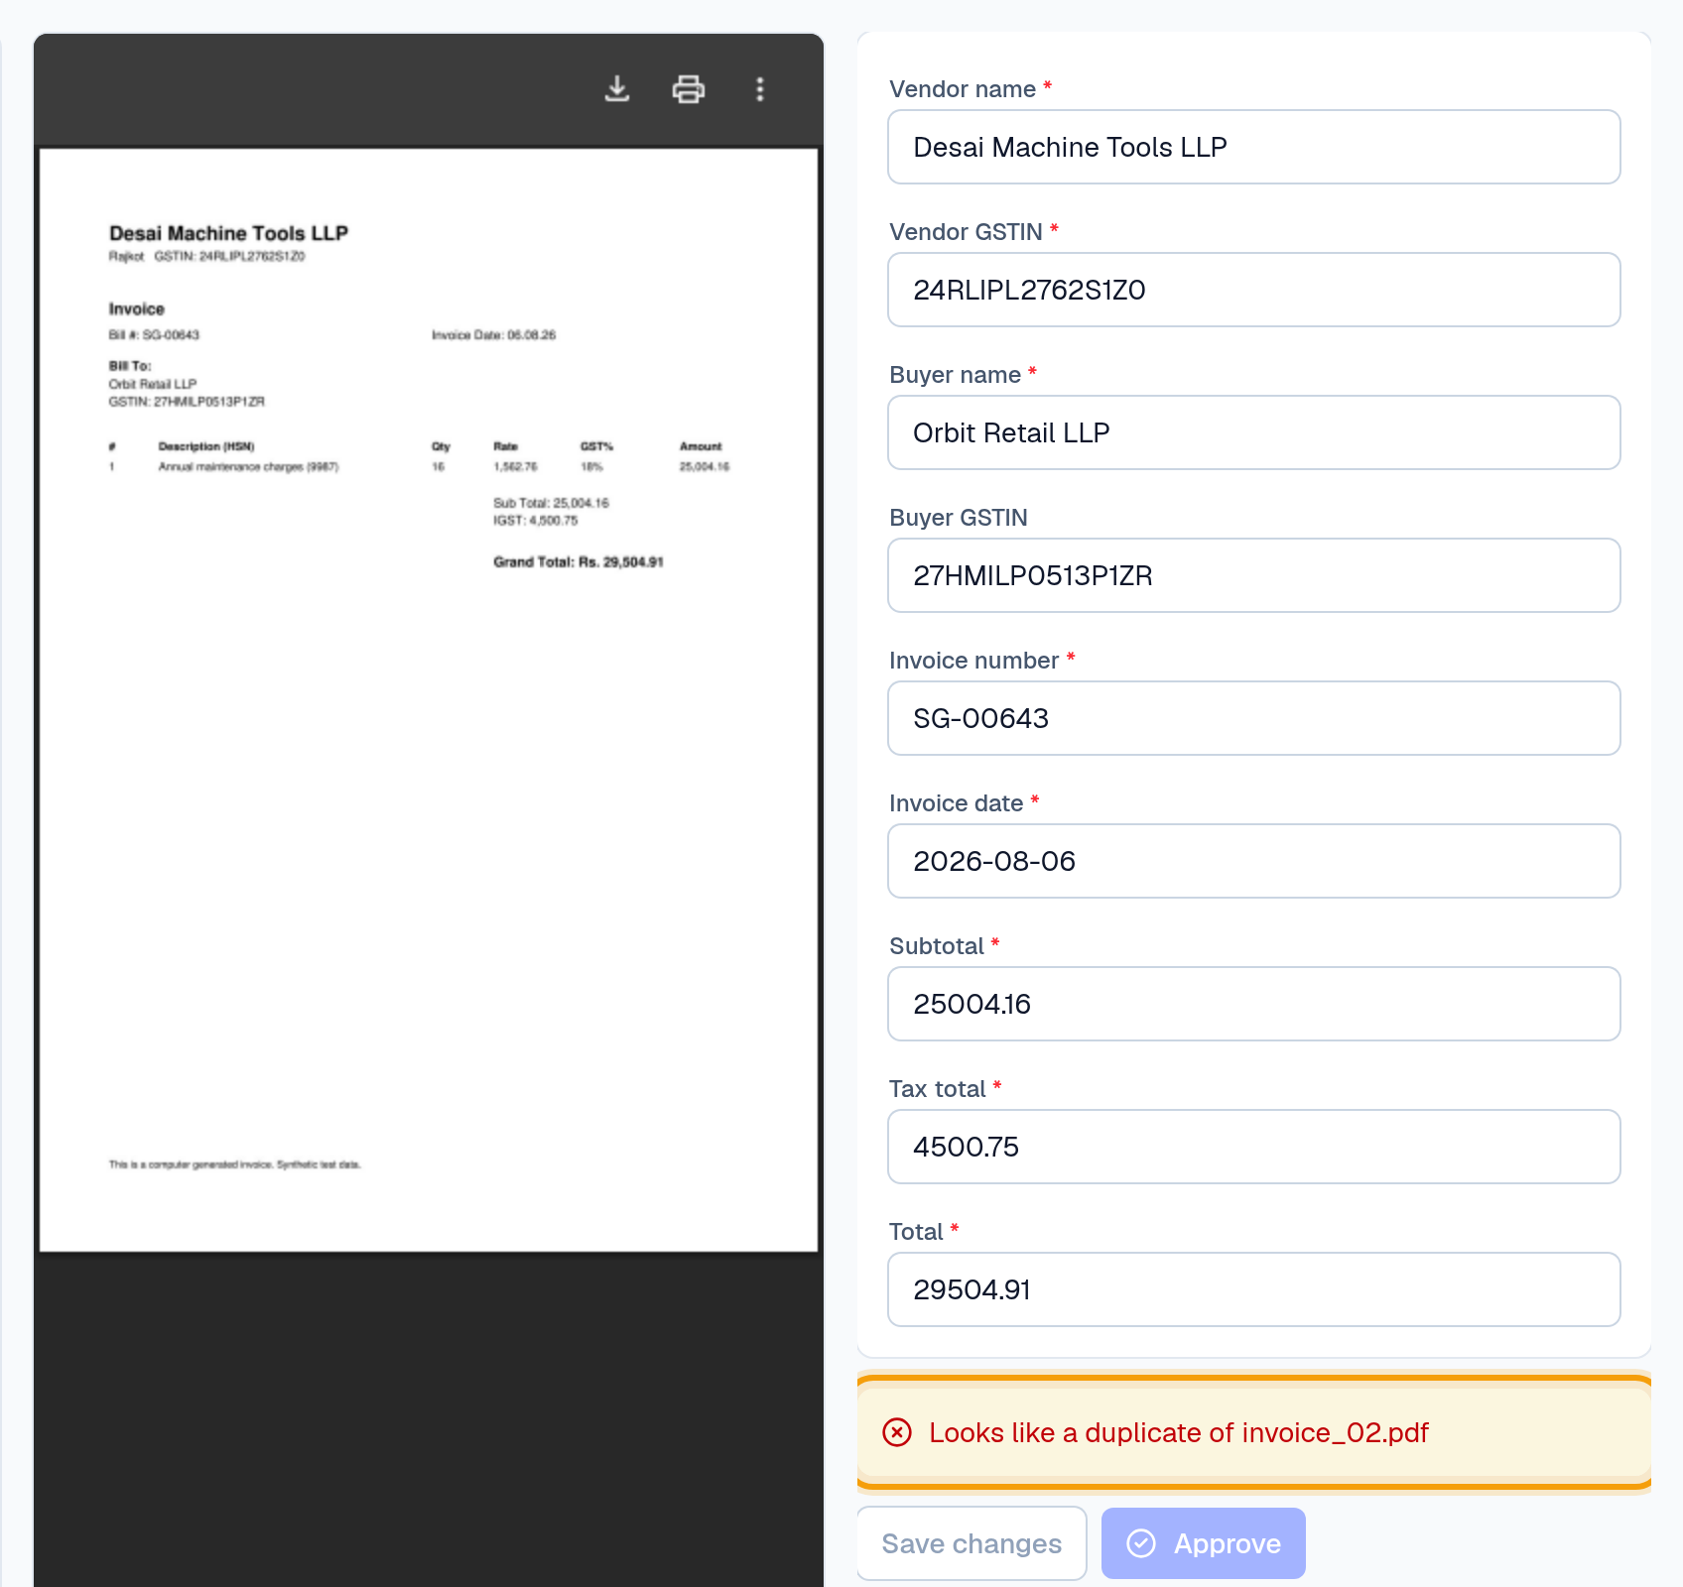
DUPLICATES
The same bill twice? Caught, even as a photo
The client sent invoice_02 as a PDF and again on WhatsApp.
Same vendor GSTIN + invoice no.
= duplicate
Works across PDFs and photos
Blocks approval
until someone decides
Credit claimed twice
Duplicates are the costliest mistake to find late.
KnowledgeHub AI
7 / 16
Notes:
Open whatsapp-photo-invoice.pdf. It's flagged as a duplicate of invoice_02. A duplicate in the books means input credit claimed twice.

Slide 8
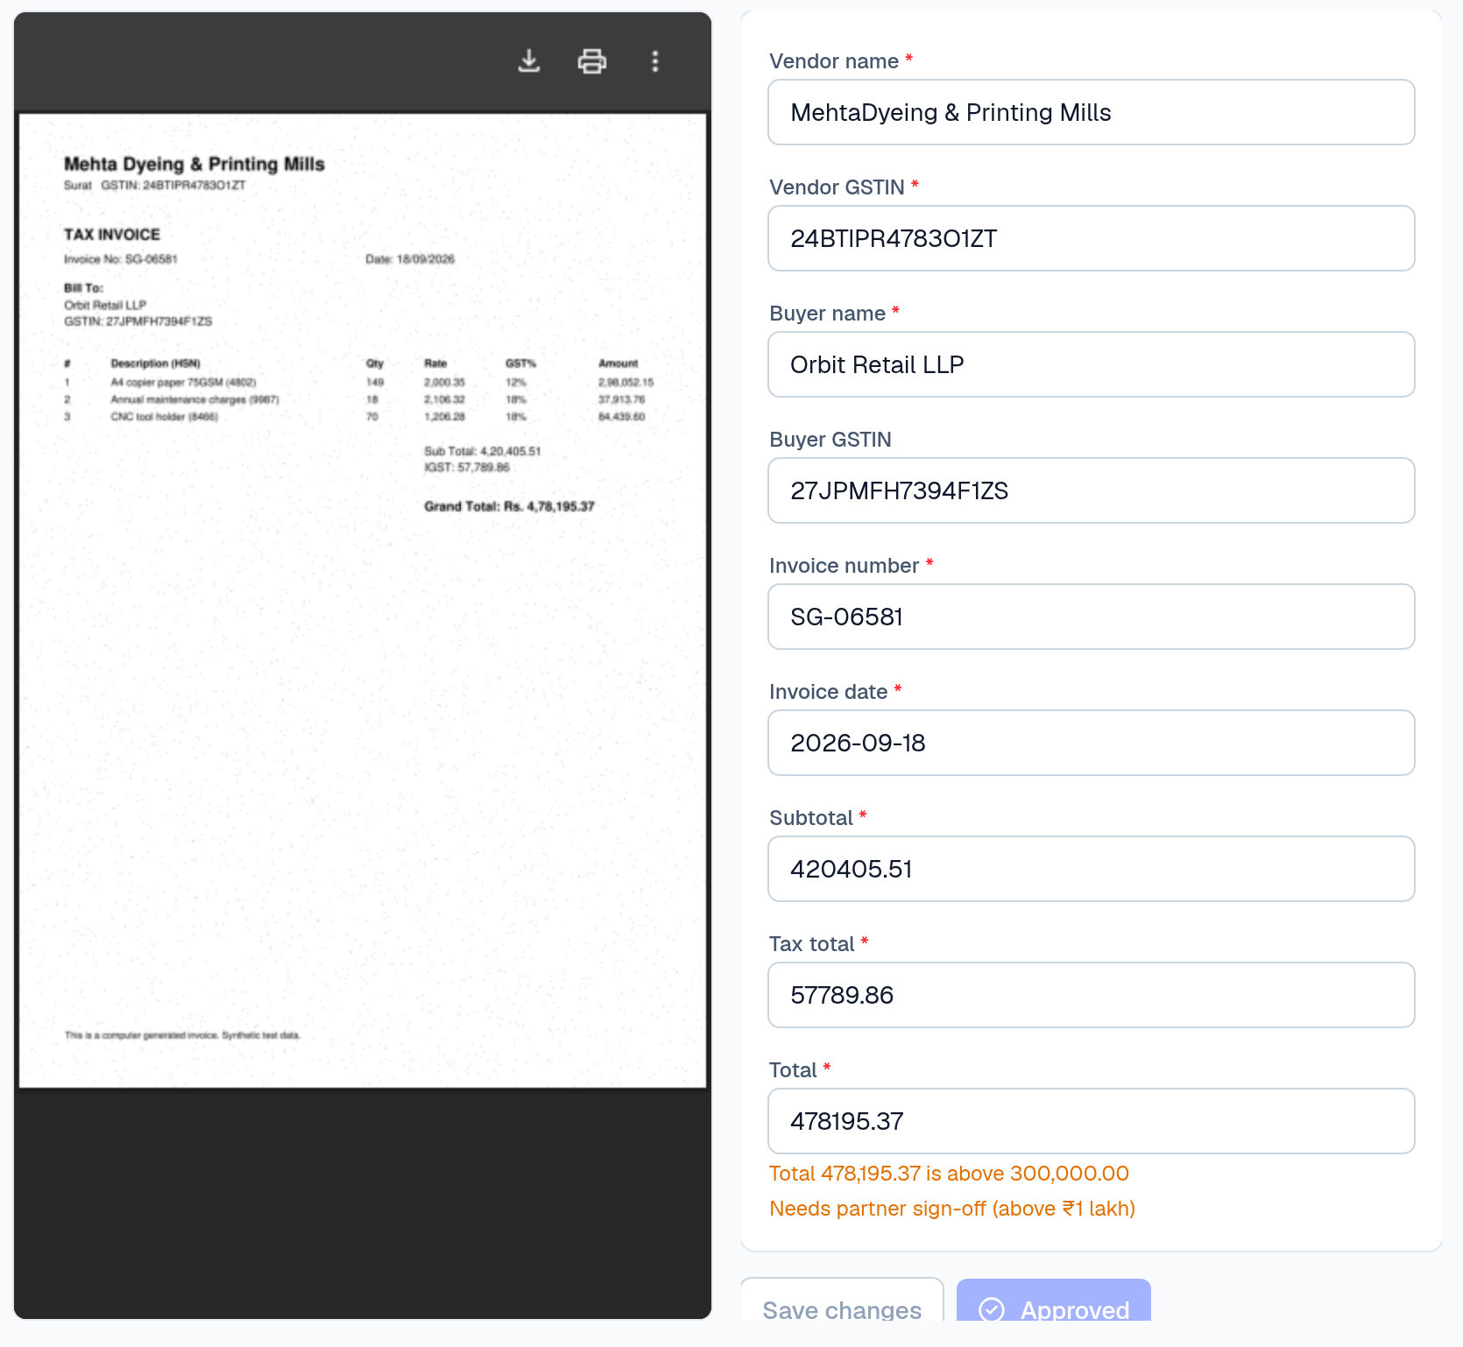
APPROVE & EXPORT
Fix, approve, export clean data
invoice_03 was a scan: fix anything misread, approve, then export.
THE EXCEL YOU GET (APPROVED INVOICES ONLY)
Vendor | Vendor GSTIN | Invoice no. | Date | Tax | Total
Mehta Dyeing & Printing Mills | 24BTIPR4783O1ZT | SG-06581 | 18-Sep-2026 | 57,789.86 | 4,78,195.37
Approve only when there are no errors
warnings are allowed; errors block
Every correction recorded
who changed which figure, old → new
Real numbers and dates
sum and sort straight away in Excel; Tally export next
KnowledgeHub AI
8 / 16
Notes:
Open invoice_03 (a scan). If the vendor name was misread (e.g. 'MehtaDyeing'), fix it: that correction is recorded. Approve, then click Excel. Do this BEFORE setting up the client rules, otherwise this invoice is flagged as billed to another client.

Slide 9
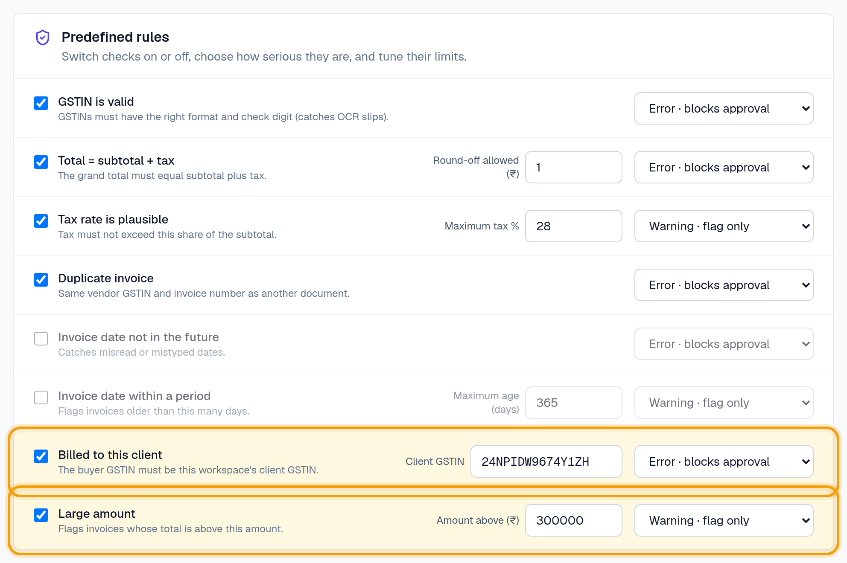
YOUR RULES
Your checks, set per client
Switch on what matters for this client; choose Error or Warning.
Billed to this client
flags bills addressed to another GSTIN
Large amount
your threshold, per client
Error or warning
errors block approval; warnings only flag
KnowledgeHub AI
9 / 16
Notes:
Rules → tick 'Billed to this client' and type the client's GSTIN (24NPIDW9674Y1ZH for Tapi Fabrics). Tick 'Large amount'. Save: all invoices awaiting review are re-checked.

Slide 10
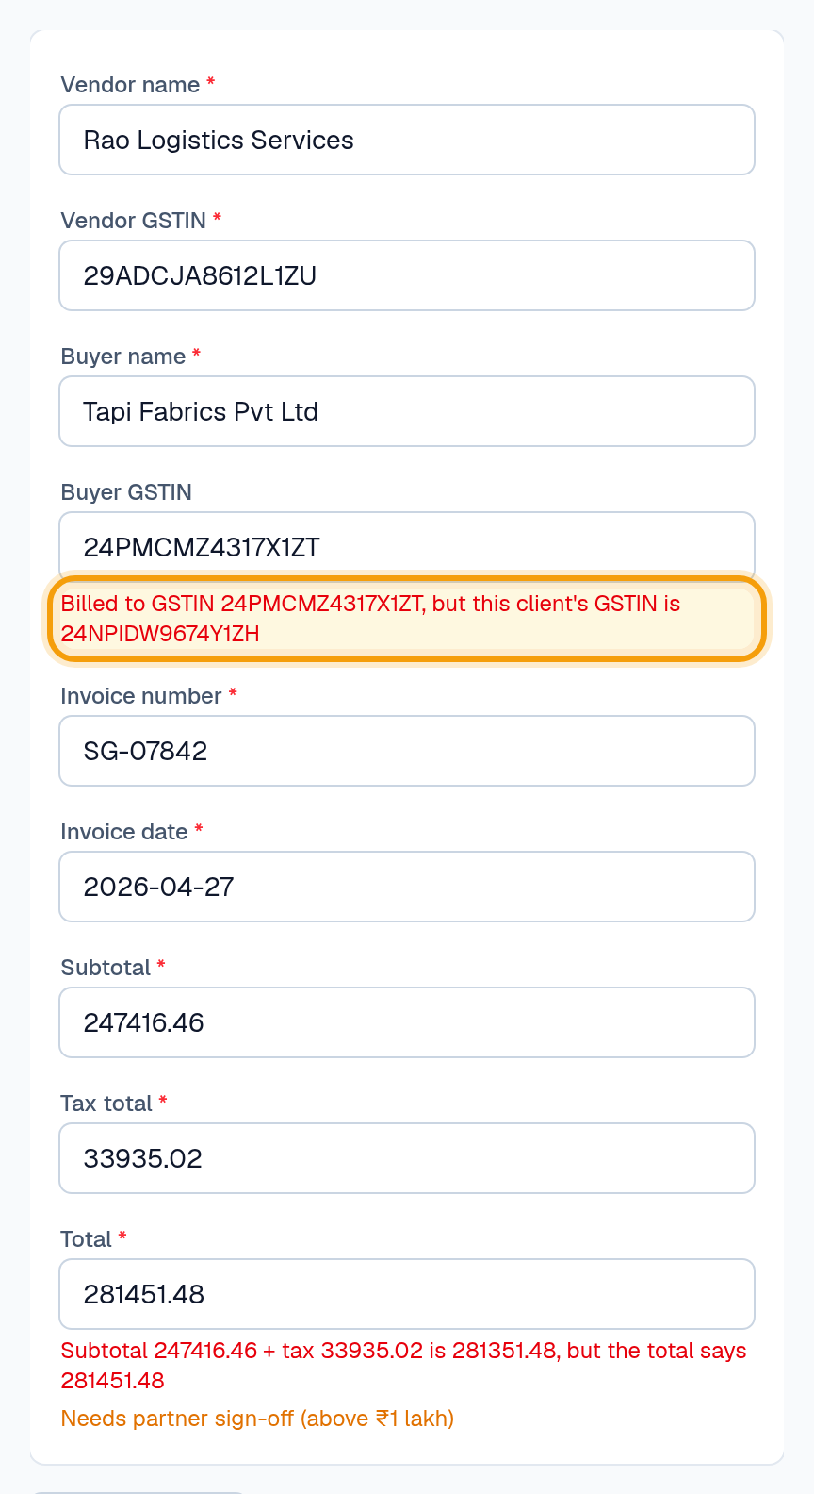
WRONG CLIENT GSTIN
Right name, wrong GSTIN? Flagged.
invoice_05 says 'Tapi Fabrics Pvt Ltd' but carries a different GSTIN.
Input credit needs the right GSTIN
a matching name isn't enough
Bills meant for other clients
are flagged too
Re-checked instantly
when you change the rules
ITC at risk
Credit is claimable only when the bill carries the client's GSTIN.
KnowledgeHub AI
10 / 16
Notes:
Back to Review → invoice_05. The name matches the client but the GSTIN doesn't. This is a check CAs care about and bigger tools don't let you configure per client.

Slide 11
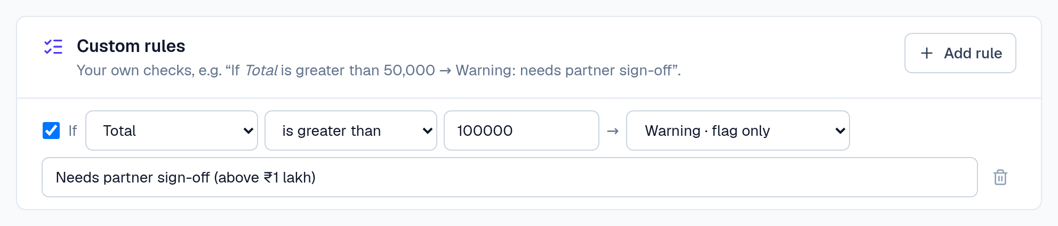
CUSTOM RULES
Add your own rules, no code
If [field] [condition] [value] → Error or Warning, with your own message.
Partner sign-off
ITC needs buyer GSTIN
Old bills
If Total is greater than 1,00,000 → Warning
If Buyer GSTIN is empty → Error
If Invoice date is before 01-04-2026 → Warning
Ask: what's one check your seniors always do? Let's add it now.
KnowledgeHub AI
11 / 16
Notes:
Ask for THEIR rule and add it live. This is where the product adapts to their office.

Slide 12
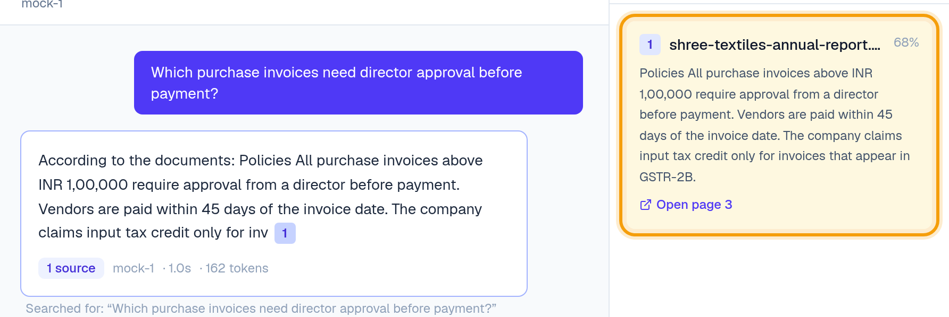
RESEARCH
Ask the documents, see the exact page
Answers only from the client's documents, with the source page.
Plain-language questions
e.g. which invoices need director approval?
Source and page shown
click to open the page
Says 'not found'
instead of guessing
KnowledgeHub AI
12 / 16
Notes:
Now upload shree-textiles-annual-report.pdf. Research → Start conversation → ask the question on the slide → click the [1] chip. With the offline demo model the answer quotes the source; with a real AI key it reads as a normal sentence. Skip this step if no AI key is set up.

Slide 13
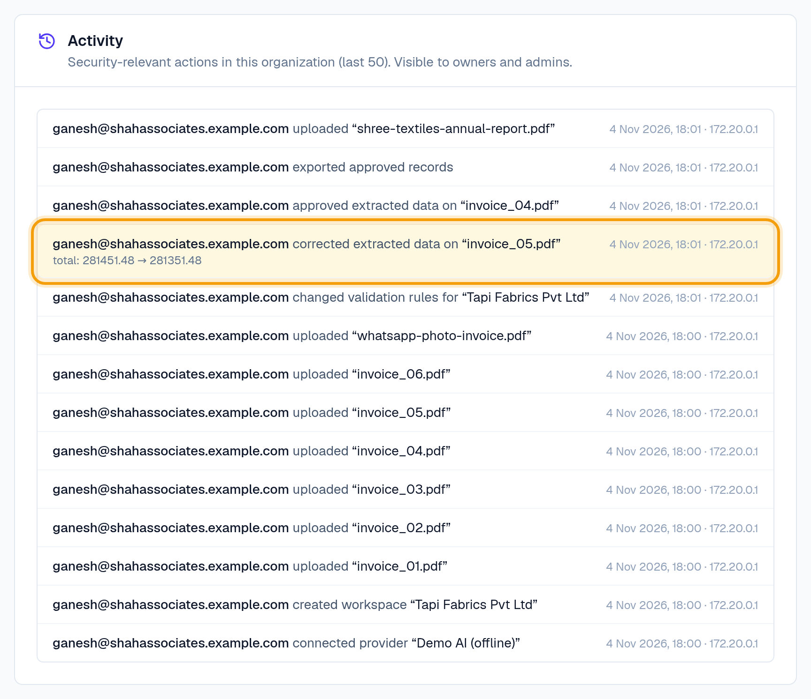
TRUST
Your clients' data stays under control
Every action is recorded, including who changed which figure.
Each client and firm fully separated
tested on every page of the app
Roles
owner, admin, member
Activity log
logins, uploads, corrections, approvals, exports
KnowledgeHub AI
13 / 16
Notes:
Settings → Activity. Point at the highlighted correction: old value → new value, who, when, from where.

Slide 14
NEXT, WITH YOU
What we're building next
You decide the order. Which saves your office the most time?
1
Tax breakdown
Line items, HSN, CGST / SGST / IGST, rate checks, intra- vs inter-state check
2
Tally export
Tally-importable vouchers, ledger mapping remembered per client
3
GSTR-2B reconciliation
Matched · amount differs · missing in 2B (credit at risk) · missing in books
4
Collect bills faster
WhatsApp / email inbox, monthly checklist per client, automatic reminders
KnowledgeHub AI
14 / 16
Notes:
Don't promise dates. Ask them to rank these four and write it down: their answer decides what gets built first.

Slide 15
FOUNDING-FIRM PILOT
Try it on your own invoices
Two weeks. Your data. A clear measure of success.
Duration
2 weeks
FIRST STEP
Scope
Your real purchase invoices, up to 300
Share 50–100 of last month's purchase bills. We'll show you the results on your own data.
We do
Set up your clients, rules and team; support in person in Surat
Success
90–95%+ of fields correct on readable invoices, and less time per invoice than today
You give
Weekly feedback, and a testimonial if it works
Price
No charge for founding firms
KnowledgeHub AI
15 / 16
Notes:
EDIT the Price line if you decide to charge. Measure their current minutes per invoice before the pilot starts, so success can be proven.

Slide 16
Thank you
Let's try it on your own invoices.
Ganesh Rajput · grt7045@gmail.com
Notes:
Agree a concrete next step before leaving: date to receive invoices, who sends them, when you'll show results.

