Slide 1
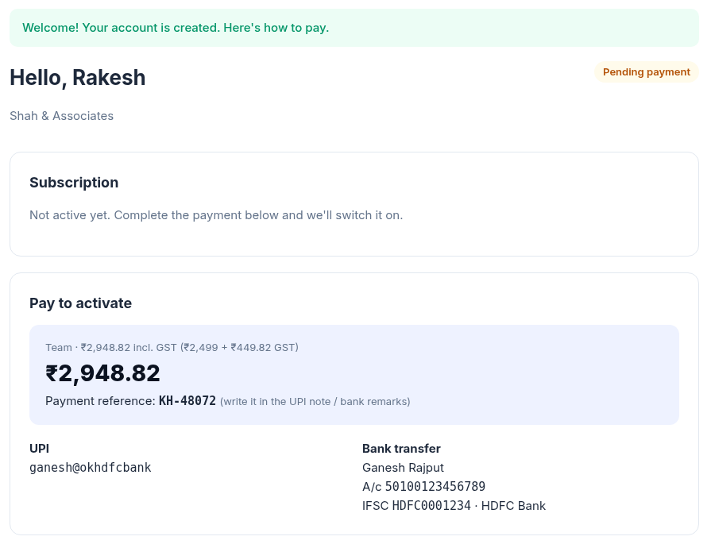
INTERNAL · RUNBOOK V2 · 5 NOV 2026
Run it. Sell it.
Operate it.
The product, the new licence system (website, admin panel, signed licences) and how a CA firm goes from sign-up to working offline.
Ganesh Rajput · KnowledgeHub AI
Notes:
Internal runbook. v1 covered the product demo; v2 adds the licence system and how to operate it.

Slide 2
WHAT'S NEW SINCE V1
The business side is built
A CA firm can now find you, sign up, pay and be activated, without you touching the database.
01
02
03
04
Customer website
Admin panel
Signed licences
Pricing research
Pricing from your plans, register, pay instructions, 'I have paid', download, computers, team, password.
Plans & prices, firms, payment confirmation, trials, blocks, logins, monthly CSV, activity log.
App login API returns a 24-hour licence signed with your private key. Can't be faked or moved to another PC.
What CA software costs in India, how it's licensed, and suggested starting plans.
Not yet: the desktop app doesn't check the licence yet, and there is no Windows installer. Sell pilots, not self-service, until Phases 2–3 are done.
KnowledgeHub AI · Runbook v2 · 5 Nov 2026
2 / 15
Notes:
Be clear with yourself: the shop is open, the product they download doesn't exist as an installer yet.

Slide 3
THE WHOLE SYSTEM
Two parts: your server, their computer
Client documents never leave the CA's office. Only the login goes over the internet.
YOUR SERVER (ONLINE)
CA'S WINDOWS PC (OFFLINE)
Customer website
register · pay · download
Desktop window
Electron, looks like any app
Admin panel /admin
you
Next.js screens
localhost only
App login API
signs 24-hour licences
login only
(a few KB)
FastAPI + OCR + rules
localhost only
Database
firms · plans · payments
PostgreSQL
their data, on their disk
KnowledgeHub AI · Runbook v2 · 5 Nov 2026
3 / 15
Notes:
Left: what you host. Right: what the installer will put on their PC. The arrow is the only connection.

Slide 4
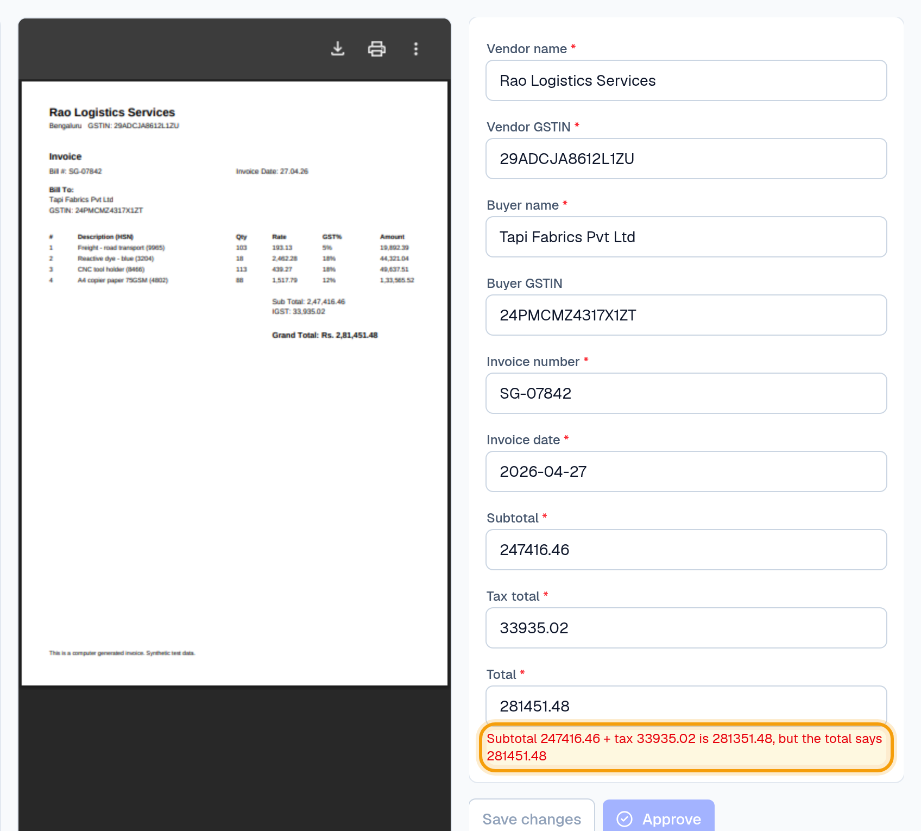
HOW A 'WEBSITE' RUNS OFFLINE
Same app you run today, packaged for Windows
You already run it on localhost: web :3000, API :8001, Postgres. The installer does the same on their PC.
Web technology ≠ internet
VS Code, Slack and WhatsApp Desktop are web screens inside a desktop window.
Everything listens on localhost only
Nobody else on their network or the internet can reach it.
One double-click starts it all
Database → API → window; shuts down cleanly on exit.
Internet only at login
A few seconds when the app opens; then up to 24 hours offline.
KnowledgeHub AI · Runbook v2 · 5 Nov 2026
4 / 15
Notes:
If a CA asks 'is this cloud?': no, it runs on your computer; only the licence check is online.

Slide 5
RUN IT
Commands you need
Product app and licence server run side by side on your machine.
Task | Command / address
Product app (first time) | ./setup.sh
Product app (daily) | ./run.sh → web :3000 · API :8001
Licence server (first time) | cd licensing · alembic upgrade head · python -m app.cli create-admin you@… · python -m app.cli generate-keys
Licence server (daily) | cd licensing · .venv/bin/uvicorn app.main:app --port 8002
Website / admin | http://localhost:8002 · http://localhost:8002/admin
Tests | backend: 237 tests · licensing: 66 tests (python -m pytest)
Guard the signing key: licensing/keys/lease_private.pem creates licences. Never commit it; back it up offline.
KnowledgeHub AI · Runbook v2 · 5 Nov 2026
5 / 15
Notes:
Ports: 3000 product web, 8001 product API (always), 8002 licence server.

Slide 6
CUSTOMER JOURNEY
From sign-up to working, in five steps
Manual payments for now: you confirm every payment in the admin panel.
01
02
03
04
05
Register
Pay
I have paid
You activate
Download & log in
Customer signs up on your website and picks a plan. Firm is Pending payment.
Their account shows the amount incl. GST, your UPI / bank details and a KH- reference.
They enter the UTR. It appears on your admin dashboard.
Check the UTR in your bank app → Check & activate → Record payment.
Download button appears. The app logs in with the same email and password.
Your only job: step 4. Check the UTR in your bank / UPI app before you click Record payment.
KnowledgeHub AI · Runbook v2 · 5 Nov 2026
6 / 15
Notes:
Step 4 is where money is verified. Never activate without seeing the money.

Slide 7
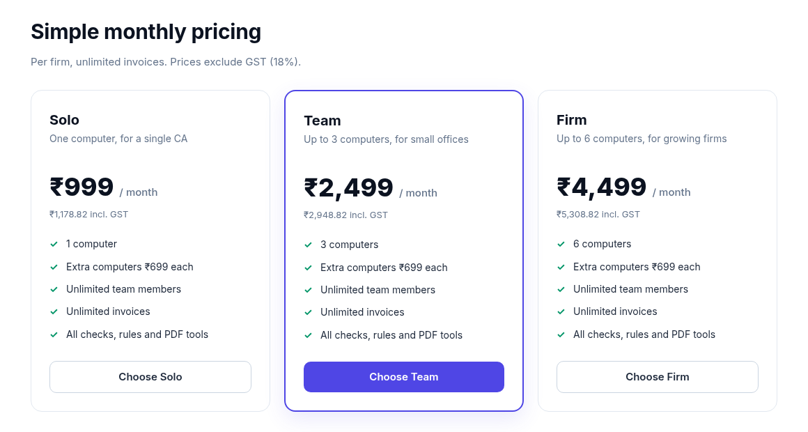

STEP 1 · WEBSITE
Your shop window
Pricing cards come live from Admin → Plans & prices.
KnowledgeHub AI · Runbook v2 · 5 Nov 2026
7 / 15
Notes:
Change a price in the admin and the website updates immediately.

Slide 8
STEPS 2–3 · PAYMENT
They see exactly what to pay
Amount incl. GST, your UPI and bank details, their KH- reference, and an 'I have paid' form.
KH- reference
Asks them to put it in the UPI note / bank remarks, so you can match the money.
I have paid
Amount, UPI or bank, UTR and date. Max 3 open reports per firm.
Set your details once
Admin → Settings → How customers pay you.
KnowledgeHub AI · Runbook v2 · 5 Nov 2026
8 / 15
Notes:
If UPI/bank details are empty, customers see 'payment details will be shared by …'. Fill them before launch.

Slide 9
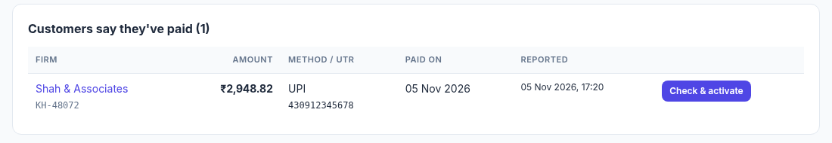
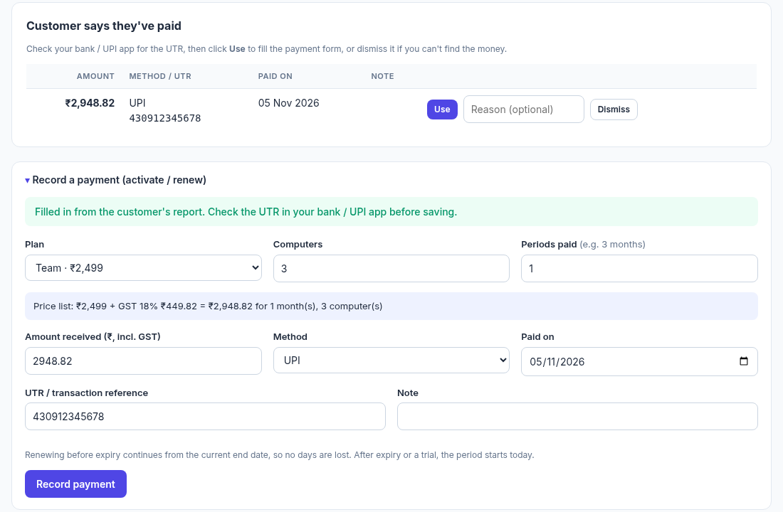
STEP 4 · YOU ACTIVATE
Check the money, then one click
Reports show on the dashboard; the payment form is filled in from the customer's report.
Price list shown
Lower amounts are allowed (discounts) but noted in the log.
Renewals never lose days
Early renewal continues from the end date.
Can't find the money?
Dismiss the report with a reason.
KnowledgeHub AI · Runbook v2 · 5 Nov 2026
9 / 15
Notes:
Open your bank app, search the UTR, compare the amount, then Record payment.

Slide 10
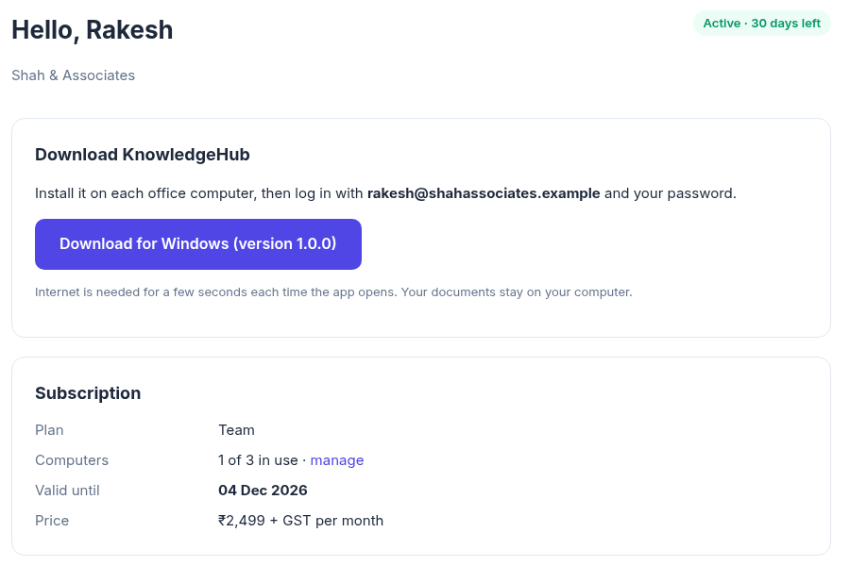
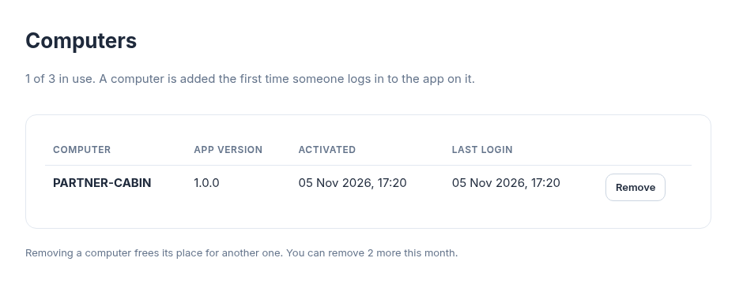
STEP 5 · DOWNLOAD & LOG IN
Active: download appears, computers fill up
Each computer takes a seat the first time someone logs in to the app on it.
Download link
Admin → Settings → Desktop app. Shown only to active firms.
Seats
Customers remove old computers themselves (2 per month).
KnowledgeHub AI · Runbook v2 · 5 Nov 2026
10 / 15
Notes:
The download link is a placeholder until the installer exists.

Slide 11
ADMIN PANEL
Everyday tasks: where to click
http://your-domain/admin
I want to… | Where
Activate a firm after payment | Dashboard → Customers say they've paid → Check & activate → Record payment
Firm paid without reporting it | Firms → firm → Record a payment (price-list total is pre-filled)
Renew | Same form. Before expiry it continues from the end date; after expiry it starts today
Change a price / plan | Plans & prices → Edit. Existing firms keep the price they paid
Private deal | New plan with 'Show on website' unticked
Trial for a pilot | Firm → Start a free trial (days, computers)
Goodwill days / fix a mistake | Firm → Adjust end date or computers (reason required)
Customer forgot password | Firm → Logins → Set new password (also unlocks the account)
New PC but all seats used | Customer removes one in My account → Computers, or you remove it on the firm page
Licence misuse | Firm → Block firm, or block a single computer
Monthly figures for your CA | Payments → month → Download CSV
UPI, bank, GST %, grace days, download link | Settings
KnowledgeHub AI · Runbook v2 · 5 Nov 2026
11 / 15
Notes:
Everything you do is written to the Activity log with your name and IP.

Slide 12
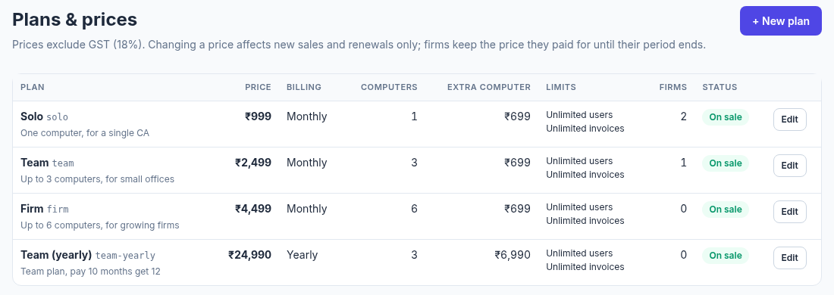
PLANS & PRICING
What the market charges, and where we start
Research 5 Nov 2026 (docs/CA-pricing-research.md). Prices excl. GST.
Vyapar TaxOne (was Suvit)
₹7,000/year, one plan, 7-day trial
Tally
Silver ₹22,500 + ₹4,500/yr · Gold ₹67,500 · rent ₹750/mo
Tally 'Docs by Ira' OCR
₹200 per 100 pages
Small firms
₹5,000–25,000 a year per product; trials 7–30 days
Suggested start: Solo ₹999/mo (1 PC) · Team ₹2,499 (3 PCs) · Firm ₹4,499 (6 PCs) · extra PC ₹699 · yearly = 10 months.
Our 24-hour online login is stricter than anything CAs use today: expect questions.
KnowledgeHub AI · Runbook v2 · 5 Nov 2026
12 / 15
Notes:
Suggested prices are a recommendation, not market data. Validate with the first 5 firms.

Slide 13
LICENCE RULES
What the app will be told at login
Every refusal comes with a message ready to show the customer.
Customer sees | Code | What you do
Wrong email or password | invalid_credentials | Check spelling; reset password in the firm's Logins panel
Too many wrong passwords | locked | Wait 15 minutes, or set a new password (unlocks)
Subscription isn't active yet | no_subscription | Confirm their payment
Subscription ended on … | expired | Record the renewal payment
All computers in use | computer_limit | Remove an old computer, or sell extra computers
Account / computer blocked | firm_blocked / computer_blocked | Unblock if resolved
Please install the latest version | update_required | Send the download link
Licence lasts 24 hours (Settings) and never beyond the subscription end + grace days. Kept in memory only.
KnowledgeHub AI · Runbook v2 · 5 Nov 2026
13 / 15
Notes:
This is the contract the desktop app (Phase 2) will implement.

Slide 14
GO-LIVE CHECKLIST
Before the first real customer
Licence server on the internet, with HTTPS.
☐
Domain + small VPS (₹1–2k/month) with HTTPS (e.g. Caddy)
☐
Strong admin password (create-admin); daily database backup
☐
Licence server .env: real DATABASE_URL, COOKIE_SECURE=true, PUBLIC_URL=https://your-domain
☐
Admin → Settings: UPI ID, bank details, GSTIN, support email/phone, grace days
☐
Run uvicorn with --proxy-headers and a single worker
☐
Admin → Plans & prices: your real plans
☐
generate-keys on the server; back up keys/lease_private.pem offline; keep the public key for the app
☐
Admin → Settings → Desktop app: download link + version (once the installer exists)
KnowledgeHub AI · Runbook v2 · 5 Nov 2026
14 / 15
Notes:
Key backup matters most: lose the private key and every installed app needs a new public key.

Slide 15
STATUS
Done, not yet, next
Ship in this order; reorder the product work by what CA firms say.
DONE
NOT YET
NEXT
• Product: extraction, rules per client, review & audit, PDF tools, Q&A, Excel export
• Licence server: customer website, admin panel, manual payments, signed 24-hour licences
• Pricing research and suggested plans
• Demo kit v1 (deck, overview, playbook)
• Licence check inside the desktop app (app doesn't refuse to run yet)
• Windows installer (Electron + bundled Postgres, Nuitka-compiled API)
• Password-reset emails, Razorpay, GST invoices for your sales
• Tally export, GSTR-2B reconciliation, line-item GST checks
Phase 2 Licence check in the app: login screen, lease kept in memory, every API call checked
Phase 3 Windows installer: one click, offline, auto-update, daily backups
Phase 4 Code signing, Razorpay auto-activation, GST invoices
Product Tax breakdown → Tally export → GSTR-2B, ordered by what CA firms say
KnowledgeHub AI · Runbook v2 · 5 Nov 2026
15 / 15
Notes:
Phase 2 is next: without it, the licence system protects nothing.

