Slide 1
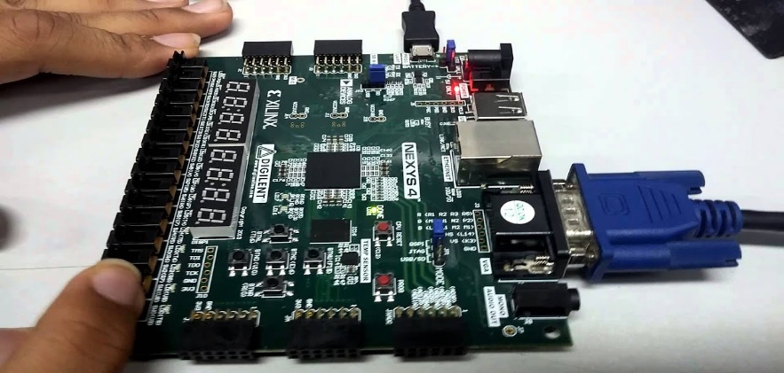

ECE365PROJECT
8-BIT ACCUMULATOR
Done By:
B. Ganesh
Aarav Kumar
Prashant Aarya

Slide 2
CONTENTS
Objective
Introduction
Universal Shift Register
Multiplexers
Flip Flops
Circuit Diagram
Verilog HDL Code
Simulation Results

Slide 3
Objective
The main objective of this project is to design an 8-bit accumulator that can perform several operations.
The goal is to design and implementation in VIVADO software.
Verify the functionality using simulation and check the output in Artix-7NEXYS-4 FPGABoard

Slide 4
Introduction
Shift Registers are commonly used in calculators and computers to move or store the binary data
Used in Data conversion either in serial to parallel or vice versa
They are available for one in four different modes with basic movement of binary data
Serial-in to Parallel-Out(SIPO)
Serial-in to Serial-Out(SISO)
Parallel-in to Serial-Out(PISO)
Parallel-in to Parallel-Out(PIPO)

Slide 5
MULTIPLEXER(mux)
Multiplexer is a combinational Circuit.
It has maximumof 2^n data inputs, ‘n’ selected lines & single output line
One of these data inputs will be connected to the output based on the values of selection line.
Since there are ‘n’ selection lines, there will be 2^n possible combinations of zeros and ones
So, each combination will select only one data input `

Slide 6
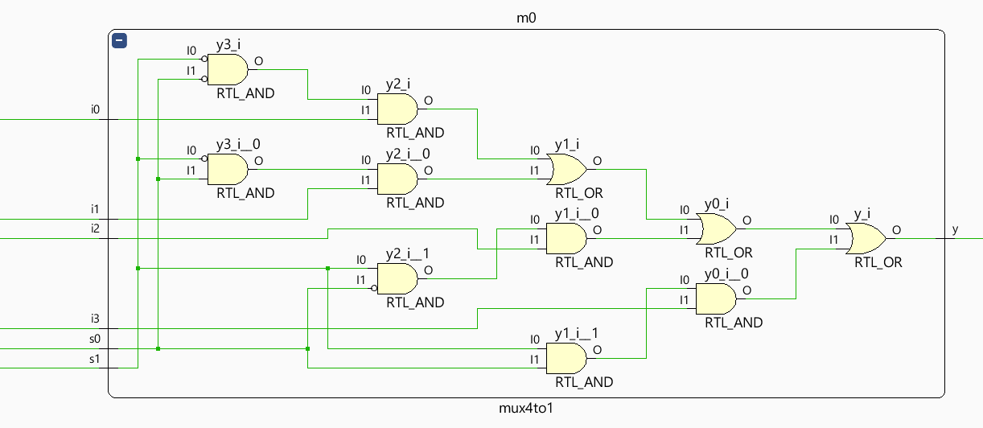
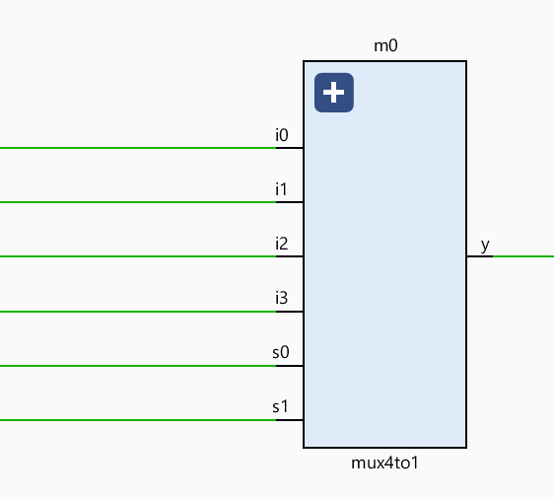
4x1 Multiplexer
S1 | S0 | Y
0 | 0 | I0
0 | 1 | I1
1 | 0 | I2
1 | 1 | I3

Slide 7
FlipFlop
A flipflop is a sequential digital electronic circuit having two stable states that can be used to store one bit of binary data
They are the fundamental building blocks of all memory devices
In this Project we have used Delay or D flipflop to get
output of Accumulator

Slide 8
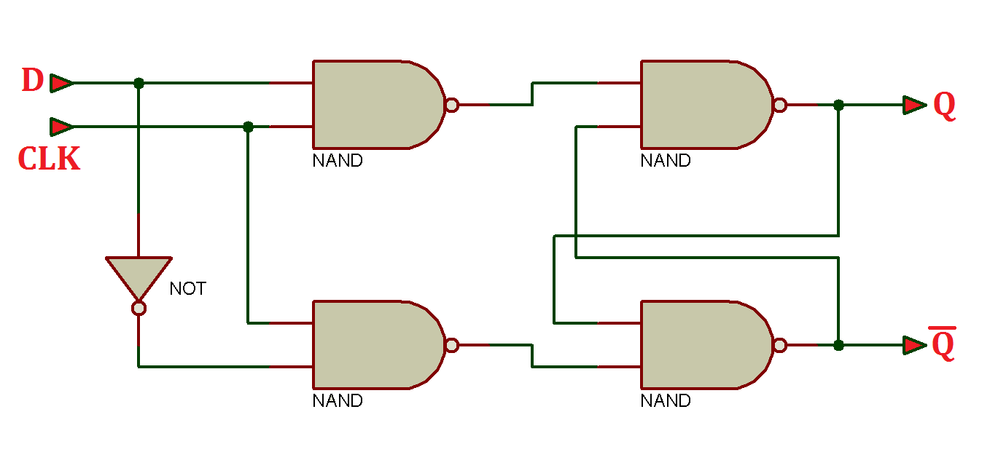
D-FlipFlop
A sequential circuit which operates only with positive
clock transitions
D latch operates with enable signal
It effects the outputs only when positive transitions of the clock signal is applied instead of active enable

Slide 9
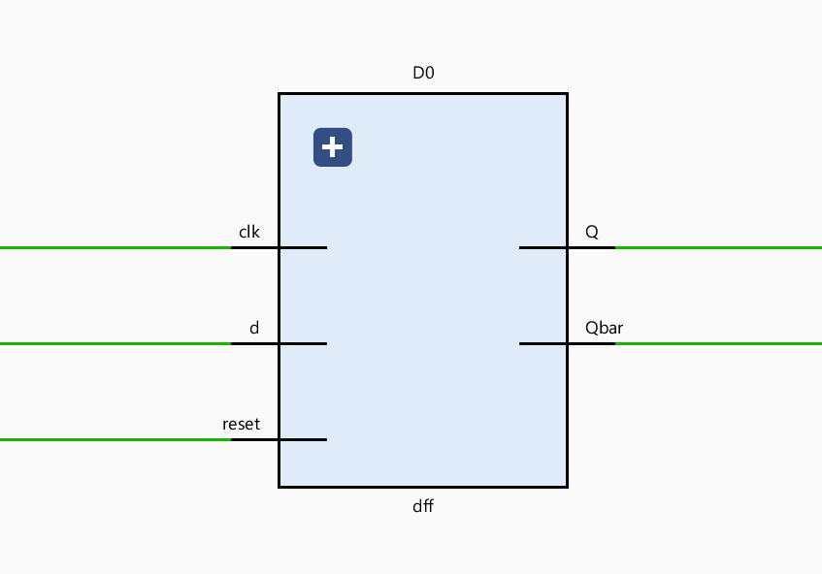
D-FlipFlop
Truth Table:
It holds the information which is available
on data input, D of earlier +ve clock signal
Next state, D flip-flop is always equal to
input, D for every positive transitions of the clock signals.
Qt+1 = D
D | Qt+1
0 | 0
1 | 1

Slide 10
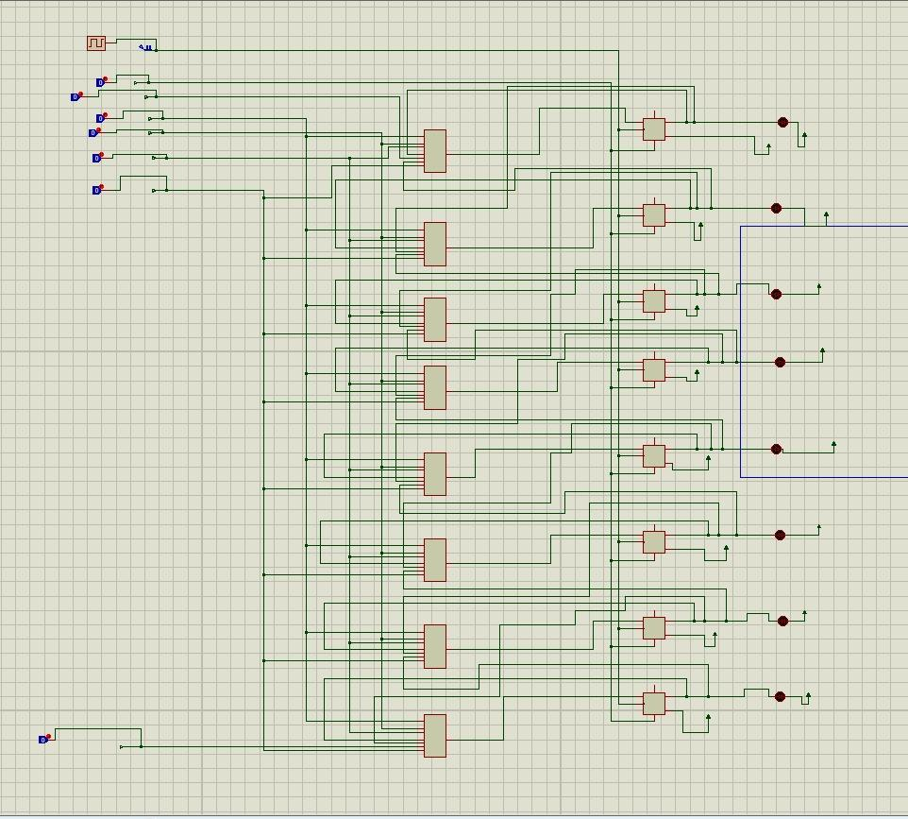
Universal Shift Register
In real world, a multi-function device that can be used in either serial-to-serial, left shifting, right shifting, serial-to-parallel, parallel-to-serial, or as a parallel-to-parallel multifunction data register, hence their name “Universal”.
SISO or PIPO configurations are used for transferring data or store the data temporarily.
Frequently used to perform Arithmetic Operations by shifting data to left or right.

Slide 11
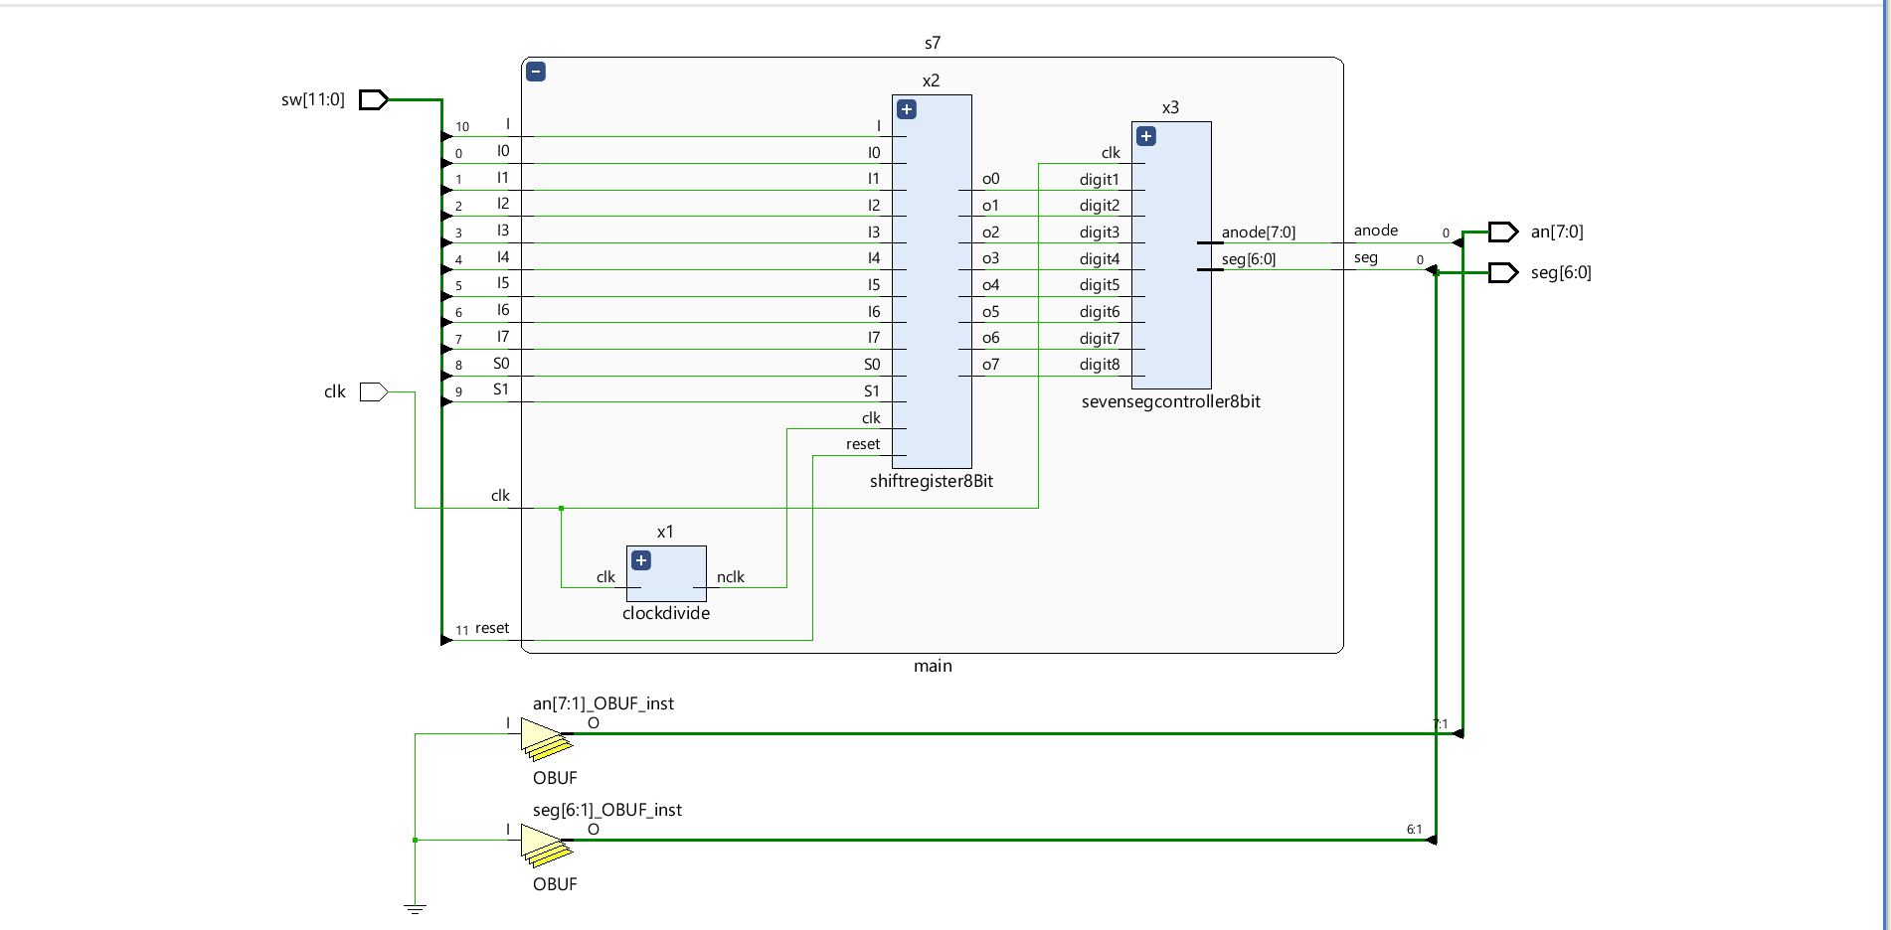
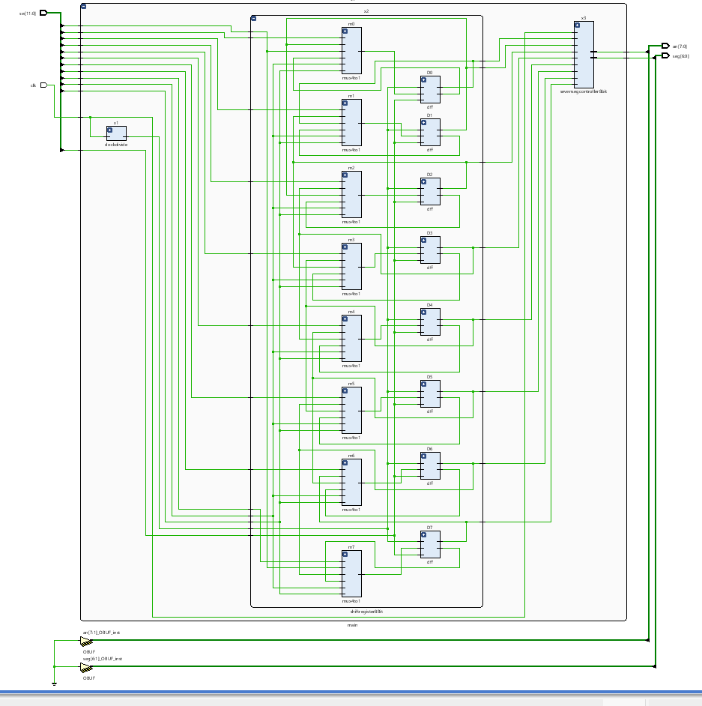
Circuit Diagram
S1 | S0 | work
0 | 0 | Load
0 | 1 | Right shift
1 | 0 | Left shift
1 | 1 | flipping

Slide 12
8-Bit Accumulator Verilog Code
module mux4to1(y,s0,s1,i0,i1,i2,i3);
input i0,i1,i2,i3,s0,s1;
output y;
assign y = (~s1&~s0&i0)|(~s1&s0&i1)|(s1&~s0&i2)|(s1&s0&i3);
endmodule
//d flipflop
module dff(Q,Qbar,d,clk,reset);
output reg Q;
output reg Qbar;
input d,clk,reset;
always@(posedge clk,posedge reset)
begin
if(reset==1'b1)
Q=1'b0;
begin
Qbar=1'b1;
end
Q<=d;
begin
Qbar=1'b1;
end
end
endmodule
module shiftregister8Bit(o0,o1,o2,o3,o4,o5,o6,o7,I0,I1,I2,I3,I4,I5,I6,I7,S0,S1,I,clk,reset);
output o0,o1,o2,o3,o4,o5,o6,o7;
input I0,I1,I2,I3,I4,I5,I6,I7,S0,S1,I,clk,reset;
wire w0,w1,w2,w3,w4,w5,w6,w7,wb0,wb1,wb2,wb3,wb4,wb5,wb6,wb7,w10,w11,w12,w13,w14,w15,w16,w17;
mux4to1 m7(w17,S0,S1,I7,I,w6,wb7);
mux4to1 m6(w16,S0,S1,I6,w7,w5,wb6);
mux4to1 m5(w15,S0,S1,I5,w6,w4,wb5);
mux4to1 m4(w14,S0,S1,I4,w5,w3,wb4);
mux4to1 m3(w13,S0,S1,I3,w4,w2,wb3);
mux4to1 m2(w12,S0,S1,I2,w3,w1,wb2);
mux4to1 m1(w11,S0,S1,I1,w2,w0,wb1);
mux4to1 m0(w10,S0,S1,I0,w1,I,wb0);
//D-flipflop instantiations//
dff D7(w7,wb7,w17,clk,reset);
dff D6(w6,wb6,w16,clk,reset);
dff D5(w5,wb5,w15,clk,reset);
dff D4(w4,wb4,w14,clk,reset);
dff D3(w3,wb3,w13,clk,reset);
dff D2(w2,wb2,w12,clk,reset);
dff D1(w1,wb1,w11,clk,reset);
dff D0(w0,wb0,w10,clk,reset);

Slide 13
assign o7 = w7;
assign o6 = w6;
assign o5 = w5;
assign o4 = w4;
assign o3 = w3;
assign o2 = w2;
assign o1 = w1;
assign o0 = w0;
endmodule
//Test Bench//
module acccumulator_tb;
wire o0,o1,o2,o3,o4,o5,o6,o7;
reg S1,S0,I0,I1,I2,I3,I4,I5,I6,I7,I,clk,reset;
shiftregister8Bit x1(o0,o1,o2,o3,o4,o5,o6,o7,I0,I1,I2,I3,I4,I5,I6,I7,S0,S1,I,clk,reset);
always #5 clk=~clk;
initial begin
clk=1'b0; reset=1'b1;
I0=1'b1; I1=1'b0; I2=1'b0; I3=1'b1; I4=1'b0; I5=1'b0; I6=1'b1; I7=1'b0; I=1'b1;
#10 reset=1'b0;
#200 $stop;
end
initial begin
S1=1'b0; S0=1'b0;
#20
S1=1'b0; S0=1'b1;
#20
S1=1'b1; S0=1'b0;
#20
S1=1'b1; S0=1'b1;
end
endmodule
module clockdivide(clk, nclk);
input clk;
output reg nclk;
reg [31:0]count=32'd0;
always@(posedge clk)
begin
count=count+1;
nclk=count[16];
end
endmodule

Slide 14
module refresh_counter(rclock, rcounter);
input rclock;
output reg [2:0]rcounter=3'b000;
always@(posedge rclock)
rcounter <= rcounter+1;
endmodule
module anode_control(rcounter, anode);
input [2:0]rcounter;
output reg [7:0]anode;
always@(rcounter)
begin
case(rcounter)
3'b000: anode=8'b11111110;
3'b001: anode=8'b11111101;
3'b010: anode=8'b11111011;
3'b011: anode=8'b11110111;
3'b100: anode=8'b11101111;
3'b101: anode=8'b11011111;
3'b110: anode=8'b10111111;
3'b111: anode=8'b01111111;
endcase
end
endmodule
module bcd_control(digit1, digit2, digit3, digit4, digit5, digit6, digit7, digit8, rcounter, bcd);
input [3:0]digit1, digit2, digit3, digit4, digit5, digit6, digit7, digit8;
input [2:0]rcounter;
output reg [3:0]bcd=4'b0000;
always@(rcounter, digit1, digit2, digit3, digit4, digit5, digit6, digit7, digit8)
begin
case(rcounter)
3'b000: bcd=digit1;
3'b001: bcd=digit2;
3'b010: bcd=digit3;
3'b011: bcd=digit4;
3'b100: bcd=digit5;
3'b101: bcd=digit6;
3'b110: bcd=digit7;
3'b111: bcd=digit8;
endcase
end
endmodule

Slide 15
module seven_seg(bcd, seg);
input [3:0]bcd;
output reg [6:0]seg;
always @(bcd)
begin
case(bcd)
4'b0000: seg=7'b1000000;
4'b0001: seg=7'b1111001;
4'b0010: seg=7'b0100100;
4'b0011: seg=7'b0110000;
4'b0100: seg=7'b0011001;
4'b0101: seg=7'b0010010;
4'b0110: seg=7'b0000010;
4'b0111: seg=7'b1111000;
4'b1000: seg=7'b0000000;
4'b1001: seg=7'b0010000;
default: seg=7'b1111111;
endcase
end
endmodule
module sevensegcontroller8bit(digit1, digit2, digit3, digit4, digit5, digit6, digit7, digit8, clk, anode, seg);
input digit1, digit2, digit3, digit4, digit5, digit6, digit7, digit8;
input clk;
output [6:0]seg;
output [7:0]anode;
wire nclk;
wire [2:0]rcounter;
wire [3:0]bcd;
clockdivide x1(clk, nclk);
refresh_counter r1(nclk, rcounter);
anode_control a2(rcounter, anode);
bcd_control b1(digit1, digit2, digit3, digit4, digit5, digit6, digit7, digit8, rcounter, bcd);
seven_seg s1(bcd, seg);
endmodule
module main (I0,I1,I2,I3,I4,I5,I6,I7,S0,S1,I,clk,reset,anode,seg);
input I0,I1,I2,I3,I4,I5,I6,I7,S0,S1,I,clk,reset;
output anode,seg;
wire o0,o1,o2,o3,o4,o5,o6,o7, ndclk;
clockdivide x1(clk, ndclk);
shiftregister8Bit x2(o0,o1,o2,o3,o4,o5,o6,o7,I0,I1,I2,I3,I4,I5,I6,I7,S0,S1,I,ndclk,reset);
sevensegcontroller8bit x3(o0,o1,o2,o3,o4,o5,o6,o7, clk, anode, seg);
endmodule

Slide 16
module main_top(sw, clk, an, seg);
input clk;
input [11:0] sw;
output [7:0]an;
output [6:0]seg;
main s7(sw[0],sw[1],sw[2],sw[3],sw[4],sw[5],sw[6],sw[7],sw[8],sw[9],sw[10],clk,sw[11],an,seg);
endmodule

Slide 17
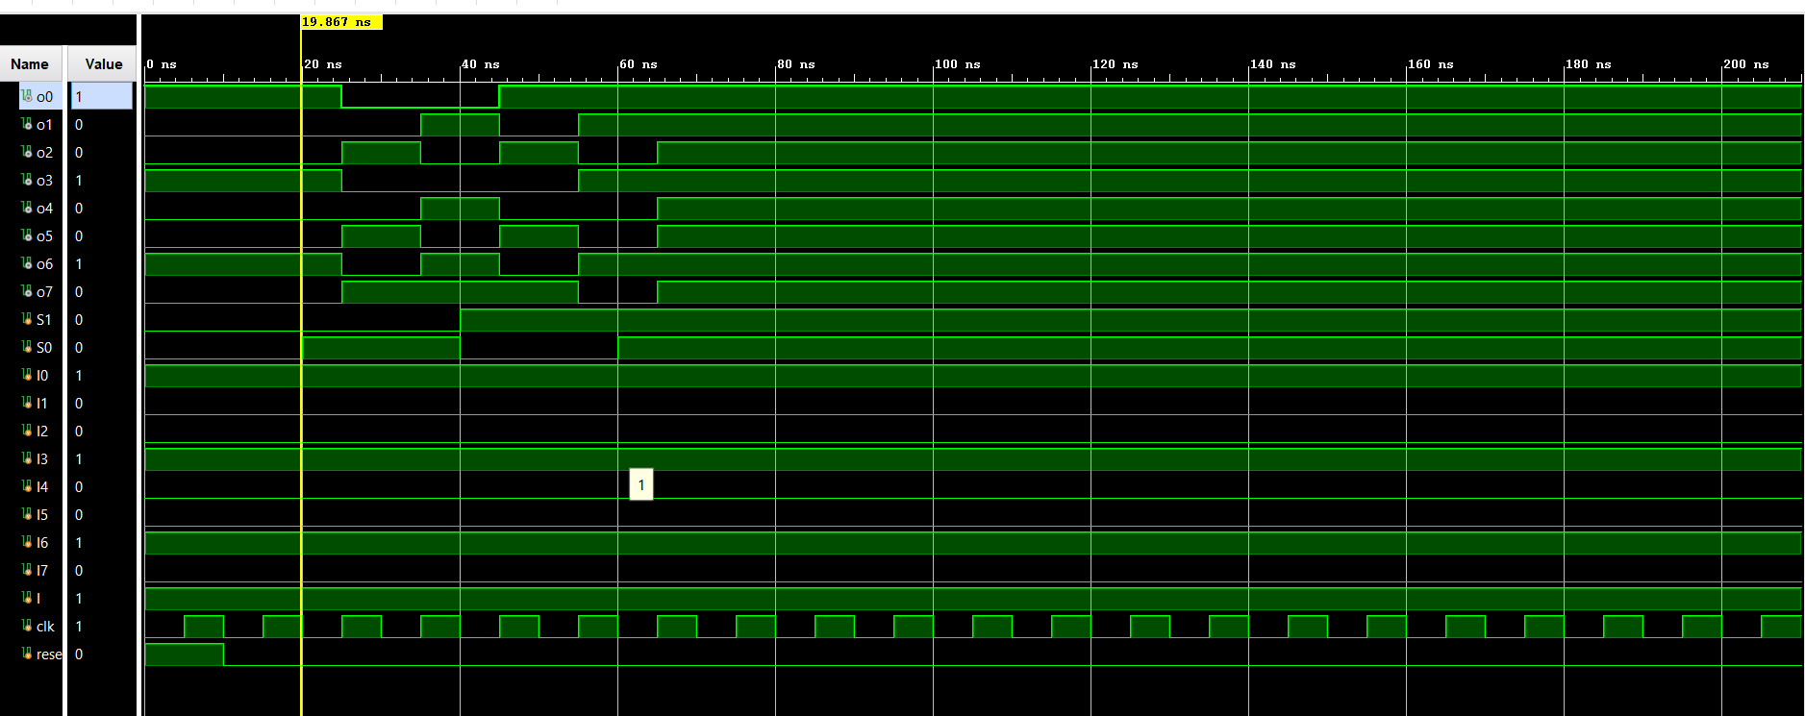
Simulation Results

Slide 18
THANK YOU

