Slide 1

TRAFFIC SUDHARO-User services
NAME:ADAPA GANESH
ROLL nO:18699F0019
DEPARTMENT: mCA 2YEARS
Guide NAME:
Mr.v. MARUTHI PRASAD
Assistant Professor

Slide 2
Abstract
As the name suggests, Traffic Sudharo is a great initiative enabling the Citizens to report Traffic Violations to the appropriate authority this application. This enables the user to Post Issue (Traffic Violation) by capturing the Photos from the Mobile Camera and it will automatically read the Geo Location, Date and Time Etc. It will also allow the users to report the images which they’ve captured out of the application. The Issues reported will be verified by Traffic Sudharo Back end team for obnoxious or obscure images and approves or rejects the issue.

Slide 3
inTRODUCTION
“Traffic Sudharo”, first the user can register, and then login into the page, the first page consists of camera, submit, cancel buttons. Whenever the user saw the Traffic violations like Cell Phone Driving, Signal Jump, and so on. User can take the violation Picture, select the violation type and click on the Submit button after clicking the submit button, the information is transformed to the Admin(Admins are Police Officers) level.
Once the Admin will approved that Request then the user can get the rewards, and also appreciation awards will get by the Government. Without Register into the page, any one can rise the issue , but only the Registered User’s will get Rewards.

Slide 4
proposed system
EXISTING SYSTEM
The Police Officers can only having the rights to take the violation pictures, when the traffic violations are happening at anywhere.
These is a web based as well as an android application, but here we are providing the access to the Public as well as police officers, the people can take pictures related to traffic violations, then the admin (police officer) will be the responsible person to make fine when the user request approved. Suppose admin will get same violation multiple times, at that time only it follows First Come First Serve (FCFS) basses remaining requests will be negligible.

Slide 5
aDVANTAGES
Everyone having the right to punish traffic violators,and to support police officers for controlling traffic accidents.
Number of dependences will decreases.
There is no special device needed for this application, it will work on any smartphone.
Only one police officer is enough for a entire city.
User will get rewards.
By the help of this, traffic violation will surely reduce, why because all traffic violaters are fear of everyone.

Slide 6
Software specifications &
hardware specifications
Processor - i3/i4/i5 Processor
RAM - 4GB
Hard Disk - 250GB
Operating System - Windows 7/8/10 or higher.
Application Server - Tomcat 8.0
Front End - HTML,CSS,BootStrap.
Scripts - JavaScript
Server side Script - Java Server Pages
Database - MySQL

Slide 7
Module Description
The Project “Traffic Sudharo” Contains mainly two modules they are given bellow:
1.User
2.Admin
Here, I developed User related modules in these Project.

Slide 8
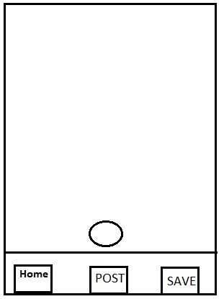
MODULE DESCRIPTION
Opening Page:
When user click on the Traffic Sudharo App, Camera should be launched automatically to capture the violation picture and the launch screen will be as shown below.
Launch screen should have the 3 options. i.e.
1. Post
2. Save
3. Home

Slide 9
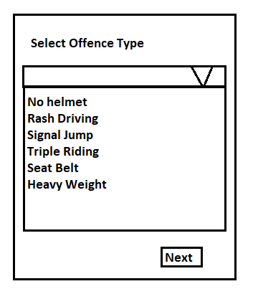
1.POST SCENARIO :
User is clicks on “Post” button the control goes to next page showing list of offence type.
After selecting respected offence type then user click on Next button window will come with reward point condition.

Slide 10
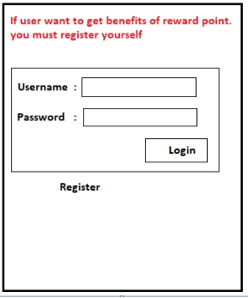
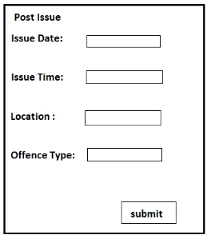
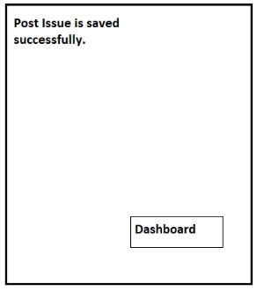
SCENARIO - A :
If user is already registered before he can use his credentials and login directly.
User can add the details in “Post Issue”
H
If user clicks on submit button then the post is saved successfully in database and it will display the one successful message.

Slide 11
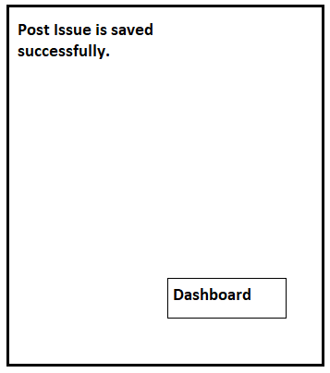
SCENARIO- A
If user clicks on submit button then the post is saved successfully in database and it will display the one successful message.

Slide 12
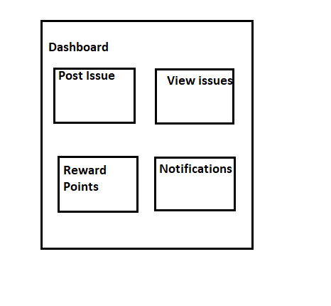
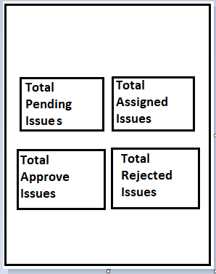
SCENARIO - A
User clicks on Dashboard then the window will come like this.
There are sub modules in View Issues that is be like this
User can see the entire thing what he already post previously.

Slide 13
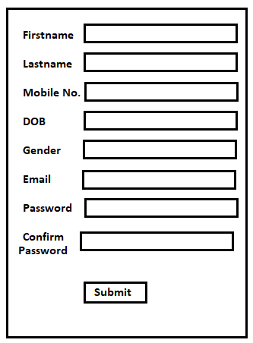
SCENARIO - A
User should be registered with the App, if he/she was a first time user.
Registered Page
On clicking submit button, user record is saved and it displays one message like registered successfully.

Slide 14
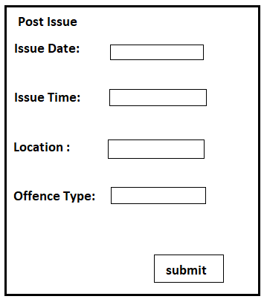
SCENARIO - A
User can add the details in “Post Issue”
If user clicks on submit button then the post is saved successfully in database and it will display a one successful message.

Slide 15
SCENARIO - A
User clicks on Dashboard then the window will come like this.
There are sub modules in View Issues that is be like this
User can see everything in this menus and user can logout.

Slide 16
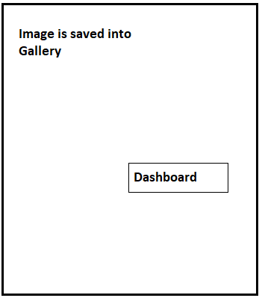
2.SAVE SCENARIO:
If user wants to Post the violation in later stage (Off-Line Mode), user can capture the image and SAVE the violation image into the Gallery.
User will get the confirmation message like: “Image is saved into Gallery”.

Slide 17
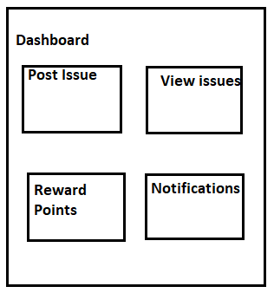
2.SAVE SCENARIO:
When User click on the Dashboard button the following screen should be displayed (Dashboard page).

Slide 18
2.SAVE SCENARIO:
User can post the issue or later he can post
Whenever user click on “Post Issue” button and window will be open like this
If user clicks on submit button then the post is saved successfully in database and it will display a one successful message.

Slide 19
2.SAVE SCENARIO:
User clicks on Dashboard then the window will come like this.
There are sub modules in View Issues that is be like this
User can see everything in this menus and user can logout.

Slide 20
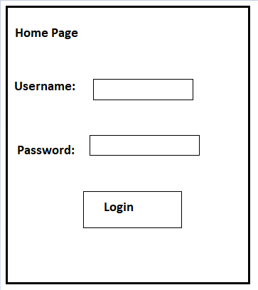
3.HOME SCENARIO
If user wants to see the Dashboard, Reward points, View Issues etc, User has to click on the “Home” button.
When user clicks on the “Home” option, user redirected to Home page.
•SCENARIO A (Registered User)

Slide 21
3.HOME SCENARIO:
If user is already registered before he can use his credentials and login directly.
User can see posts everything what he has posted previously.

Slide 22
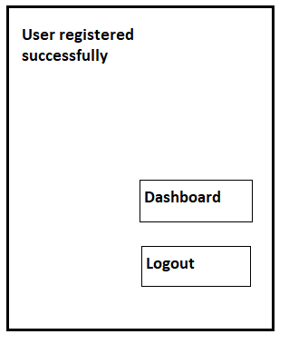
SCENARIO - B (First Time User)
User should be registered with the App, if he/she was a first time user.
Registered Page
On clicking submit button, user record is saved and it displays one message like registered successfully.

Slide 23
3.HOME SCENARIO:
If user is click on Dashboard, it directly goes to Dashboard

Slide 24
4.View Issues
User can see all his Posted issues.
User can see the total pending post, total assigned post, reward points and notifications.
If User clicks on “Total Pending Post” option, user can see all the Pending Issues.
If User clicks on “Total Assigned Post” option, user can see all the posts which are assigned to Agents.
If User clicks on “Total Approved Post” option user can see all Approved Issues.
If User clicks on “Total Rejected Post” option, user can see all the Rejected Issues.

Slide 25
UML DIAGRAMS:
There are different types of UML Diagrams :
In my project i drawn these bellow Uml Diagrams,
1. Class diagram
2. Sequence diagram
3.collaboration diagram
4.Use case diagram
5. Activity diagram
6. Component diagram

Slide 26
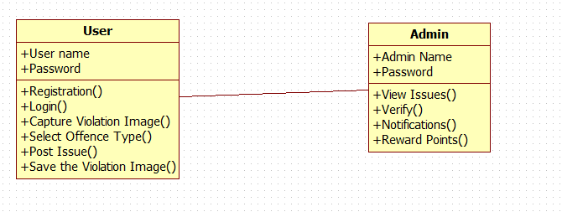
Class diagram

Slide 27
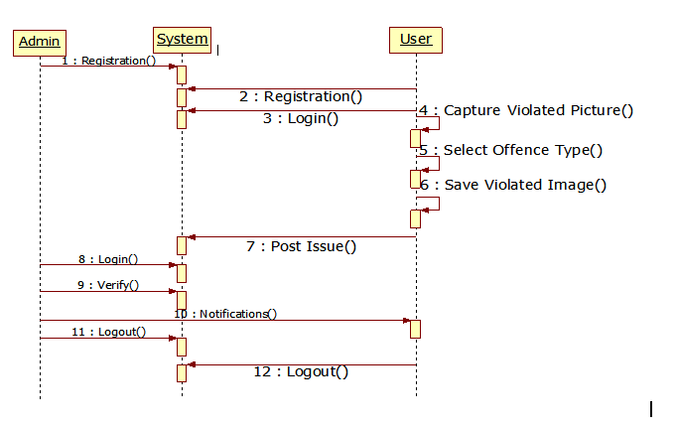
Sequence diagram

Slide 28
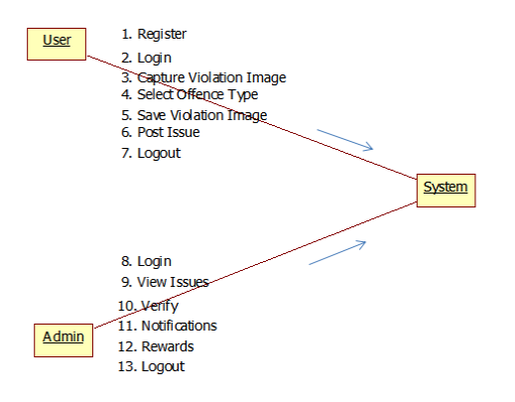
COLLABORATION DIAGRAM

Slide 29
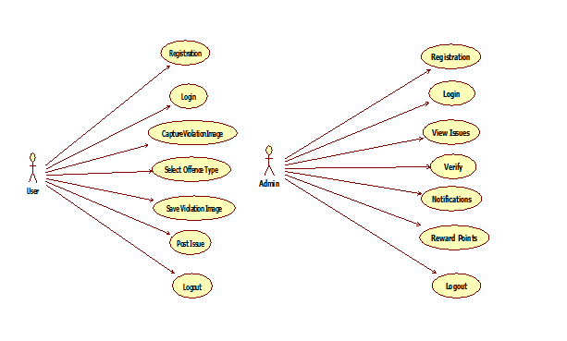
Usecase diagram

Slide 30
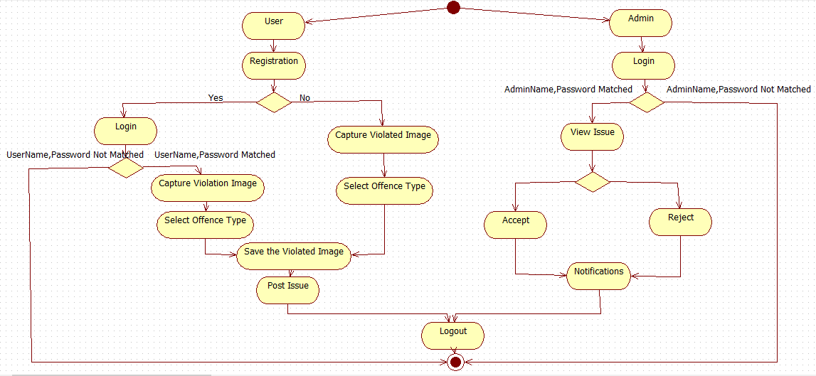
Activity diagram :

Slide 31
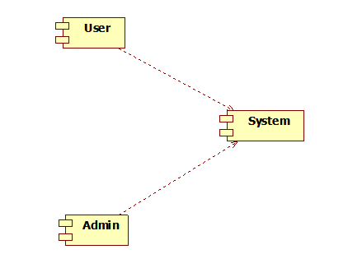
Component diagram

Slide 32
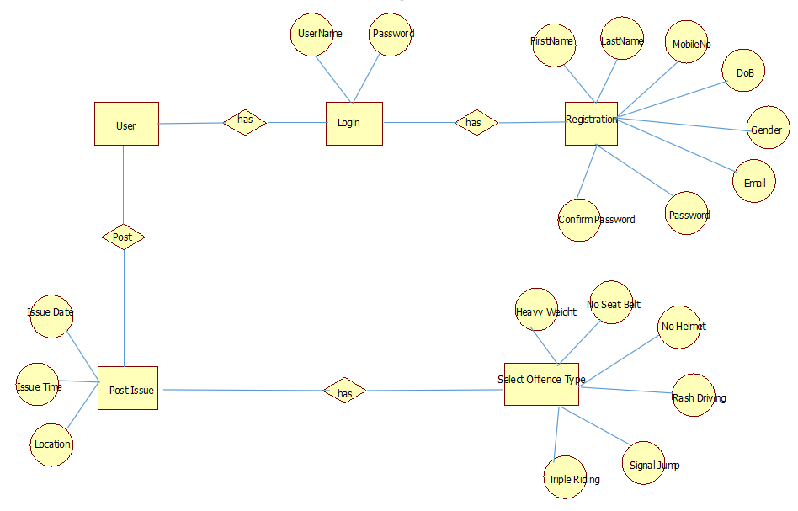
ER-Diagram FOR USER:

Slide 33
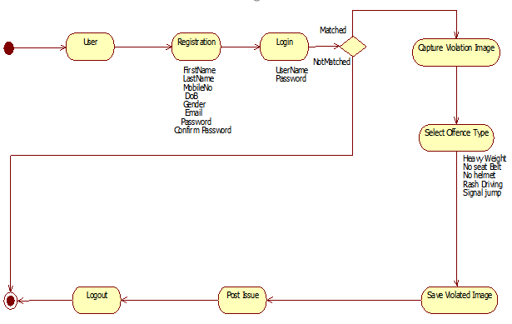
Data Flow Diagram FOR USER:

Slide 34
SCREEN SHOTS OF APPLICATION...

Slide 35

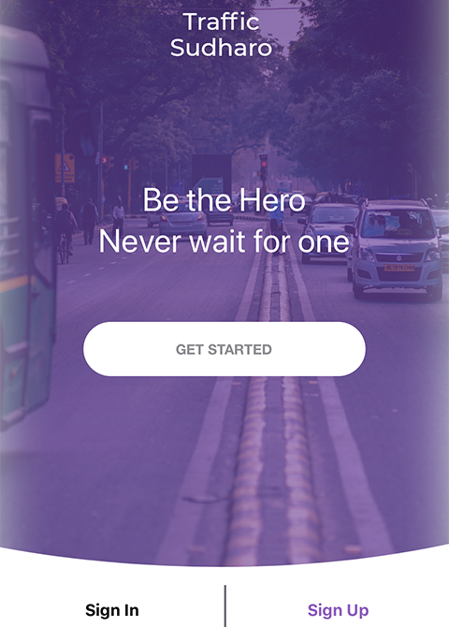
HOME PAGE:
This is the first page that displayed to the user after opening the application
The user want to post any violation that he captured,then he/she need to login/sign into the application
If the user is already registered, they can simply login ,otherwise they need to register.

Slide 36
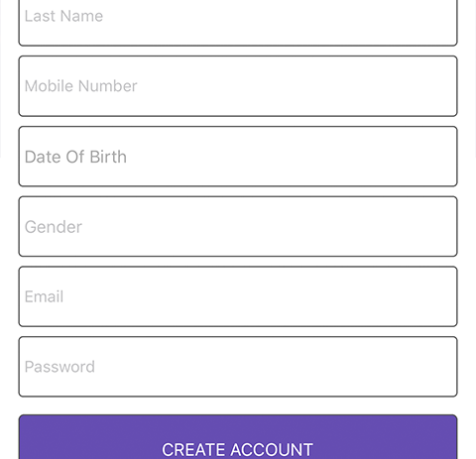
Registration page:
This is the registration slide ​
Who are not registered then they can register ​
After register only they can post any violation and they can get rewards to their posts​

Slide 37
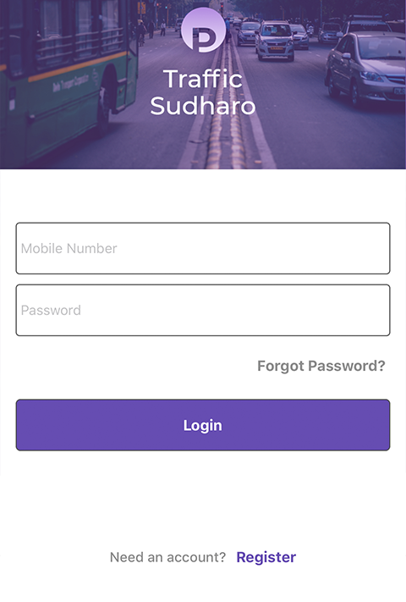
Login Page:
If the user is already registered then they can simply loginbyusing their credentials
Username has tobe mobile number
And password shold be as per rule some special charecters and numbers and alphabets
If they forgot the password aslo there is an option to reset the password by cliking the forgot password

Slide 38
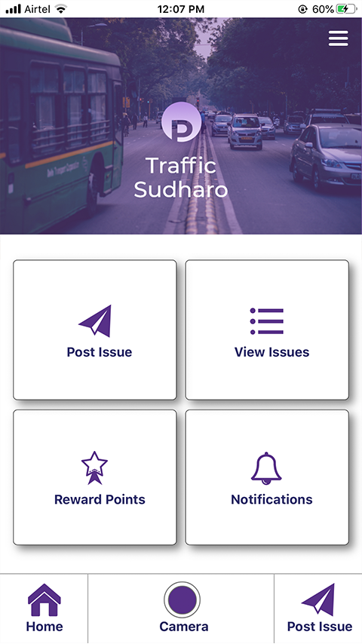
dashboard page:
This is the slide which is having post issue option and view issue option and reward points and notifications

Slide 39
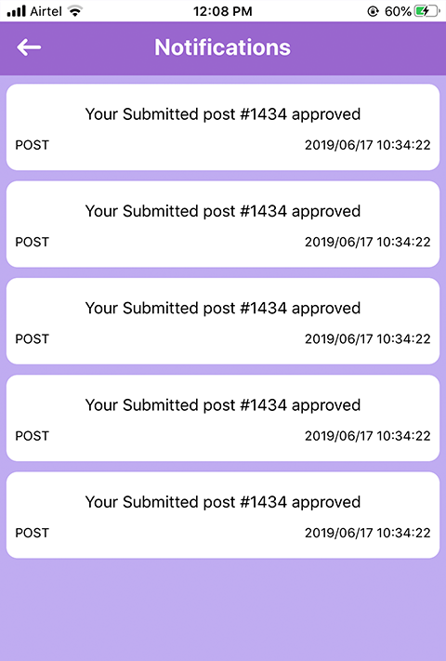
Notification page:
Noificaion page wil display the notifications about the user any violation is posted and that was valid then it will be approved
After approving the user can get the notification as your submitted post is aproved
And also if any rewards are aproved to that violation then also they will get notification

Slide 40
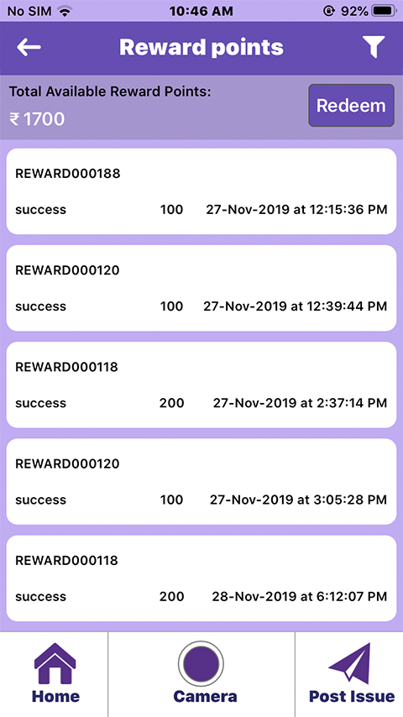
Rewards page:
This page will show the all the rewards that got the user
Firstly they give rewards as a points then the user can redeem the points as money

Slide 41
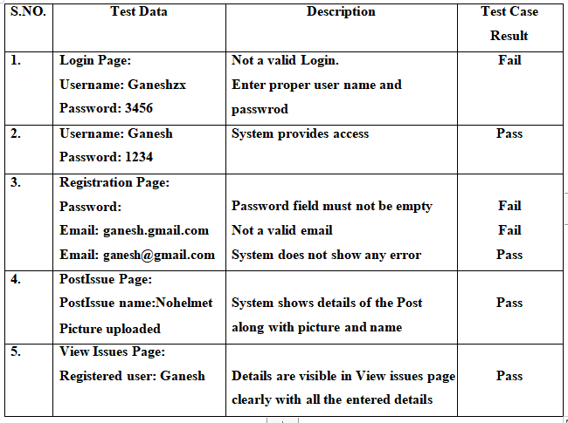
Testing Screenshot

Slide 42
Conclusion:
By the help of this project we can make everyone has to aware of traffic rules and must follow, Otherwise you will be punished by anyone. Respect and follow our traffic rules given by the Government,so that we can control the traffic violations, by the help of these Application, finally we can reduce the Traffic Accidents.

Slide 43
Furture Enhancement
Always I follow the traffic rules updates from the concern government and update in violation types.
I will follow the feedback given by the users and if any reasonable suggestions found, I will follow with that and try to implement in the project

Slide 44
References: bOOK rEsources:
1. E.Balagurusamy, “Programming in Java”, 5th Edition, BPB Publications, 2010
2. Herbert Schildt, “Java – The Complete Reference”, 4th Edition, McGrawHill, 2014
3. Abraham Silberscatz, Korth, Sudarshan – Database Management Systems, 4th Edition, McGrawHill, 2002
4. Bruce Eckel, Thinking in Java, 2nd Edition, Prentice Hall, June 2000.
5. Hans Bergsten, Java Server Pages, Oreille, 3rd Edition December 2003

Slide 45
web resources:
1. www.java2share/jdbcconnectivity.html
2. www.way2java/jspintroduction.html
3. www.java2s/javapagesexamples.solvedexamples.html
4. www.roseindia/dbconnectivity.html
5. www.javatpoint/htmlregistration/example.html
6. www.ajava2all/connectingjavawithtml.html
7. www.booksboon.com

Slide 46


Thank You!

