Slide 1
Incident Impact Prediction

Slide 2
Business Problem
To predict the impact of the incident raised by customer.
Objective
The Objective Of The Analysis Is To Predict An Item When Sold, What Is The Probability That Customer Would File Fraudulent / Genuine Warranty And To Understand Important Factors Associated With Them.

Slide 3
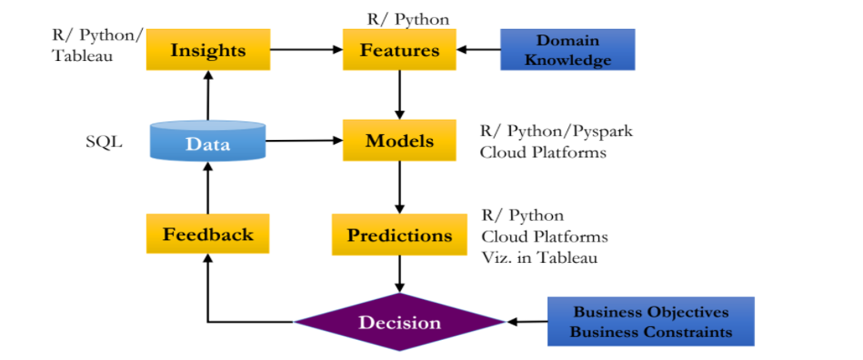
Project Architecture / Project Flow

Slide 4
Exploratory Data Analysis (EDA)

Slide 5
Data set details
The dataset is having incidents raised by customers. Which contains an event log of an incident management process extracted from a service desk platform of an IT company.
Total 141713 observations of 36 variables are as follows,

Slide 6
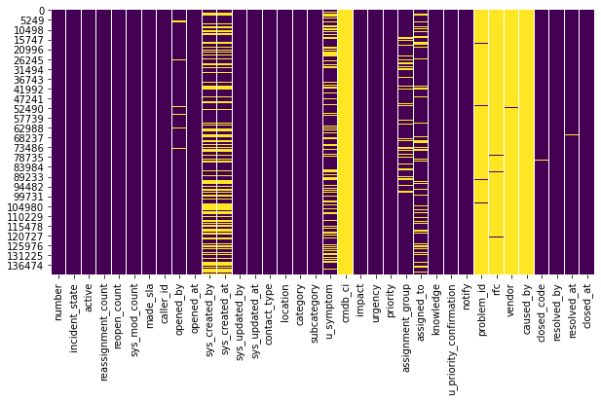
HeatMap for null values
Dataset contains 30% of missing values mainly in below dropping columns.

Slide 7
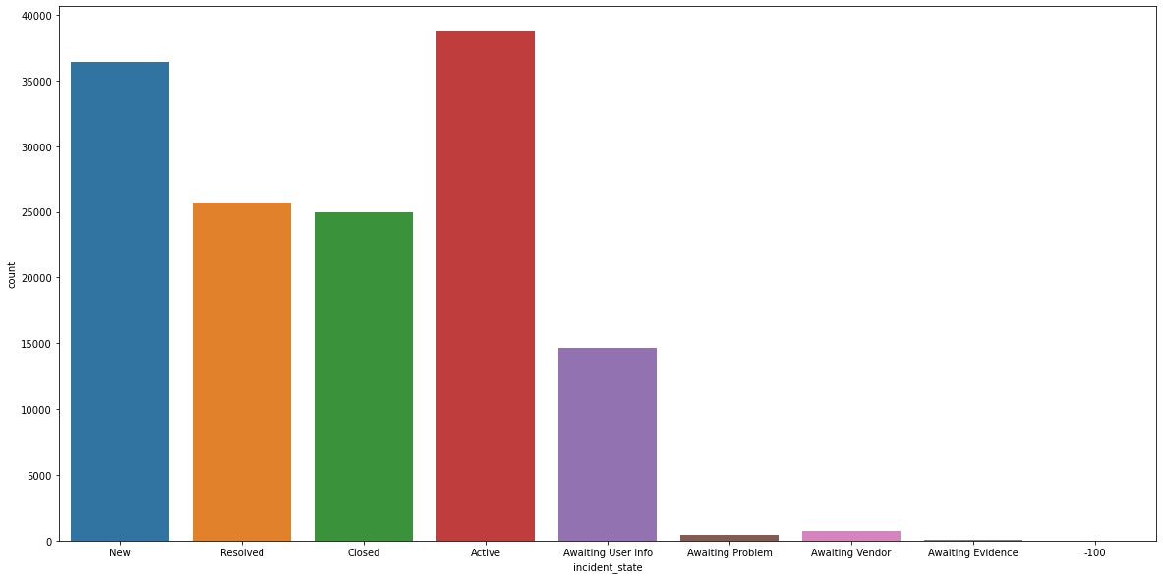
Impact on incident_state
Most of the incident states are in active state.

Slide 8
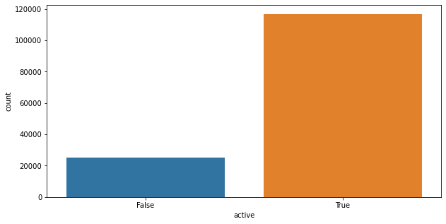
Impact on active
Proportion of high impact on active cases.

Slide 9
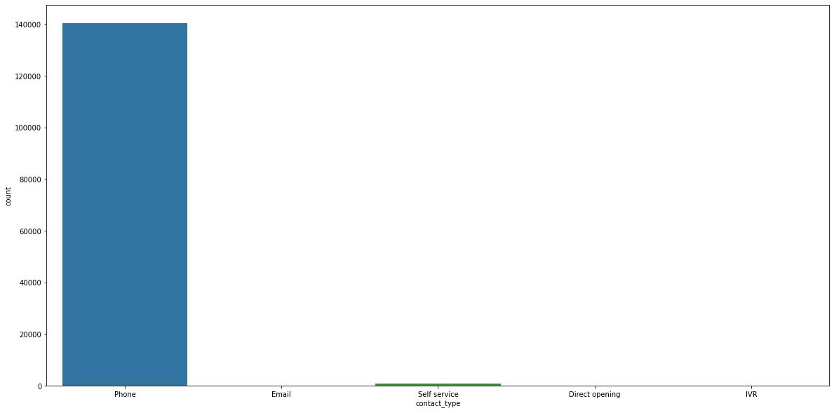
Impact on contact_type
Most of the Incidents registered through mobile which has high impact.

Slide 10
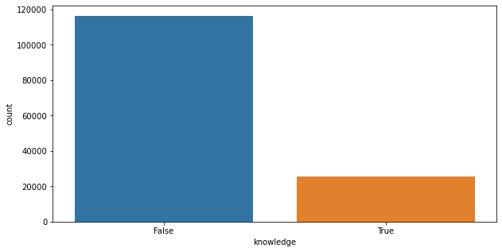
Impact on knowledge
Proportion of high impact while working according to dataset.

Slide 11
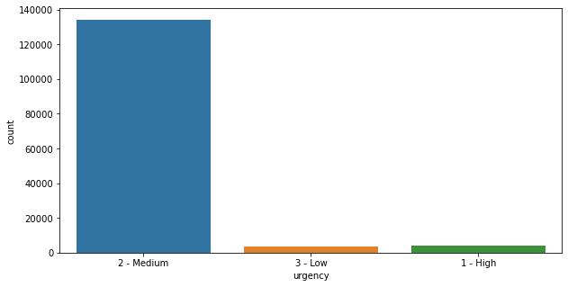
Impact on urgency
Most of the incidents are 2-Medium level urgency.

Slide 12
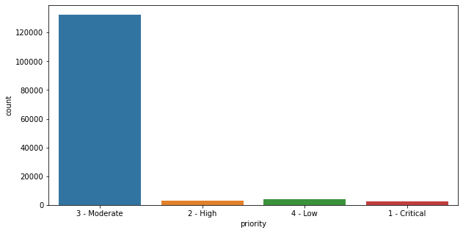
Impact on priority
Most of the incidents are 3-Moderate state priority.

Slide 13
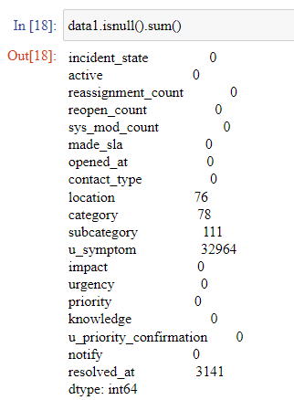
Random Sampling Imputation for 'u_symptom' feature
Encoding Used : Label Encoding
Independent Variables with less proportion of missing values are dropped.
Random sampling imputation applied on the u_symptom.

Slide 14
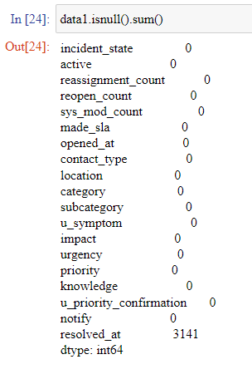
Mode Imputaion for ['location','category','subcategory’]
Encoding Used : Label Encoding
Independent Variables with less proportion of missing values are dropped.
Mode imputation applied on the location,category,subcategory.

Slide 15
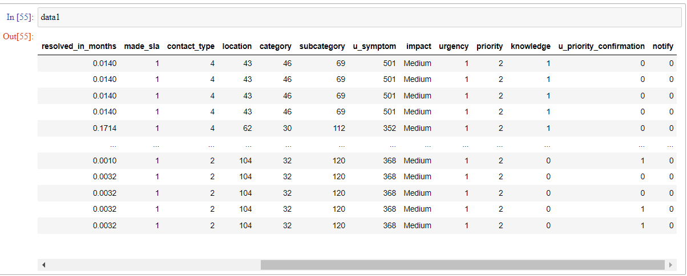
Imputated Data

Slide 16
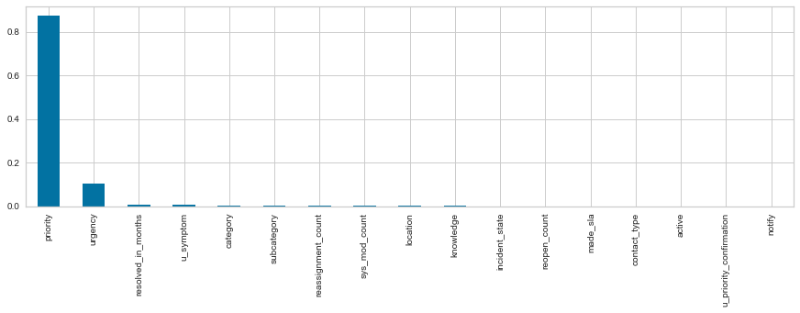
Feature Selection Using Decision Tree Classifier
Algorithm Used: Decision Tree classifier

Slide 17
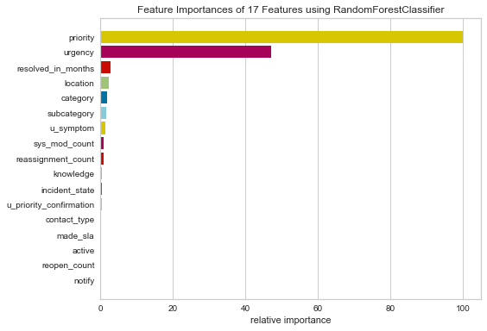
Feature Selection Using Random Forest Classifier
Algorithm Used: Random forest classifier

Slide 18
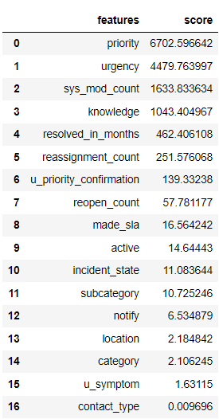
Features for consideration
These are the top considering features for model building

Slide 19
Model Building

Slide 20
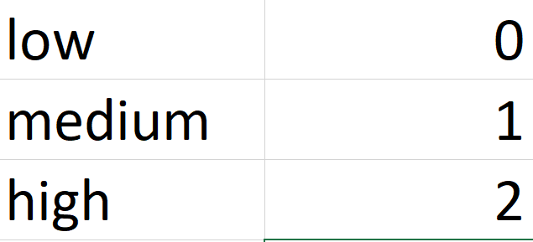
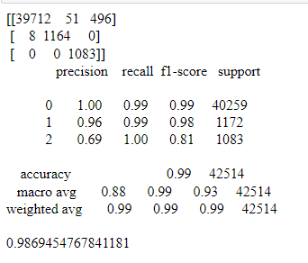
Using DecisionTreeClassifier
Accuracy:98.69%
Only 69% of the times low impact incident is considered as low otherwise 31%of time high or medium incident are predicted a low.
99% of high impact incident cases were wrongly predicted as low or medium impact incidents.
19% of the times low is wrongly predicted as high or medium impact incident.

Slide 21
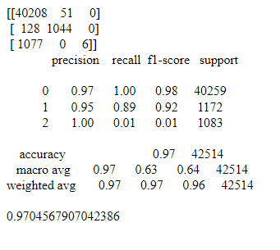
Using RandomForestClassifier
Accuracy:97.04%
3% of the times low and medium incidents were considered as High
99% of the times low is wrongly predicted as high or medium impact incident.
99% of the times low is wrongly predicted as high or medium impact incident.

Slide 22
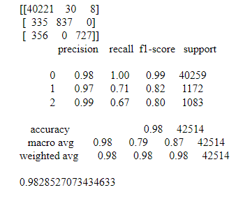
Using K Neighbors Classifier
Accuracy:98.28%
2% of the times low and medium incidents were considered as High(Precision).
33% of the times low is wrongly predicted as high or medium impact incident.
20% of the times low is wrongly predicted as high or medium impact incident.

Slide 23
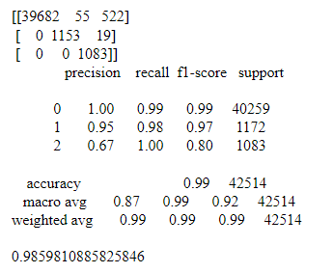
Using GaussianNB
Accuracy:98.59%
Only 67% of the times low impact incident is considered as low otherwise 33%of time high or medium incident are predicted a low.
99% of high impact incident cases were wrongly predicted as low or medium impact incidents.
20% of the times low is wrongly predicted as high or medium impact incident.

Slide 24
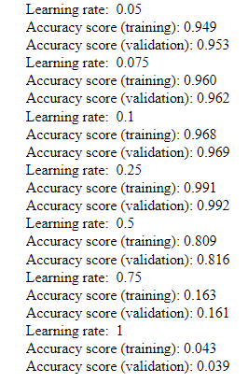
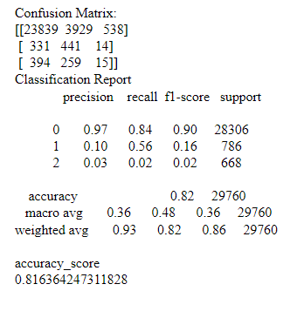
Using Gradient Boosting Classifier
Accuracy : 81.63%
Only 3% of the times low impact incident is considered as low otherwise 97%of time high or medium incident are predicted a low.
84% of high impact incident cases were wrongly predicted as low or medium impact incidents.
98% of the times low is wrongly predicted as high or medium impact incident

Slide 25
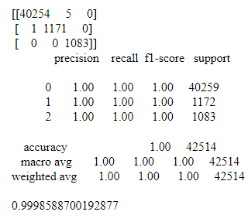
Using XGB Classifier :
Accuracy : 99.98%

Slide 26
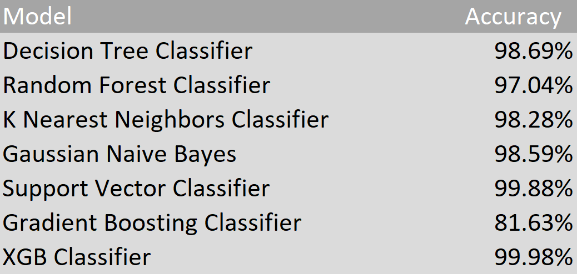
Model Summary
Impact prediction using XGB Classifier the good accuracy, Precision, Recall and f1-score. Therefore, this model is Selected for deployment to predict the incident impact.

Slide 27
Model Deployment

Slide 28
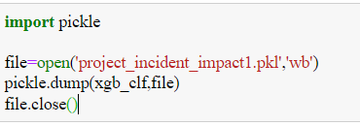
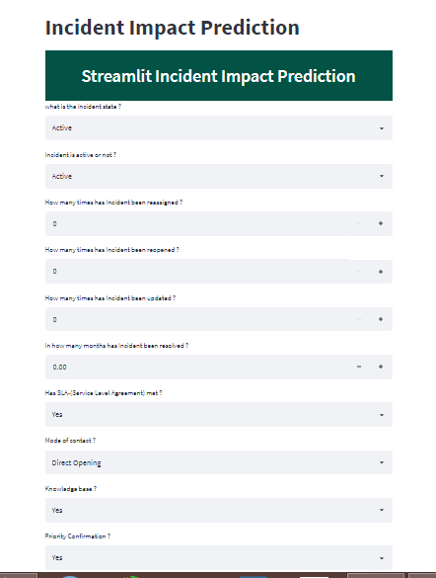
Using Streamlit
http://localhost:8501/

Slide 29
Challenges faced?
Understanding of data set due to various features.
More NA values.
More Irrelevant Features.
How did you overcome?
Gained Domain Knowledge with Domain Experts.
Done EDA phase to replace NA values by using some imputations.
Done Feature engineering phase to eliminate the Irrelevant Features.

Slide 30
Thank You

