Slide 1
GENVOX
A Voice Activated Multi-model generative Ai Companion
S.V.V.Prasanna Kumar 21X41A4251
J.Mahalakshmi 21X41A4222
P.Mani kanta 21X41A4239
L.Ganesh Kumar 22X45A4204
Guided By:
Dr.D.Anusha

Slide 2
Abstract:
GenVox a voice-activated multimodal generative AI companion could combine the latest advancements in natural language processing, image generation, and audio synthesis to deliver a highly interactive and versatile experience and it is a virtual AI companion that interacts seamlessly with users through voice commands and produces outputs in multiple formats, such as text, images and audio. It could serve as a personal assistant, creative collaborator, or learning partner, leveraging generative AI to adapt to the user’s needs.
The project includes core features like voice controlled text generation like storytelling, content creation, Q&A, and summarization via voice commands. Image creation via voice prompts like generate art, illustrations, or designs based on spoken descriptions. Audio Synthesis content.

Slide 3
Interactive Cross-Modal Content Creation Combine models based on vocal input, such as describing a text, image and etc. By using the technologies like large language models (LLM’s) for the content creation and gTTs enterprise for the text to speech conversion, pyttsx3 for the natural language processing, python 3.0 for the project development and python Kivy for android development, API keys of Together ai, hugging face for using of prebuilt generative models. This project would let users activate and interact with various generative AI models through natural voice commands, making content creation intuitive and accessible.
Keywords: LLM’s, gTTs, Llama-3.0-turbo-free, Python3.0, Python Kivy, Together ai, hugging face API keys

Slide 4
Existing System:
Voice-Based Virtual Assistant (VBVA) project aimed at creating a smart, hands-free, voice-activated assistant leveraging cutting-edge machine learning and speech recognition technologies. The assistant provides personalized responses, task automation (e.g., setting reminders, making calls, sending messages), and retrieves real-time information (e.g., weather, news).
It includes multilingual and context-aware functionalities to enhance usability and adaptability. Core technologies include Python libraries like Speech Recognition for speech-to-text and pyttsx3 for text-to-speech. Future directions involve integrating VBVA into compact hardware like Raspberry Pi and expanding smart home automation capabilities. This innovation targets improved accessibility, efficiency, and intuitive user interaction.

Slide 5
Proposed System:
The existing systems for AI interaction primarily focus on single-modal outputs such as text-only chatbots or voice assistants like Siri and Alexa. These systems have the following limitations:
Restricted Output Modalities: Lack of support for generating images, videos, or multimodal content.
Low Interactivity: Limited personalization and static responses.
Application Constraints: Tailored for specific use cases, with minimal adaptability for creative tasks.
GenVox aims to overcome these challenges with the following innovations From the general Existing system like Alexa, google assistant:
Voice-Activated Interaction: Real-time, natural conversation using advanced speech recognition.
Multimodal Generative AI: Outputs in text, audio, image based on context and user needs.
Personalization: Learns from user preferences to deliver customized experiences.
Scalable Framework: Modular architecture allows integration with various third-party APIs and services.

Slide 6
System Requirements:
Hardware Requirements:
Processor: Intel i5 or above (for development)
RAM: Minimum 8 GB
Microphone and speaker setup for voice input/output
Optional: GPU-enabled device for model training/testing
Software Requirements:
Development Tools:
Python3.0
Python Kivy for mobile app development
Google Colab

Slide 7
APIs and Libraries:
Google gTTs speech recognition
Stability Ai for text and image generation
Text-to-Speech (TTS) libraries
Hugging face LLM API’s
Together Ai API,s
Network Requirements:
Internet connection for API usage and cloud interactions

Slide 8
Technologies Used:
Programming Languages: Python, Kivy (for Android apps)
Tools: Google gTTS, TogetherAI APIs, Hugging face LLM API’s
Natural Language Processing: For understanding and generating human-like text (e.g., GPT models).
Speech Recognition and Synthesis: Google Speech-to-Text, custom TTS models.
Generative AI Models: Stable diffuser pipeline for image generation libraries.
Platforms: Mobile Platforms (Android Emulator)

Slide 9
Modules Description
User Module
Purpose: Handles user interactions and personalization.
Features:
Speech-to-text conversion for voice commands.
Multilingual support for diverse users.
Personalization based on user preferences and interaction history.
Task automation like setting reminders, sending messages, and retrieving information.
Administration Module
Purpose: Manages the system’s backend and monitoring.
Features:
Monitoring user details and system performance.
Configuring AI model parameters and updates.
Implementing and auditing privacy and security measures.

Slide 10
3. Database Module
Purpose: Stores and retrieves user data, configurations, and interaction logs.
Features:
Secure storage of user profiles, preferences, and interaction history.
Logs of voice commands and system responses.
APIs to access and manage stored data for personalization and analytics.
Compliance with data protection regulations (e.g., GDPR, CCPA)
System Module
1. Task Management Module
Purpose: Executes user-requested tasks.
Features:
Integration with calendar, messaging, and smart home systems.
Real-time retrieval of information (e.g., weather, news).
Handling multiple tasks simultaneously with a queue system.

Slide 11
2. Generative AI Module
Purpose: Processes user queries and generates intelligent responses.
Features:
Natural Language Processing for intent recognition.
AI-based content generation using GPT or similar models.
Context awareness to maintain conversation flow.
3. Security and Compliance Module
Purpose: Ensures the system’s privacy, security, and compliance.
Features:
Data encryption and secure API communication.
User consent management and data deletion options.

Slide 12
Literature survey
TITLE | AUTHOR | YEAR | DESCRIPTION | OUTCOMES
VOICE BASED VIRTUAL ASSISTANT | Dilshad Ahmad, Kiran H, Girish Kumar, Hanumanta DH | 2023 | Focused on: Developing a hands-free, smart AI assistant for real-time task automation. Future Scope: Deploy on Raspberry Pi and integrate with smart home automation. | Created a multilingual, context-aware AI assistant with task automation
Enhancing Voice Assistants with Generative AI Language Models for Interactive Conversations | Shivam Hajong | 2024 | Focused on: Using LLMs to create an interactive and intelligent voice assistant system. Future Scope: Improve the usability and scalability of AI-driven voice assistants. | Developed a voice assistant application integrating HTML/CSS, JavaScript, Python, SQLite, and Hugging Face API.
Voice Control Using AI-Based Voice Assistant | S. Subhash, R. Kumar, P. Sharma, M. Verma | 2020 | Focused on: AI-powered voice commands for task automation. Future Scope: Improve speech recognition accuracy and integrate with smart devices. | Demonstrated the efficiency of AI voice commands for simplifying everyday tasks.

Slide 13
Literature survey
TITLE | AUTHOR | YEAR | DESCRIPTION | OUTCOMES
Research on the Development of Voice Assistants in the Era of Artificial Intelligence | Yuqi Huang, L. Zhang, F. Wei, T. Chen | 2023 | Focused on: Comparative analysis of voice assistants in different regions. Future Scope: Study user preferences and optimize voice assistants for cultural adaptability. | Identified regional differences in voice assistant preferences and functionalities.
Intelligent Personal Assistants: The Future of AI-Powered Voice Assistants | J. Williams, R. Patel, M. Anderson, K. Lee | 2021 | Focused on: Evolution of voice assistants like Siri, Alexa, and Google Assistant. Future Scope: Use deep learning to enhance conversational AI. | Demonstrated how deep learning is making AI assistants more human-like.
Artificial Intelligence-Based Chatbot with Voice Assistance | A. Balamurugan, D. Thiruppathi, S. P. Santhoshkumar, K. Susithra | 2024 | Focused on: Merging AI-based chatbots with voice assistance to improve user engagement. Future Scope: Enhance chatbot personalization and adaptability for diverse applications. | Developed a web-based AI chatbot integrating GPT-3.5 and voice assistance for improved interaction.

Slide 14
Literature survey
TITLE | AUTHOR | YEAR | DESCRIPTION | OUTCOMES
Voice-Based Home Automation Using AI | M. Sharma, R. Mehta, A. Joshi, S. Desai | 2023 | Focused on: Using AI to control IoT-based smart home systems via voice. Future Scope: Enhance real-time response and energy efficiency for smart homes. | Integrated voice-controlled IoT devices, enhancing home automation efficiency.
Smart AI Voice Assistant through Generative Text Transformer and NLP Implementation in Python | Devesh Bajpai, Mallela Uday Kiran, Busi Hemanth Reddy, Suresh Kumar Natarajan | 2024 | Focused on: Improving AI decision-making and user interaction using AI, NLP, GTT, and speech recognition. Future Scope: Enhance context-awareness and deep learning capabilities of AI voice assistants. | Implemented Generative Text Transformer (GTT) and NLP for advanced language processing in AI assistants.
Voice Assistant Applications in Healthcare | R. Patel, M. Gupta, S. Khan, P. Roy | 2022 | Focused on: AI voice assistants in telemedicine and patient care. Future Scope: Improve AI-based diagnostics and emergency response systems. | Showed how voice assistants reduce workload in hospitals and improve patient experience.

Slide 15
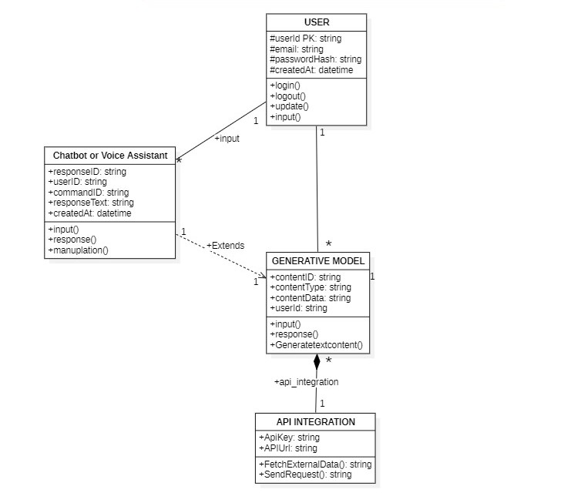
Class Diagram

Slide 16
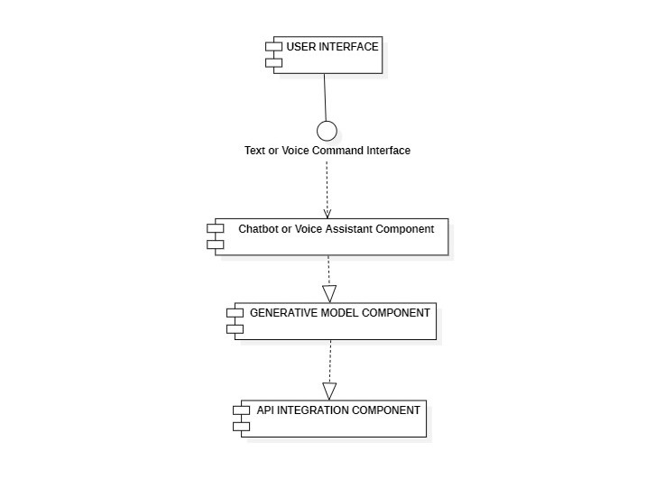
Component Diagram

Slide 17
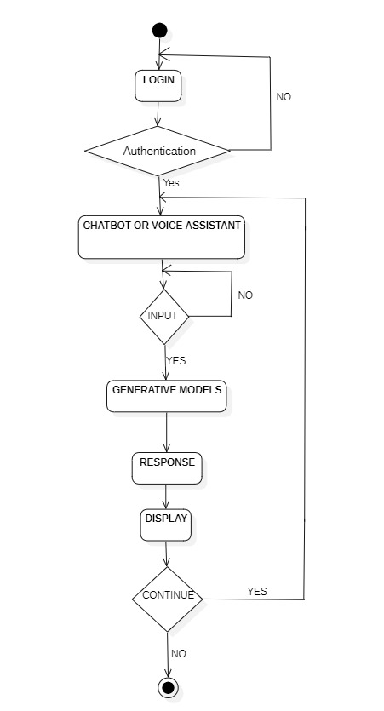
Activity Diagram

Slide 18
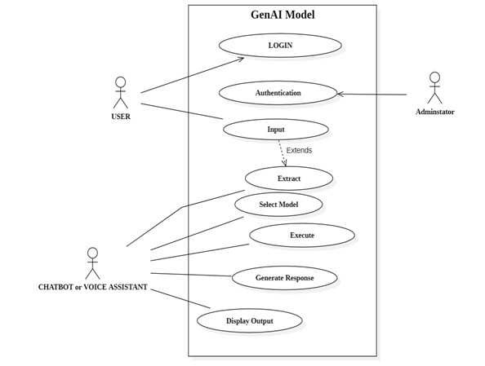
Use Case

Slide 19
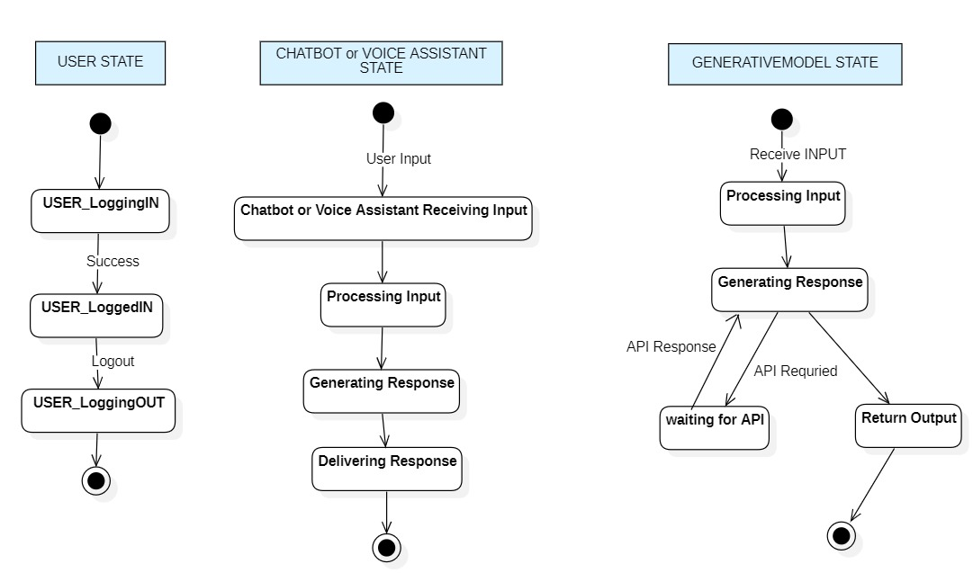
State Machine Diagram

Slide 20
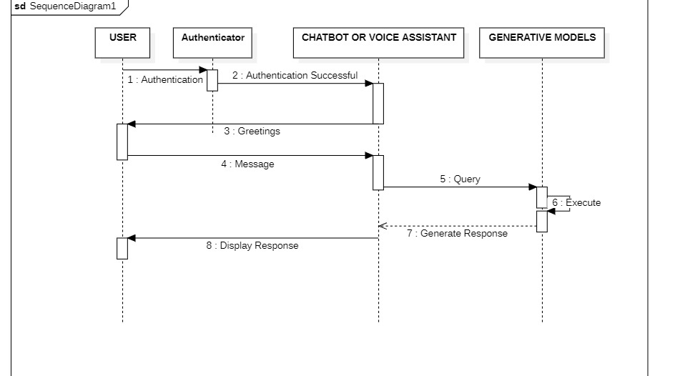
Sequence Diagram

Slide 21
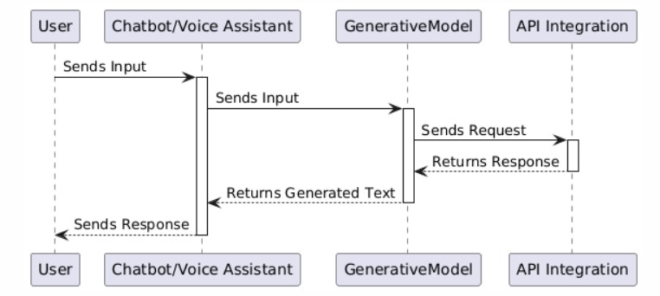
Communication Diagram

Slide 22
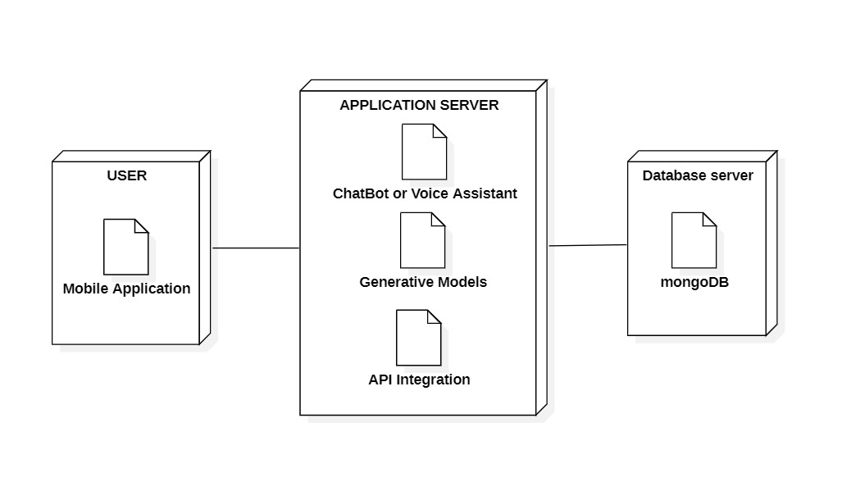
Deployment Diagram

Slide 23
Proposed System Methodology
Overview:
GenVox is a voice-activated multimodal generative AI companion that enables users to interact with AI models using voice commands. The system supports text, image, and audio generation using deep learning and NLP techniques.
Methodology:
1. Voice Recognition & NLP Processing
Captures user input via speech-to-text (gTTS).
Converts voice commands into structured text queries.
Processes queries using large language models (LLMs) like LLaMA-3,etc.
2. Multimodal AI Interaction
Processes text input for various AI models.
Image Generation (Stable Diffusion-xl-1.0).
Code Generation (Llama-3.0-turbo-free).
Audio Generation (gTTS,Pysxtt3).

Slide 24
3. User Response and Output Handling
Displays generated results (text responses, images, or code snippets).
Converts generated responses into voice outputs using TTS (Text-to-Speech).
Stores user preferences and interactions in MongoDB.
4. Deployment & UI Integration
Mobile App (Built using Python-Kivy for Android compatibility).
Cloud-hosted backend (Together ai API for AI model requests).
Secure authentication and user data management.

Slide 25
Proposed System Architecture
Architecture Components:
Frontend: Kivy-based Mobile App (Android UI for Voice & Chatbot interface).
Backend: Kivy for AI model integration.
Database: MongoDB for user data storage.
AI Model Processing: Together for LLaMA-3, and Hugging Face models.
Voice & NLP: gTTS for Speech-to-Text and pysxtt3 for speech recognition.
Workflow:
1. User interacts via voice input.
2. The app processes the command and sends it to the backend.
3. Backend calls the appropriate AI model (text, image, code, or audio generation).
4. The AI-generated response is sent back to the app.
5. The result is displayed in the app (or converted to speech for voice response).

Slide 26
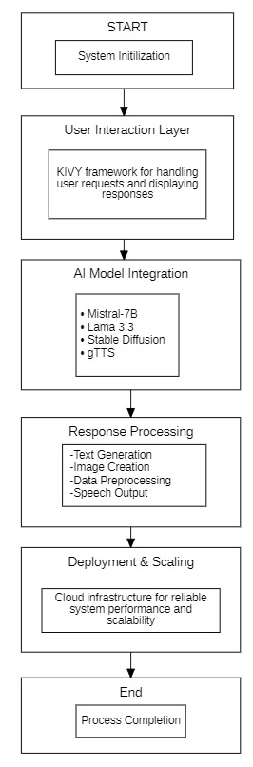
Architecture

Slide 27
Proposed Algorithms Explanation
A) Text-to-Speech Processing ( Google gTTs)
Input: User’s voice.
Preprocessing: Noise filtering & speech segmentation.
Model Processing:The gTTS (Google Text-to-Speech) library is a Python-based tool that converts text into natural-sounding speech. It utilizes Google’s TTS API, supporting multiple languages and accents to enhance accessibility and communication. The model processes input text, synthesizes it into speech, and saves it as an audio file or plays it directly. It uses deep learning-based speech synthesis, ensuring clarity and proper pronunciation. With its lightweight and easy-to-use nature, gTTS is widely used in AI assistants, voice-enabled applications, and accessibility tools.
Output: reading the user input as loud

Slide 28
B) Text & Code Generation (LLaMA-3 )
Input: User’s text prompt (converted from speech if needed).
Processing:
The Meta-Llama 3.3-70B Instruct-Turbo model generates code using an autoregressive transformer approach, predicting the next token based on prior context. It has been fine-tuned on diverse programming languages to understand syntax, structure, and best practices. The model leverages self-attention mechanisms to maintain logical consistency across complex code blocks. Using context-aware token prediction, it ensures accurate function definitions, variable usage, and formatting. Finally, its probability-based decoding helps generate efficient, readable, and optimized code for various programming tasks.
Output: AI-generated text or code snippet.

Slide 29
C) Image Generation (Stable Diffusion )
Input: User prompt describing an image.
Processing:
The Stable Diffusion XL Base 1.0 model generates images using a process called latent diffusion. Instead of working directly in pixel space, it compresses images into a lower-dimensional latent space for more efficient processing. A CLIP-based text encoder converts input prompts into numerical embeddings, which guide the image generation. The model starts with random noise and progressively refines the image through a U-Net-based denoising process, following a noise scheduling technique. Finally, a decoder reconstructs the image from the latent space, often with optional upscaling for higher-quality outputs..
Output: AI-generated image.

Slide 30
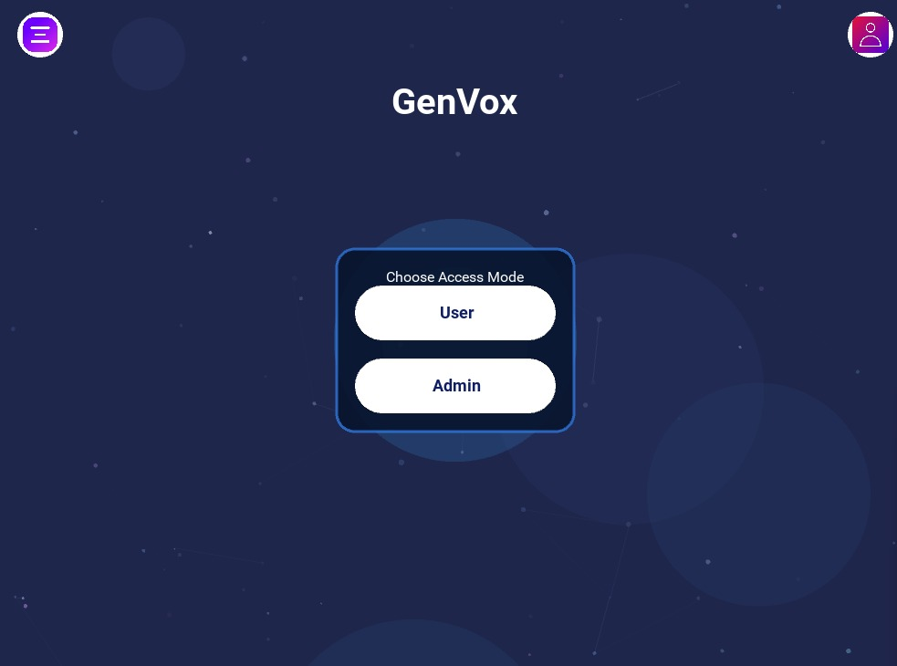
Sample Screenshots

Slide 31
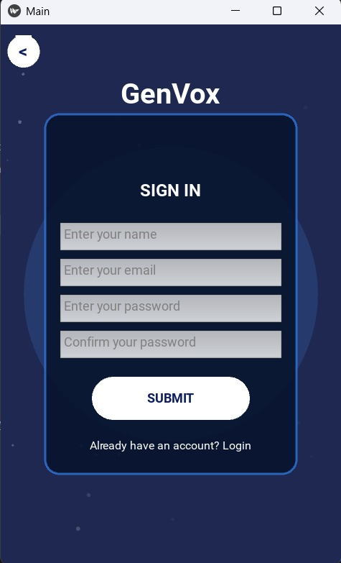
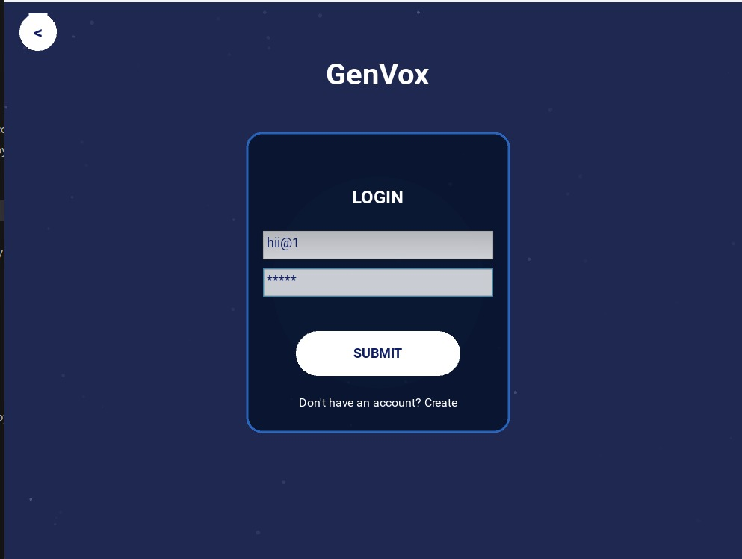
Login Page Sign In Page

Slide 32
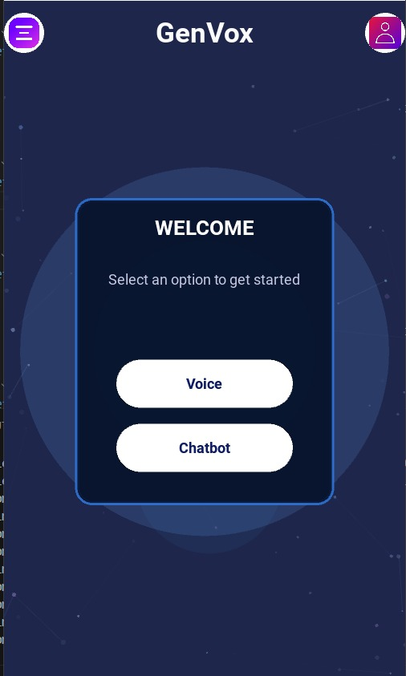
Home Page

Slide 33
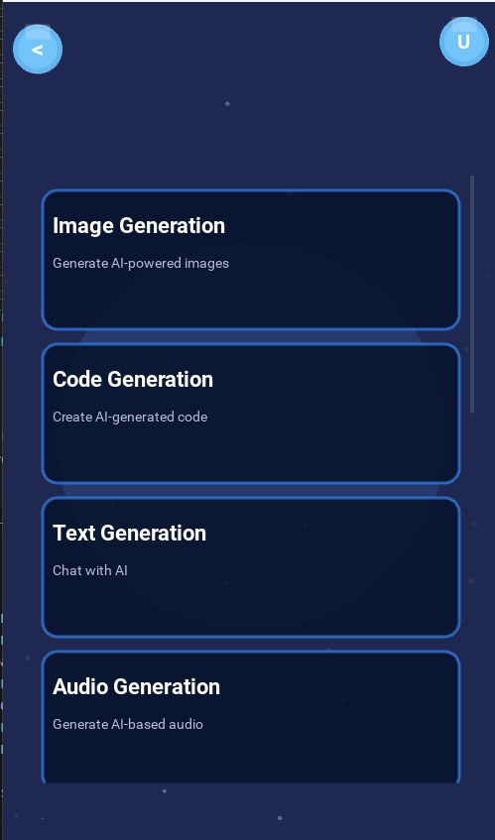
Models Page

Slide 34
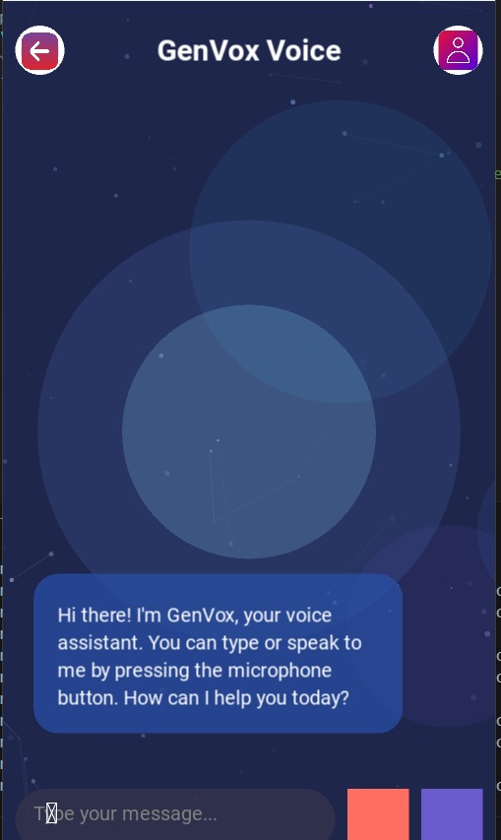
Voice Generator

Slide 35
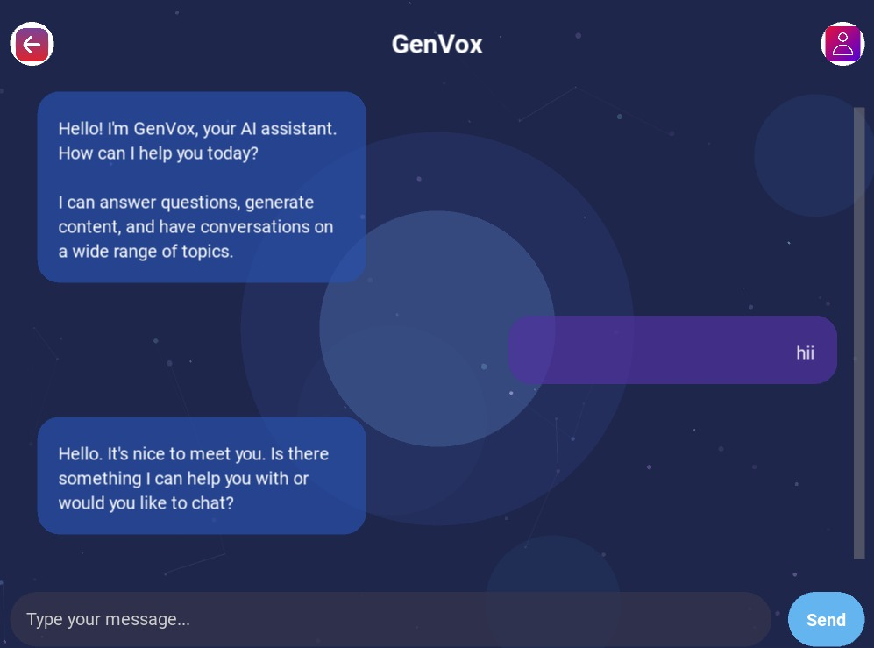
Chat Bot Page

Slide 36
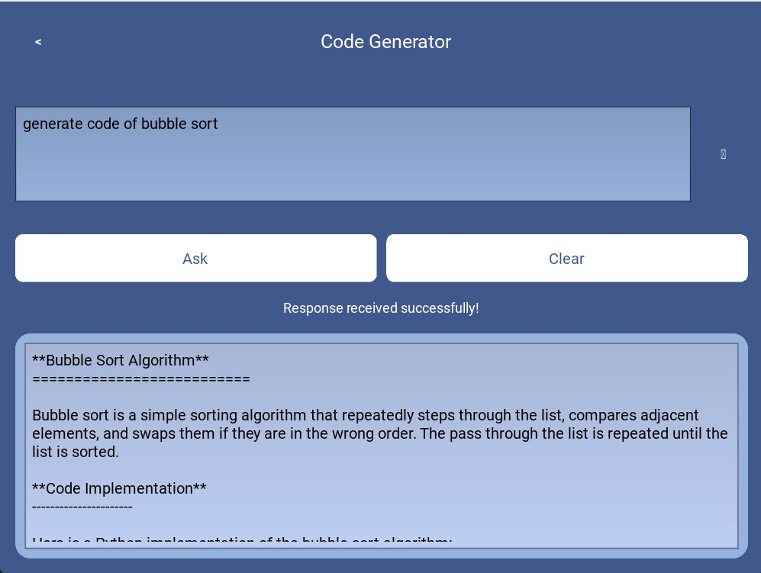
Code Generator

Slide 37
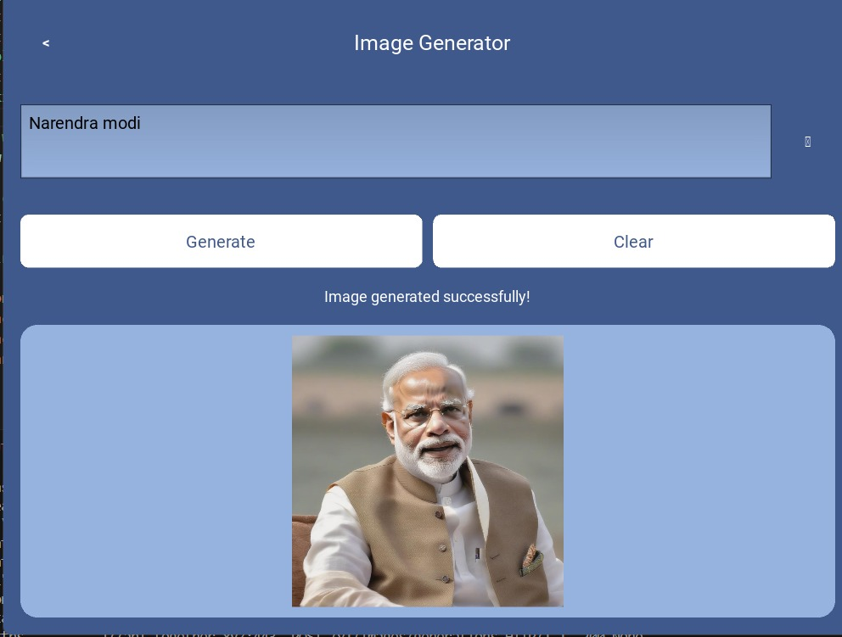
Image Generator

Slide 38
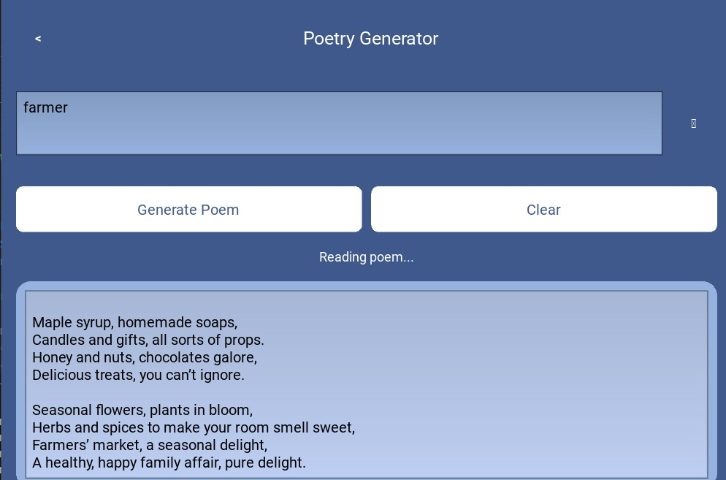
Poetry Generator

Slide 39
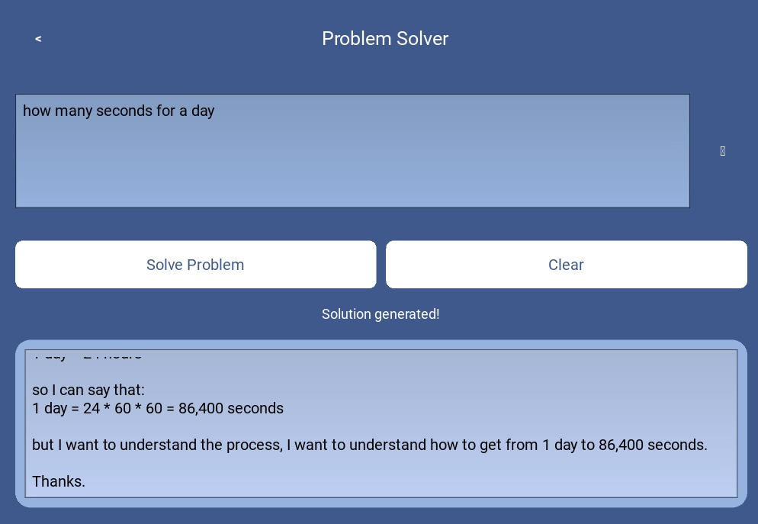
Problem Solver

Slide 40
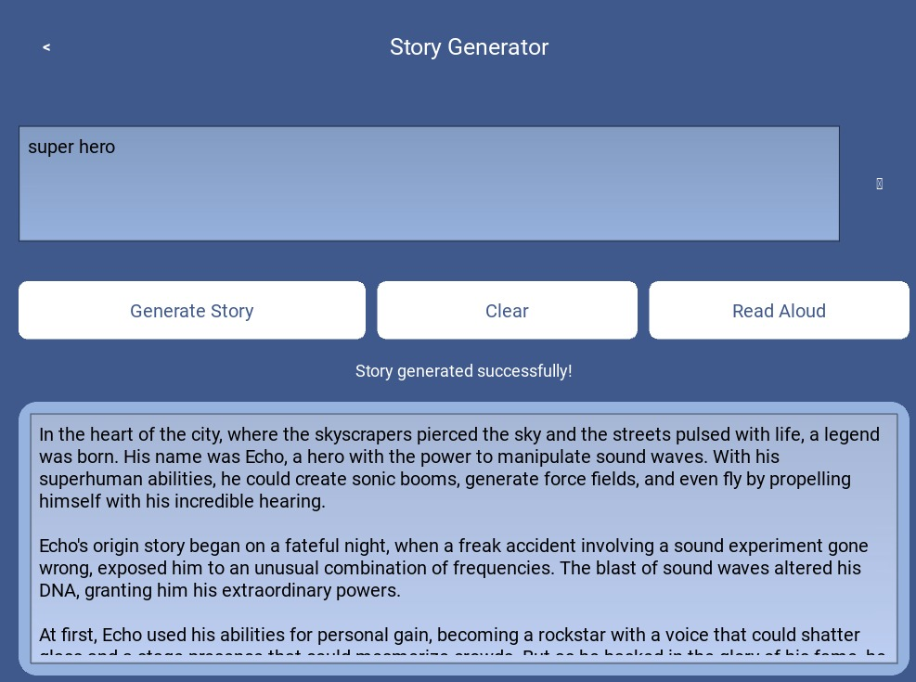
Story Generator

Slide 41
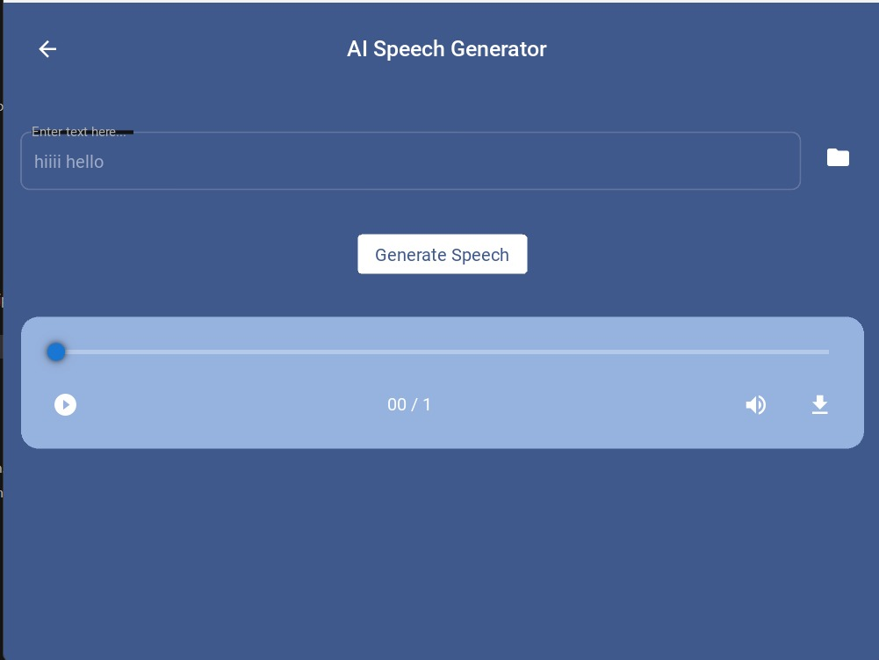
AI Speech Generator

Slide 42
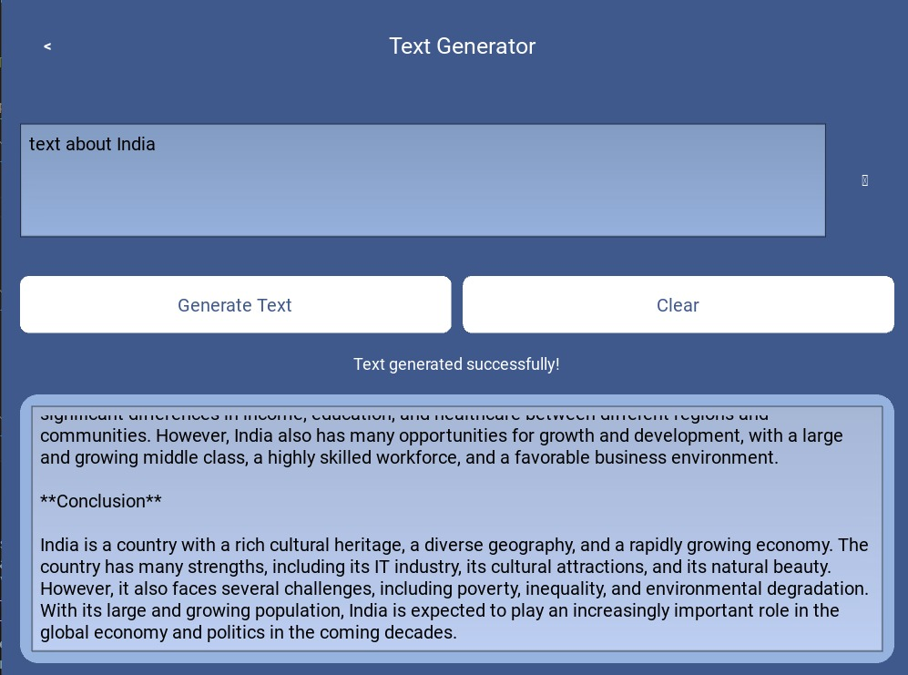
Text Generator

Slide 43
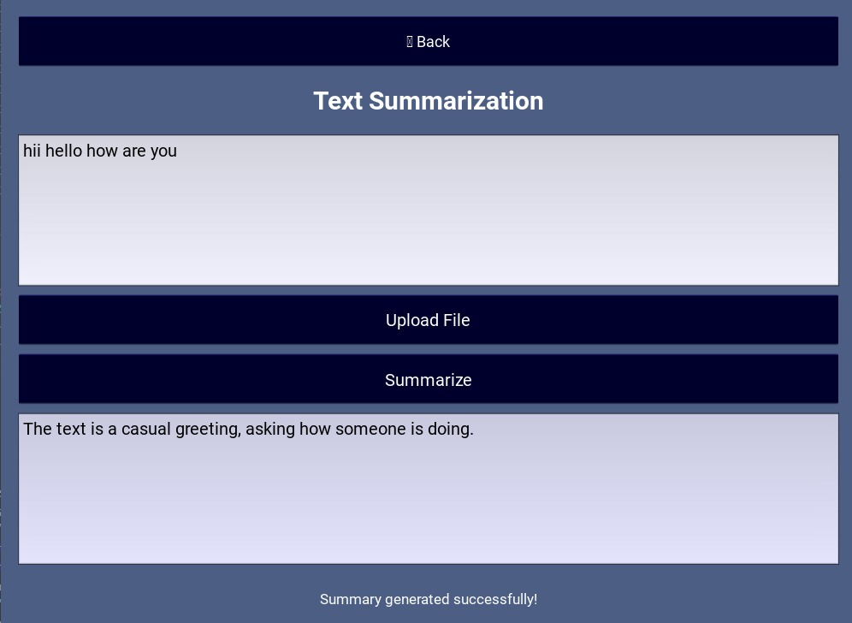
Text Summarization

Slide 44
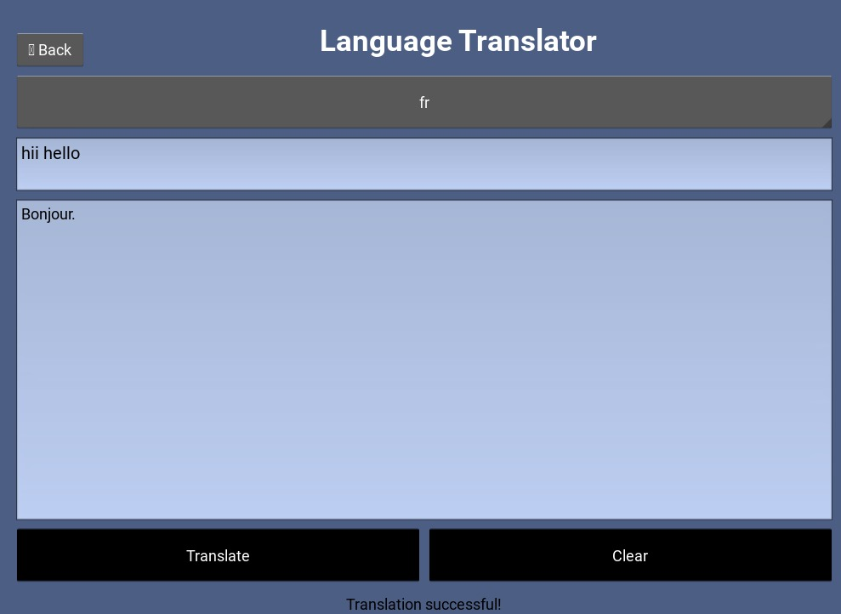
Language Translator

Slide 45
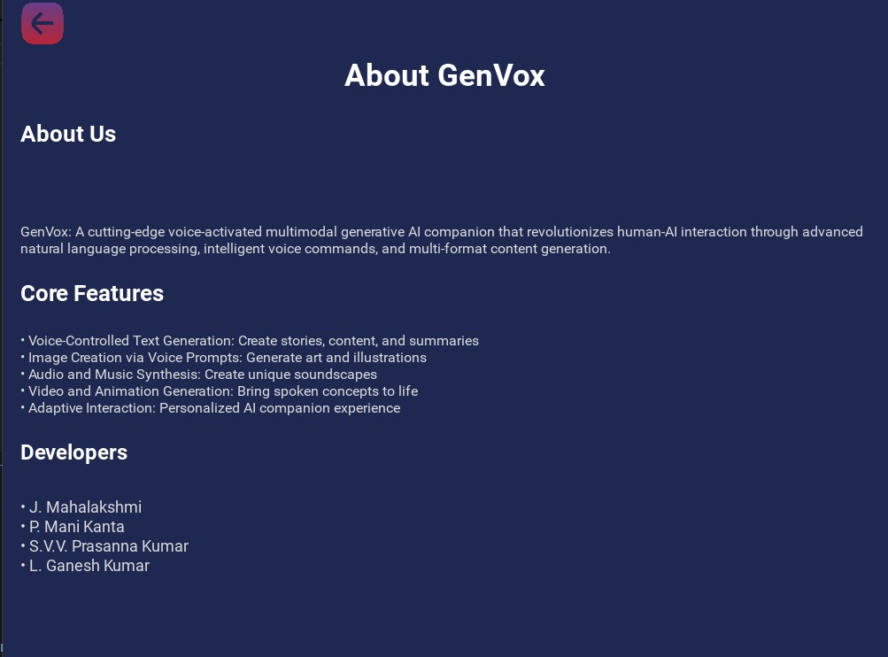
About Page

Slide 46
FEATURE SCOPE :
These projects leverage AI-driven automation and seamless integrations to enhance user experience. The Voice Assistant provides hands-free control using speech recognition. The Worker-Connect App includes worker registration, live location tracking, and real-time service discovery. The Chatbot enables intelligent conversations with free LLMs. The Code Generation Tool automates coding based on natural language prompts, with API key automation for seamless integration. Future improvements include AI optimization, multi-language support, enhanced security, and a more intuitive UI/UX.

Slide 47
CONCLUSION :
Through these projects, we successfully developed innovative solutions using AI, ML, and software development technologies. The voice assistant enhances user interaction through speech recognition, while the Worker-Connect app efficiently links skilled workers with the public. The chatbot leverages free LLMs for natural language processing, and the code generation tool simplifies coding with AI-driven automation. These projects demonstrate practical applications of technology, with future improvements focused on scalability, efficiency, and enhanced user experience.

Slide 48
THANK YOU

