Slide 1
Node.js
Advanced-Part1

Slide 2
Need?
It's important that we first dive into fundamental principles and patterns, not only for writing correct code, but also to be able to take effective design decisions when it comes to solving bigger and more complex problems.

Slide 3
Agenda
The Node.js philosophy, the "Node way"
The reactor pattern: the mechanism at the heart of the Node.js asynchronous architecture
The Node.js callback pattern and its set of conventions
The module system and its patterns: the fundamental mechanisms for organizing code in Node.js
The observer pattern and its Node.js incarnation

Slide 4
The Node.js philosophy
Every platform has its own philosophy
a set of principles and guidelines that are generally accepted by the community.
an ideology of doing things that influences the evolution of a platform, and how applications are developed and designed.
Some of these principles arise from the technology itself.
Some of them are enabled by its ecosystem.
Some are just trends in the community.
and others are evolutions of different ideologies.
In Node.js, some of these principles come directly from its creator, Ryan Dahl, from all the people who contributed to the core, from charismatic figures in the community, and some of the principles are inherited from the JavaScript culture or are influenced by the Unix philosophy.

Slide 5
Small core
The Node.js core itself has its foundations built on a few principles; one of these is, having the smallest set of functionality, leaving the rest to the so-called userland (or userspace), the ecosystem of modules living outside the core.
This principle has an enormous impact on the Node.js culture, as it gives freedom to the community to experiment and iterate fast on a broader set of solutions within the scope of the userland modules, instead of being imposed with one slowly evolving solution that is built into the more tightly controlled and stable core.
Keeping the core set of functionality to the bare minimum then, not only becomes convenient in terms of maintainability, but also in terms of the positive cultural impact that it brings on the evolution of the entire ecosystem.

Slide 6
2) Small modules
Node.js uses the concept of module as a fundamental mean to structure the code of a program. It is the brick for creating applications and reusable libraries called packages (a package is also frequently referred to as just module; since, usually it has one single module as an entry point).
In Node.js, one of the most evangelized principles is to design small modules, not only in terms of code size, but most importantly in terms of scope.

Slide 7
2) Small modules(contd..)
Along with the help of npm, the official package manager, Node.js helps solving the dependency hell problem by making sure that each installed package will have its own separate set of dependencies, thus enabling a program to depend on a lot of packages without incurring in conflicts.
The Node way, in fact, involves extreme levels of reusability, whereby applications are composed of a high number of small, well-focused dependencies.
While this can be considered unpractical or even totally unfeasible in other platforms, in Node.js this practice is encouraged. As a consequence, it is not rare to find npm packages containing less than 100 lines of code or exposing only one single function.

Slide 8
2) Small modules(contd..)
Besides the clear advantage in terms of reusability, a small module is also considered to be the following:
- Easier to understand and use
- Simpler to test and maintain
- Perfect to share with the browser
Having smaller and more focused modules empowers everyone to share or reuse even the smallest piece of code; it's the Don't Repeat Yourself (DRY) principle applied at a whole new level.

Slide 9
3) Small surface area
In addition to being small in size and scope, Node.js modules usually also have the characteristic of exposing only a minimal set of functionality.
The main advantage here is an increased usability of the API, which means that the API becomes clearer to use and is less exposed to erroneous usage.
Most of the time, in fact, the user of a component is interested only in a very limited and focused set of features, without the need to extend its functionality or tap into more advanced aspects.
In Node.js, a very common pattern for defining modules is to expose only one piece of functionality, such as a function or a constructor, while letting more advanced aspects or secondary features become properties of the exported function or constructor.
This helps the user to identify what is important and what is secondary. It is not rare to find modules that expose only one function and nothing else, for the simple fact that it provides a single, unmistakably clear entry point.
Another characteristic of many Node.js modules is the fact that they are created to be used rather than extended. Locking down the internals of a module by forbidding any possibility of an extension might sound inflexible, but it actually has the advantage of reducing the use cases, simplifying its implementation, facilitating its maintenance, and increasing its usability.

Slide 10
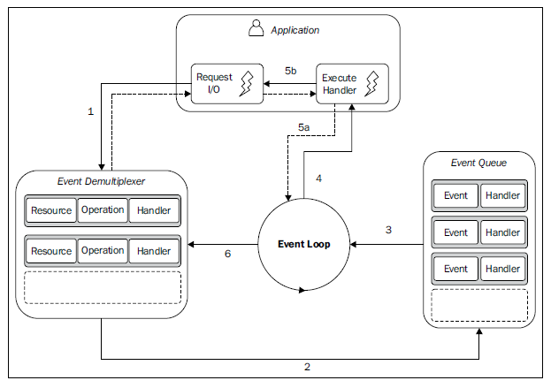
The reactor pattern
The main idea behind it is to have a handler (which in Node.js is represented by a callback function) associated with each I/O operation, which will be invoked as soon as an event is produced and processed by the event loop.
Notes:
1) The application generates a new I/O operation by submitting a request to the Event Demultiplexer. The application also specifies a handler, which will
be invoked when the operation completes. Submitting a new request to the Event Demultiplexer is a non-blocking call and it immediately returns the
control back to the application.
2. When a set of I/O operations completes, the Event Demultiplexer pushes the new events into the Event Queue.
3. At this point, the Event Loop iterates over the items of the Event Queue.
4. For each event, the associated handler is invoked.
5. The handler, which is part of the application code, will give back the control to the Event Loop when its execution completes (5a). However, new asynchronous operations might be requested during the execution of the handler (5b), causing new operations to be inserted in the Event Demultiplexer (1), before the control is given back to the Event Loop.
6. When all the items in the Event Queue are processed, the loop will block again on the Event Demultiplexer which will then trigger another cycle.
The asynchronous behavior is now clear: the application expresses the interest to access a resource at one point in time (without blocking) and provides a handler, which will then be invoked at another point in time when the operation completes.

Slide 11
The non-blocking I/O engine of Node.js – libuv
Each operating system has its own interface for the Event Demultiplexer: epoll on Linux, kqueue on Mac OS X, and I/O Completion Port API (IOCP) on Windows.
Besides that, each I/O operation can behave quite differently depending on the type of the resource, even within the same OS.
For example, in Unix, regular filesystem files do not support non-blocking operations, so, in order to simulate a non-blocking behaviour, it is necessary to use a separate thread outside the Event Loop. All these inconsistencies across and within the different operating systems required a higher-level abstraction to be built for the Event Demultiplexer.
This is exactly why the Node.js core team created a C library called libuv, with the objective to make Node.js compatible with all the major platforms and normalize the non-blocking behavior of the different types of resource; libuv today represents the low-level I/O engine of Node.js.
Besides abstracting the underlying system calls, libuv also implements the reactor pattern, thus providing an API for creating event loops, managing the event queue, running asynchronous I/O operations, and queuing other types of tasks.

Slide 12
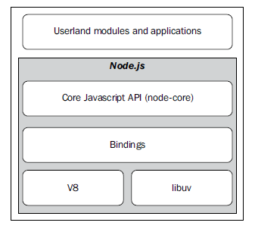

Slide 13
The callback pattern
Callbacks are the materialization of the handlers of the reactor pattern and they are literally one of those imprints that give Node.js its distinctive programming style.
Callbacks are functions that are invoked to propagate the result of an operation and this is exactly what we need when dealing with asynchronous operations.
They practically replace the use of the return instruction that, as we know, always executes synchronously.
JavaScript is a great language to represent callbacks, because as we know, functions are first class objects and can be easily assigned to variables, passed as arguments, returned from another function invocation, or stored into data structures. Also, closures are an ideal construct for implementing callbacks.
With closures, we can in fact reference the environment in which a function was created, practically, we can always maintain the context in which the asynchronous operation was requested, no matter when or where its callback is invoked.

Slide 14
The continuation-passing style
In JavaScript, a callback is a function that is passed as an argument to another function and is invoked with the result when the operation completes. In functional programming, this way of propagating the result is called continuation-passing style, for brevity, CPS.
It is a general concept, and it is not always associated with asynchronous operations. In fact, it simply indicates that a result is propagated by passing it to another function (the callback), instead of directly returning it to the caller.

Slide 15
Synchronous continuation-passing style
let's take a look at a simple synchronous function:
function add(a, b) {
return a + b;
}
There is nothing special here; the result is passed back to the caller using the return instruction; this is also called direct style, and it represents the most common way of returning a result in synchronous programming.
The equivalent continuation-passing style of the preceding function would be as follows:
function add(a, b, callback) {
callback(a + b);
}
The add() function is a synchronous CPS function, which means that it will return a value only when the callback completes its execution. The following code demonstrates this statement:
console.log(‘Before');
add(1, 2, function(result) {
console.log('Result: ' + result);
});
console.log('after');
Since add() is synchronous, the previous code will trivially print the following:
Before
Result: 3
After

Slide 16
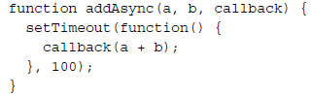
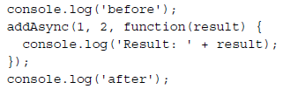

Asynchronous continuation-passing style
let's consider the case where the add() function is asynchronous, which is as follows:-
In the previous code, we simply use setTimeout() to simulate an asynchronous invocation of the callback. Now, let's try to use this function and see how the order of the operations changes:
The preceding code will print the following:-

Slide 17

Non continuation-passing style callbacks
There are several circumstances in which the presence of a callback argument might make you think that a function is asynchronous or is using a continuation-passing style; that's not always true, for example, the map() method of the Array object:
Clearly, the callback is just used to iterate over the elements of the array, and not to pass the result of the operation. In fact, the result is returned synchronously using a direct style. The intent of a callback is usually clearly stated in the documentation of the API.

Slide 18
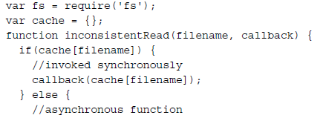
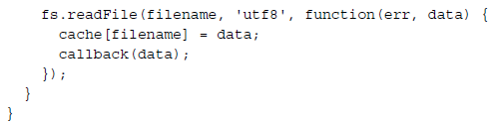
Synchronous or asynchronous?
One of the most dangerous situations is to have an API that behaves synchronously under certain conditions and asynchronously under others.
The preceding function uses the cache variable to store the results of different file read operations.
The preceding function is dangerous because it behaves asynchronously until the cache is not set—which is until the fs.readFile() function returns its results—but it will also be synchronous for all the subsequent requests for a file already in the cache—triggering an immediate invocation of the callback.
1-SyncOrAsync.js

Slide 19
The preceding code will print the following output:
As you can see, the callback of the second operation is never invoked. Let's see why:
During the creation of reader1, our inconsistentRead() function behaves asynchronously, because there is no cached result available. Therefore, we have all the time to register our listener, as it will be invoked later in another cycle of the event loop, when the read operation completes.
Then, reader2 is created in a cycle of the event loop in which the cache for the requested file already exists. In this case, the inner call to inconsistentRead() will be synchronous. So, its callback will be invoked immediately, which means that also all the listeners of reader2 will be invoked synchronously. However, we are registering the listeners after the creation of reader2, so they will never be invoked.
The callback behavior of our inconsistentRead() function is really unpredictable, as it depends on many factors, such as the frequency of its invocation, the filename passed as argument, and the amount of time taken to load the file.
The bug that we've just seen might be extremely complicated to identify and reproduce in a real application.
Imagine to use a similar function in a web server, where there can be multiple concurrent requests; imagine seeing some of those requests hanging, without any apparent reason and without any error being logged.
This definitely falls under the category of nasty defects.

Slide 20
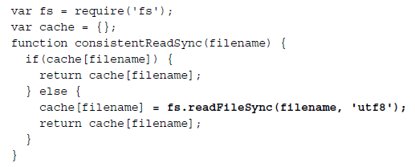
Using synchronous APIs
The lesson to learn from the unleashing Zalgo example is that it is imperative for an API to clearly define its nature, either synchronous or asynchronous.
One suitable fix for our inconsistentRead() function, is to make it totally synchronous. This is possible because Node.js provides a set of synchronous direct style APIs for most of the basic I/O operations.
For example, we can use the fs.readFileSync() function in place of its asynchronous counterpart.
We can see that the entire function was also converted to a direct style. There is no reason for the function to have a continuation-passing style if it is synchronous.In fact, we can state that it is always a good practice to implement a synchronous API using a direct style; this will eliminate any confusion around its nature and will also be more efficient from a performance perspective.

Slide 21
using a synchronous API instead of an asynchronous one has some caveats:
A synchronous API might not be always available for the needed functionality.
A synchronous API will block the event loop and put the concurrent requests on hold. It practically breaks the Node.js concurrency, slowing down the whole application.
Use blocking API only when they don't affect the ability of the application to serve concurrent requests.

Slide 22
Deferred execution
Another alternative for fixing our inconsistentRead() function is to make it purely asynchronous. The trick here is to schedule the synchronous callback invocation to be executed "in the future" instead of being run immediately in the same event loop cycle.
In Node.js, this is possible using process.nextTick(), which defers the execution of a function until the next pass of the event loop.
Its functioning is very simple; it takes a callback as an argument and pushes it on the top of the event queue, in front of any pending I/O event, and returns immediately. The callback will then be invoked as soon as the event loop runs again.
2-NextTick.js
Talk about setImmediate() and IO starvation/CPU bound tasks

Slide 23
Node.js callback conventions
These conventions apply to the Node.js core API but they are also followed virtually by every userland module and application. So, it's very important that we understand them and make sure that we comply whenever we need to design an asynchronous API.
Callbacks come last
In Node.js, if a function accepts in input a callback, this has to be passed as the last argument. Let's take the following Node.js core API as an example:
As you can see from the signature of the preceding function, the callback is always put in last position, even in the presence of optional arguments. The motivation for this convention is that the function call is more readable in case the callback is defined in place.

Slide 24
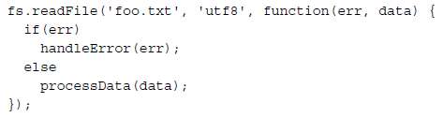
2) Error comes first
In CPS, errors are propagated as any other type of result, which means using the callback. In Node.js, any error produced by a CPS function is always passed as the first argument of the callback, and any actual result is passed starting from the second argument. If the operation succeeds without errors, the first argument will be null or undefined.
It is a good practice to always check for the presence of an error, as not doing so will make it harder for us to debug our code and discover the possible points of failures.
Another important convention to take into account is that the error must always be of type Error. This means that simple strings or numbers should never be passed as error objects.

Slide 25
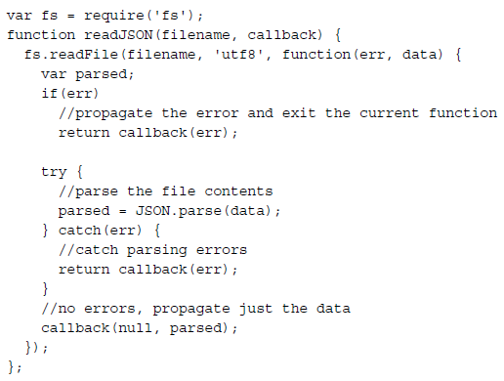
3) Propagating errors
Propagating errors in synchronous, direct style functions is done with the well-known throw command, which causes the error to jump up in the call stack until it's caught.
In asynchronous CPS however, proper error propagation is done by simply passing the error to the next callback in the CPS chain.
The detail to notice in the code on left is how the callback is invoked when we
want to pass a valid result and when we want to propagate an error.

Slide 26
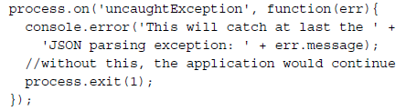
4) Uncaught exceptions
You might have seen from the readJSON() function defined previously that in order to avoid any exception to be thrown into the fs.readFile() callback, we put a try-catch block around JSON.parse(). Throwing inside an asynchronous callback, in fact, will cause the exception to jump up to the event loop and never be propagated to the next callback.
In Node.js, this is an unrecoverable state and the application will simply shut down printing the error to the stderr interface.
The application is aborted the moment an exception reaches the event loop; however, we still have a last chance to perform some cleanup or logging before the application terminates. In fact, when this happens, Node.js emits a special event called uncaughtException just before exiting the process.
It's important to understand that an uncaught exception leaves the application in a state that is not guaranteed to be consistent, which can lead to unforeseeable problems.For example, there might still have incomplete I/O requests running, or closures might have become inconsistent. That's why it is always advised, especially in production, to exit anyway from the application after an uncaught exception is received.

Slide 27
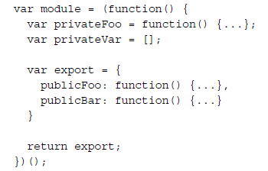
The module system and its patterns
Modules are the bricks for structuring non-trivial applications, but also the main mechanism to enforce information hiding by keeping private all the functions and variables that are not explicitly marked to be exported.
One of the major problems with JavaScript is the absence of namespacing. A popular technique to solve this problem is called revealing module pattern and it looks like the following:
This pattern leverages a self-invoking function to create a private scope, exporting only the parts that are meant to be public. In the preceding code, the module variable contains only the exported API, while the rest of the module content is practically inaccessible from outside. As we will see in a moment, the idea behind this pattern is used as a base for the Node.js module system.
3-moduleSystem.js

Slide 28
require()
A module name is accepted as input and the very first thing that we do is resolve the full path of the module, which is called id. This task is delegated to require.resolve(), which implements a specific resolving algorithm(we will talk about it later).
If the module was already loaded in the past, it should be available in the cache. In this case, it is returned immediately.
If the module was not yet loaded, an environment is set up the for the first load. In particular, node create a module object that contains an exports property initialized with an empty object literal. This property will be used by the code of the module to export any public API.
The module object is cached.
The module source code is read from its file and the code is evaluated. We provide to the module, the module object that is just created in step 3, and a reference to the require() function. The module exports its public API by manipulating or replacing the module.exports object.
Finally, the content of module.exports, which represents the public API of the module, is returned to the caller.

Slide 29
Defining globals
Even if all the variables and functions that are declared in a module are defined in its local scope, it is still possible to define a global variable. In fact, the module system exposes a special variable called global, which can be used for this purpose. Everything that is assigned to this variable will end up automatically in the global scope.
Please note that polluting the global scope is considered a bad practice and nullifies the advantage of having a module system. So, use it only if you really know what you are doing.

Slide 30



module.exports vs exports
The variable exports is just a reference to the initial value of module.exports; we have seen that such a value is essentially a simple object literal created before the module is loaded.
This means that we can only attach new properties to the object referenced by the exports variable
Reassigning the exports variable doesn't have any effect, because it doesn't change the contents of module.exports, it will only reassign the variable itself. The following code is therefore wrong:
If we want to export something other than an object literal, as for example a function,an instance, or even a string, we have to reassign module.exports as follows:

Slide 31

require is synchronous
Another important detail that we should take into account is that require function is synchronous. In fact, it returns the module contents using a simple direct style, and no callback is required. This is true for the original Node.js require() function too. As a consequence, any assignment to module.export must be synchronous as well. For example, the following code is incorrect:

Slide 32
The resolving algorithm[require.resolve()]
dependency hell: describes a situation whereby the dependencies of a software, in turn depend on a shared dependency, but require different incompatible versions. Node.js solves this problem elegantly by loading a different version of a module depending on where the module is loaded from
the resolve() function takes a module name (which we will call here, moduleName) as input and it returns the full path of the module. This path is then used to load its code and also to identify the module uniquely.
The resolving algorithm can be divided into the following three major branches:
File modules: If moduleName starts with "/" it's considered already an absolute path to the module and it's returned as it is. If it starts with "./", then moduleName is considered a relative path, which is calculated starting from the requiring module.
Core modules: If moduleName is not prefixed with "/" or "./", the algorithm will first try to search within the core Node.js modules.
Package modules: If no core module is found matching moduleName,then the search continues by looking for a matching module into the first node_modules directory that is found navigating up in the directory structure starting from the requiring module. The algorithm continues to search for a match by looking into the next node_modules directory up in the directory tree, until it reaches the root of the filesystem.

Slide 33
The resolving algorithm(contd..)
For file and package modules, both the individual files and directories can match moduleName. In particular, the algorithm will try to match the following:
<moduleName>.js
<moduleName>/index.js
The directory/file specified in the main property of <moduleName>/package.json
The node_modules directory is actually where npm installs the dependencies of each package. This means that, based on the algorithm we just described, each package can have its own private dependencies.

Slide 34
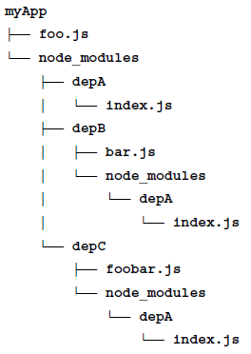
Example
In the example, myApp, depB, and depC all depend on depA; however, they all have their own private version of the dependency!
Following the rules of the resolving algorithm, using require('depA') will load a different file depending on the module that requires it, for example:
Calling require('depA') from /myApp/foo.js will load /myApp/node_modules/depA/index.js
Calling require('depA') from /myApp/node_modules/depB/bar.js will load /myApp/node_modules/depB/node_modules/depA/index.js
Calling require('depA') from /myApp/node_modules/depC/foobar.js will load /myApp/node_modules/depC/node_modules/depA/index.js
The resolving algorithm is the magic behind the robustness of the Node.js dependency management, and is what makes it possible to have hundreds or even thousands of packages in an application without having collisions or problems of version compatibility.

Slide 35
Module definition patterns
The module system, besides being a mechanism for loading dependencies, is also a tool for defining APIs. As for any other problem related to API design, the main factor to consider is the balance between private and public functionality. The aim is to maximize information hiding and API usability, while balancing these with other software qualities like extensibility and code reuse.

Slide 36
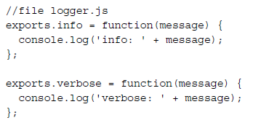

Module definition patterns(contd..)
Named exports
The most basic method for exposing a public API is using named exports, which consists in assigning all the values we want to make public to properties of the object referenced by exports (or module.exports). In this way, the resulting exported object becomes a container or namespace for a set of related functionality.
The CommonJS specification only allows the use of the exports variable to expose public members. Therefore, the named exports pattern is the only one that is really compatible with the CommonJS specification. The use of module.exports is an extension provided by Node.js to support a broader range of module definition patterns,as those we are going to see next.

Slide 37
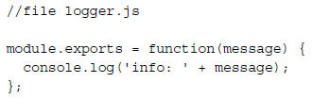


Module definition patterns(contd..)
2) Exporting a function
One of the most popular module definition patterns consists in reassigning the whole module.exports variable to a function. Its main strength it's the fact that it exposes only a single functionality, which provides a clear entry point for the module, and makes it simple to understand and use; it also honors the principle of small surface area very well. This way of defining modules is also known in the community as substack pattern
A possible extension of this pattern is using the exported function as namespace for other public APIs. This is a very powerful combination, because it still gives the module the clarity of a single entry point (the main exported function), but it also allows us to expose other functionalities that have secondary or more advanced use cases.

Slide 38
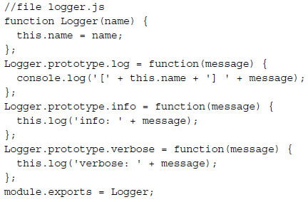
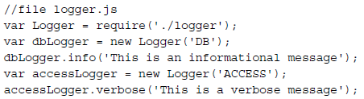
Module definition patterns(contd..)
3) Exporting a constructor
A module that exports a constructor is a specialization of a module that exports a function. The difference is that with this new pattern, we allow the user to create new instances using the constructor, but we also give them the ability to extend its prototype and forge new classes.
Exporting a constructor still provides a single entry point for the module, but compared to the substack pattern, it exposes a lot more of the module internals; however on the other side it allows much more power when it comes to extending its functionality.

Slide 39
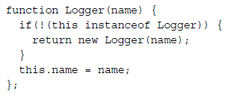

Module definition patterns(contd..)
3) Exporting a constructor(contd…)
A variation of this pattern consists in applying a guard against invocations that don't use the new instruction. This little trick allows us to use our module as a factory.
The trick is simple; we check whether this exists and is an instance of Logger. If any of these conditions is false, it means that the Logger() function was invoked without using new, so we proceed with creating the new instance properly and returning it to the caller. This technique allows us to use the module also as a factory,

Slide 40
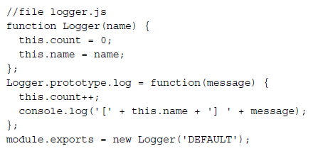

Module definition patterns(contd..)
4) Exporting an instance
We can leverage the caching mechanism of require() to easily define stateful instances—objects with a state created from a constructor or a factory, which can be shared across different modules.
Because the module is cached, every module that requires the logger module will actually always retrieve the same instance of the object, thus sharing its state.
This pattern is very much like creating a Singleton, however, it does not guarantee the uniqueness of the instance across the entire application, as it happens in the traditional Singleton pattern.

Slide 41
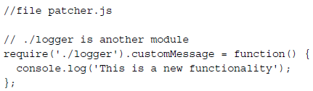
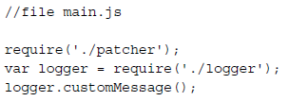
Module definition patterns(contd..)
5) Modifying other modules or the global scope
A module can even export nothing. This can look a bit out of place, however, we should not forget that a module can modify the global scope and any object in it, including other modules in the cache. Please note that these are in general considered bad practices, but since this pattern can be useful and safe under some circumstances (for example, for testing) and is sometimes used in the wild, it is worth to know and understand it. So, we said a module can modify other modules or objects in the global scope. Well, this is called monkey patching, which generally refers to the practice of modifying the existing objects at runtime to change or extend their behavior or to apply temporary fixes.
it affects the state of entities outside their scope, which can have consequences that are not always predictable, especially when multiple modules interact with the same entities.
most importantly it would have repercussions on the entire application.

Slide 42
The Observer pattern
Another important and fundamental pattern used in Node.js is the observer pattern. Together with reactor, callbacks, and modules, this is one of the pillars of the platform and an absolute prerequisite for using many node-core and userland modules.
Pattern (observer): defines an object (called subject), which can notify a set of observers (or listeners), when a change in its state happens.
The main difference from the callback pattern is that the subject can actually notify multiple observers, while a traditional continuation-passing style callback will usually propagate its result to only one listener, the callback.

Slide 43
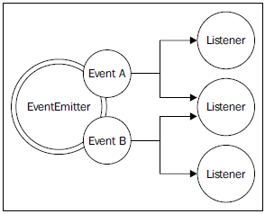

The EventEmitter
The observer pattern is already built into the core and is available through the EventEmitter class. The EventEmitter class allows us to register one or more functions as listeners, which will be invoked when a particular event type is fired.

Slide 44
The essential methods of the EventEmitter are given as follows:
on(event, listener): This method allows you to register a new listener (a function) for the given event type (a string)
once(event, listener): This method registers a new listener, which is then removed after the event is emitted for the first time
emit(event, [arg1], […]): This method produces a new event and provides additional arguments to be passed to the listeners
removeListener(event, listener): This method removes a listener for the specified event type
Create and Use Event emitter

Slide 45
Make any object observable
Sometimes, creating a new observable object directly from the EventEmitter class is not enough, as this makes it impractical to provide functionality that goes beyond the mere production of new events. It is more common, in fact, to have the need to make a generic object observable; this is possible by extending the EventEmitter class.
Example
This is a pretty common pattern in the Node.js ecosystem, for example, the Server object of the core http module defines methods such as listen(), close(), setTimeout(), and internally it also inherits from the EventEmitter function, thus allowing it to produce events, such as request, when a new request is received, or connection, when a new connection is established, or closed, when the server is closed.

Slide 46
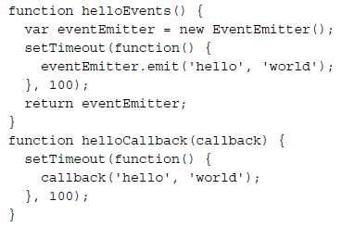
EventEmitter vs Callbacks
The general differentiating rule is semantic: callbacks should be used when a result must be returned in an asynchronous way; events should instead be used when there is a need to communicate that something has just happened.
a lot of confusion is generated from the fact that the two paradigms are most of the time equivalent and allow you to achieve the same results.
Example

Slide 47
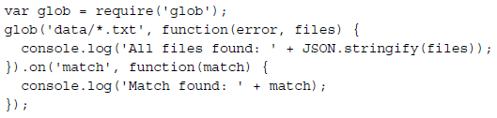
Descion Factors…
As a first observation, we can say that callbacks have some limitations when it comes to supporting different types of events. In fact, we can still differentiate between multiple events by passing the type as an argument of the callback, or by accepting several callbacks, one for each supported event. However, this cannot exactly be considered an elegant API. In this situation, an EventEmitter can give a better interface and leaner code.
Another case where the EventEmitter might be preferable is when the same event can occur multiple times, or not occur at all. A callback, in fact, is expected to be invoked exactly once, whether the operation is successful or not. The fact that we have a possibly repeating circumstance should let us think again about the semantic nature of the occurrence, which is more similar to an event that has to be communicated rather than a result; in this case an EventEmitter is the preferred choice.
Lastly, an API using callbacks can notify only that particular callback, while using an EventEmitter function it's possible for multiple listeners to receive the same notification.
the practice of exposing a simple, clean, and minimal entry point while still providing more advanced or less important features with secondary means is quite common in Node.js, and combining EventEmitter with traditional callbacks is one of the ways to achieve that.

Slide 48
Conclusion…
We have seen how the Node.js platform is based on a few important principles that provide the foundation to build efficient and reusable code. The philosophy and the design choices behind the platform have, in fact, a strong influence on the structure and behavior of every application and module we create.
Often, for a developer moving from another technology, these principles might seem unfamiliar and the usual instinctive reaction is to fight the change by trying to find more familiar patterns inside a world which in reality requires a real shift in the mindset.
On one hand, the asynchronous nature of the reactor pattern requires a different programming style made of callbacks and things that happen at a later time, without worrying too much about threads and race conditions.
On the other hand, the module pattern and its principles of simplicity and minimalism creates interesting new scenarios in terms of reusability, maintenance, and usability.
Finally, besides the obvious technical advantages of being fast, efficient, and based on JavaScript, Node.js is attracting so much interest because of the principles we have just discovered. For many, grasping the essence of this world feels like returning to the origins, to a more humane way of programming for both size and complexity and that's why developers end up falling in love with Node.js.

