Slide 1
Advanced Node.js (Day2)
Asynchronous Control
Flow Patterns

Slide 2
The difficulties of asynchronous programming
Losing control of asynchronous code in JavaScript is undoubtedly easy.
Closures and in-place definition of anonymous functions allow a smooth programming experience that doesn't require the developer to jump to other points in the code base. This is perfectly in line with the KISS principle; it's simple, it keeps the code flowing, and we get it working in less time.
Unfortunately, sacrificing qualities such as modularity, reusability, and maintainability will sooner or later lead to the uncontrolled proliferation of callback nesting, the growth in the size of functions, and will lead to poor code organization.
Most of the time, creating closures is not functionally needed, so it's more a matter of discipline than a problem related to asynchronous programming.
Recognizing that our code is becoming unwieldy—or even better, knowing in advance that it might become unwieldy—and then acting accordingly with the most adequate solution is what differentiates a novice from an expert.

Slide 3
Example
To explain the problem, we will create a little web spider, a command-line application that takes in a web URL as input and downloads its contents locally into a file.
1-simple-web-spider.js

Slide 4
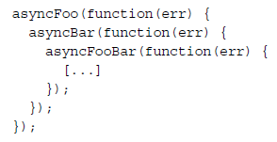
The callback hell
The situation where the abundance of closures and in-place callback definitions transform the code into an unreadable and unmanageable blob is known as callback hell.
It's one of the most well recognized and severe anti-patterns in Node.js and JavaScript in general.
The typical structure of a code affected by this problem looks like the following:
We can see how code written in this way assumes the shape of a pyramid due to the deep nesting and that's why it is also colloquially known as the pyramid of doom.
Problems:-
The most evident problem with code such as the preceding one is the poor readability. Due to the nesting being too deep, it's almost impossible to keep track of where a function ends and where another one begins.
Another issue is caused by the overlapping of the variable names used in each scope.Often, we have to use similar or even identical names to describe the content of a variable. The best example is the error argument received by each callback.
Also, we have to keep in mind that closures come at a small price in terms of performances and memory consumption. In addition, they can create memory leaks that are not so easy to identify because we shouldn't forget that any context referenced by an active closure is retained from garbage collection.

Slide 5
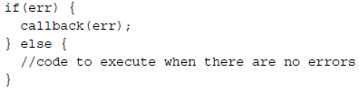

Callback discipline
When writing asynchronous code, the first rule to keep in mind is to not abuse closures when defining callbacks. It can be tempting to do so, because it does not require any additional thinking for problems such as modularization and reusability; however, we have seen how this can have more disadvantages than advantages. Most of the times, fixing the callback hell problem does not require any library, fancy technique, or change of paradigm but just some common sense.
These are some basic principles that can help us keep the nesting level low and
improve the organization of our code in general:
You must exit as soon as possible. Use return, continue, or break, depending on the context, to immediately exit the current statement instead of writing (and nesting) complete if/else statements. This will help keep our code shallow.
You need to create named functions for callbacks, keeping them out of closures and passing intermediate results as arguments. Naming our functions will also make them look better in stack traces.
You need to modularize the code. Split the code into smaller, reusable functions whenever it's possible.
Refactor code for spider web using above techniques. 2-refactored.js

Slide 6

We now begin our exploration of the asynchronous control flow patterns.
Sequential execution
Executing a set of tasks in sequence means running them one at a time, one after the other. The order of execution matters and must be preserved, because the result of a task in the list may affect the execution of the next.
There are different variations of this flow:
Executing a set of known tasks in sequence, without chaining or propagating results
Using the output of a task as the input for the next (also known as chain, pipeline, or waterfall)
Iterating over a collection while running an asynchronous task on each element, one after the other

Slide 7
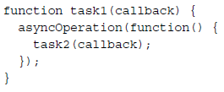
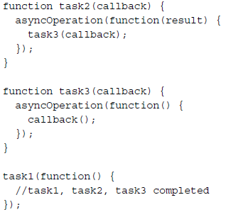
Executing a known set of tasks in sequence
The preceding pattern shows how each task invokes the next upon the completion of a generic asynchronous operation.
The pattern puts the emphasis on the modularization of tasks, showing how closures are not always necessary to handle asynchronous code.

Slide 8
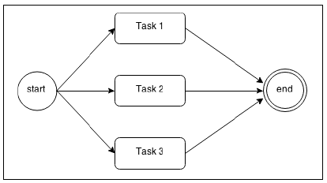
Parallel execution
There are some situations where the order of the execution of a set of asynchronous tasks is not important and all we want is just to be notified when all those running tasks are completed. Such situations are better handled using a parallel execution flow, as shown in the following diagram:
This may sound strange if we consider that Node.js is single threaded, but if we remember what we discussed in day1, Node.js Design Fundamentals, we realize that even though we have just one thread, we can still achieve concurrency, thanks to the nonblocking nature of Node.js.
In fact, the word parallel is used improperly in this case, as it does not mean that the tasks run simultaneously, but rather that their execution is carried out by an underlying nonblocking API and interleaved by the event loop.
As we know, a task gives the control back to the event loop when it requests a new asynchronous operation allowing the event loop to execute another task.The proper word to use for this kind of flow is concurrency, but we will still use parallel for simplicity.

Slide 9
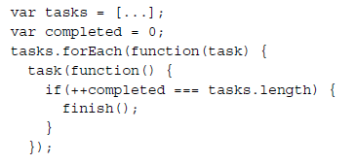
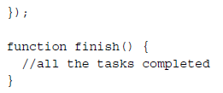
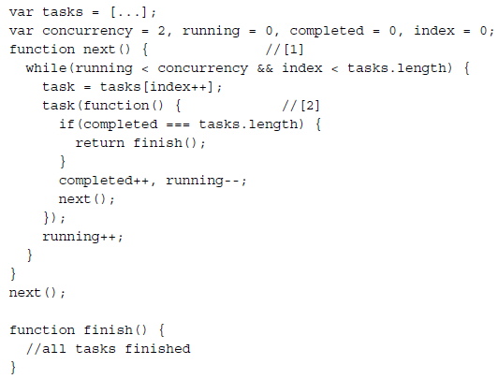
Limiting the concurrency

Slide 10
The async library
The async library is a very popular solution, in Node.js and JavaScript in general, to deal with asynchronous code. It offers a set of functions that greatly simplify the execution of a set of tasks in different configurations and it also provides useful helpers for dealing with collections asynchronously. Even though there are several other libraries with a similar goal, async is a de facto standard in Node.js due to its popularity.
Sequential execution
there are around 20 different functions to choose from, including: eachSeries(),mapSeries(), filterSeries(), rejectSeries(), reduce(), reduceRight(),detectSeries(), concatSeries(), series(), whilst(), doWhilst(), until(),doUntil(), forever(), waterfall(), compose(), seq(), applyEachSeries(),iterator(), and timesSeries().
Parallel execution
The async library doesn't lack functions to handle parallel flows, among them we can find each(), map(), filter(), reject(), detect(), some(), every(), concat(), parallel(), applyEach(), and times().
Limited parallel execution
If you are wondering if async can also be used to limit the concurrency of parallel tasks, the answer is yes, it can! We have a few functions we can use for that, namely, eachLimit(), mapLimit(), parallelLimit(), queue(), and cargo().
Homework-Read and implement these methods.
http://caolan.github.io/async/

Slide 11
Promises
CPS is not the only way towrite asynchronous code. In fact, the JavaScript ecosystem provides alternatives to the traditional callback pattern. One of these in particular is receiving a lot of momentum,especially now that it is going to be part of the ECMAScript 6 specification (also known as ES6 or Harmony), the upcoming version of the JavaScript language. We are talking, of course, about promises, and in particular about those implementations that follow the Promises/A+ specification (https://promisesaplus.com).
What is a promise?
Promises are an abstraction that allow an asynchronous function to return an object called a promise, which represents the eventual result of the operation.
we say that a promise is pending when the asynchronous operation is not yet complete
it's fulfilled when the operation successfully completes
and rejected when the operation terminates with an error.
Once a promise is either fulfilled or rejected, it's considered settled.
To receive the fulfillment value or the error (reason) associated with the rejection,we can use the then() method of the promise. The following is its signature:
promise.then([onFulfilled], [onRejected])
Where onFulfilled() is a function that will eventually receive the fulfillment value of the promise, and onRejected() is another function that will receive the reason of the rejection (if any). Both functions are optional.

Slide 12
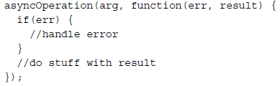
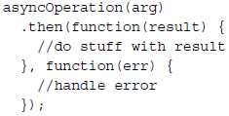
To have an idea of how Promises can transform our code, let's consider the following :-
One crucial property of the then() method is that it synchronously returns another promise.
If any of the onFulfilled() or onRejected() functions return a value x, the promise returned by the then() method will be as follows:
Fulfill with x if x is a value
Fulfill with the fulfillment value of x if x is a promise or a thenable
Reject with the eventual rejection reason of x if x is a promise or a thenable
A thenable is a promise-like object with a then() method. This term is used to indicate a promise that is foreign to the particular promise implementation in use.
This feature allows us to build chains of promises, allowing easy aggregation and arrangement of asynchronous operations in several configurations. Also, if we don't specify an onFulfilled() or onRejected() handler, the fulfillment value or rejection reasons are automatically forwarded to the next promise in the chain. This allows us, for example, to automatically propagate errors across the whole chain until caught by an onRejected() handler. With a promise chain, sequential execution of tasks suddenly becomes a trivial operation

Slide 13
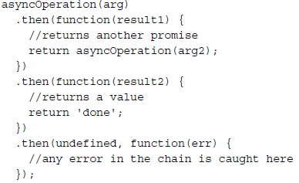
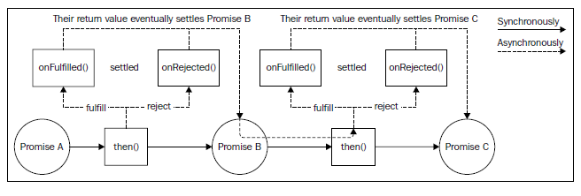
The following diagram provides another perspective on how a promise chain works:

Slide 14
Another important property of promises is that the onFulfilled() and onRejected() functions are guaranteed to be invoked asynchronously, even if we resolve the promise synchronously with a value, as we did in the preceding example, where we returned the string done in the last then() function of the chain. This behavior shields our code against all those situations where we could unintentionally release Zalgo, making our asynchronous code more consistent and robust with no effort.
Now comes the best part. If an exception is thrown (using the throw statement) from the onFulfilled() or onRejected() handler, the promise returned by the then() method will automatically reject with the exception as the rejection reason. This is a tremendous advantage over CPS, as it means that with promises, exceptions will propagate automatically across the chain, and that the throw statement is not an enemy anymore.
Promises/A+ implementations
In Node.js, and in general in JavaScript, there are several libraries implementing the Promises/A+ specifications. The following are the most popular:
Bluebird (https://npmjs.org/package/bluebird)
Q (https://npmjs.org/package/q)
RSVP (https://npmjs.org/package/rsvp)
Vow (https://npmjs.org/package/vow)
When.js (https://npmjs.org/package/when)
ES6 Promises

Slide 15
q-library
Standard implementation with A+ standards.
Similar to Angular.js $q implementation.
Examples
a really basic chaining example
an example of how to make an HTTP Request, then process the Response, and then do something with the processed response
I have some functions that can happen simultaneously, and others which must happen in a certain order - how do I do that?

Slide 16
Generators
The ES6 specification introduces another mechanism that, besides other things, can be used to simplify the asynchronous control flow of our Node.js applications.
We are talking about generators, also known as semi-coroutines.
They are a generalization of subroutines, where there can be different entry points.
In a normal function, in fact, we can have only one entry point, which corresponds to the invocation of the function itself.
A generator is similar to a function, but in addition, it can be suspended (using the yield statement) and then resumed at a later time.
In Node.js, generators are available starting from Version 0.11, but this feature is still not enabled by default and it's necessary to invoke Node.js with the --harmony or --harmony-generators flags to get generators working.

Slide 17



The basics
a generator function can be declared by appending the * (asterisk) operator after the function keyword:
Inside the makeGenerator() function, we can pause the execution using the keyword yield and return to the caller the value passed to it:
The makeGenerator() function is essentially a factory that, when invoked, returns a new generator object:
The most important method of the generator object is next(), which is used to start/resume the execution of the generator and returns an object in the following form:
In the preceding code, the generator yields a string, Hello World, by putting the execution of the function on pause. When the generator is resumed, the execution will start from console.log('Re-entered').
This object contains the value yielded by the generator (value) and a flag to indicate if the generator has completed its execution (done).

Slide 18
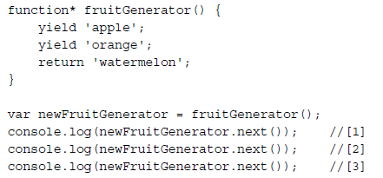
A simple example
To demonstrate generators, let's create a new module. We can call it fruitGenerator.js and include the following code:
We can run the new module with the following command:
node --harmony-generators fruitGenerator
The preceding code should print the following output:
{ value: 'apple', done: false }
{ value: 'orange', done: false }
{ value: 'watermelon', done: true }
This is a short explanation of what happened in the preceding code:
The first time newFruitGenerator.next() was invoked, the generator started its execution until it reached the first yield command, which put the generator on pause and returned the value apple, to the caller.
At the second invocation of newFruitGenerator.next(), the generator resumed, starting from the second yield command, which in turn put on pause the execution again, while returning the value orange to the caller.
The last invocation of newFruitGenerator.next() caused the execution of the generator to resume from its last instruction, a return statement, which terminates the generator, returns the value, watermelon, and sets the done property to true in the result object.

Slide 19
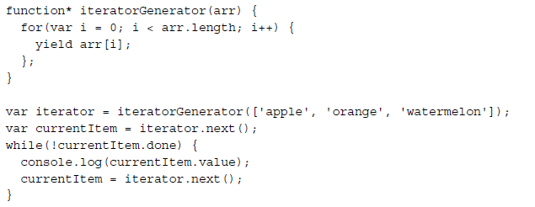

Generators as iterators
To better understand why generators are so useful for the implementation of iterators, let's build one. In a new module, which we will call iteratorGenerator.js, let's write the following code:
We can execute this code using the following command: node --harmony-generators iteratorGenerator
The preceding simple program should print the list of the items in the array as follows:
In this example, each time we call iterator.next(), we resume the for loop of the generator, which runs another cycle by yielding the next item in the array.
This demonstrates how the state of the generator is maintained across invocations.
When resumed, the loop and all the variables are exactly the same as when the execution was put on pause.

Slide 20
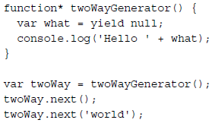

Passing values back to a generator
what we need to do is just providing an argument to the next() method, and that value will be provided as the return value of the yield statement inside the generator.
When executed, the preceding code will print Hello world. This means that the following has happened:
When the first next() method is invoked, the generator reaches the first yield function and is then put on pause.
When next('world') is invoked, the generator resumes from the point where it was put on pause, which is on the yield instruction, but this time we have a value that is passed back to the generator. This value will then be set into the what variable.
The generator then executes the console.log() instruction and terminates.
In a similar way, we can force a generator to throw an exception. This is made possible by using the throw method of the generator, as shown in the following example:
Using this last code snippet, the twoWayGenerator() function will throw an exception the moment the yield function returns. This works exactly as if an exception was thrown from inside the generator, and this means that it can be caught and handled like any other exception using a try-catch block.

Slide 21
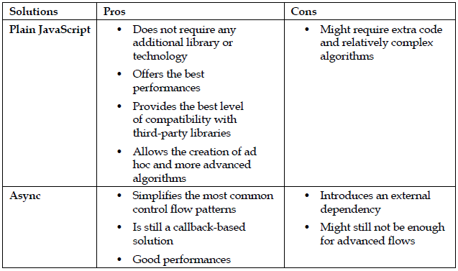
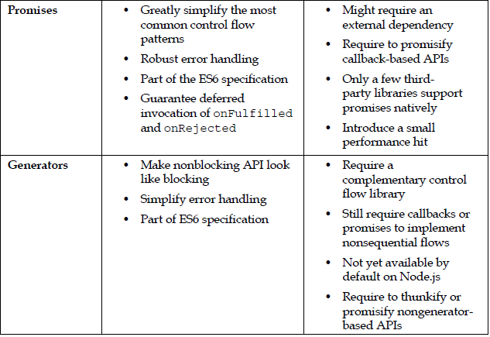
Comparison

