Slide 1

Anomaly Detection in Voice Recordings
Presented by:
Aishwarya Rao Ganesh Gopalakrishna

Slide 2
Project Objective
To find anomalies in the dataset of voice recordings of a person.
Anomalies to be detected:
Background noise
Different person/people speaking
No sound

Slide 3
APPROACH
Dataset used: Voice recordings of Nelson Mandela. Each file is in WAV format(.wav extension), having 1 second of duration and 32KB Size(Memory): https://www.kaggle.com/datasets/kongaevans/speaker-recognition-dataset/data
Feature extraction: Spectrogram, Mel Spectrogram and MFCC(Mel-frequency cepstral coefficients).
Algorithms used:
Training One-Class SVM (Support Vector Machine) and Isolation Forest using Mel Spectrogram.
Test data:
Voice recordings of the same person along with noise and voice recordings of different people.

Slide 4
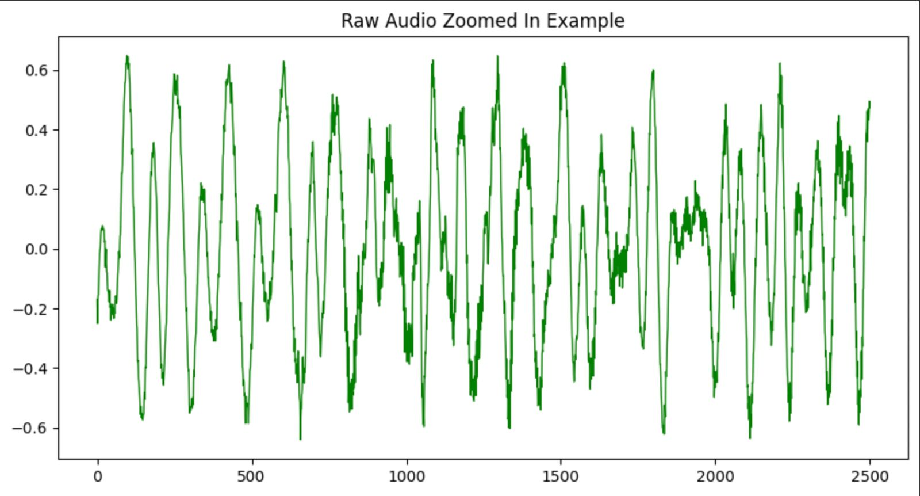

Slide 5
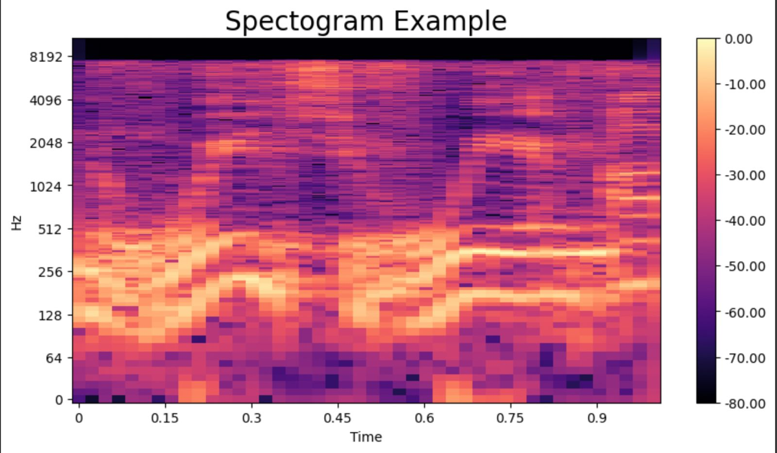

Slide 6
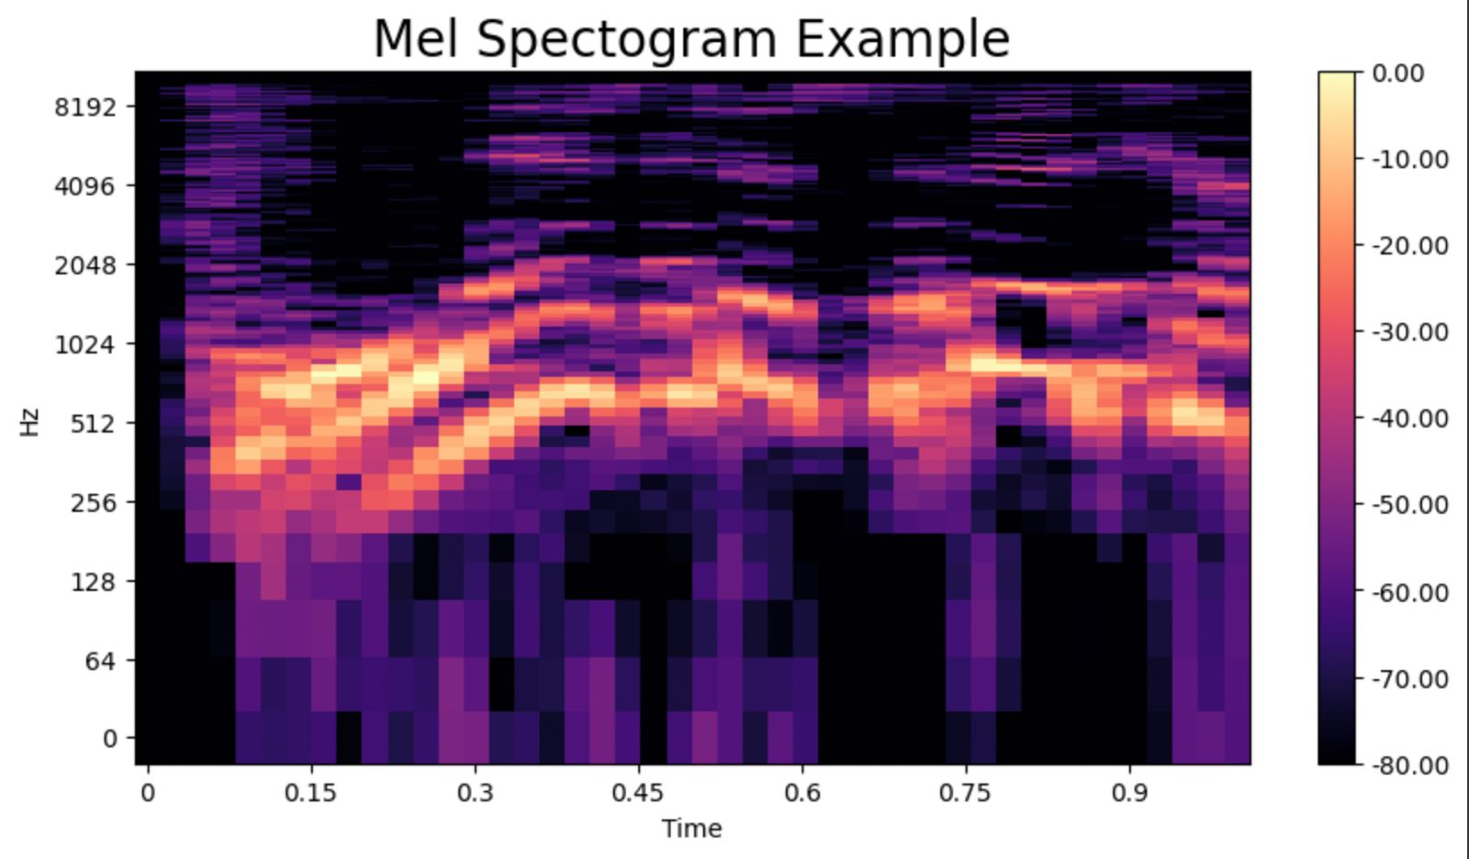

Slide 7
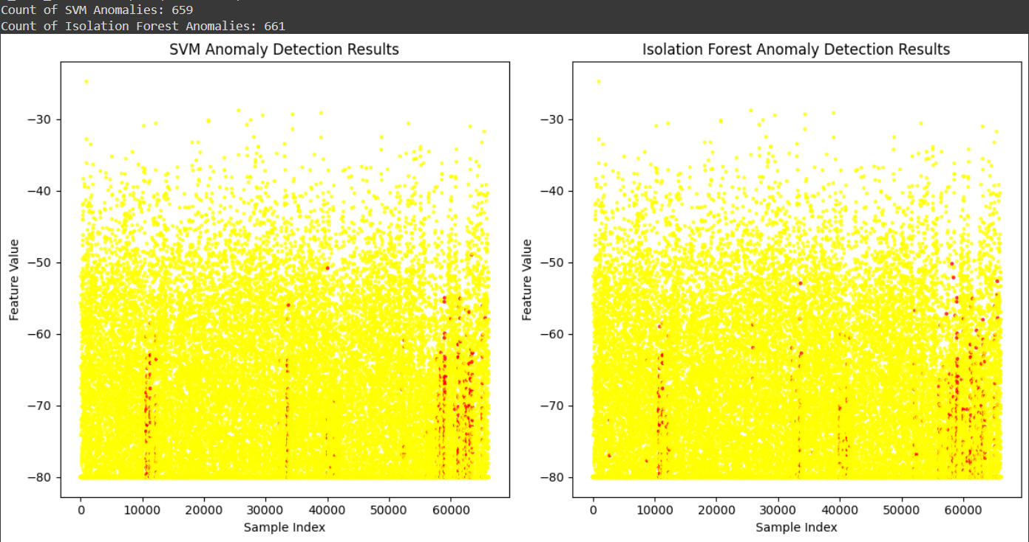
Results
Metrics and Graph plotted while testing with the same dataset(Voice of the same person):

Slide 8
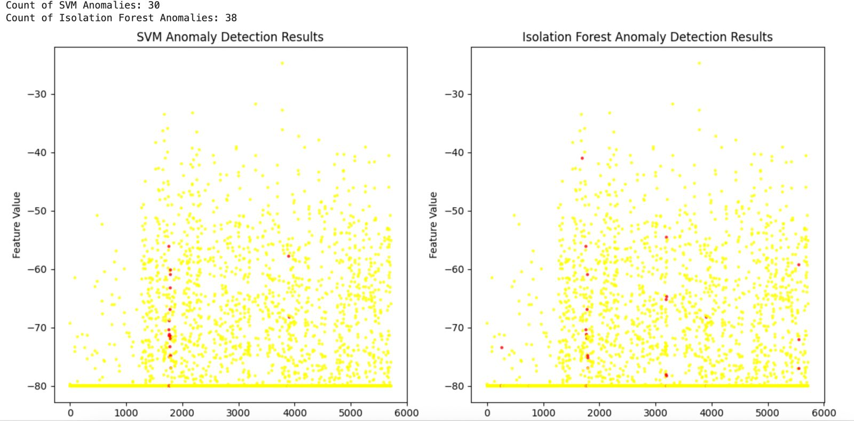
Metrics and Graph plotted while testing with the sample test dataset(Voice of different people):

Slide 9
Observations
Both One-Class SVM and Isolation-Forest detected similar number of anomalies in both examples.
Considering the graphs for both algorithms, the anomalies seem to be present in the same region.
Audio data requires preprocessing to transform it to usable format. (Size of audio files, format of file)
Feature extraction: Data can be extracted based on the methodology/goal of the project.

Slide 10
lessons learnt AND LIMITATIONS
Learnt how to extract relevant data like frequency and data points from audio files.
Tried to make a classification report to show the metrics of the algorithms used but it wasn’t completely accurate since we didn’t have labels to use.
Couldn’t find a solution while trying to use audio files of different duration or format.
Mapping the anomaly detected to its file name was not successful.

Slide 11
Thank you

