Slide 1
Service Provider System
Dhiraj Chauhan (2046491245015)
Ganesh Golhar (2046491245017)
Prof. Sandesh Jain

Slide 2
Outlines
Introduction.
Objectives and Scope of Service Provider System.
Stakeholders.
Proposed Solution.
Expected Outcomes.
Technologies Used
Conclusion.

Slide 3
Introduction
A web portal developed for customer in which they have facility to appoint services according to their need.
This web portal will help the customer to get the personalized service according to their requirement
Given web portal is a digital platform for local service businesses in India. This system mainly focuses on expert services clustered around Home and life (Example- Electricians ,plumbers ,etc).
Service provider has a facility to register their services.
Share feedback on the work has facilitates for customers on the portal.

Slide 4
Objectives
To develop a web portal for providing personalized service to all the customers according to their needs.
To provide an employment to the service providers (plumbers, electricians etc.).
Provide a dashboard to admin for all the facilities and data to the service provider and customer
Focus on create and provide excellent services through web portal.
To focus on customers need according to their requirement in detail and matches it to verified service provider.
Web portal containing Evaluation module for grievance and feedback.

Slide 5



Stakeholders
Service Provider
Customer
Portal Manager

Slide 6
Proposed Solution
Developing a web portal for dissemination of service provider information to the all customer
Service provider will register their services on the web portal by filling details like personal details, contact details, services they provide, experience, location, relevant certificates etc.
Customers will login on portal where they can search for the service provider and the desired services and appoint him to particular service by seeing the details
Service provider will visit the customer respective place and provide a service that customer wished for.
Customer pays a fees to service provider for their services and these all process update on the web portal
Customers will be able to give their reviews about services through the web portal.

Slide 7
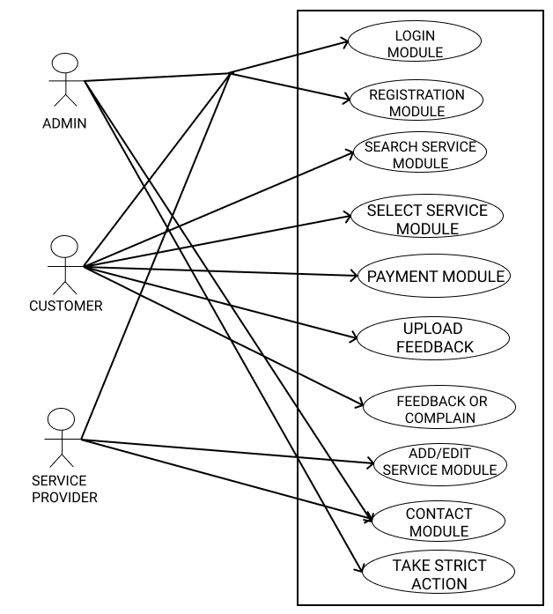
USE CASE DIAGRAM

Slide 8
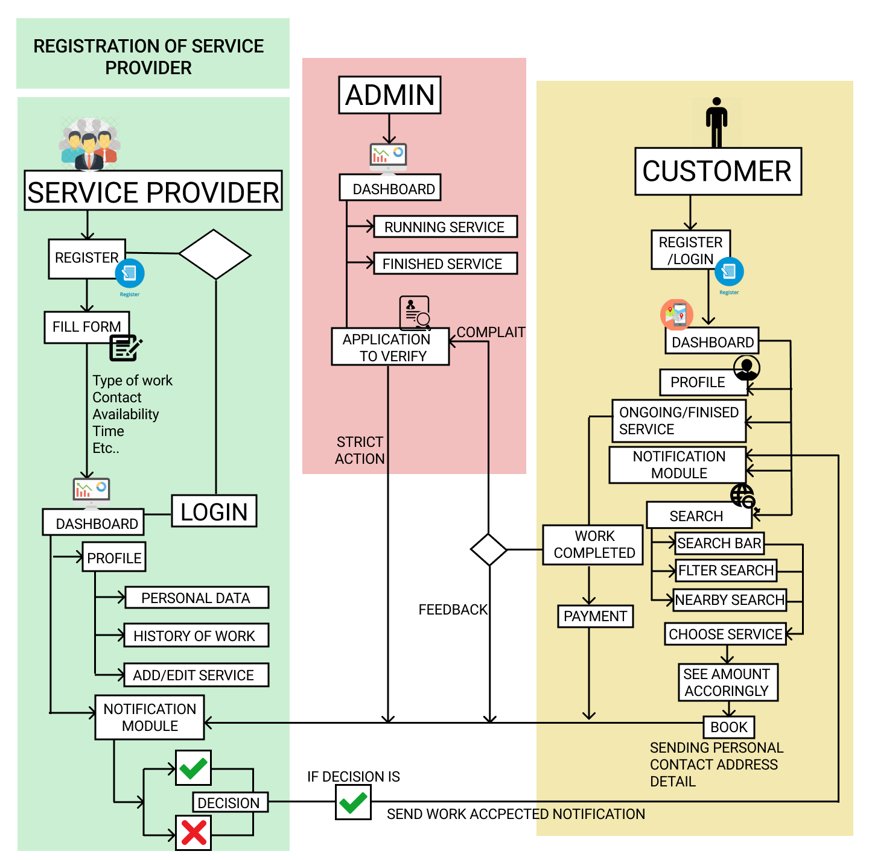
Process Flow

Slide 9
Technologies Used
HTML
HTML ensures the proper formatting of text and images for your Internet browser.
MySql
CSS
MySQL is an open source relational database management system which is an abbreviation for Structured Query Language.
CSS is used to control the style of web document in a simple and easy way.
PHP
JavaScript
Bootstrap
It is the server-side languages that could be embedded into HTML, making it easier to add functionality to web pages without needing to call external files for data.
It is designed for creating network-centric applications. It is complementary to and integrated with Java.
Designed to enable responsive development of mobile-first websites, Bootstrap provides a collection of syntax for template designs.

Slide 10
Conclusion
This website will help the customer to get the personalized service according to their requirement resulting in building relationship and trust to make a local services digital that can use by various user.
Due to Online search and review model customers will be able to easily find the right service provider.
Choosing local services helps in maintaining local area’s diversity and distinctive flavor.

Slide 11
Thank You.

