Slide 1
An overview of internship

Slide 2
OVERVIEW OF THE ORGANIZATION
Company Name: Abhivriddhi Infotech.
Mission Statement: Empowering businesses through innovative and effective web solutions that drive growth and success.
Team: Our team comprises skilled and experienced professionals, including:
• Web Developers
• UI/UX Designers
• Mobile App Developers
• Project Managers
• Quality Assurance Specialists
• Business Analysts

Slide 3

Vision and Mission
Vision:
“To be a leading force in the digital landscape, pioneering innovative web solutions that transform businesses and enrich the online experience for users globally. We envision a future where our commitment to excellence and cutting-edge technology empowers organizations to thrive in the digital era. We aim to help youngsters with startup ideas & act as a startup incubator to fuel their ideas.”

Slide 4

Mission:
“At Abhivriddhi, our mission is to deliver tailored web development solutions that exceed client expectations. We are dedicated to leveraging our expertise in web technologies to create impactful, user-centric digital experiences. By fostering creativity, embracing challenges, and prioritizing client success, we aim to build lasting partnerships and contribute to the growth of businesses in an ever-evolving digital world.”

Slide 5


ORGANIZATION STRUCTURE
Abhilash Naidu G
CEO
(Test Engineer & SQL developer)
Sharath Kumar K
Content Creator & Front End
developer
Vignesh
Senior Spring Boot (java)
Developer
Manohara
Full Stack Developer
Arvind
Python Front End Developer
Shashidhar
Java back End Developer

Slide 6
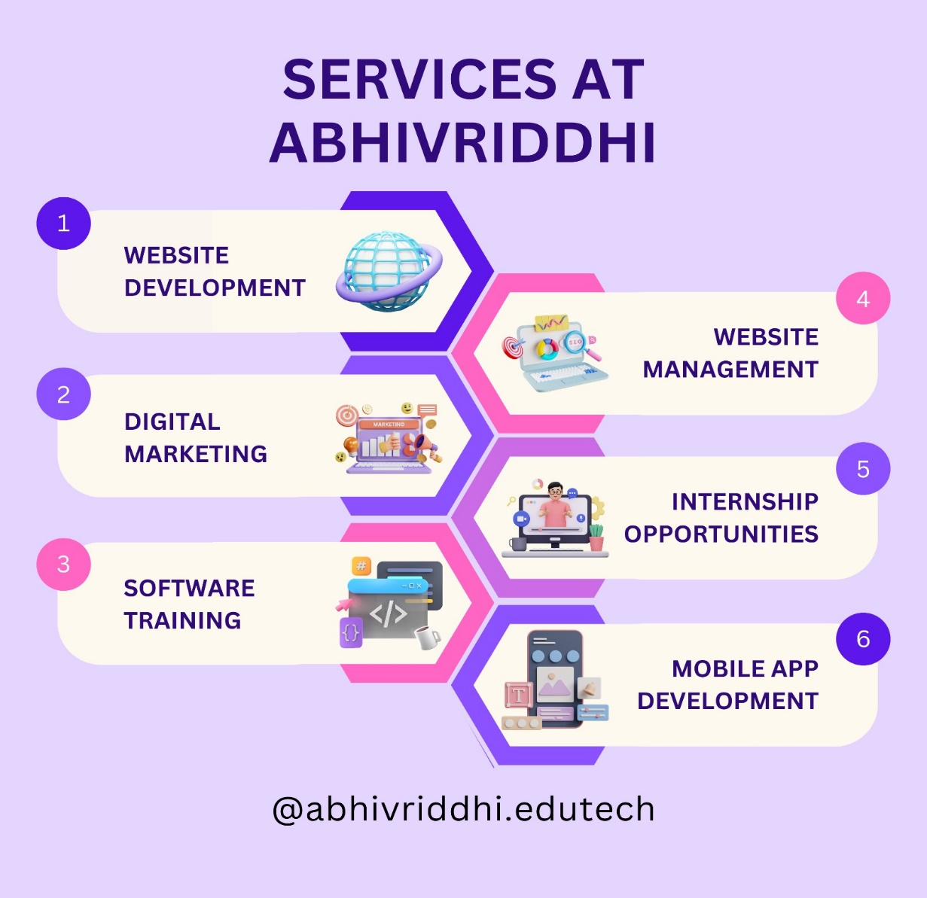
Services Offered:

Slide 7
Full Stack development
Topics:
Introduction to Front-end, Back-end, Database.
Front-end languages(HTML, CSS, JS).
Back-end languages(Java).
Database languages(MySql).

Slide 8
Introduction to front-end languages
HTML: It stands for hyper text markup language. It used to create structure or building blocks of the website.
CSS: It stands for cascading style sheets. It used to create design in the webpage and make website more attractive.
JS: It stands for Java Script. it is a Scripting language & it is used to add functionality
to the webpage.

Slide 9

Introduction to Back-end language:
Java: java is high-level programming language & it is statically typed, functionally typed, object oriented & it is both compiled and interpreter language.

Slide 10
Difference Between programming & scripting language
Programming language
It is compiler based language.
It takes all lines of code at a time for
Execution if there is no error in any line
it executes or if any error in any line it
will terminate the whole code.
It multi threaded programming language.
It is statically typed language.
It is client side programming language.
Ex:- Java, C, C++ etc.
Scripting language
It is interpreter based language.
It takes the code line by line for the execution
if there is no error all lines are executed or if there is any error in any line it will stop the execution from that line.
It is single threaded programming language.
It is dynamically typed language.
It is both client & server sided programing language.
Ex:- Python, JavaScript, Php, etc.
file
interpreter
file
interpreter
compiler
output
output

Slide 11
Data base language
SQL: it denotes “Structured Query language”.it stores data in a structural format and data is retrieve using queries.
Data: It is a raw fact which describes attributes of entity.
Database: It is place or medium in which we store the data in a particular and organized manner.
DBMS: It stands for Database Management System. It is used maintain and manage data.
Software
+ Security
+ Authorisation
Query language
data
Files
Databases
DBMS

Slide 12
Types of DBMS:
HDBMS(hierarchy DBMS)
RDBMS(Relational DBMS)
NDBMS(Network DBMS)
OODBMS(Object oriented DBMS)
RDBMS: It stands for relational database management system. It is also used to maintain and manage data
Software
+ Security
+ Authorisation
Structured query language
data
Tables
Databases
RDBMS

Slide 13
Over view of the project
Project:- Static Website
Softland is a modern one page, free website template created with the latest version of Bootstrap framework. softland can be used to build gorgeous looking website for creative agencies, corporate, personal portfolio, creative blog etc.Softland HTML template is a uniquely crafted modern looking template with great design details. Softland It is fully responsive and looks great on all devices and screen sizes. Its easy to use and customise with commented code and well organized files and asset resources.
Key Features:
Responsive layout
On click effects
Text alignments
Easy to customise

Slide 14
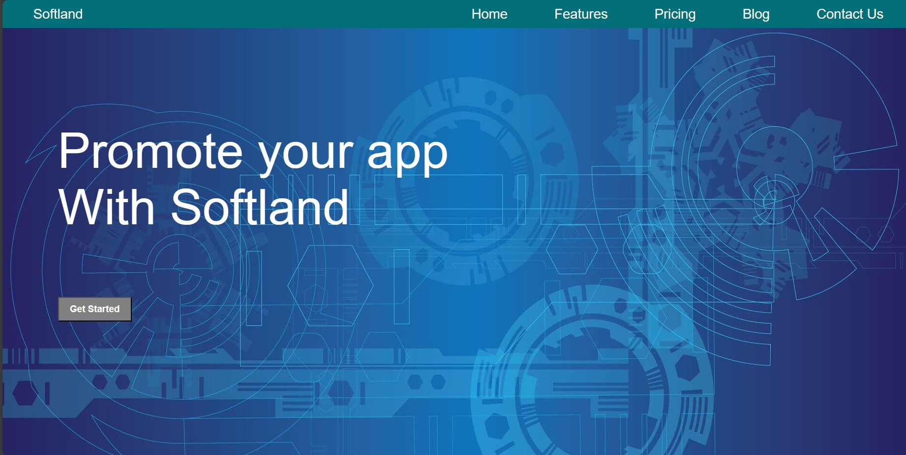
Project:-

Slide 15
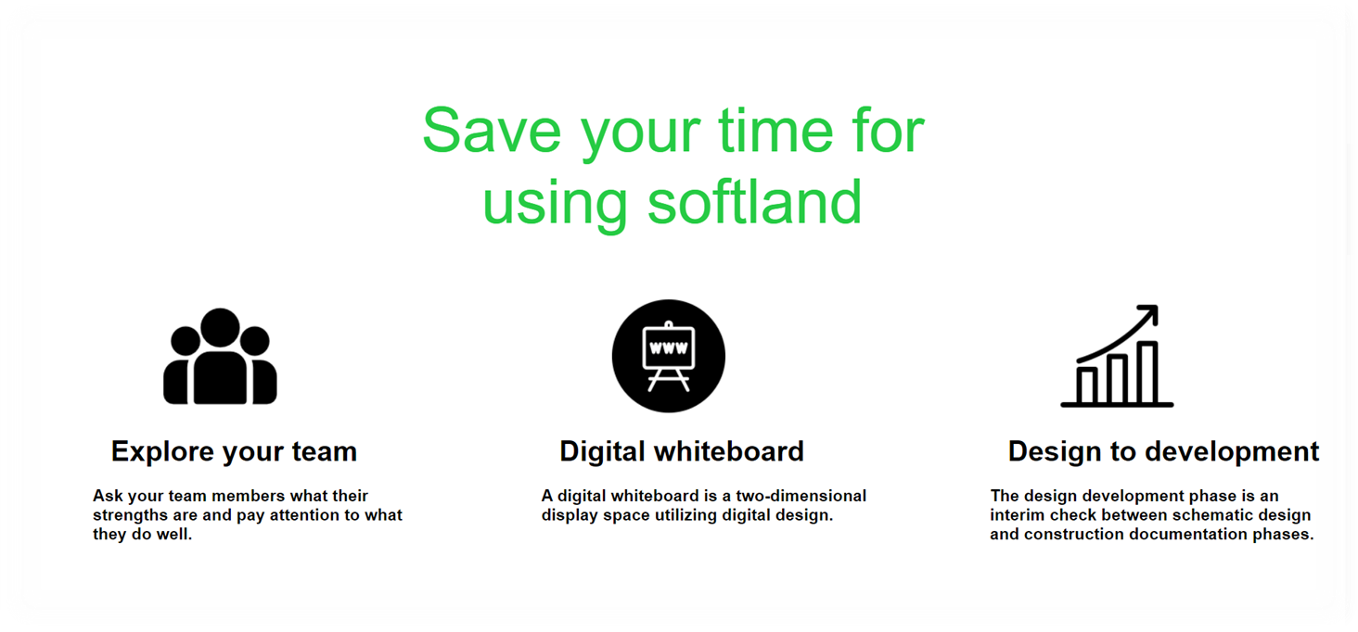
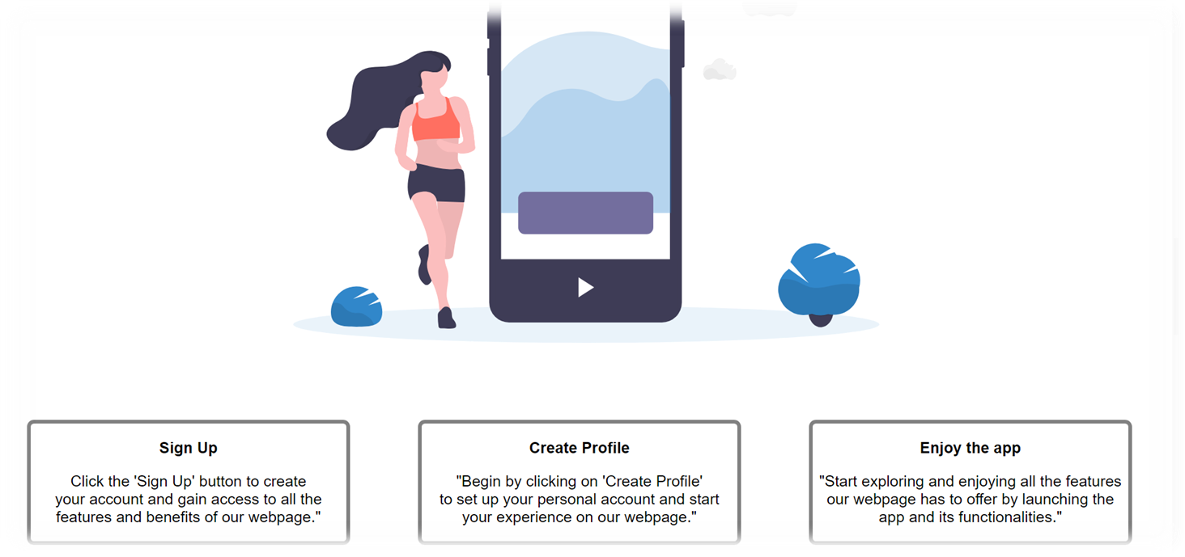

Slide 16
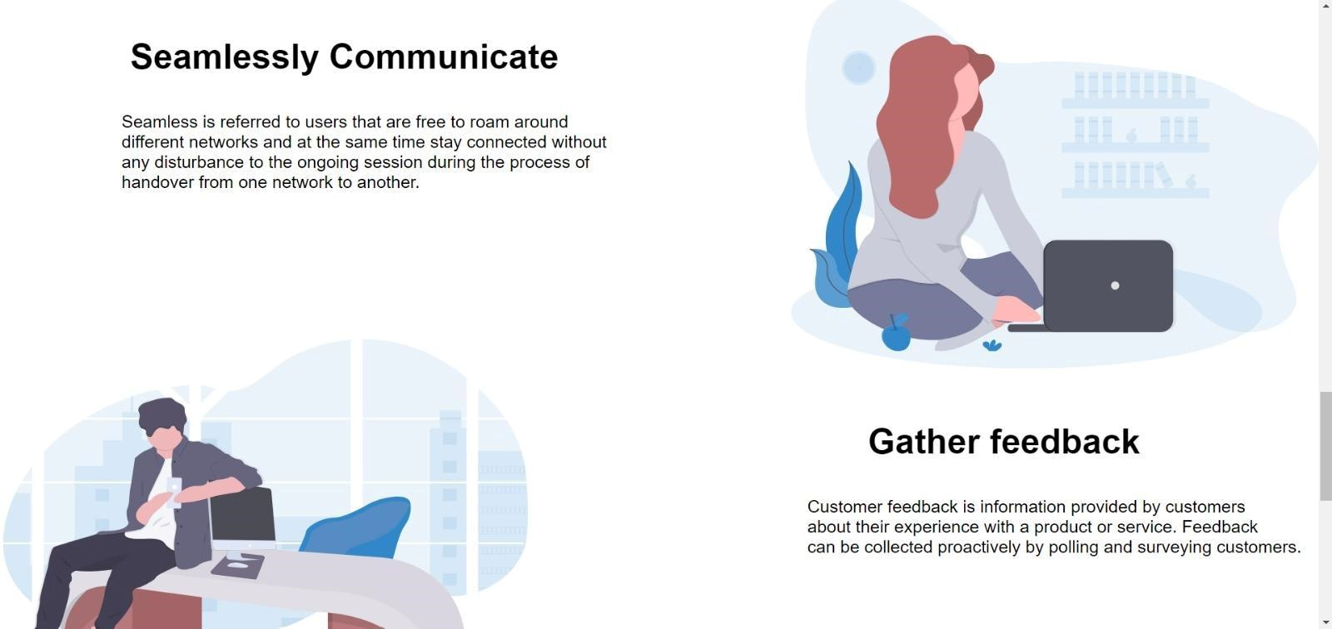
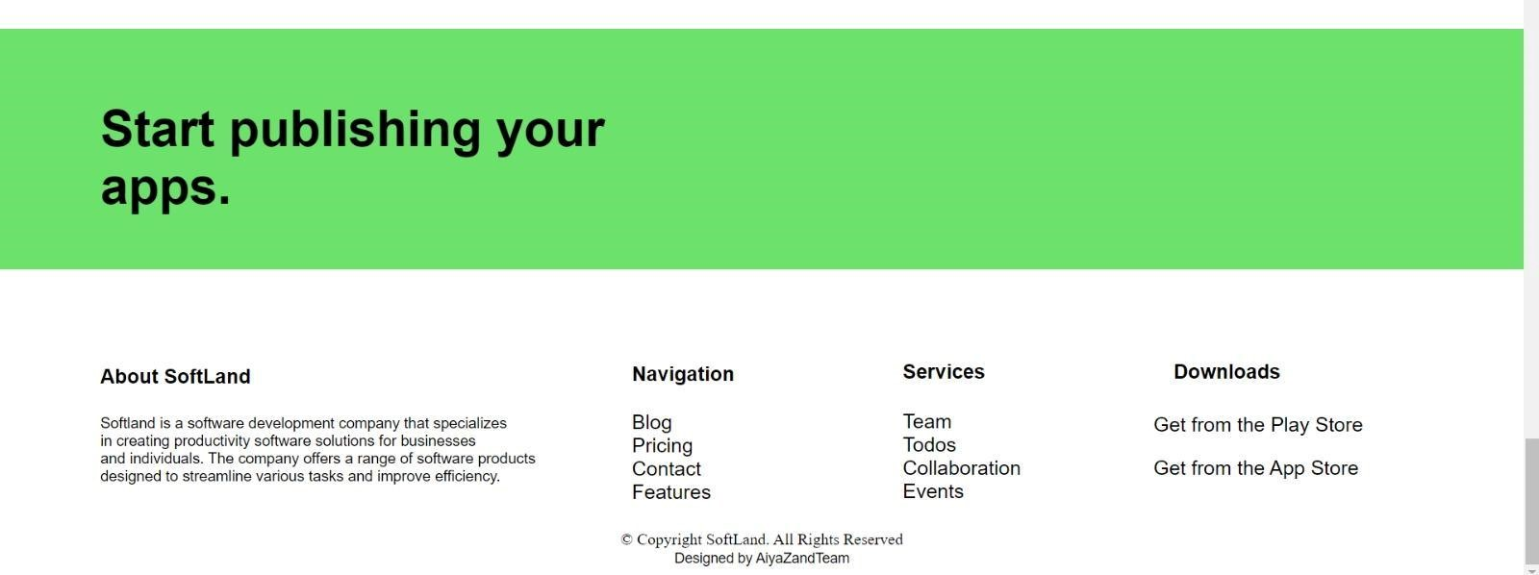

Slide 17
Here we created the static website project by using html,css.
HTML is used to structure the content of a webpage, while CSS is used to style and design the visual presentation of that content. So, the images you're referring to are likely created by combining HTML elements to define the structure and CSS rules to define their appearance and layout.
I've created a section for each page by using a <div> tag, making it easy for anyone to understand the code by visually organizing the sections.
I've designed a horizontal list that alters its color when hovered over, and it contains a dropdown menu that changes to orange when hovered over as well.
I've created a horizontal list with a transparent background layer using the rgba color format. I've created a button labeled "Get Started" that changes color when hovered over, and upon clicking it, it scrolls down to the next page.

Slide 18
Specific tasks or areas in the project
My team consists of four members:-
Aiyaz
Ganesh kumar
Bhuvana
Kushi
As the team member, I've divided the work into four parts. I’m and Aiyaz are responsible for designing the website. Bhuvana is responsible for adding styles to make it attractive. Khushi is responsible for testing the website to ensure it functions perfectly. If any errors are found, the whole team collaborates to solve them and ensure the project is completed on time.
Here, I have used Visual Studio code software to create this project.

Slide 19
Thank you

