Slide 1

Sentiment analysis using twitter data

Slide 2

01 - Abstract
02 - Introduction
03 - Existing System
04 - Proposed Model
05 - Implementation

Slide 3
01 - Abstract
Sentiment analysis is a field of Research under analytics. By using sentiment analysis written expression can be evaluated which can be favorable, unfavorable.
People use different types of social media like Facebook, twitter, people sentiments can be determined in an effective way by using twitter dataset. In this various machine learning techniques are used.
Raw data is read from twitter, and it is compared against trained machine which can be positive or negative.

Slide 4
02 - Introduction
Over last years, sentiment category has made vital interest. Large number of facts generated online can be processed into data to help managerial, operational and decision making.
Opinion mining is also same as sentiment analysis in which out of
the supplied sentences we can determine which one is positive,
negative, and impartial. Another function it performs is that it
identifies and extracts reviews and attitudes from the given text.

Slide 5
03 – Existing System
Existing system uses Natural Language Processing libraries and Naïve bayes algorithm especially gaussian Naive bayes.
Naive Bayes is a probabilistic machine learning algorithm that is widely used for classification tasks, including sentiment analysis. It's based on Bayes' theorem and is known for its simplicity, efficiency, and effectiveness, especially in situations where the assumption of independence among features holds.

Slide 6
04 – Proposed Model
Our model uses Natural Language Processing libraries and Logistic Regression.
Logistic Regression is widely used statistical technique in sentiment analysis , a field focused on determining the emotional tone behind a piece of text. In the context of sentiment analysis , logistic regression serves as a binary classifier , predicting whether a given text expresses positive or negative sentiment . The algorithm employs a logistic function to model the probability of a particular sentiment class based on a set of input features.

Slide 7
There are 4 steps involved in developing the model :
Collect data. The text being analyzed is identified and collected. Here twitter dataset for analysis is used which is a csv file.
Clean the data. The data is processed and cleaned to remove noise and parts of speech that don't have meaning relevant to the sentiment of the text. This includes contractions, such as I'm, and words that have little information such as is, articles such as the, punctuation, URLs, special characters and capital letters. This is referred to as standardizing.
Extract features. A machine learning algorithm automatically extracts text features to identify negative or positive sentiment. It includes the bag-of-words technique that tracks the occurrence of words in a text and the more nuanced word-embedding technique.

Slide 8
4. Sentiment classification. Once a model is picked and used to analyze a piece of text, it assigns a sentiment score to the text including positive, negative or neutral. Organizations can also decide to view the results of their analysis at different levels, including document level, which pertains mostly to professional reviews and coverage

Slide 9
05 – Implementation
We are using Jupyter notebook IDE to develop the model.
The algorithm used are natural language processing and Logistic Regression to get accurate results.
We used a dataset called sentimental140 from kaggle.com and divided the dataset into 80% and 20%. It contains a total of 1.6 million parameters.

Slide 10
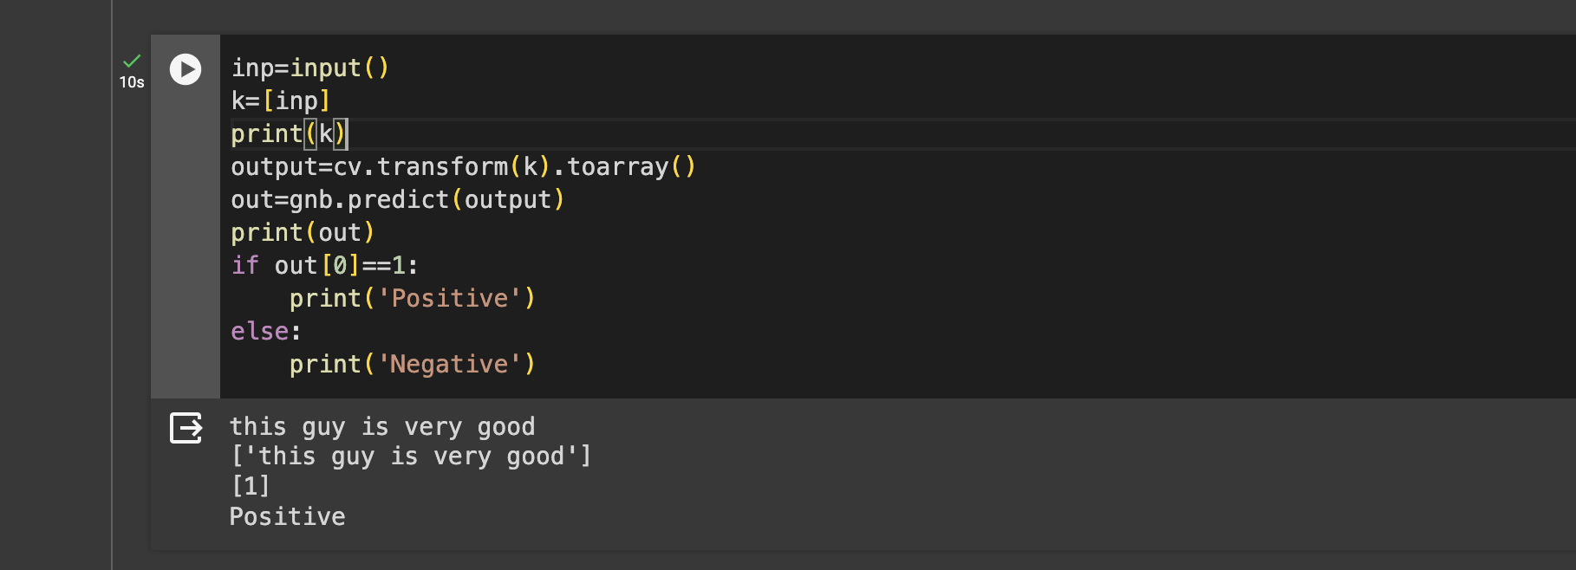
Outputs

Slide 11
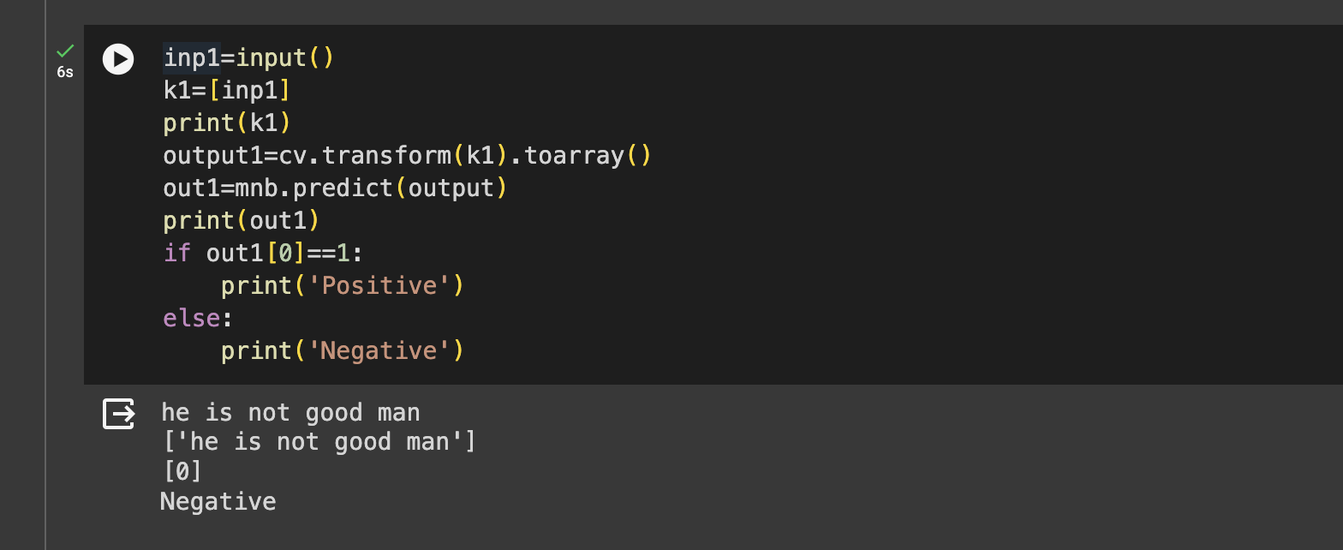

Slide 12

Thank
You !!

