Slide 1

Introduction to
Sameeh Jubran, Sameeh@daynix.com

Slide 2
So what is github?
GitHub.com is a site for online storage of Git repositories.
Many open source projects use it, such as the Linux kernel.
You can get free space for open source projects or you can pay for private projects.
Question: Do I have to use github to use Git?
Answer: No!
you can use Git completely locally for your own purposes, or
you or someone else could set up a server to share files, or
you could share a repo with users on the same file system, such as we did for homework 9 (as long everyone has the needed file permissions).

Slide 3
Basic Workflow
Basic Git workflow:
Modify files in your working directory.
Stage files, adding snapshots of them to your staging area.
Do a commit, which takes the files as they are in the staging area and stores that snapshot permanently to your Git directory.
Notes:
If a particular version of a file is in the git directory, it’s considered committed.
If it’s modified but has been added to the staging area, it is staged.
If it was changed since it was checked out but has not been staged, it is modified.

Slide 4
What is a Tortoise Git
It is a free open-source Server for the Git Version Control System.
Manages Files over time.
Saves every changes made to local directory.
Git is a open source server for git application.

Slide 5
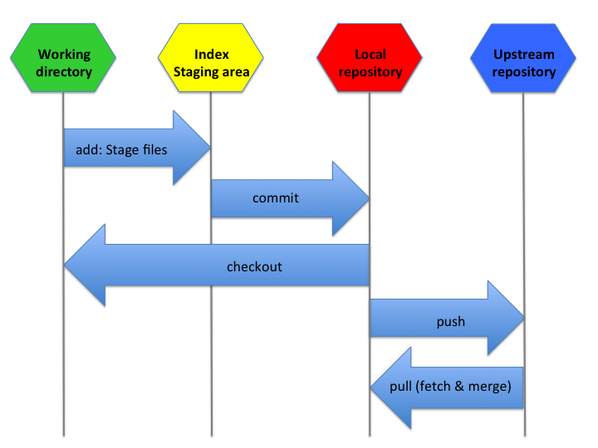

Slide 6
TortoiseGit's Features
Shell integration
Icon overlays
Easy access to Git commands
Distributed version control

Slide 7
Atomic commits
Strong support for non-linear development
Efficient handling of large projects
Efficient branching and tagging

Slide 8
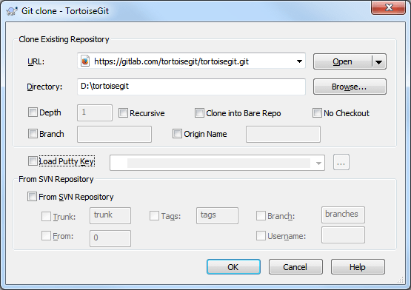
CLONE REPOSITORY

Slide 9
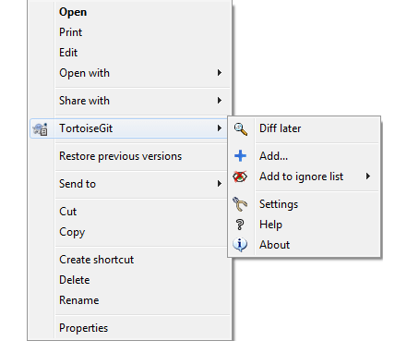
Git Add

Slide 10
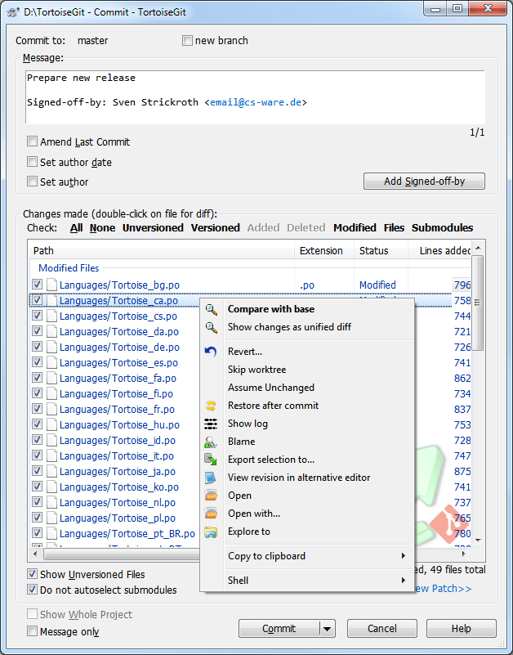
Git commit

Slide 11
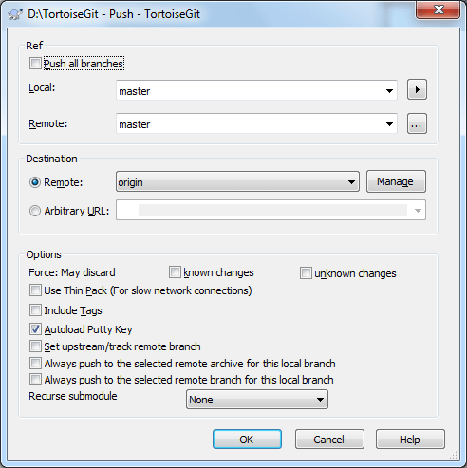
GIT PUSH

Slide 12
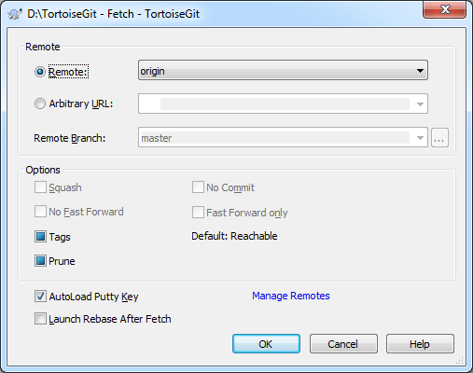
Fetch

Slide 13
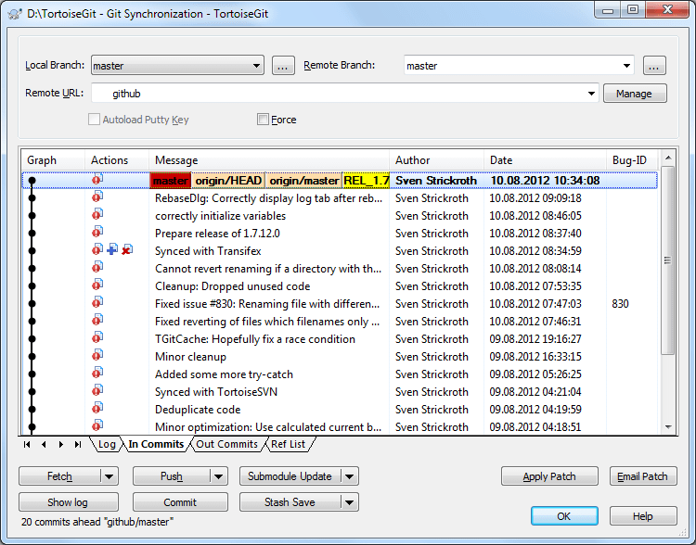
Sync

